Slide 1


Relationships Between
Fetal Growth and
Non Communicable Diseases
Anthony Chapman

Slide 2
Introduction - NCDs
Asthma, epilepsy, ADHD, type II diabetes, obesity
Everywhere and important
Associated to reduced birth weight
Antenatal origins implicated
How can we study antenatal well being?

Slide 3
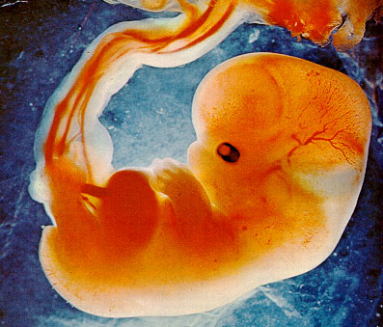
Challenges of Fetal Ultrasound
Gestational accuracy
Large enough sample size
Linear regression cancellation
Need to link fetal growth to medication-defined outcomes

Slide 4
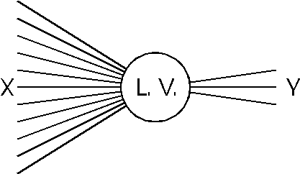
Challanges of Routine Data
Large amounts of missing data
Different measurements representing the same value
Latent variables

Slide 5
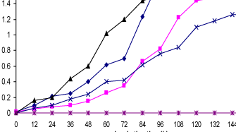
Hypothesis
Unsteady growth is associated with higher risk of NCDs in children and adults

Slide 6
Main objectives
Find relationships between growth factors to non communicable diseases such as asthma, epilepsy, obesity and ADHD
Computationally efficient / automated data analysis - should be able to be used nationwide

Slide 7
Research Questions
Epidemiological Questions
What are the relationships between fetal growth and NCD
Methodological Questions
How accurate is gestational assessment using DI as the gold standard
Can we analyse data with large amounts of missingness without compromising the results
Can we use clustering for pattern matching
What is the best computational approach?

Slide 8
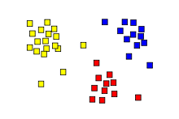
Methods
Multiple Imputation by Chain Equations
Cluster analysis
Gestational assessment using DI
Original Dataset
MICE
Artificially Complete
Dataset

Slide 9
Future Plans
Finish automated artificial completeness algorithm
Obtain approvals from:
- Guardians/custodians of databases, inc PAC
- NHSG info governance
- NHSG research and development
- University of Aberdeen (sponsor)
- Medical research ethics
- Grampian data safe haven
Data mining time

Slide 10
Thesis Chapter Listings
Ch 1 - Intro
Ch 2 - Assessing artificial completeness
Ch 3 - Clustering and latent modelling
Ch 4 - Growth vs NCDs
Ch 5 - Growth vs NCDs ctn
Ch 6 - Future work
Ch 7 - Discussion & conclusion
Appendix & bibliography

Slide 11
The end, any question?
Anthony Chapman -
    a.s.chapman.10@aberdeen.ac.uk

