Slide 1
Time Series Data Analysis - I
Wei Pang

Slide 2
In this lecture you learn
What are Time Series?
How to analyse time series?
  Pre-processing
  Trend analysis
  Pattern analysis
Dept. of Computing Science, University of Aberdeen

Slide 3
Introduction
What are Time Series?
  Values of a variable measured at different time points
Why time series are important?
  Many domains have tons of time series
    Meteorology – weather simulations predict values of dozens of weather parameters such as temperature and rainfall at hourly intervals
    Gas turbines carry hundreds of sensors to measure parameters such as fuel intake and rotor temperature every second
    Neonatal Intensive Care Units (NICU) measure physiological data such as blood pressure and heart rate every second
  Time series reveal temporal behaviour of the underlying mechanism that produced the data
Dept. of Computing Science, University of Aberdeen

Slide 4
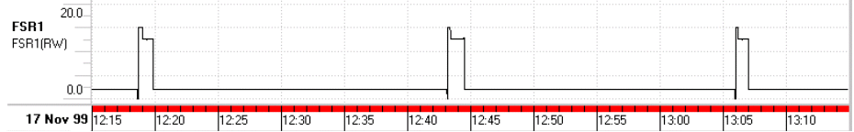
Example (Gas Turbine)
A time series has sequence of
  Values and
  Their corresponding timestamps (the time at which the values are true)
Dept. of Computing Science, University of Aberdeen

Slide 5
Time Series Autocorrelation
Autocorrelation is a special property of time series
  Each value of a time series is correlated to older values from the same series
  This means, data measurements in a time series are not independent
  Periodic patterns seen on the gas turbine plot in the previous slide are results of autocorrelation
Time series analysis is special because of this temporal dependency among values of a series
  A time series exhibits internal structure
Dept. of Computing Science, University of Aberdeen

Slide 6
Analysis of Time Series
Three main steps
  Pre-processing
  Trend analysis
  Pattern analysis
Not all applications require all three steps
  Knowledge acquisition studies provide the guidance to determine the required steps
Preprocessing
  Input raw series may be noisy
    Due to errors in measurement or observation
  Data needs to be smoothed to remove noise
  Many noise removal techniques – also known as filters such as
    Moving averages or mean filter
    Median filter
Dept. of Computing Science, University of Aberdeen

Slide 7
Example Series
Time | X
0 | 32
0.5 | 33
1.0 | 30
1.5 | 34
2.0 | 29
2.5 | 32
3.0 | 33
3.5 | 31
4.0 | 30
4.5 | 28
5.0 | 34
Dept. of Computing Science, University of Aberdeen

Slide 8
Rate of change sensitive to noise
Time | X | Rate of change
0 | 32 | 0
0.5 | 33 | 2
1.0 | 30 | -6
1.5 | 34 | 8
2.0 | 29 | -10
2.5 | 32 | 6
3.0 | 33 | 2
3.5 | 31 | -4
4.0 | 30 | -2
4.5 | 28 | -4
5.0 | 34 | 12
Dept. of Computing Science, University of Aberdeen

Slide 9
Mean Filter
There are many versions
Our version ( weighted average method)
  Assume a window time size, T for the filter
  dT – difference in time between two successive values
  For each value in the series, compute
    Current smoothed value =((previous smoothed value * T) + (current value*dT))/(T+dT)
Dept. of Computing Science, University of Aberdeen

Slide 10
Smoothing
Time | X | Smoothed X | Rate of change
0 | 32 | 32 | 0
0.5 | 33 | 32.2 | 0.4
1.0 | 30 | 31.76 | 0.88
1.5 | 34 | 31.21 | 0.9
2.0 | 29 | 31.57 | -1.28
2.5 | 32 | 31.65 | 0.16
3.0 | 33 | 31.92 | 0.54
3.5 | 31 | 31.74 | 0.36
4.0 | 30 | 31.39 | 0.70
4.5 | 28 | 30.71 | -1.76
5.0 | 34 | 31.37 | 1.32
Dept. of Computing Science, University of Aberdeen
Notes:
Window T=0.5

Slide 11
Median Filter
The idea is similar to Mean filter
Instead of using mean we use median
Note: in our version of the mean we did not compute a simple mean (average) of the selected values
We used a weighted average
Known to perform better in the presence of outliers
Dept. of Computing Science, University of Aberdeen

Slide 12
Trend Analysis
Trends can be established using
  line fitting techniques for linear data
  curve fitting techniques for non-linear data
Line Fitting techniques for time series more popularly called segmentation techniques
Many segmentation algorithms
  Sliding window
  Top-down
  Bottom-up and
  Others (genetic algorithms, wavelets, etc)
All segmentation algorithms have different flavours of implementation within the main method
  We only learn the main method
Segmentation in general can be viewed as a search
  for a best possible combination of segments
  in a space of all the possible segments
Dept. of Computing Science, University of Aberdeen

Slide 13
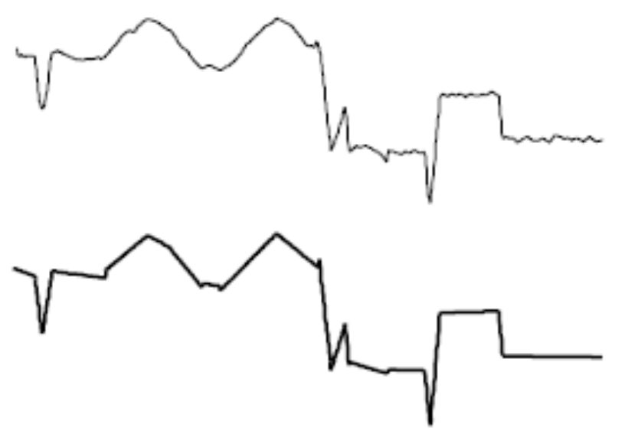
Segmentation
The curve at the top shows the original time series
The next graphic is the piecewise linear representation or segmented version of it
Segmented version of the time series is an approximation of the original series
In other words, segmentation may involve loss of information in addition to the loss of noise
Dept. of Computing Science, University of Aberdeen

Slide 14
Error Tolerance Value
One important parameter controlling the segmentation process is the error tolerance value
It is the amount of error that can be allowed in the segmented representation
  Corresponds to the allowed information loss
If the value of ETV is zero segmentation returns a segmented representation without any information loss
Large enough values of ETV make segmentation to return one segment losing all the information contained in the original signal in the segmentation process
Specification of ETV is linked to the distinction of information and noise
  In a particular context
  For a particular task
Dept. of Computing Science, University of Aberdeen

Slide 15
Cost Computation
All segmentation algorithms need a method to compute the cost of segmentation
Several possible techniques:
  Simply take maximum error in a segment
  Compute the total error in a segment
  Compute the least square error
Dept. of Computing Science, University of Aberdeen

Slide 16
Sliding window segmentation
This algorithm is suitable for segmenting time series obtained in real time (streaming time series)
Requirements
  Develop a method for computing the cost of merging adjacent segments
  Select two parameters
    an appropriate window size and
    Error tolerance value
The method
  Form a segment with the values of the input series falling in the window
  Compute the cost of the segment
  while the cost of the segment is below the error tolerance value
    Grow the segment by moving the window forward in the series
  When a segment cannot grow any more store it in the segmented representation and continue at step 1 with a new segment
Dept. of Computing Science, University of Aberdeen

Slide 17
Bottom–up Segmentation
Empirical evaluation studies with all segmentation algorithms suggest that the bottom-up algorithm is the best
  Because it provides a globally optimized segmented representation
Requirements
  Develop a method for computing the cost of merging adjacent segments
  Select an appropriate error tolerance value
Bottom-up approach to segmentation
  Begin by creating n/2 segments joining adjacent points in a n-length time series
  Compute the cost of merging adjacent segments
  Iteratively merge the lowest cost pair until a stopping criterion is met
    The stopping criterion is based on error tolerance value
Dept. of Computing Science, University of Aberdeen

Slide 18
Wind Prediction Data
Hour | Wind Speed
06:00 | 4.0
09:00 | 6.0
12:00 | 7.0
15:00 | 10.0
18:00 | 12.0
21:00 | 15.0
24:00 | 18.0
Dept. of Computing Science, University of Aberdeen

Slide 19
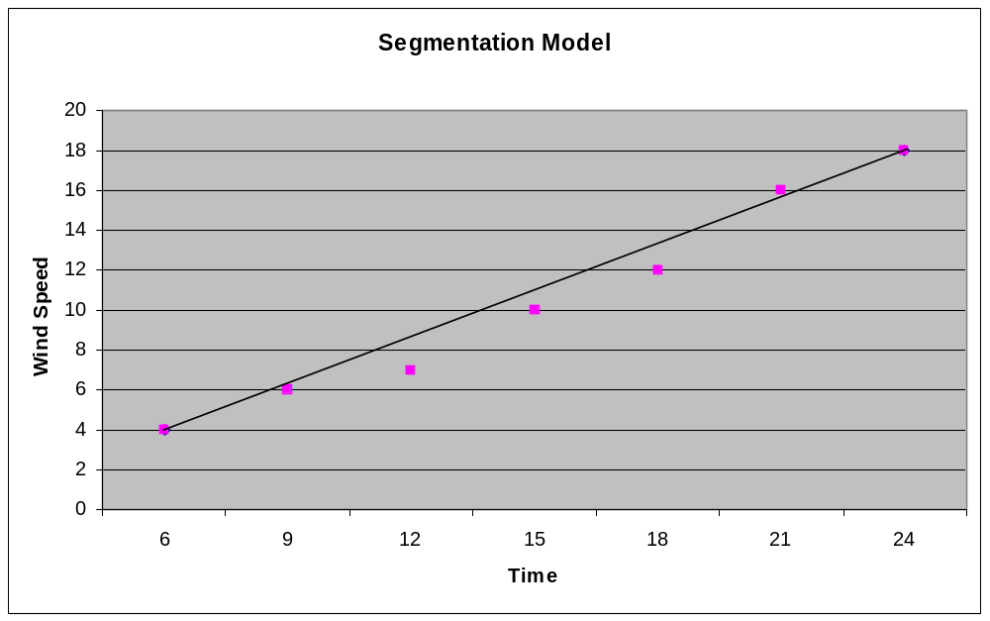
Segmentation of wind prediction data
Dept. of Computing Science, University of Aberdeen

Slide 20
Pattern Analysis
What is a pattern?
  A portion of the series that can be identified as a unit rather than as enumeration of all the values in that portion
  Some patterns may be periodic – they repeat at regular time intervals (autocorrelation)
Users are interested in patterns occurring in time series
  E.g. Spikes and oscillations in gas turbine data
Mainly two steps
  Pattern location
  Pattern classification
Dept. of Computing Science, University of Aberdeen

Slide 21
Pattern classification and Time Scale
Most patterns are classified based on the visual shape of the pattern
E.g. A step pattern looks like a step
When the time scale changes the visual shape of a pattern changes
Pattern classification sensitive to the time scale at which visualization is shown
Normal time scale
Lower time scale
Dept. of Computing Science, University of Aberdeen

Slide 22
Symbolic Representations of Time Series
Latest trend in mining time series
  Convert numerical time series into an equivalent symbolic representation
Symbolic Aggregate Approximation (SAX) is a well known representation
Efficient algorithms available for doing this transformation
Once a time series is available in string form
  String analysis techniques can be used for analysing time series data
baabccbc
Dept. of Computing Science, University of Aberdeen

Slide 23
Summary
Time Series are Ubiquitous!
Three main data analysis steps
  Pre-processing
    smoothing
  Trend analysis
    Line fitting
  Pattern analysis
    Location and classification
    Issues due to time scale
Dept. of Computing Science, University of Aberdeen

