Slide 1
Mining Time Series

Slide 2
Why is Working With Time Series so Difficult? Part I
Answer: How do we work with very large databases?
1 Hour of ECG data: 1 Gigabyte.
Typical Weblog: 5 Gigabytes per week.
Space Shuttle Database: 200 Gigabytes and growing.
Macho Database: 3 Terabytes, updated with 3 gigabytes a day.
Since most of the data lives on disk (or tape), we need a representation of the data we can efficiently manipulate.
(c) Eamonn Keogh, eamonn@cs.ucr.edu

Slide 3
Why is Working With Time Series so Difficult? Part II
Answer: We are dealing with subjectivity
The definition of similarity depends on the user, the domain and the task at hand. We need to be able to handle this subjectivity.
(c) Eamonn Keogh, eamonn@cs.ucr.edu

Slide 4
Why is working with time series so difficult? Part III
Answer: Miscellaneous data handling problems.
  Differing data formats.
  Differing sampling rates.
  Noise, missing values, etc.
We will not focus on these issues here.
(c) Eamonn Keogh, eamonn@cs.ucr.edu

Slide 5
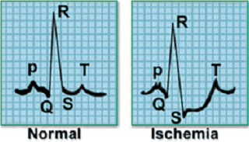

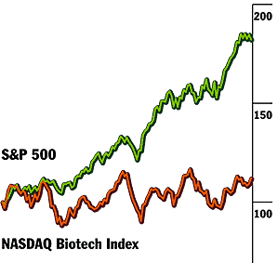


What do we want to do with the time series data?
Clustering
Classification
Motif Discovery
Rule Discovery
Query by Content
10
⇒
s = 0.5
c = 0.3
Visualization
Novelty Detection
(c) Eamonn Keogh, eamonn@cs.ucr.edu
Notes:
Clustering:
Lin, J., Vlachos, M., Keogh, E., & Gunopulos, D (2004). Iterative Incremental Clustering of Time Series. In proceedings of the IX Conference on Extending Database Technology. Crete, Greece. March 14-18, 2004
Keogh, E., Lonardi, S. and Ratanamahatana, C. (2004). Towards Parameter-Free Data Mining. In proceedings of the tenth ACM SIGKDD International Conference on Knowledge Discovery and Data Mining. Seattle, WA, Aug 22-25, 2004.
Classification:
Chotirat Ann Ratanamahatana and Eamonn Keogh. (2004). Making Time-series Classification More Accurate Using Learned Constraints. In proceedings of SIAM International Conference on Data Mining (SDM '04), Lake Buena Vista, Florida, April 22-24, 2004. pp. 11-22. Keogh, E., Lonardi, S. and Ratanamahatana, C. (2004). Towards Parameter-Free Data Mining. In proceedings of the tenth ACM SIGKDD International Conference on Knowledge Discovery and Data Mining. Seattle, WA, Aug 22-25, 2004.
Motif Discovery:
Chiu, B. Keogh, E., & Lonardi, S. (2003). Probabilistic Discovery of Time Series Motifs. In the 9th ACM SIGKDD International Conference on Knowledge Discovery and Data Mining. August 24 - 27, 2003. Washington, DC, USA. pp 493-498.
Rule Discovery:
E. Keogh, J. Lin, and W. Truppel. (2003). Clustering of Time Series Subsequences is Meaningless: Implications for Past and Future Research. In proceedings of the 3rd IEEE International Conference on Data Mining . Melbourne, FL. Nov 19-22. pp 115-122.
Query by Content:
Keogh, E., Palpanas, T., Zordan, V., Gunopulos, D. and Cardle, M. (2004) Indexing Large Human-Motion Databases. In proceedings of the 30th International Conference on Very Large Data Bases, Toronto, Canada.
Chotirat Ann Ratanamahatana and Eamonn Keogh. (2004). Making Time-series Classification More Accurate Using Learned Constraints. In proceedings of SIAM International Conference on Data Mining (SDM '04), Lake Buena Vista, Florida, April 22-24, 2004. pp. 11-22
Keogh, E. (2002). Exact indexing of dynamic time warping. In 28th International Conference on Very Large Data Bases. Hong Kong. pp 406-417.
Keogh, E., Hochheiser, H. and Shneiderman, B. (2002). An Augmented Visual Query Mechanism for Finding Patterns in Time Series Data. In the 5th International Conference on Flexible Query Answering Systems. October 27 - 29, 2002, Copenhagen, Denmark. Springer, LNAI 2522, Troels Andreasen, Amihai Motro, Henning Christiansen, and Henrik Legind Larsen (eds)., pp. 240-250.
Visualization
Lin, J., Keogh, E., Lonardi, S., Lankford, J. P. & Nystrom, D. M. (2004). Visually Mining and Monitoring Massive Time Series. In proceedings of the tenth ACM SIGKDD International Conference on Knowledge Discovery and Data Mining. Seattle, WA, Aug 22-25, 2004.
(This work also appears as a VLDB 2004 demo paper, under the title "VizTree: a Tool for Visually Mining and Monitoring Massive Time Series.")
Novelty Detection
Keogh, E., Lonardi, S and Chiu, W. (2002). Finding Surprising Patterns in a Time Series Database In Linear Time and Space. In the 8th ACM SIGKDD International Conference on Knowledge Discovery and Data Mining. July 23 - 26, 2002. Edmonton, Alberta, Canada. pp 550-556.

Slide 6
All these problems require similarity matching
Clustering
Classification
Motif Discovery
Rule Discovery
Query by Content
10
⇒
s = 0.5
c = 0.3
Visualization
Novelty Detection
(c) Eamonn Keogh, eamonn@cs.ucr.edu
Notes:
Clustering:
Lin, J., Vlachos, M., Keogh, E., & Gunopulos, D (2004). Iterative Incremental Clustering of Time Series. In proceedings of the IX Conference on Extending Database Technology. Crete, Greece. March 14-18, 2004
Keogh, E., Lonardi, S. and Ratanamahatana, C. (2004). Towards Parameter-Free Data Mining. In proceedings of the tenth ACM SIGKDD International Conference on Knowledge Discovery and Data Mining. Seattle, WA, Aug 22-25, 2004.
Classification:
Chotirat Ann Ratanamahatana and Eamonn Keogh. (2004). Making Time-series Classification More Accurate Using Learned Constraints. In proceedings of SIAM International Conference on Data Mining (SDM '04), Lake Buena Vista, Florida, April 22-24, 2004. pp. 11-22. Keogh, E., Lonardi, S. and Ratanamahatana, C. (2004). Towards Parameter-Free Data Mining. In proceedings of the tenth ACM SIGKDD International Conference on Knowledge Discovery and Data Mining. Seattle, WA, Aug 22-25, 2004.
Motif Discovery:
Chiu, B. Keogh, E., & Lonardi, S. (2003). Probabilistic Discovery of Time Series Motifs. In the 9th ACM SIGKDD International Conference on Knowledge Discovery and Data Mining. August 24 - 27, 2003. Washington, DC, USA. pp 493-498.
Rule Discovery:
E. Keogh, J. Lin, and W. Truppel. (2003). Clustering of Time Series Subsequences is Meaningless: Implications for Past and Future Research. In proceedings of the 3rd IEEE International Conference on Data Mining . Melbourne, FL. Nov 19-22. pp 115-122.
Query by Content:
Keogh, E., Palpanas, T., Zordan, V., Gunopulos, D. and Cardle, M. (2004) Indexing Large Human-Motion Databases. In proceedings of the 30th International Conference on Very Large Data Bases, Toronto, Canada.
Chotirat Ann Ratanamahatana and Eamonn Keogh. (2004). Making Time-series Classification More Accurate Using Learned Constraints. In proceedings of SIAM International Conference on Data Mining (SDM '04), Lake Buena Vista, Florida, April 22-24, 2004. pp. 11-22
Keogh, E. (2002). Exact indexing of dynamic time warping. In 28th International Conference on Very Large Data Bases. Hong Kong. pp 406-417.
Keogh, E., Hochheiser, H. and Shneiderman, B. (2002). An Augmented Visual Query Mechanism for Finding Patterns in Time Series Data. In the 5th International Conference on Flexible Query Answering Systems. October 27 - 29, 2002, Copenhagen, Denmark. Springer, LNAI 2522, Troels Andreasen, Amihai Motro, Henning Christiansen, and Henrik Legind Larsen (eds)., pp. 240-250.
Visualization
Lin, J., Keogh, E., Lonardi, S., Lankford, J. P. & Nystrom, D. M. (2004). Visually Mining and Monitoring Massive Time Series. In proceedings of the tenth ACM SIGKDD International Conference on Knowledge Discovery and Data Mining. Seattle, WA, Aug 22-25, 2004.
(This work also appears as a VLDB 2004 demo paper, under the title "VizTree: a Tool for Visually Mining and Monitoring Massive Time Series.")
Novelty Detection
Keogh, E., Lonardi, S and Chiu, W. (2002). Finding Surprising Patterns in a Time Series Database In Linear Time and Space. In the 8th ACM SIGKDD International Conference on Knowledge Discovery and Data Mining. July 23 - 26, 2002. Edmonton, Alberta, Canada. pp 550-556.

Slide 7
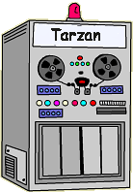


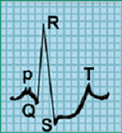
Here is a simple motivation for time series data mining
You go to the doctor because of chest pains. Your ECG looks strange…
You doctor wants to search a database to find similar ECGs, in the hope that they will offer clues about your condition...
ECG tester
  How do we define similar?
  How do we search quickly?
Two questions:
(c) Eamonn Keogh, eamonn@cs.ucr.edu

Slide 8


Two Kinds of Similarity
Similarity at the level of shape
Similarity at the structural level
(c) Eamonn Keogh, eamonn@cs.ucr.edu

Slide 9

Defining Distance Measures
Definition: Let O₁ and O₂ be two objects from the universe of possible objects. The distance (dissimilarity) is denoted by D(O₁,O₂)
D(A,B) = D(B,A) Symmetry
D(A,A) = 0 Constancy
D(A,B) = 0 IIf A= B Positivity
D(A,B) ≤ D(A,C) + D(B,C) Triangular Inequality
What properties are desirable in a distance measure?
(c) Eamonn Keogh, eamonn@cs.ucr.edu

Slide 10
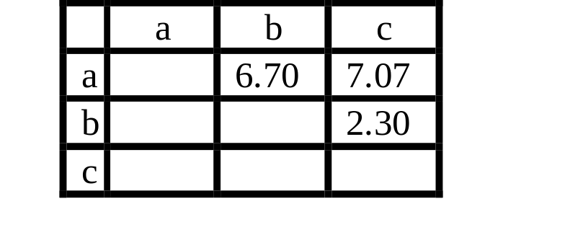
Why is the Triangular Inequality so Important?
Virtually all techniques to index data require the triangular inequality to hold.
Suppose I am looking for the closest point to Q, in a database of 3 objects.
Further suppose that the triangular inequality holds, and that we have precomplied a table of distance between all the items in the database.
Q
a
c
b
(c) Eamonn Keogh, eamonn@cs.ucr.edu

Slide 11
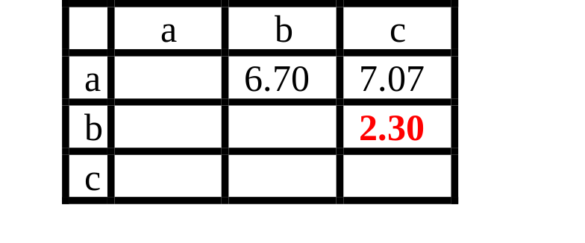
Why is the Triangular Inequality so Important?
Virtually all techniques to index data require the triangular inequality to hold.
I find a and calculate that it is 2 units from Q, it becomes my best-so-far. I find b and calculate that it is 7.81 units away from Q.
I don’t have to calculate the distance from Q to c!
I know D(Q,b) ≤ D(Q,c) + D(b,c)
D(Q,b) - D(b,c) ≤ D(Q,c)
7.81 - 2.30 ≤ D(Q,c)
5.51 ≤ D(Q,c)
So I know that c is at least 5.51 units away, but my best-so-far is only 2 units away.
Q
a
c
b
(c) Eamonn Keogh, eamonn@cs.ucr.edu

Slide 12
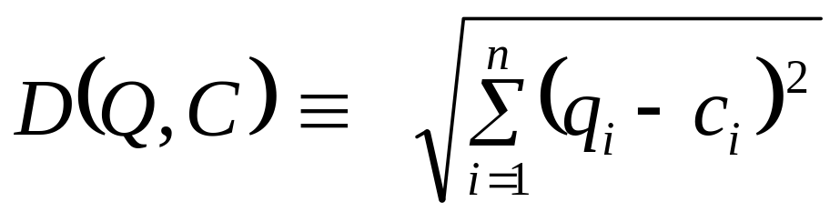
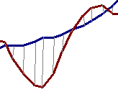


Euclidean Distance Metric
Given two time series:
Q = q₁…q_{n}
C = c₁…c_{n}
C
Q
About 80% of published work in data mining uses Euclidean distance
D(Q,C)
(c) Eamonn Keogh, eamonn@cs.ucr.edu
Notes:
Keogh, E. and Kasetty, S. (2002). On the Need for Time Series Data Mining Benchmarks: A Survey and Empirical Demonstration. In the 8th ACM SIGKDD International Conference on Knowledge Discovery and Data Mining. July 23 - 26, 2002. Edmonton, Alberta, Canada. pp 102-111.

Slide 13
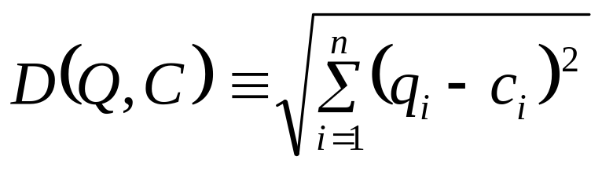

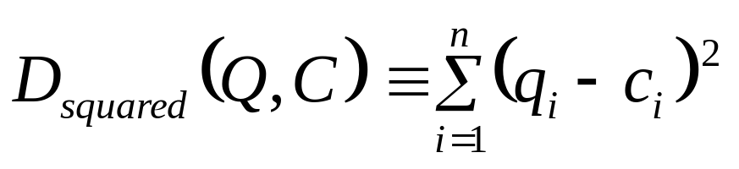
Optimizing the Euclidean Distance Calculation
Instead of using the
Euclidean distance
we can use the
Squared Euclidean distance
Euclidean distance and Squared Euclidean distance are equivalent in the sense that they return the same clusterings and classifications
This optimization helps with CPU time, but most problems are I/O bound.
(c) Eamonn Keogh, eamonn@cs.ucr.edu
Notes:
Keogh, E. and Kasetty, S. (2002). On the Need for Time Series Data Mining Benchmarks: A Survey and Empirical Demonstration. In the 8th ACM SIGKDD International Conference on Knowledge Discovery and Data Mining. July 23 - 26, 2002. Edmonton, Alberta, Canada. pp 102-111.

Slide 14



Preprocessing the data before distance calculations
If we naively try to measure the distance between two “raw” time series, we may get very unintuitive results
This is because Euclidean distance is very sensitive to some “distortions” in the data. For most problems these distortions are not meaningful, and thus we can and should remove them
In the next few slides we will discuss the 4 most common distortions, and how to remove them
Offset Translation
Amplitude Scaling
Linear Trend
Noise
(c) Eamonn Keogh, eamonn@cs.ucr.edu

Slide 15
Transformation I: Offset Translation
3
3
D(Q,C)
2.5
2.5
2
2
1.5
1.5
1
1
0.5
0.5
0
0
50
100
150
200
250
300
0
0
50
100
150
200
250
300
Q = Q - mean(Q)
C = C - mean(C)
D(Q,C)
0
50
100
150
200
250
300
0
50
100
150
200
250
300
(c) Eamonn Keogh, eamonn@cs.ucr.edu

Slide 16
Transformation II: Amplitude Scaling
0
100
200
300
400
500
600
700
800
900
1000
0
100
200
300
400
500
600
700
800
900
1000
Q = (Q - mean(Q)) / std(Q)
C = (C - mean(C)) / std(C)
D(Q,C)
(c) Eamonn Keogh, eamonn@cs.ucr.edu

Slide 17
Transformation III: Linear Trend
12
5
10
4
8
3
6
2
4
1
2
0
0
-1
-2
-2
-4
0
20
40
60
80
100
120
140
160
180
200
-3
0
20
40
60
80
100
120
140
160
180
200
The intuition behind removing linear trend is…
Fit the best fitting straight line to the time series, then subtract that line from the time series.
Removed linear trend
Removed offset translation
Removed amplitude scaling
(c) Eamonn Keogh, eamonn@cs.ucr.edu

Slide 18
Transformation IIII: Noise
8
8
6
6
4
4
2
2
0
0
-2
-2
-4
0
20
40
60
80
100
120
140
-4
0
20
40
60
80
100
120
140
Q = smooth(Q)
The intuition behind removing noise is...
Average each datapoints value with its neighbors.
C = smooth(C)
D(Q,C)
(c) Eamonn Keogh, eamonn@cs.ucr.edu
Notes:
Smoothing Smoothing techniques are used to reduce irregularities (random fluctuations) in time series data. They provide a clearer view of the true underlying behavior of the series.
In some time series, seasonal variation is so strong it obscures any trends or cycles which are very important for the understanding of the process being observed. Smoothing can remove seasonality and makes long term fluctuations in the series stand out more clearly.
The most common type of smoothing technique is moving average smoothing although others do exist. Since the type of seasonality will vary from series to series, so must the type of smoothing.
Exponential Smoothing
Exponential smoothing is a smoothing technique used to reduce irregularities (random fluctuations) in time series data, thus providing a clearer view of the true underlying behavior of the series. It also provides an effective means of predicting future values of the time series (forecasting).
Moving Average Smoothing
A moving average is a form of average which has been adjusted to allow for seasonal or cyclical components of a time series. Moving average smoothing is a smoothing technique used to make the long term trends of a time series clearer.
When a variable, like the number of unemployed, or the cost of strawberries, is graphed against time, there are likely to be considerable seasonal or cyclical components in the variation. These may make it difficult to see the underlying trend. These components can be eliminated by taking a suitable moving average.
By reducing random fluctuations, moving average smoothing makes long term trends clearer.
Running Medians Smoothing
Running medians smoothing is a smoothing technique analogous to that used for moving averages. The purpose of the technique is the same, to make a trend clearer by reducing the effects of other fluctuations.

Slide 19


A Quick Experiment to Demonstrate the Utility of Preprocessing the Data
Clustered using Euclidean distance on the raw data.
Clustered using Euclidean distance, after removing noise, linear trend, offset translation and amplitude scaling
3
9
2
8
9
7
6
5
8
6
5
4
7
3
4
2
1
1
(c) Eamonn Keogh, eamonn@cs.ucr.edu

Slide 20
Dynamic Time Warping
Fixed Time Axis
Sequences are aligned “one to one”.
“Warped” Time Axis
Nonlinear alignments are possible.
Notes:
Keogh, E. (2002). Exact indexing of dynamic time warping. In 28th International Conference on Very Large Data Bases. Hong Kong. pp 406-417.

Slide 21

Results: Error Rate
Dataset | Euclidean | DTW
Word Spotting | 4.78 | 1.10
Sign language | 28.70 | 25.93
GUN | 5.50 | 1.00
Nuclear Trace | 11.00 | 0.00
Leaves# | 33.26 | 4.07
(4) Faces | 6.25 | 2.68
Control Chart* | 7.5 | 0.33
2-Patterns | 1.04 | 0.00
Using 1-nearest-neighbor, leaving-one-out evaluation!
Notes:
* The results here appear to conflict with other published results. This is because the data here is normalized. When the data is unnormalized the problem is a little easer, but this is really cheating! Consider the GUN problem, if we did not normalize the data, it would be easy to distinguish between the male actor from the female actor (who is more than a foot (25cm) shorter). However, those results would not generalize. Imagine that we try to classify new data where the female stands closer to the video camera…
In general, all data should be z-normalized, unless you have concrete reasons to believe that the mean and offsets have meaning.
For more information on the importance of normalization, see figures 8 and 9 of the Journal version of.
Keogh, E. and Kasetty, S. (2002). On the Need for Time Series Data Mining Benchmarks: A Survey and Empirical Demonstration.
# This 'leaf_all.zip' is a newer version of the leaf dataset, and is slightly different from the leaf dataset used in [a]. Even though, they both came from the same image data, different parameters were used when extracting time series from the images. The new version gives a slightly improved accuracy for DTW.
[a] C.A.Ratanamahatana and E.Keogh. Making Time-series Classification more Accurate Using Learned Constraints. In proceedings of SIAM Int'l Conference on Data Mining (SDM'04) pp. 11-22.

Slide 22

Results: Time (msec )
Dataset | Euclidean | DTW
Word Spotting | 40 | 8,600
Sign language | 10 | 1,110
GUN | 60 | 11,820
Nuclear Trace | 210 | 144,470
Leaves | 150 | 51,830
(4) Faces | 50 | 45,080
Control Chart | 110 | 21,900
2-Patterns | 16,890 | 545,123
DTW is two to three orders of magnitude slower than Euclidean distance
215
110
197
687
345
901
199
32

Slide 23
We are done with shape similarity
Two Kinds of Similarity
Let us consider
similarity at the structural level
(c) Eamonn Keogh, eamonn@cs.ucr.edu

Slide 24

For long time series, shape based similarity will give very poor results. We need to measure similarly based on high level structure
Euclidean Distance
(c) Eamonn Keogh, eamonn@cs.ucr.edu
Notes:
Cluster 1 (datasets 1 ~ 5):
BIDMC Congestive Heart Failure Database (chfdb): record chf02
Start times at 0, 82, 150, 200, 250, respectively
Cluster 2 (datasets 6 ~ 10):
BIDMC Congestive Heart Failure Database (chfdb): record chf15
Start times at 0, 82, 150, 200, 250, respectively
Cluster 3 (datasets 11 ~ 15):
Long Term ST Database (ltstdb): record 20021
Start times at 0, 50, 100, 150, 200, respectively
Cluster 4 (datasets 16 ~ 20):
MIT-BIH Noise Stress Test Database (nstdb): record 118e6
Start times at 0, 50, 100, 150, 200, respectively

Slide 25

Structure or Model Based Similarity
The basic idea is to extract global features from the time series, create a feature vector, and use these feature vectors to measure similarity and/or classify
A
B
C
Time
Series
 | A | B | C
Max Value | 11 | 12 | 19
Autocorrelation | 0.2 | 0.3 | 0.5
Zero Crossings | 98 | 82 | 13
… | … | … | …
Feature
(c) Eamonn Keogh, eamonn@cs.ucr.edu

Slide 26
Motivating example revisited…
You go to the doctor because of chest pains. Your ECG looks strange…
Your doctor wants to search a database to find similar ECGs, in the hope that they will offer clues about your condition...
ECG
  How do we define similar?
  How do we search quickly?
Two questions:
(c) Eamonn Keogh, eamonn@cs.ucr.edu

Slide 27

The Generic Data Mining Algorithm
Create an approximation of the data, which will fit in main memory, yet retains the essential features of interest
Approximately solve the problem at hand in main memory
Make (hopefully very few) accesses to the original data on disk to confirm the solution obtained in Step 2, or to modify the solution so it agrees with the solution we would have obtained on the original data
This only works if the approximation allows lower bounding
(c) Eamonn Keogh, eamonn@cs.ucr.edu

Slide 28
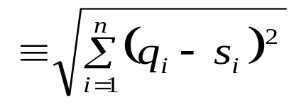
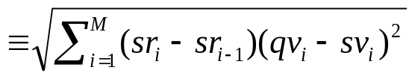

What is Lower Bounding?
Q
Q’
Raw Data
Approximation
or
“Representation”
S
S’
D_{LB}(Q’,S’)
D(Q,S)
D_{LB}(Q’,S’)
The term (sr_{i}-sr_{i-1}) is the length
of each segment. So long segments
contribute more to the distance measure.
Lower bounding means that for all Q and S, we have: D_{LB}(Q’,S’) ≤ D(Q,S)
(c) Eamonn Keogh, eamonn@cs.ucr.edu

Slide 29
Exploiting Symbolic Representations of Time Series
Important properties for representations (approximations) of time series
  Dimensionality Reduction
  Lowerbounding
SAX (Symbolic Aggregate ApproXimation) is a lower bounding dimensionality reducing time series representation!
We have studied SAX in an earlier lecture
(c) Eamonn Keogh, eamonn@cs.ucr.edu
Notes:
http://www.cs.ucr.edu/~jessica/sax.htm

Slide 30
Conclusions
Time series are everywhere!
Similarity search in time series is important.
The right representation for the problem at hand is the key to an efficient and effective solution.
(c) Eamonn Keogh, eamonn@cs.ucr.edu

