Slide 1
Learning Qualitative Models
Wei Pang

Slide 2
Incomplete Knowledge and Sparse Data
Data are sparse and noisy.
Biology: Experiments are time consuming and very expensive to carry out.
Social Science: measurements are subjective and hard to quantify.
Background knowledge about the problem may be very less.

Slide 3
Qualitative Modelling
Behavioural Abstraction
3

Slide 4
Qualitative Simulation
qi is steadily positive, how will V and qo change?
??
qi
V ↑ → qo ↑
dV/dt=qi – qo
V
qo
{+,-}
V
{+,0}
Rate of change
Qualitative Prediction
{+,-}
Quantitative Prediction
{0,+}
{+,+}
magnitude
Time
Notes:
Notice: global pictures: numerical simulation has three conditions depending or different initial input
For example, the single tank system. What’s happening here?
First, we guess, when the volume increase, the output
Increase as well. The difference of inflow and outflow cause the change of the volume.
In the whole modeling process, we didn’t use any real number, we only use qualitative description, or qualitative values.

Slide 5
Learning Qualitative Models
qi
qi
V
V
qo
qo
V
{+,-}
{+,0}
Qualitative Learning
V ↑ → qo ↑
dV/dt=qi – qo
Physical Knowledge
{0,+}
{+,+}
Time
Notes:
Qualitative model learning:
Inferring the qulatiative structure of a dynamic system. (physical or biological system).

Slide 6
Qualitative Model Learning
The domain knowledge are not very clear, no sufficient data, then there are many possibilities.
Nothing is known, no data, then everything is possible
Background
Knowledge
Possible
Qualitative
Models
Data
Everything is known, sufficient data to support, only one possibility
Notes:
What makes qualitative model learning useful is the situation when biological background is incomplete, with insufficient data, then applying qualitative model learning, we can exclude other possibilities and provide a set of possible models.
The better the algorithm is, the less the number of possible models.

Slide 7
Constraining heuristics
7
Modeling assumption
Dimensional consistency
Non-disjoint
Non-redundant
Model preferences
Parsimony
Integral causality
No algebraic loops
Notes:
7

Slide 8
Experiments
Power set of envisionment
Tests sensitivity to sparcity of data
Replacement by noisy states
Simulates quantitative to qualitative conversion
Addition of noisy states
As above for noisy signals
Testing of complete process
Quantitative data with varying S:N ratios
8
Notes:
8

Slide 9
Coupled Compartments
Input flow: <0, std>
u
State | x₁ | x₂ | f_{x}
1 | <0, std> | <0, std> | <0, std>
2 | <0, inc> | <(0, inf), dec> | <(minf, 0), inc>
3 | <(0, inf), dec> | <0. inc> | <(0, inf), dec>
4 | <(0, inf), dec> | <(0, inf), inc> | <(0, inf), dec>
6 | <(0, inf), inc> | <(0, inf), dec> | <(minf, 0), inc>
7 | <(0, inf), dec> | <(0, inf), std> | <(0, inf), dec>
8 | <(0, inf), std> | <(0, inf), dec> | <0, inc>
9 | <(0, inf), dec> | <(0, inf), dec> | <(0, inf), dec>
10 | <(0, inf), dec> | <(0, inf), dec> | <(0, inf), std>
11 | <(0, inf), dec> | <(0, inf), dec> | <(0, inf), inc>
1
k₁₂.x₁
2
k₂₁.x₂
k₂₀.x₂
9

Slide 10
Coupled Compartments cont’d
u
x₁’=0
x₂
8
1
k₁₂.x₁
2
6
11
2
k₂₁.x₂
10
x₂’=0
9
k₂₀.x₂
7
4
8
9
3
1
3
x₁
1
4
6
7
10
11
2
10

Slide 11
Benchmark Results
u
1
k₁₂.x₁
2
k₂₁.x₂
k₂₀.x₂
The method has been successfully validated by well-known benchmark systems
Have successfully learned models containing hidden variables
Can also find hidden relations
11
Notes:
11

Slide 12
Cascaded system: incremental
0
2
7
3
4
8
12
Notes:
12

Slide 13
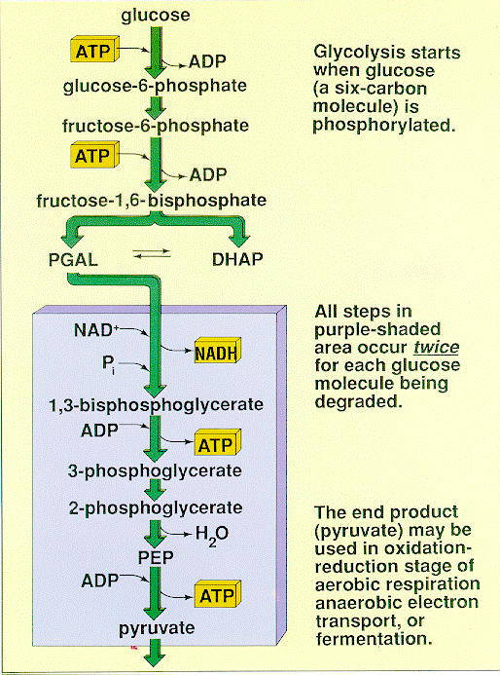
Glycolysis
13

Slide 14
Glycolysis
Glc
ADP
7
NAD+
10
NADH
G6P
ATP
3PDGlyc
ADP
1
8
F6P
3PG
ATP
ADP
9
2
F16BP
ATP
2PG
4
H2O
5
DHAP
PEP
3
ADP
G3P
6
Pyr
ATP
14
Notes:
14

Slide 15
Glycolysis variation 1
Glc
NAD+
32
NADH
ADP
11
3PDGlyc
ADP
G6P
ATP
13
1
3PG
ATP
F6P
2
ADP
17
2PG
F16BP
ATP
5
H2O
PEP
7
DHAP
19
G3P
3
Pyr
15
Notes:
15

Slide 16
The Detoxification Pathway of Methylglyoxal
GlxI
GlxII
MG
HTA
SLG
D-lactate
GSH
Non-Enzymatic:
MG + GSH
HTA
MG: Methylglyoxal
GlxI
GSH: glutathione
Enzymatic:
HTA
SLG
HTA:hemithioacetal
GlxII
GlxI: glyoxalase I
SLG
GSH
SLG: S-lactoyl-glutathione
GlxII: glyoxalase II
Methylglyoxal (CH₃-CO-CH=O): naturally occurring toxic electrophile (positively charged reagent)
Notes:
The definition of electrophile: is a reagent attracted to electrons that participates in a chemical reaction by accepting an electron pair in order to bond to a nucleophile.
Three points:
1. A brief introduction about Methyglyoxal(MG
2. Detailed description of the pathway:
3. Why qualitative analysis?
See the details below:
1. A brief introduction about Methyglyoxal(MG
Where does MG come from?
It is a naturally occurring toxic electrophile.
It is produced mainly through the glycolysis pathway.
Since glycolysis occurs in all organisms, MG formation seems to be an unavoidable consequence of this pathway.
What can MG do?
MG modifies amino acid residues in proteins and
reacts with guanyl nucleotides in DNA,
impairing the biochemical functions of these important macromolecules. Therefore, excessive production of MG leads to cell death.
2. Detailed description of the pathway:
The detoxification Pathway:
Most of the organisms protect themselves from deleterious effects of MG by detoxifying it with the help of glyoxalase pathway which comprises two enzymes, gly I [lactoylglutathione lyase] that uses GSH as a cofactor for the conversion of MG to S-D-lactoylglutathione and gly II [hydroxyacylgutathione hydrolase] that gives GSH back to the system leading to the production of D-lactate. This pathway has been reported from a diverse group of organisms like humans, mouse, yeast, protozoa, fungi, bacteria and plants.
MG can easily come across the membrane and enters into the cell. GSH reacts spontaneously with MG to produce
MG is a side-product of several metabolic pathways.
-------------------------------------------------------------
3. Why qualitative analysis?
HTA. Catalyzed by the enzyme GlxI, HTA is converted into SLG. Catalyzed by a second enzyme GlxII, SLG is converted into GSH and non-toxic D-lactate.
As D-lactate
D-lactate has no contribution to the kinetics of the system
There are numerous reasons why we use qualitative analysis.
a.
Qualitative Analysis is a natural way for scientists, including biologist.
Human brains reason qualitatively, not quantitatively.
When scientists start to study a problem, such as a biological process, a pathway,
at the very beginning, they appear to use qualitative approaches to
Initially understand the system, they may also use qualitative methods to interpret the experimental result, describe the process and Mechanisms.
b. sketch

Slide 17
Assumptions
Biological
Background
MG
SLG
HTA
GSH
GlxI
GlxII
MG
HTA
SLG
D-lactate
GSH
Non-enzymatic reactions: Mass action
Enzymatic reactions: Michaelis-Menten
There are hidden variables
Notes:
In our case, this is the biological background.
Suppose we know all the components, but we don’t know the connections.
We made the following reasonable assumptions.
non-enzymatic reactions conform to mass action law.
We use Michaelis-Menten kinetics to describe the enzymatic reactions.

Slide 18
Qualitative Data
Data
MG
MG
SLG
HTA
GSH
Time
 | MG | GSH | HTA | SLG
Qualitative State 1 | {+,+} | {+,+} | {+,-} | {+,-}
Qualitative State 2 | {+,0} | {+,+} | {+,-} | {+,-}
Qualitative State 3 | {+,-} | {+,-} | {+,-} | {+,-}
 | …. | …. | …. | …
{+,+}
{+,0} | {+,-}
Notes:
Suppose this is the experimental data for MG.
We can represent these data in qualitative forms.
As shown in this table. The first plus sign means the concentration of MG
is above zero, which is always the case. The second plus sign means the concentration is increasing With time.
Similarly, constant concentration is represented by {+,0}, and a decreasing concentration is represented by {+,-}.
In this way, all data are converted into qualitative forms.
In this table, each row is a possible behaviour of this pathway.
For example, Behaviour 1, the concentrations of MG and GSH increase, and HTA and SLG decrease.
And so on and so forth.
All behaviours constitute qualitative data.
33 qualitative states
The qualitative data are extracted from the limited quantitative data.
Currently, all the qualitative states are acquired by using JMoreven to simulate the qualitative model of MG pathway.

Slide 19
Converting Pathways to Qualitative Models
MG+GSH<---->HTA
MG---->SLG
HTA---->GSH
GSH---->SLG
Convert
Qualitative Model
Mass action: A+B <--- > C+D
[A]*[B] ↑ , [C]*[D] ↓ V ↑
Michaelis-Menten kinetic:
A-- >B
V
Vmax
[A] ↑ V ↑
[A]
Notes:
We developed a converting algorithm which can convert a pathway into a qualitative model.
The converting algorithm can be considered as encoding domain-specific knowledge into the form that can be used by
Qualtiative model learning algorithms to narrow down the search space (reduce the number of possible models)

Slide 20
A Qualitative Model Learning System
All possible
Reactions
Convert
MG+GSH<---->HTA
MG---->SLG
HTA---->GSH
GSH---->SLG
Qualitative Model
Search
Strategy
Simulation
Initial Search Space
Qualitative State 1
Qualitative State 2
Qualitative State 3
…….
…..
…..
…….
All species are included
Unique product (s)
Only enzymatic reactions are irreversible.
Additional assumptions
Biological
Background
Comparison
Data
Pang & Coghill Natural Computing 10(1), 2011
Notes:
1. Initial search space generation
First we generate all possible reactions, then these reactions are partitioned to several subsets, each
Subsets contain the reactions with the same substrates.
2. Search possible pathways
A possible pathway satisfies the following conditions:
In one model, all species are included; each combination of reactants only gives you unique products.
Only enzymatic reactions are irreversible. Beyond these three conditions, we introduced additional
Assumptions to generate models.
3. Convert a pathway into qualitative models
4. simulated the models, and generated behaviours.
5. These predicted behaviours were compared with data.
If these behaviours are consistent with data, the corresponding model is a possible pathway.

Slide 21
Scalability of the Learning System
Initial Search Space
Search Strategy
Possible Pathways
For complicated pathways with hidden variables, deterministic search algorithms could be intractable.
Highly multimodal search space
More efficient search strategies
CLONALG: Clonal Selection Algorithm (de Castro et al. 2002)
Opt-AiNet: Immune Network (Timmis, 2004)
Notes:
For more complex system, Exhaustively listing could be intractable, this necessitates more efficient algorithms.

Slide 22
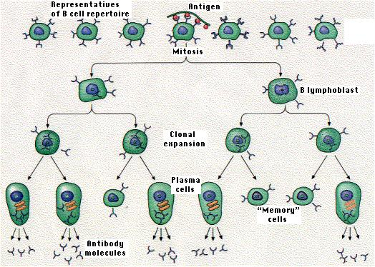
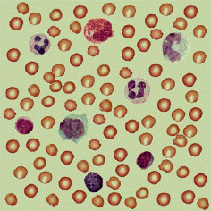
QML-CSA: Clonal Selection Algorithm
Antibody
repertoire
Random
Antibodies
An Evolutionary Algorithm Inspired
by the clonal selection principle
of immune system
Using hyper-mutation and re-selection
instead of crossover and mutation.
selection
Selected
Antibodies
Memory
cell
Update
Repertoire
Selected
Antibodies
Reselection
proliferation
Affinity
Mature
cloned
Antibodies
matured
Antibodies
Hyper-mutation
Notes:
22
Why CSA:
1. Well-established Immune inspired algorithm
2. Highly multi-modal search spaces
Optimization version of CSA:
Selection : In the optimization version, all the antibodies will be selected to undergo a proliferate process (clone), every antibody will be cloned to ten copies.
clone proliferation: each antibody will be clone to a specified number (called clonal size) of copies.
Hyper-mutation: the hyper mutation is different from the mutation in GA at two points: first, the probability is very high, second, the mutation operator will act on every bit of the individual during a whole hyper-mutation process.
Reselection: select the antibodies with high affinity, and update the old antibody repertoire. Meanwhile, some portion of the antibodies in the old repertoire will be replaced by randomly generated antibodies.
Memory cell: in our algorithm, we construct a memory cell pool to record good antibodies, when the algorithm finds a good solution, the corresponding antibody will be recorded by the memory pool and then be replaced by randomly generated antibodies.

Slide 23
QML_{PI}-AiNet
1.Random Generation
2. Clonal Selection
2.1 Fitness Evaluation
2.2 Clone Nc Copies
2.3 Mutation, Evaluation
2.4 Selection
2.5 Average Fitness Error
3. Network Suppression
4. Add d% new antibodies
Each antibody represents a possible pathway, which could be converted to a qualitative model

Slide 24
Antibody Encoding
Antibody
4
3.6
2.3
Possible Pathway:
r4
r11
…
…
r99
1. r1
2. r2
r3
r4
…..
…..
r8
r9
3. r10
4. r11
…..
…..
r98
r99
r100
4. …..
……
Set 1
Set 2
Set n

Slide 25
Fitness Evaluation
Consider the following aspects of a possible pathway
Completeness
Consistency
Bayesian Score
The better these constraints are satisfied, the higher score of the fitness

Slide 26
Muggleton’s Bayesian Learning Approach
Hypothesis
Observed Data
Num. of E
Constant
Size of H
Posterior Probability
Generality of H
H and E are both countable sets.
H: a QDE model
E: given qualitative states
g(H): the proportion of states simulated by a QDE to all possible states.
Sz(H): size of the model.
This approach considers a balance between model structure simplicity and output simplicity
S.Muggleton, LNCS 1314, pp. 358-376

Slide 27


QML_{PI}-AiNet: Hyper-Mutation
Antibody
4
3.6
2.3
QML-AiNet:
Uniform Random Number
Gaussian Random Variable
r1
r2
r3
4. r4
…..
….
Normalized Fitness
Control Parameter

Slide 28
QML-AiNet: Network Suppression
Phenotype distance: the number of different constraints between two models
Pathway 1
r1
r10
r3
r8
Pathway 2
r1
r10
r5
r6

Slide 29
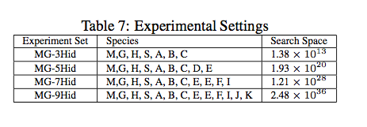
Experiment Settings

Slide 30
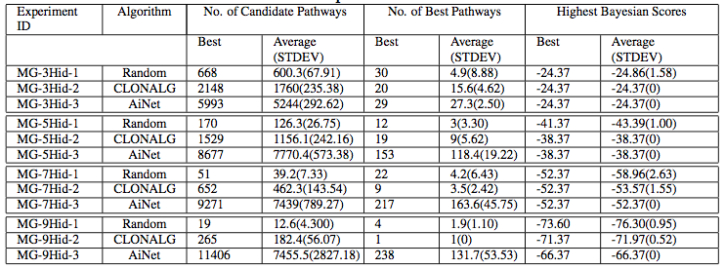
Experimental Results
Random: Totally Random Search
CLONALG: Clonal Selection Algorithm
AiNet: Opt-AiNet
Ten trials for each experiment. Each algorithm was run 2000 seconds.
Notes:
Note: what is backtracking, BKFC?
The backtracking algorithm also works on the partitioned search space, it will incrementally select one reaction from one subset to construct a partial model. If the current partial model didn’t satisfy given constraints, the latest added reaction will be abandoned, and the algorithm backtracks to previous subset and select another pathway, and so on and so forth.
Based on BK, The BKFC adds the forward checking method: every time when a new reaction is added to the current partial model, all reactions which are not consistent with this reaction will be recorded and they will not be considered in the following search.

Slide 31
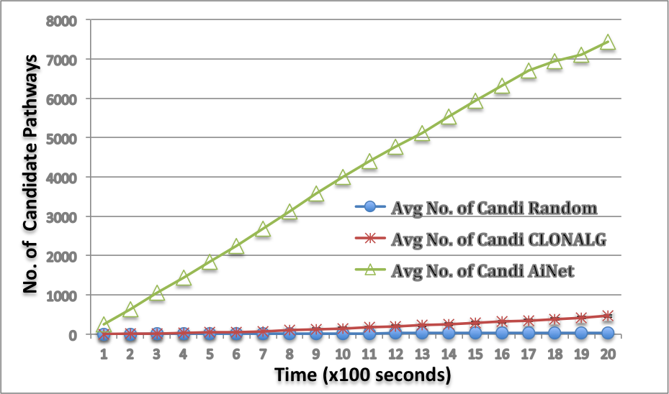
Experimental Results MG-7Hid

Slide 32
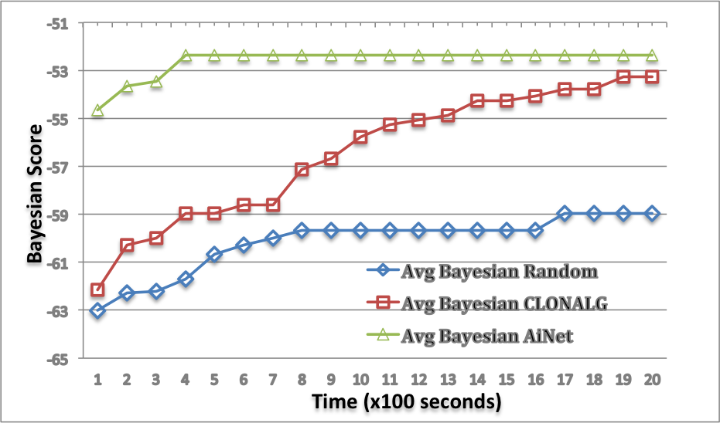
Experimental Results MG-7Hid Cont’d

Slide 33
Summary
Data mining when there are not many data.
Learning Qualitative Models
Incomplete knowledge
Sparse noisy data
Real world applications

