Slide 1
CS4038/5012 Revision Lecture Part I
Lectures 1, 2, 3,7,8,9, 16,17,18,19
Wei Pang

Slide 2
What is Data Mining, and What is not?
Process of automatically (or semi-automatically) discovering useful, novel and meaningful patterns from substantial quantities of data.
Sorting a customer database based on customer ID number.
Computing the total sales of a company
Predicting the future profit of a company based on sales records from previous years.
Detect abnormal weather conditions based on historical weather information.

Slide 3
Data

Slide 4
Types of data sets
Record
Data Matrix
Document Data
Transaction Data
Graph
World Wide Web
Molecular Structures
Ordered
Spatial Data
Temporal Data
Sequential Data
Genetic Sequence Data

Slide 5
Record Data
Data that consists of a collection of records, each of which consists of a fixed set of attributes

Slide 6
Important Characteristics of Structured Data
Dimensionality
Curse of Dimensionality
Sparsity
Only presence counts
Resolution
Patterns depend on the scale

Slide 7
Operations allowed on Levels of Measurement
Nominal
= and ≠
Ordinal
Operations allowed for nominal and
< and >
Interval
Operations allowed for Ordinal and
+ and –
Ratio
Operations allowed for interval and
* and /

Slide 8
Attribute Type
Description
Examples
Operations
Nominal
The values of a nominal attribute are just different names, i.e., nominal attributes provide only enough information to distinguish one object from another. (=, ≠)
zip codes, employee ID numbers, eye color, sex: {male, female}
mode, entropy, contingency correlation, χ² test
Ordinal
The values of an ordinal attribute provide enough information to order objects. (<, >)
hardness of minerals, {good, better, best}, grades, street numbers
median, percentiles, rank correlation, run tests, sign tests
Interval
For interval attributes, the differences between values are meaningful, i.e., a unit of measurement exists. (+, - )
calendar dates, temperature in Celsius or Fahrenheit
mean, standard deviation, Pearson's correlation, t and F tests
Ratio
For ratio variables, both differences and ratios are meaningful. (*, /)
temperature in Kelvin, monetary quantities, counts, age, mass, length, electrical current
geometric mean, harmonic mean, percent variation

Slide 9
Exploratory Data Analysis

Slide 10
Introduction
Applying data mining (InfoVis as well) techniques requires gaining useful insights into the input data first
We saw this in the previous lecture
Exploratory Data Analysis (EDA) helps to achieve this
EDA offers several techniques to comprehend data
But EDA is more than a library of data analysis techniques
EDA is an approach to data analysis
EDA involves inspecting data without any assumptions
Mostly using information graphics
Modern InfoVis tools use many of the EDA techniques
Insights gained from EDA help selecting appropriate data mining (InfoVis) technique.

Slide 11
Some Concepts
Mean
Median
Frequency
Mode
Range & Standard Deviation
Z Score

Slide 12
EDA Answers Questions
All the techniques presented so far are the tools useful for EDA
But without an understanding built from the EDA, effective use of tools is not possible
A detective investigating a crime scene needs tools for obtaining finger prints.
Also needs an understanding (common sense) to know where to look for finger prints
Door knobs better places than door hinges?
EDA helps to answer a lot of questions
What is a typical value?
What is the uncertainty of a typical value?
What is a good distributional fit for the data?
What are the relationships between two attributes?
etc

Slide 13
Clustering

Slide 14
Types of Clusters
Well-separated clusters
Center-based clusters
Contiguous clusters
Density-based clusters
Property or Conceptual
Described by an Objective Function

Slide 15
Types of Clusters: Well-Separated
Well-Separated Clusters:
A cluster is a set of points such that any point in a cluster is closer (or more similar) to every other point in the cluster than to any point not in the cluster.
3 well-separated clusters

Slide 16
Types of Clusters: Center-Based
Center-based
A cluster is a set of objects such that an object in a cluster is closer (more similar) to the “center” of a cluster, than to the center of any other cluster
The center of a cluster is often a centroid, the average of all the points in the cluster, or a medoid, the most “representative” point of a cluster
4 center-based clusters

Slide 17
Types of Clusters: Contiguity-Based
Contiguous Cluster (Nearest neighbor or Transitive)
A cluster is a set of points such that a point in a cluster is closer (or more similar) to one or more other points in the cluster than to any point not in the cluster.
8 contiguous clusters

Slide 18
Types of Clusters: Density-Based
Density-based
A cluster is a dense region of points, which is separated by low-density regions, from other regions of high density.
Used when the clusters are irregular or intertwined, and when noise and outliers are present.
6 density-based clusters

Slide 19
Several Clustering Algorithms
Partitioning Methods
K-means and k-medoids
Hierarchical Methods
Agglomerative
Density-based Methods
DBSCAN
Notes:
Partitional Clustering
A division data objects into non-overlapping subsets (clusters) such that each data object is in exactly one subset
Hierarchical clustering
A set of nested clusters organized as a hierarchical tree

Slide 20
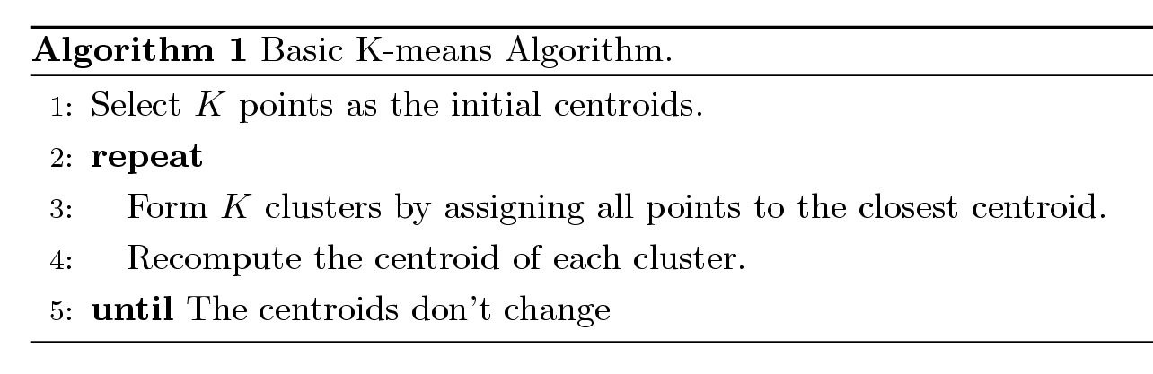
K-means Clustering
Partitional clustering approach
Each cluster is associated with a centroid (center point)
Each point is assigned to the cluster with the closest centroid
Number of clusters, K, must be specified
The basic algorithm is very simple

Slide 21
K-means in Euclidean Space
In Euclidean Space, the centroid is the mean of all data points within the cluster. It has been mathematically proven that the centroid that minimizes the SSE (sum of the squared error) is the mean.

Slide 22
Evaluating K-means Clusters
Most common measure is Sum of Squared Error (SSE)
For each point, the error is the distance to the nearest cluster
To get SSE, we square these errors and sum them.
x is a data point in cluster C_{i} and m_{i} is the representative point for cluster C_{i}
can show that m_{i} corresponds to the center (mean) of the cluster
Given two clusters, we can choose the one with the smallest error
One easy way to reduce SSE is to increase K, the number of clusters
A good clustering with smaller K can have a lower SSE than a poor clustering with higher K

Slide 23
Exercise
Data Point | X | y
a | 2 | 4
b | 1 | 4
c | 3 | 7
d | 3 | 9
e | 4 | 5
Manually calculate the process of K-means.

Slide 24
EM Clustering Algorithm

Slide 25
EM Algorithm
EM = Expectation – Maximization
Generalize k-means to probabilistic setting
Input: Collection of instances and number of clusters, k
Output: probabilities with which each instance belongs to each of the k clusters
Method:
Start by guessing values for all the parameters of the k clusters (similar to guessing centroids in k-means)
Repeat
E ‘Expectation’ Step: Calculate cluster probability for each instance
M ‘Maximization’ Step: Estimate distribution parameters from cluster probabilities
Store cluster probabilities as instance weights
Estimate parameters from weighted instances
Until we obtain distribution parameters that predict the input data
EM is a generalised k-means algorithm.
Notes:
http://www.robots.ox.ac.uk/~az/lectures/ml/lect8.pdf
http://www.cs.ccsu.edu/~markov/ccsu_courses/DataMining-10.pdf

Slide 26
Hierarchical Clustering

Slide 27
Hierarchical Clustering
Two main types of hierarchical clustering
Agglomerative:
Start with the points as individual clusters
At each step, merge the closest pair of clusters until only one cluster (or k clusters) left
Divisive:
Start with one, all-inclusive cluster
At each step, split a cluster until each cluster contains a point (or there are k clusters)
Traditional hierarchical algorithms use a similarity or distance matrix
Merge or split one cluster at a time

Slide 28
Agglomerative Clustering Algorithm
More popular hierarchical clustering technique
Basic algorithm is straightforward
Compute the proximity matrix
Let each data point be a cluster
Repeat
Merge the two closest clusters
Update the proximity matrix
Until only a single cluster remains
Key operation is the computation of the proximity of two clusters
Different approaches to defining the distance between clusters distinguish the different algorithms

Slide 29
How to Define Inter-Cluster Similarity
p1
p2
p3
p4
p5
. . .
p1
Similarity?
p2
p3
p4
p5
MIN
MAX
Group Average
Distance Between Centroids
Other methods driven by an objective function
Ward’s Method uses squared error
.
.
.
Proximity Matrix

Slide 30
How to Define Inter-Cluster Similarity
p1
p2
p3
p4
p5
. . .
p1
p2
p3
p4
p5
MIN
MAX
Group Average
Distance Between Centroids
Other methods driven by an objective function
Ward’s Method uses squared error
.
.
.
Proximity Matrix

Slide 31
How to Define Inter-Cluster Similarity
p1
p2
p3
p4
p5
. . .
p1
p2
p3
p4
p5
MIN
MAX
Group Average
Distance Between Centroids
Other methods driven by an objective function
Ward’s Method uses squared error
.
.
.
Proximity Matrix

Slide 32
How to Define Inter-Cluster Similarity
p1
p2
p3
p4
p5
. . .
p1
p2
p3
p4
p5
MIN
MAX
Group Average
Distance Between Centroids
Other methods driven by an objective function
Ward’s Method uses squared error
.
.
.
Proximity Matrix

Slide 33
How to Define Inter-Cluster Similarity
p1
p2
p3
p4
p5
. . .
p1
×
×
p2
p3
p4
p5
MIN
MAX
Group Average
Distance Between Centroids
Other methods driven by an objective function
Ward’s Method uses squared error
.
.
.
Proximity Matrix

Slide 34
Cluster Similarity: MIN or Single Link
Similarity of two clusters is based on the two most similar (closest) points in the different clusters
Determined by one pair of points, i.e., by one link in the proximity graph.
1
2
3
4
5

Slide 35
Hierarchical Clustering: MIN
5
1
3
5
2
1
2
3
6
4
4
Nested Clusters
Dendrogram

Slide 36
Cluster Similarity: MAX or Complete Linkage
Similarity of two clusters is based on the two least similar (most distant) points in the different clusters
Determined by all pairs of points in the two clusters
1
2
3
4
5

Slide 37
Cluster Similarity: Group Average
Proximity of two clusters is the average of pairwise proximity between points in the two clusters.
Need to use average connectivity for scalability since total proximity favors large clusters
1
2
3
4
5

Slide 38
1. Whether it is a dissimilarity or similarity matrix. 2. Not only the results, but also detailed steps of your calculation for MIN, MAX, and Group Average.

Slide 39
MST: Divisive Hierarchical Clustering

Slide 40
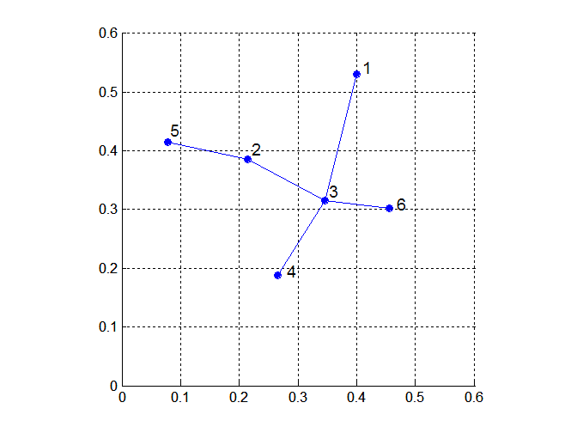
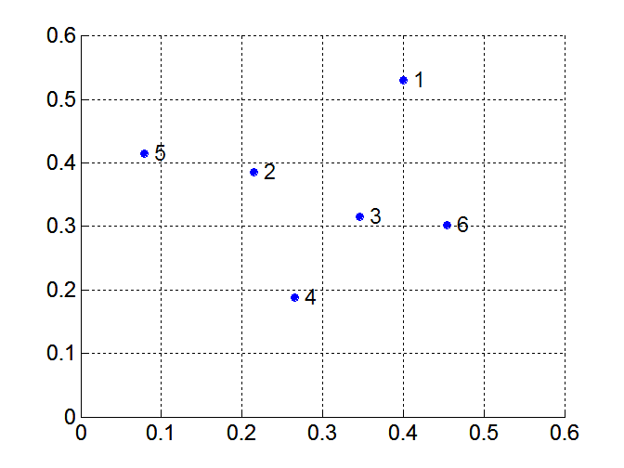
MST: Divisive Hierarchical Clustering
Build MST (Minimum Spanning Tree)
Start with a tree that consists of any point
In successive steps, look for the closest pair of points (p, q) such that one point (p) is in the current tree but the other (q) is not
Add q to the tree and put an edge between p and q
Notes:
a tree is an undirected graph in which any two vertices are connected by exactly one simple path
Given a connected, undirected graph, a spanning tree of that graph is a subgraph that is a tree and connects all the vertices together

Slide 41
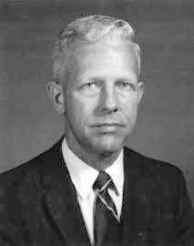
Prim’s Algorithm
Robert Clay Prim
Prim Approach:
Choose an arbitrary start node v
At any point in time, we have connected component N containing v and other nodes V-N
Choose the minimum weight edge from N to V-N
Prim's Algorithm:
let T be a single vertex x
while (T has fewer than n vertices)
{
find the smallest edge connecting T to G-T
add it to T
}

Slide 42
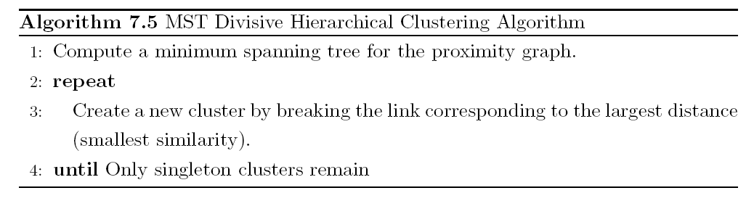
MST: Divisive Hierarchical Clustering
Use MST for constructing hierarchy of clusters

Slide 43
Cluster Validity

Slide 44
Measures of Cluster Validity
Numerical measures that are applied to judge various aspects of cluster validity, are classified into the following three types.
External Index: Used to measure the extent to which cluster labels match externally supplied class labels.
Entropy
Internal Index: Used to measure the goodness of a clustering structure without respect to external information.
Sum of Squared Error (SSE)
Relative Index: Used to compare two different clusterings or clusters.
Often an external or internal index is used for this function, e.g., SSE or entropy
Sometimes these are referred to as criteria instead of indices
However, sometimes criterion is the general strategy and index is the numerical measure that implements the criterion.

Slide 45
Time Series Data Mining

Slide 46
PAA & SAX

Slide 47
Symbol mapping - breakpoints
Breakpoints for different alphabet sizes can be structured as a lookup table
When a=3
Average values below -0.43 are replaced by ‘A’
Average values between -0.43 and 0.43 are replaced by ‘B’
Average values above 0.43 are replaced by ‘C’
Using this table, SAX for our input series is ‘ADD’
 | a=3 | a=4 | a=5
b1 | -0.43 | -0.67 | -0.84
b2 | 0.43 | 0 | -0.25
b3 |  | 0.67 | 0.25
b4 |  |  | 0.84

Slide 48
Given a time series, manually Calculate PAA and SAX (Refer to the practical)

Slide 49
SAX Computation – in pictures
C
C
0
20
40
60
80
100
120
This slide taken from Eamonn’s Tutorial on SAX
c
c
c
b
b
b
a
a
-
-
0
0
20
40
60
80
100
120
baabccbc

Slide 50
Dynamic Time Warping

Slide 51
Why Dynamic Time Warping?
i
i
i
i
i+2
time
time
A non-linear (elastic) alignment produces a more intuitive similarity measure, allowing similar shapes to match even if they are out of phase in the time axis.
Any distance (Euclidean, Manhattan, …) which aligns the i-th point on one time series with the i-th point on the other will produce a poor similarity score.

Slide 52
Warping Function
Time Series A
1
i_{s}
n
m
p_{k}
To find the best alignment between A and B one needs to find the path through the grid
P = p₁, … , p_{s} , … , p_{k}
p_{s} = (i_{s} , j_{s} )
which minimizes the total distance between them.
P is called a warping function.
j_{s}
p_{s}
Time Series B
1
p₁

Slide 53

Defining Distance Measures
Definition: Let O₁ and O₂ be two objects from the universe of possible objects. The distance (dissimilarity) is denoted by D(O₁,O₂)
D(A,B) = D(B,A) Symmetry
D(A,A) = 0 Constancy
D(A,B) = 0 IIf A= B Positivity
D(A,B) ≤ D(A,C) + D(B,C) Triangular Inequality
What properties are desirable in a distance measure?

Slide 54
Why is the Triangular Inequality so Important?
Virtually all techniques to index data require the triangular inequality to hold.
Suppose I am looking for the closest point to Q, in a database of 3 objects.
Further suppose that the triangular inequality holds, and that we have precomplied a table of distance between all the items in the database.
Q
a
c
b

Slide 55
Why is the Triangular Inequality so Important?
Virtually all techniques to index data require the triangular inequality to hold.
I find a and calculate that it is 2 units from Q, it becomes my best-so-far. I find b and calculate that it is 7.81 units away from Q.
I don’t have to calculate the distance from Q to c!
I know D(Q,b) ≤ D(Q,c) + D(b,c)
D(Q,b) - D(b,c) ≤ D(Q,c)
7.81 - 2.30 ≤ D(Q,c)
5.51 ≤ D(Q,c)
So I know that c is at least 5.51 units away, but my best-so-far is only 2 units away.
Q
a
c
b

Slide 56

What is Lower Bounding?
Q
Q’
Raw Data
Approximation
or
“Representation”
S
S’
D_{LB}(Q’,S’)
D(Q,S)
D_{LB}(Q’,S’)
The term (sr_{i}-sr_{i-1}) is the length
of each segment. So long segments
contribute more to the distance measure.
Lower bounding means that for all Q and S, we have: D_{LB}(Q’,S’) ≤ D(Q,S)

Slide 57
Learning Qualitative Models

Slide 58
Learning Qualitative Models
qi
qi
V
V
qo
qo
V
{+,-}
{+,0}
Qualitative Learning
V ↑ → qo ↑
dV/dt=qi – qo
Physical Knowledge
{0,+}
{+,+}
Time
Notes:
Qualitative model learning:
Inferring the qulatiative structure of a dynamic system. (physical or biological system).

Slide 59
Qualitative Model Learning
The domain knowledge are not very clear, no sufficient data, then there are many possibilities.
Nothing is known, no data, then everything is possible
Background
Knowledge
Possible
Qualitative
Models
Data
Everything is known, sufficient data to support, only one possibility
Notes:
What makes qualitative model learning useful is the situation when biological background is incomplete, with insufficient data, then applying qualitative model learning, we can exclude other possibilities and provide a set of possible models.
The better the algorithm is, the less the number of possible models.

Slide 60
Summary
Answer questions as much as you can.
Manual calculation for some important algorithms K-means, hierarchical, PAA&SAX
Remember important definitions and concepts.
If asked to give detailed steps, make it clear.

