Slide 1

2/21/16
Predicting Customer Churn
Tony Caballero

Slide 2
AGENDA
Problem
Data
Hypothesis
Model
Results
Next Steps
Notes:
More background statistical modelling is required for presentation to Staff in Jan

Slide 3
Problem
Objective:
Leverage the data warehouse to generate insight into customer cohorts and serve as the foundation for a predictive model to predict churn
Problem Statement:
Churn is difficult to predict. Doing so (accurately) on a monthly basis for the next year will guide Optimizely’s efforts as well as guide how we invest our resources to service segments where we find favorability

Slide 4
Data
So far, I’ve collected over 40 variables in the customer data cube
Some variables are time series (MRR, Traffic, # of logins)
others are static variables (industry, segment, country, region, AE, etc)
Type of data = Salesforce data, Optimizely product data, finance data
200,000 records generated via SQL query
Simplified the data set by excluding customers who’ve never paid $300 in MRR since they have a different behavior profile
Cube consists of 5 years’ worth of data – the integrity of the data improves over time as well as amount of data

Slide 5
Hypothesis
At least one of the variables that I caputred will be a significant linear predictor of churn
Notes:
A challenge is that dollar based net expansion (my dependent variable) is a ratio, and it’s very difficult to do meaningful arithmetic on a ratio, so this may change how I measure my output variable.

Slide 6
Approach
Start with a tiny version of the data set to get a sense of which variables were interesting, then scale out to full data set
This approach showed that my time series and product usage data yielded more interesting results
My statis/attribute variables were just too general to yield significant results
Notes:
A challenge is that dollar based net expansion (my dependent variable) is a ratio, and it’s very difficult to do meaningful arithmetic on a ratio, so this may change how I measure my output variable.

Slide 7
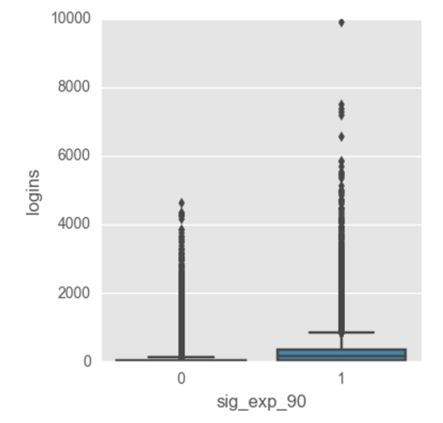
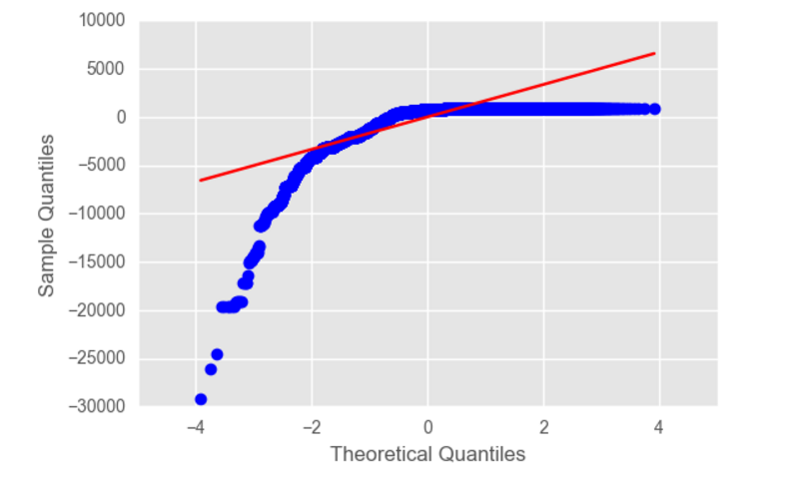
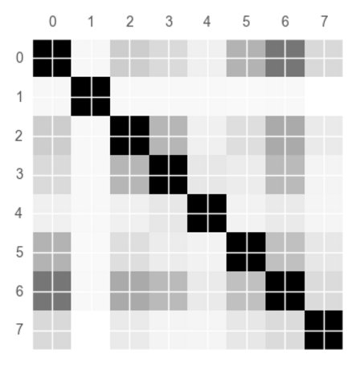
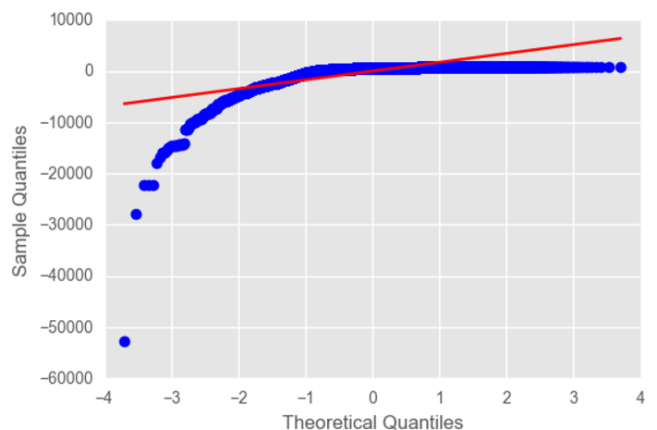
Data Visualization
Notes:
A challenge is that dollar based net expansion (my dependent variable) is a ratio, and it’s very difficult to do meaningful arithmetic on a ratio, so this may change how I measure my output variable.

Slide 8
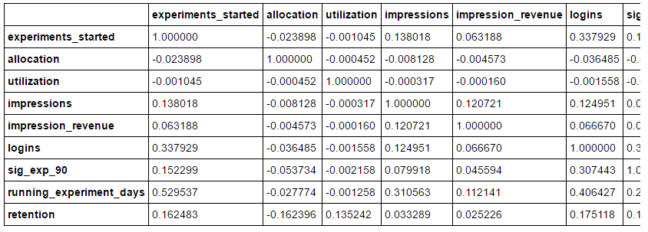
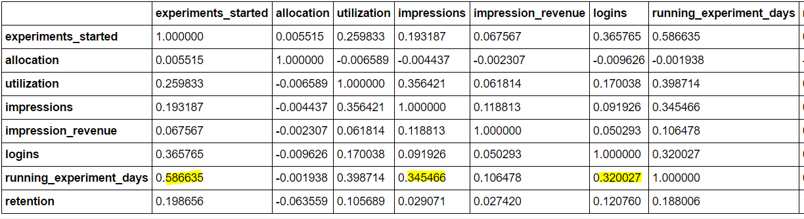
Data
Notes:
A challenge is that dollar based net expansion (my dependent variable) is a ratio, and it’s very difficult to do meaningful arithmetic on a ratio, so this may change how I measure my output variable.

Slide 9
Model
I decided to focus my attention on Logistic Regression due to how non-normal the data was when I attempted linear regression
I created a binary flag indicating if the customer churned in the next month or not, which also got rid of many of my NA values
Given my previous analysis I had already done with covariance and graphing the data, I could tell sig_exp_90 would be worth splitting data on
Notes:
A challenge is that dollar based net expansion (my dependent variable) is a ratio, and it’s very difficult to do meaningful arithmetic on a ratio, so this may change how I measure my output variable.

Slide 10
Results
When Sig_Exp_90 == 0:
training misclassification = 0.253
testing misclassification = 0.255
When Sig_Exp_90 == 1:
training misclassification = 0.119079071523
testing misclassification = 0.113250283126
Linear regression doesn’t seem like the way to go. More useful to use Linear Regression.
Challenges:
Data has time series element to it.
Notes:
A challenge is that dollar based net expansion (my dependent variable) is a ratio, and it’s very difficult to do meaningful arithmetic on a ratio, so this may change how I measure my output variable.

Slide 11
Next Steps
Do some time series analysis across variables that have time components. It would be good to incorporate this time series dimension into regression tree so that I can rank each variables significance and see how this ranking changes over time
If using Time Series, it’d be good to split customers into segments
Another useful next step is to be able to predict how many dollars we will churn in the future
Notes:
A challenge is that dollar based net expansion (my dependent variable) is a ratio, and it’s very difficult to do meaningful arithmetic on a ratio, so this may change how I measure my output variable.

