Slide 1
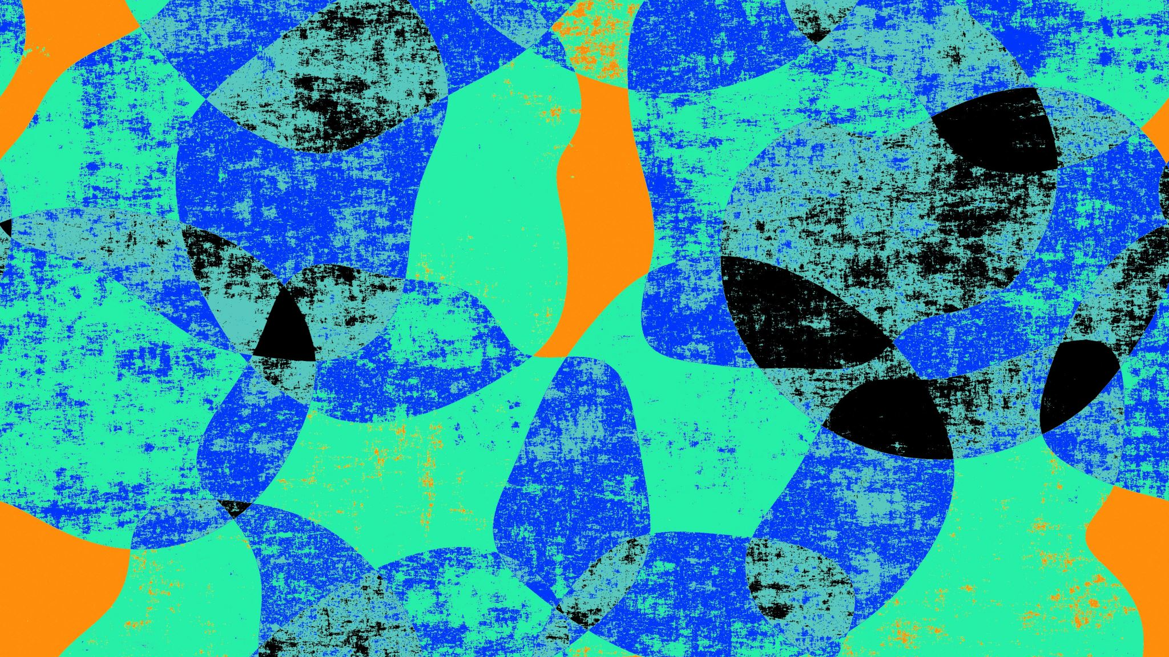
Undergrad Project Final Presentation
FLAT Implementation
Zeyu Chen

Slide 2
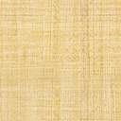
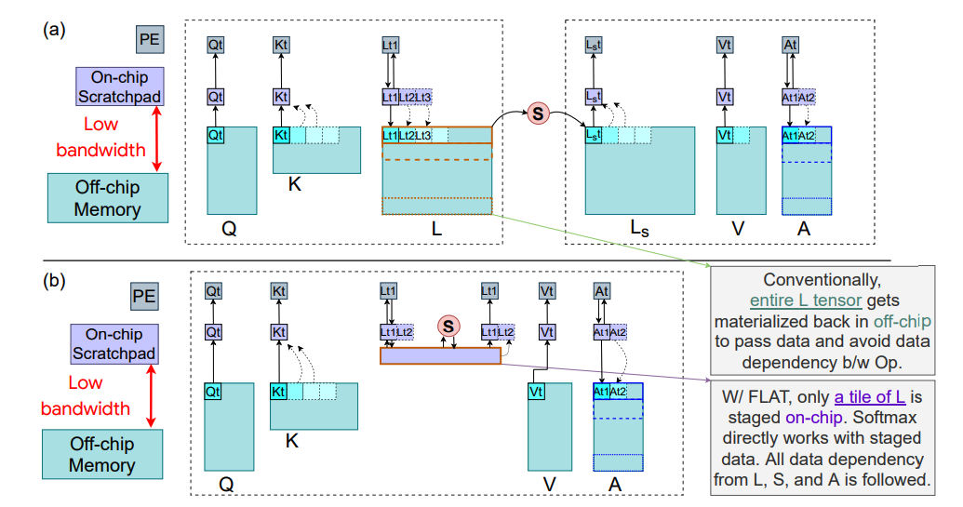
Background: What is FLAT?
FLAT stands for Fused Logit Attention Tiling, which is a specialized strategy aimed to improve memory intensity in attention layer calculation. FLAT resolves problem of Large Intermediate Tensor Footprint in L/A through an idea similar to vector chaining.
The key idea here is that the program shouldn’t be waiting until it gets the full product of Query matrix and Key matrix to start operation like Softmax. Instead, we split the matrix into different granularities, feed them to different operators one after another, and concatenate the temp result to get the correct output at last. We provide different level granularities, *(i.e. batch, head, length) to fit into different input/cache configuration. With this method, we successfully solve the O(BHN^2) space complexity. As the input sequence length of NLP models increasing dramatically, this method might provide a new way to accelerate the calculation.
Paper Reference: https://arxiv.org/pdf/2107.06419.pdf

Slide 3
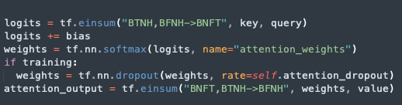
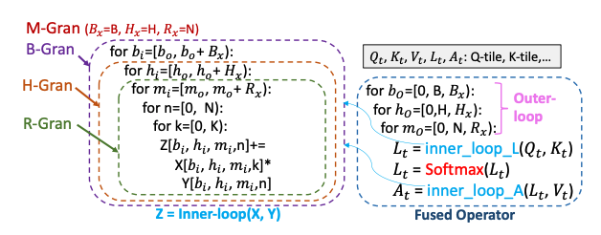
Code Implementation
All the implementation code is written in python on Google Colab, with the help of Tensorflow2.0 Framework.
Source GitHub Repo: https://github.com/tensorflow/models/tree/master/official/nlp/transformer
OUR GitHub Repo: https://github.com/tonycccccc/tony.github.io
Pseudo Code of Our Implementation
Previous Code

Slide 4
Let’s take a look at code！

Slide 5
Evaluation Metrics
Memory:
Memory Profiling is done through tf.config.experimental.get_memory_info() function. Basically, before we run any program, we set the runtime type to GPU and sort the GPU memory using tf.config.experimental.reset_memory_stats() after loading required data. Note this function doesn’t mean it will clear all stuff in the GPU memory; instead, it just cleans the memory and keeps the data we just loaded. In this way, every algorithm, before we run, should be on the same page. We then call the tf.config.experimental.get_memory_info() to record the memory info and run the program. After each iteration it finishes, we record the info again and write them to some file.

Slide 6
Evaluation Metrics
Time:
For time, I measured both GPU and CPU runtime. For the traditional CPU, fetching data from memory though limited bandwidth really lowers the performance. Maximizing the use of on-chip memory may help us break the bottleneck and reduce the runtime.
However, for GPU, as a SIMD device, it is designed for matrix multiplication. Fetching data from memory may take time, but if the whole matrix can be fed into the program, time saved by computation might compensate the memory time.
Not so sure about this. Need to further explore GPU working principles.

Slide 7
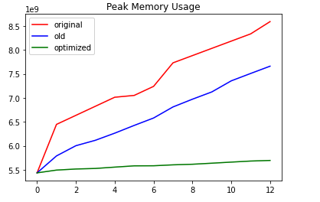
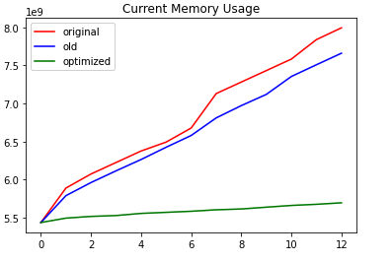
Test Result
Type 1: 12 * 576 * 64 * 16 * 64 matrix as input; 12 different inputs, with 576 as batch size, 64 as sequence length, 16 as head num and 64 as dimension per head

Slide 8
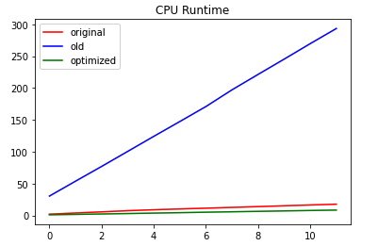
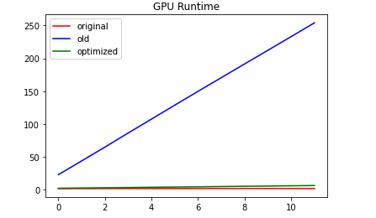
Test Result
Same shape data running on CPU and GPU

Slide 9
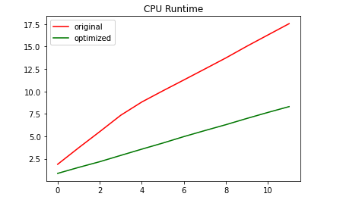
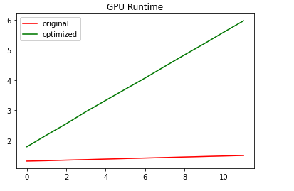

Slide 10
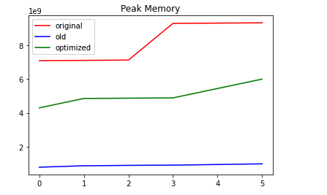
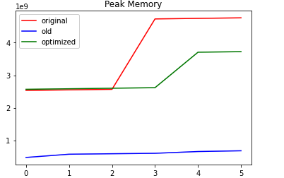
Test Result
Type 2: Matrix with shape 4 * 1 * 4k * 16 * 64

Slide 11
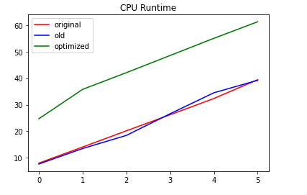
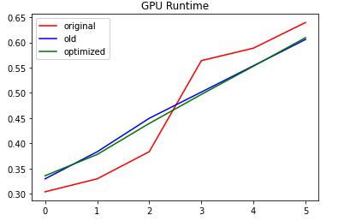

Slide 12
Conclusion
Granularity matters!

Slide 13
Live Demo
Notice the final demo flat function only returns the memory profiling and runtime result on GPU. If the user wants to test runtime on CPU, he/she can find separate file in the git repo.
Originally planned to do an UI, but unfortunately, Colab doesn’t support any GUI.

Slide 14
Look through our github!
Some obstacles we face throughout semester
Unresolved Question

Slide 15
Question?

Slide 16
Conclusion
Thanks Felix for helping me out throughout the semester.
Thanks Professor Tushar for giving me this chance to do the project!

