Slide 1
请点击以下链接下载WinHEC的演讲材料
Download WinHEC presentations here:
http://channel9.msdn.com/Events/WinHEC/2015

Slide 2
Minimum System HW Requirements & Compatibility for Windows Platforms
Paul Reed
Senior Program Manager

Slide 3
Introduction and Agenda
Session Introduction
In this session will leave with a better understand for the hardware requirements for Windows 10.
Learn about the Windows 10 Compatibility Program.
Session Agenda:
Understand the Minimum Hardware Specification for Windows 10
Learn about the Windows Hardware Compatibility Program
Call to action

Slide 4
Windows 10 Minimum Hardware Specification

Slide 5
Purpose of this Specification
This specification defines the minimum hardware requirements necessary to:
Boot and run Windows 10.
Update and service Windows 10.
Provide a baseline user experience that is comparable with similar devices and computers.
This specification does not provide certification requirements for devices and computers that run Windows 10 or implementation guidance for exceptional user experiences.

Slide 6



New SoC Processor Support for Windows 10
New
Carrizo
Carrizo-L
New
MSM8909
MSM8208
MSM8994
MSM8992
MSM8952
New
Cherry Trail
Skylake
Atom x3 (LTE)

Slide 7
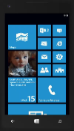
Windows Mobile Hardware Requirements
Resolution | Memory
2560x2048 (QSZGA) and higher | >= 4GB
2048 x 1152 (QWXGA) to 2560 x 1600 (WQXGA) | >= 3GB
1440 x 900 (WSXGA) to 1920 x 1200 (WUXGA) This range includes: 1920 x 1080 (FHD/1080p) | >= 2GB
960 x 540 (qHD) to 1366 x 768 (WXGA) This range includes: 1280 x 720 (HD/720p) 1024 x 600 (WSVGA) | >= 1GB
800 x 480 (WVGA) to 854 x 480 (FWVGA) | >= 512 MB
Firmware UEFI 2.3.1 Secure boot enabled
Memory 512MB for 32-bit
Storage >= 4GB of flash SD Card required for 4GB devices in order to support updates
Graphics DirectX 9
Buttons Required – Power, Volume Up/Down Start, back, search required for phones that use WVGA display
3 – 7.99”

Slide 8
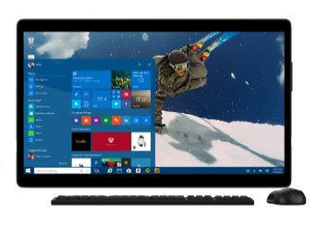
Windows Desktop Minimum Hardware Requirements
Firmware UEFI 2.3.1 Secure boot enabled
Memory 2GB for 64-bit 1GB for 32-bit
Storage >= 16GB for 32-bit OS >=20GB for 64-bit OS
Graphics DirectX 9
Tablet Buttons Required – Power, Volume Up/Down Optional – Start, Rotation lock
>= 8-inches for consumer
>= 7-inches for Pro
800x600 and higher

Slide 9
Optional Components and Connectivity
Component |  | Windows “Mobile” | Windows “Desktop”
Cellular radio |  | Required for phones. Data and voice supported | Optional. Data only, no cellular voice support
Audio |  | Primary, Loudspeaker, Earpiece required for phones | Optional
Connectors |  | Headphone/headset jack required for phones | Optional
Wireless |  | 802.11b/g required for phones | Optional
Sensors |  | Optional. E.g. Accelerometer, Magnetometer, ALS, Proximity, Gyroscope
Notification |  | Vibration mechanism required | Optional
Touch |  | Optional. If implemented, Two-Finger touch, must be HID compliant
Buttons |  | Power, Volume up and Volume down required. Start, Back, Search required for WVGA screen. | Power required. Volume up and Volume down required on tablets and devices with detachable keyboards.

Slide 10
Windows 10 Security Requirements
 | UEFI Secure Boot Requirement | TPM at RTM | TPM at RTM + 365 days
Windows “Mobile” | Enabled and switch to disable is optional | Required to be enabled, switch to disable is optional.
Windows “Desktop” |  | Discrete TPM is optional. It can be TPM 1.2 or TPM 2.0. If SoC/Processor supports fTPM, it must be enabled. | TPM 2.0 required on all new systems.
For more information on security features in Windows, see session ‘Building More Secure Windows 10 Devices with the TPM’.

Slide 11
Windows Hardware Compatibility Program

Slide 12
Windows Hardware Compatibility Program
Enhances customer confidence that products are compatible and reliable with Windows
Through active partner engagement:
Engage in a carefully structured process of defining program terms
Helps partners build compatible products
Validate compliance via testing in the Hardware Lab Kit (HLK)
Documenting the program online
Assure quality after the product goes to market
Products that pass testing are listed on Microsoft sites
Not a requirement to ship Windows 10 products, but many commercial and government customers make it a requirement

Slide 13
Partner Benefits: Reasons to Participate
Association with one of the strongest, most well-known brands in the world – Microsoft Windows
Value add against competitors
Meeting corporate and retail purchasing criteria
Receiving a Windows Compatibility Center listing
Drivers published on Windows Update
Lower support costs and reduced product returns

Slide 14
Changes to make it easier
Windows 8.1 814 Component and peripheral
246 System
Windows 10 623 Component and Peripheral
163 System
Focus on:
What is needed to run Windows
Ensure compatibility and reliability
Hardware Certification Kit 2.1
Hardware Lab Kit
Windows 8.1 Certification
Windows 10 Compatibility Program

Slide 15
Road to Program Qualification
Establish Your Member ship on Sysdev
Design, Build and Test
Submit and Qualify
Manage

Slide 16
Road to Program Qualification
Establish Your Member ship on Sysdev
Design, Build and Test
Submit and Qualify
Manage
Get a EV Certificate
Sign your company up at the HW Portal
Review & sign the legal agreements

Slide 17
Road to Program Qualification
Establish Your Member ship on Sysdev
Design, Build and Test
Submit and Qualify
Manage
Review the Program Qualification Terms
Download the HLK

Slide 18
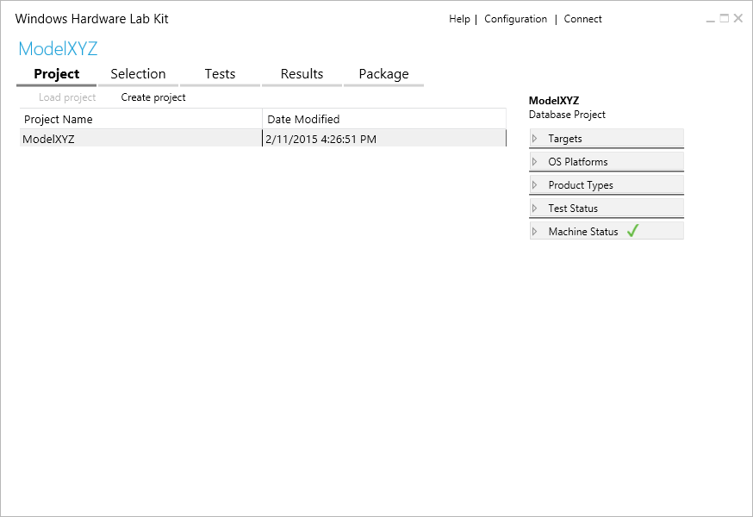
Hardware Lab Kit
Enables you to evaluate driver compatibility with Windows and assess ship readiness
Used to validate compliance with Windows 10 Compatibility Program

Slide 19
Major Product Types
System Components
Audio
Bus controllers
Digitizers
Graphics
Input
Network
Storage
Externally Connected
Network Media Devices
Portable Devices
Printing
Systems
All In One
Desktop
Laptop
Tablet
Server

Slide 20
Road to Program Qualification
Establish Your Member ship on Sysdev
Design, Build and Test
Submit and Qualify
Manage
Upload test Results to HW Portal (Sysdev)
Products that pass appear on Certified Products List

Slide 21
Road to Program Qualification
Establish Your Member ship on Sysdev
Design, Build and Test
Submit and Qualify
Manage
Monitor driver Telemetry
Submit updated Drivers
Post drivers on Windows Update

Slide 22
Making it easier
Getting systems certified (passing HLK) is not a requirement for shipping systems
Windows Touch Test Lab not required for Touch and PTP submissions
Touch and PTP “Blobs” are optional for Windows 10
Partners can get their drivers signed without submitting test results and have their drivers on Windows Update

Slide 23
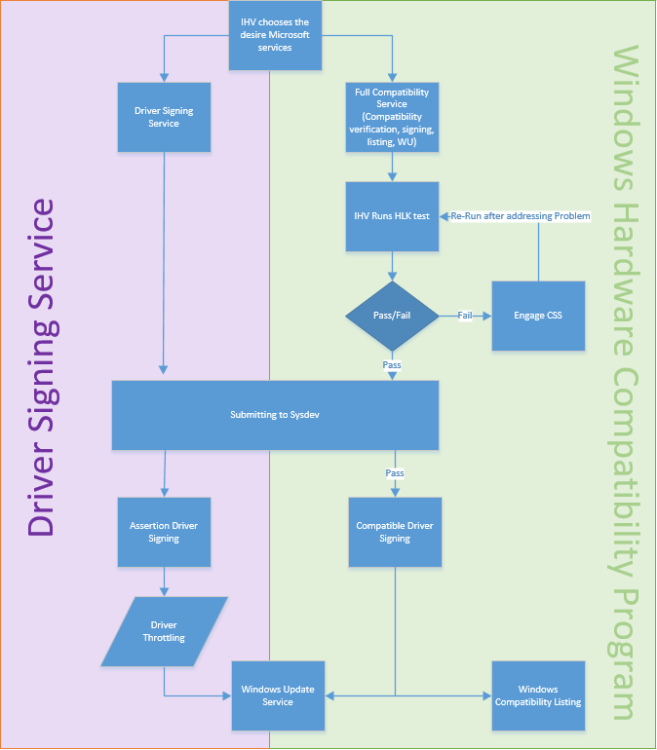
Driver Signing Service
Available for production signing
Does not require HLK results
Windows 10 treats driver the same
Drivers can be posted to Windows Update
Components will not be listed on the Certified Products List
Cannot use Compatible with Windows artwork

Slide 24
Call to action
Session Objective(s):
Review the Minimum Hardware Specifications. This documents the requirements for Windows 10 devices.
Windows 10 Hardware Certification Program Opens April 30
Leverage the Hardware Lab Kit for testing your devices.

Slide 25
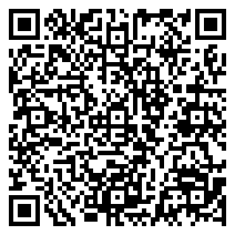
Please Complete an Evaluation. Your input is important!
Access Evaluation Forms:

Slide 26
(c) 2015 Microsoft Corporation. All rights reserved. This document is provided "as-is." Information and views expressed in this document, including URL and other Internet Web site references, may change without notice. You bear the risk of using it. This document does not provide you with any legal rights to any intellectual property in any Microsoft product. You may copy and use this document for your internal, reference purposes.
Some information relates to pre-released product which may be substantially modified before it’s commercially released. Microsoft makes no warranties, express or implied, with respect to the information provided here.

