Slide 1
Yield Curve Inversions
Tony Chen

Slide 2
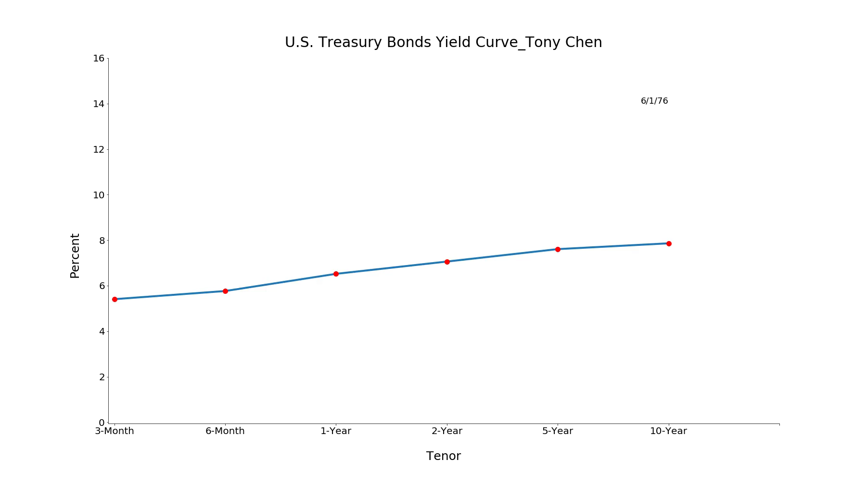
Yield Curve Animation
The animation shows the change in treasury yield curve from 1976 to 2019
Yield curve inversions happened during several periods: 1980, 1990, 2001 and 2008

Slide 3
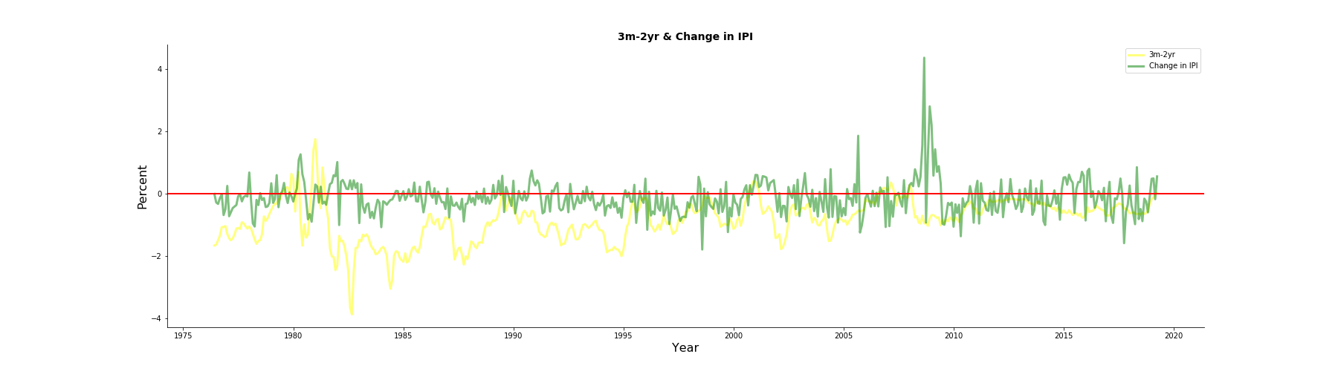
Yield Curve Inversions & Change in IPI
Monthly Industrial Production Index has been multiplied by -1, so that an increase actually signifies poorer production performance. As we could see from the graph, economic downtowns usually follow an inversion in 3m-2yr curve.

Slide 4
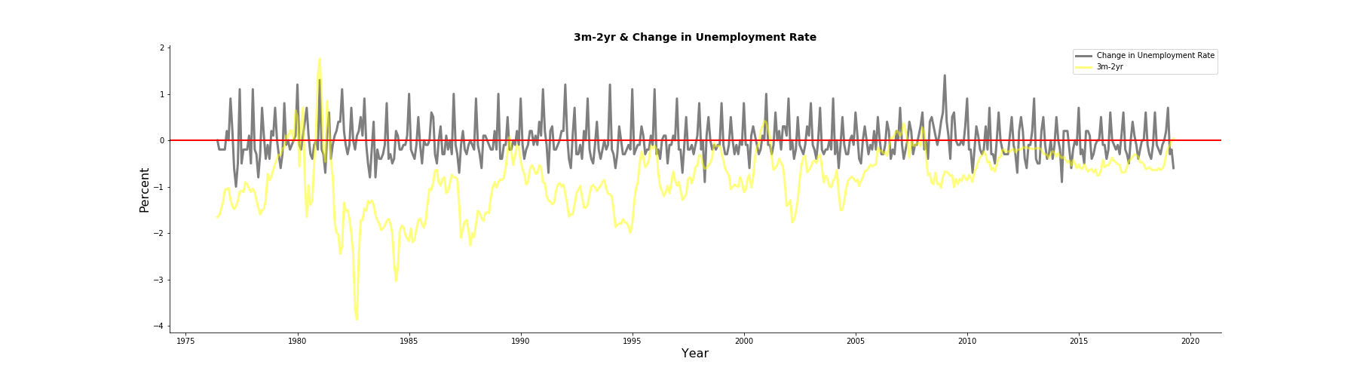
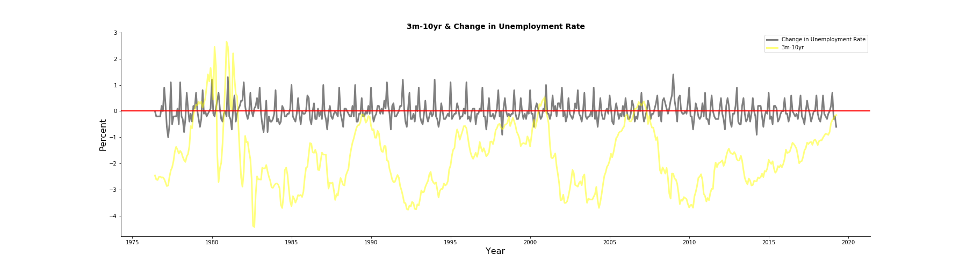
Yield Curve Inversions & Change in Unemployment
Unemployment rate tends to rise for a sustained period of time after yield curve inverts

Slide 5
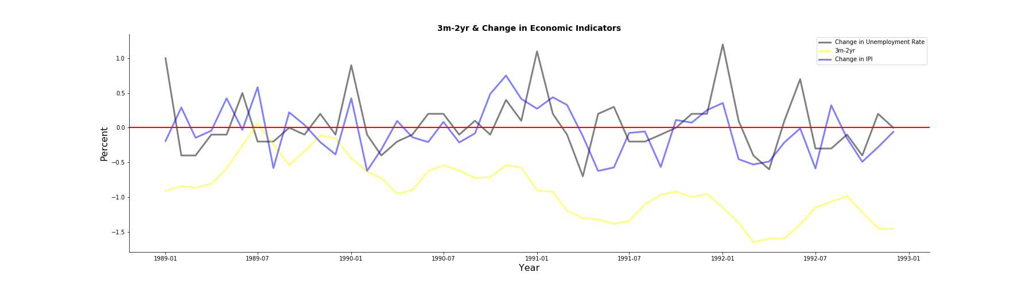
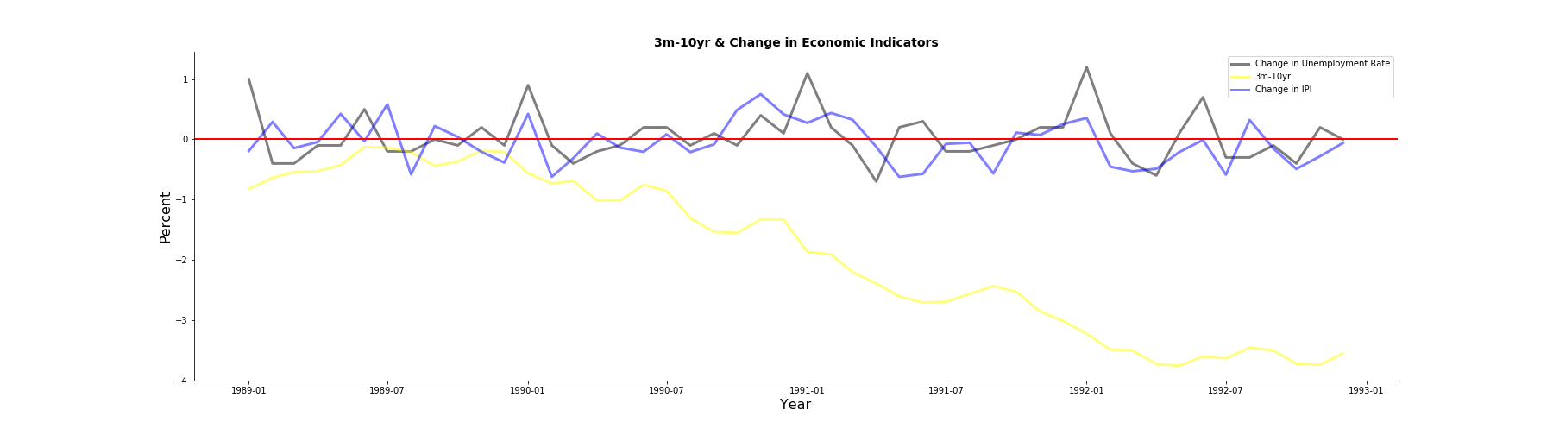
3m-2yr & 3m-10yr
3m-2yr and 3m-10yr curves do not always invert at the same time. 3m-2yr curve inverted around July 1989, but 3m-10yr curve did not invert.

Slide 6
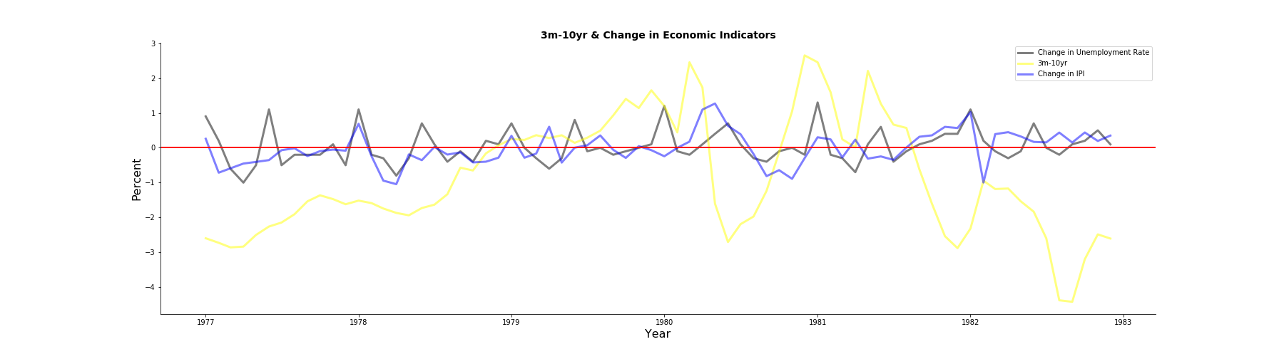
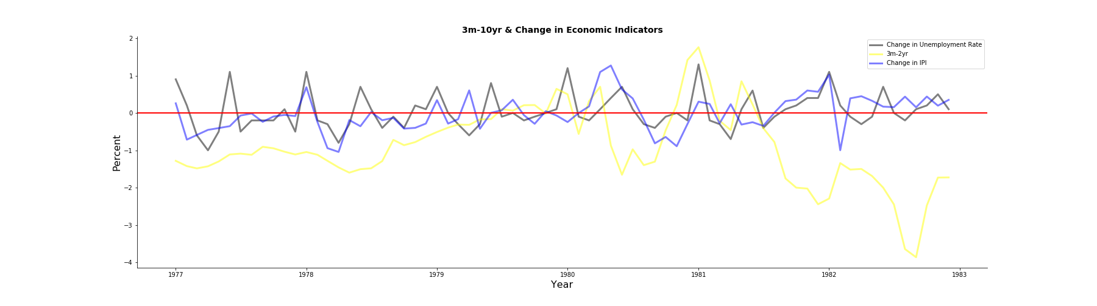
3m-2yr & 3m-10yr
The inversion of 3m-10yr curve usually precedes the inversion of 3m-2yr curve, as seen during 1980, 2001 and 2008.

