Slide 1
Low-dose CT Image Reconstruction with Machine Learning
Name: Kecheng Chen
Supervisor: Dr. Haoliang Li
11.03.2023

Slide 2
Low-dose CT Image Reconstruction with Machine Learning
Outline
1. Background and Motivation
2. Existing Approaches
3. Potential Limitations
4. Conclusion

Slide 3
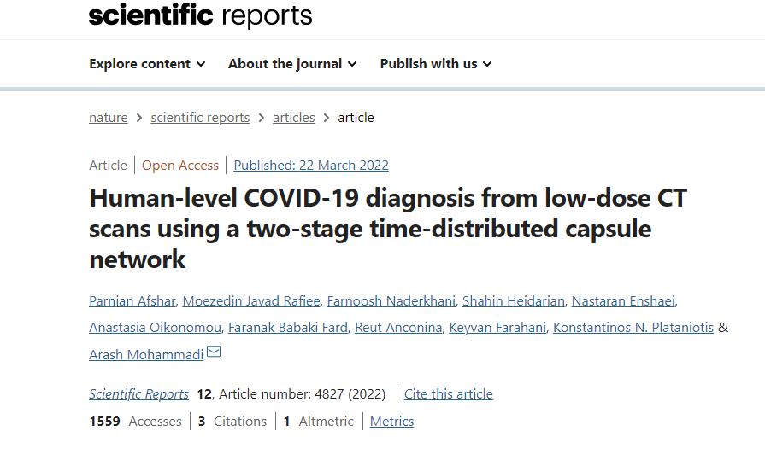
Low-dose CT Image Reconstruction with Machine Learning
Background
Quality Optimization for Low-dose CT Image ------ Mainstream
A Full-Dose CT scan of the Chest has a Radiation Dose of up to 7mSv
Low-dose CT Radiation Dose is only 1/5 of the full dose
An Important Screening Method for
Lung Cancer and Covid-19 Pneumonia
1
1
Afshar, Parnian. "Human-level COVID-19 diagnosis from low-dose CT scans using a two-stage time-distributed capsule network."
Scientific Reports 12.1 (2022): 1-11.

Slide 4
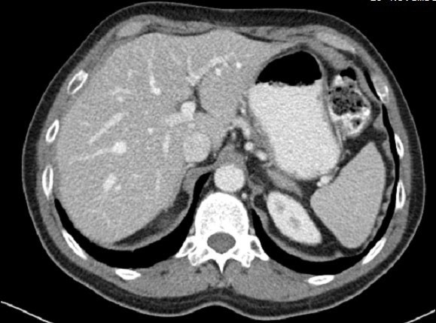
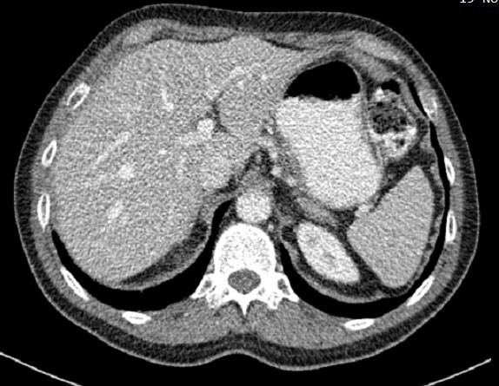


Low-dose CT Image Reconstruction with Machine Learning
Background
Quality Degradation
Dose Reduction
Artifacts and Noise
Normal-dose Abdomen CT
Quarter-dose Abdomen CT

Slide 5
Low-dose CT Image Reconstruction with Machine Learning
Background
Goals of LDCT Reconstruction
√ Noise suppression
√ Structure retention
√ Artifacts suppression
Reconstruction
Normal-dose Abdomen CT
Quarter-dose Abdomen CT

Slide 6
Low-dose CT Image Reconstruction with Machine Learning
Background
Goals of LDCT Reconstruction
√ Noise suppression
√ Structure retention
√ Artifacts suppression
Reconstruction
Normal-dose Abdomen CT
Quarter-dose Abdomen CT

Slide 7




Low-dose CT Image Reconstruction with Machine Learning
Method
Reconstruction
1
LDCT
High-quality CT
Sinogram Filtering
Iterative Reconstruction
Deep Learning
⨂ High Time-consumption
⨂ 𝐒inogram (Projection) Data Unavailable
⨂ Limited Extension with AI-based Tasks
√ Fast Processing with GPU
√ Work on Image domain (Postprocessing)
√ Potential integration with AI-based Tasks
1
G. Wang, J. C. Ye, and B. De Man, “Deep learning for tomographic image reconstruction,” Nature Machine Intelligence, pp. 737–748, 2020

Slide 8
Low-dose CT Image Reconstruction with Machine Learning
Method
LDCT
Reconstruction
High-quality CT
Projection Domain:
Diverse Filtering Techniques
(Mean Filtering, Moving Average)
Sinogram Filtering
Iterative Reconstruction
Deep Learning
Image Domain:
Image Prior Regularization
( Sparse, Low-rank, Non-local
Similarity)
⨂ High Time-consumption
⨂ 𝐒inogram (Projection) Data Unavailable
⨂ Limited Extension with AI-based Tasks
√Fast Processing with GPU
√Work on Image domain (Postprocessing)
√ Potential integration with AI-based Tasks
**From projection data to image data, FBP (Filtered Back Projection) method can be used.

Slide 9
Low-dose CT Image Reconstruction with Machine Learning
Method
LDCT
Reconstruction
High-quality CT
As a Mainstream Method recently
Works on Image Domain and No
Handcrafted Prior Inserting
Sinogram Filtering
Iterative Reconstruction
Deep Learning
⨂ High Time-consumption
⨂ 𝐒inogram (Projection) Data Unavailable
⨂ Limited Extension with AI-based Tasks
√ Fast Processing with GPU
√ Work on Image domain (Postprocessing)
√ Potential integration with AI-based Tasks

Slide 10


Low-dose CT Image Reconstruction with Machine Learning
Method (1)
Most deep learning-based LDCT denoising frameworks
(same case)
LDCT
(Case X)
Paired low/normal-dose CT datasets
Estimated NDCT
DNN-based Models
Update
loss
NDCT
(Case X)

Slide 11
Low-dose CT Image Reconstruction with Machine Learning
Method (1)
Most deep learning-based LDCT denoising frameworks
How to design a good reconstruction model
(same case)
LDCT
(Case X)
1
1. Unet-based models
Paired low/normal-dose CT datasets
2
Estimated NDCT
2. Self-Attention based models
DNN-based Models
Update
loss
NDCT
(Case X)
3. Generative Adversarial Networks (GANs) based models
3
1
Shan, Hongming, et al. "3-D convolutional encoder-decoder network for low-dose CT via transfer learning from a 2-D trained network." IEEE TMI,2018
2
Li, Meng, et al. "SACNN: Self-attention convolutional neural network for low-dose CT denoising with self-supervised perceptual loss network." IEEE TMI 39.7 (2020)
3
Huang, Zhizhong, et al. "DU-GAN: Generative adversarial networks with dual-domain U-Net-based discriminators for low-dose CT denoising." IEEE TMI 71 (2021): 1-12.

Slide 12
Low-dose CT Image Reconstruction with Machine Learning
Method (1)
Most deep learning-based LDCT denoising frameworks
(same case)
LDCT
(Case X)
Paired low/normal-dose CT datasets
Estimated NDCT
DNN-based Models
Update
loss
NDCT
(Case X)
Limitations of existing methods:
Heavily rely on paired datasets

Slide 13
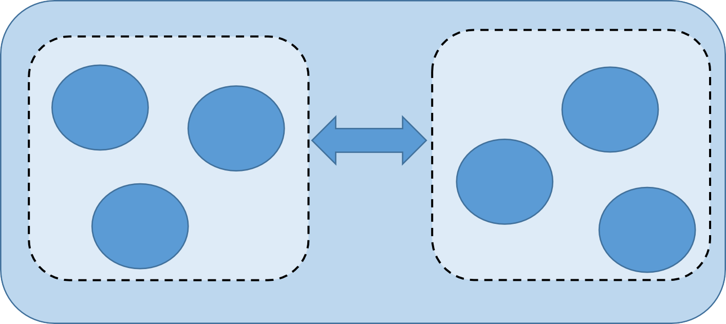
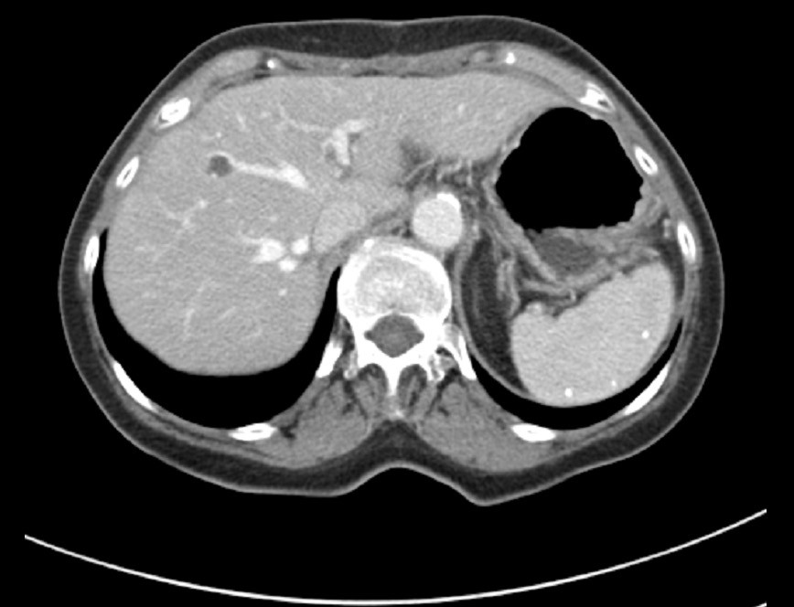
Low-dose CT Image Reconstruction with Machine Learning
Method (2)
Unpaired Data Set in Clinic
Case A
unpaired
Case F
Case B
content
Case D
Case C
Case G
Normal-Dose CT(NDCT)
Low-Dose CT(LDCT)
ⅹ
Data (LDCT)
Label (NDCT)

Slide 14
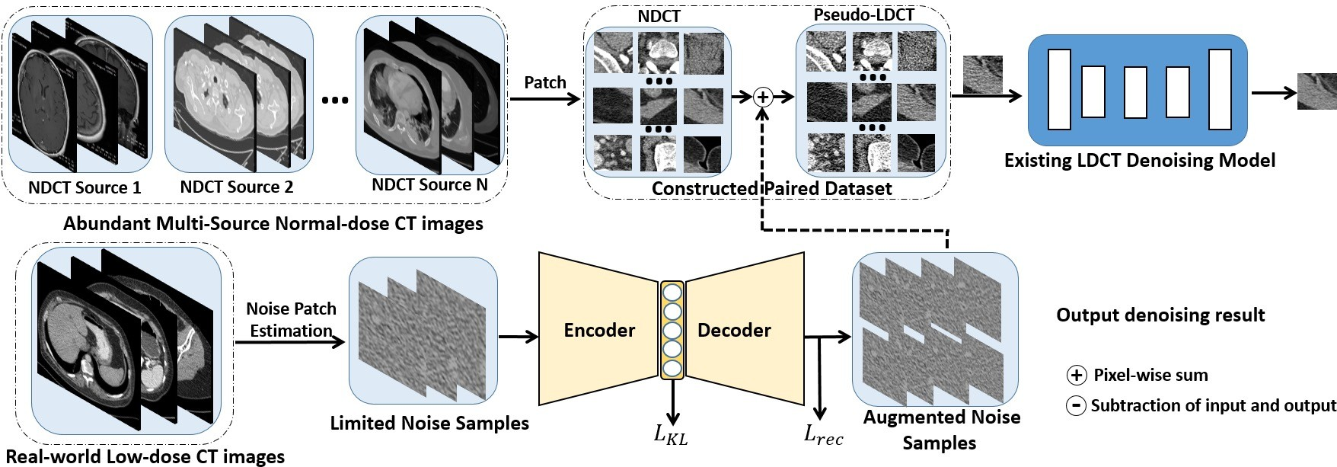

Low-dose CT Image Reconstruction with Machine Learning
Method (2)
Unpaired Data Set in Clinic
1
Task-Driven Deep Learning (TDDL) Framework for LDCT denoising
1
Chen, K., et al. "Task-driven deep learning for ldct image denoising." ISICDM. 2022.

Slide 15
Low-dose CT Image Reconstruction with Machine Learning
Potential Limitation
Disconnection between Quality Optimization and High-level Tasks
Step 1
AI-based Quality Optimization Process
Step 2
AI-based Lesion Detection/Segmentation
Detection
ⅹ
Disconnection
segmentation

Slide 16
Low-dose CT Image Reconstruction with Machine Learning
Potential Limitation
Step 1
AI-based Quality Optimization Process
Step 2
AI-based Lesion Detection/Segmentation
Detection
ⅹ
Disconnection
segmentation
⨂ Unknown Usability for Step 2 in clinic
⨂ Don’t orient practical high-level tasks
⨂ Evaluated Difficulty for optimized image

Slide 17
Low-dose CT Image Reconstruction with Machine Learning
Potential Limitation
Step 1
AI-based Quality Optimization Process
Step 2
AI-based Lesion Detection/Segmentation
Detection
ⅹ
Disconnection
segmentation
⨂ Unknown Usability for Step 2 in clinic
⨂ Don’t orient practical high-level tasks
⨂ Evaluated Difficulty for optimized image

Slide 18
Low-dose CT Image Reconstruction with Machine Learning
Conclusion
Deep learning-based methods are dominant for LDCT image Reconstruction task.
Deep learning-based methods focus on paired and unpaired settings.
Deep learning-based methods have some limitations need to be resolved.

Slide 19
Low-dose CT Image Reconstruction with Machine Learning
Thanks !
Q and A

