Slide 1
Principals of Measurement, Lab 1
Henrik Raeder
Haakon Haakstad
University of Oslo

Slide 2
Learning goals for today
Estimating and interpreting:
Correlations between variables
Test-retest reliability & Alternate/Parallel test-forms
Internal consistency
Cronbach’s alpha
The single factor model
Omega

Slide 3
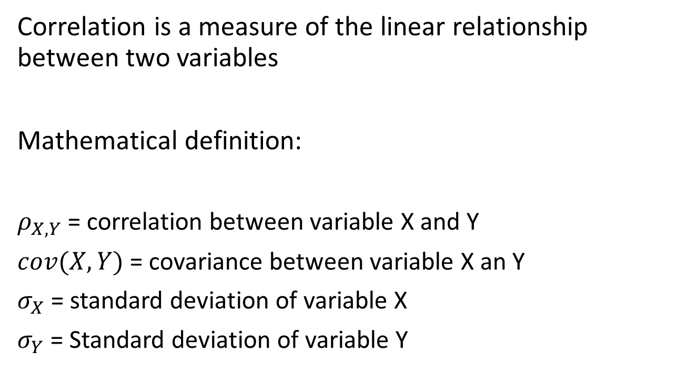
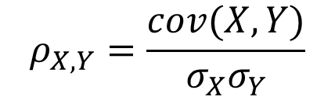
Correlations between variables
(Pearson correlation coefficient)
Correlation is a measure of the linear relationship between two variables
Mathematical definition:
$ρ_{X, Y}$ = correlation between variable X and Y
$cov(X, Y)$ = covariance between variable X an Y
$σ_{X}$ = standard deviation of variable X
$σ_{Y}$ = Standard deviation of variable Y
$$ρ_{X, Y}=\frac{cov(X, Y)}{σ_{X}σ_{Y}}$$

Slide 4

Task:
Estimate the correlation between a pair of variables in likert_data, and comment on the relationship between the variables you chose.

Slide 5
Test-retest reliability
Uses the correlation of the sum-score as a measure of test-reliability
Alternate test forms
Uses the correlation of the sum-score as a measure of test-reliability

Slide 6


Cronbach’s alpha ($α$)
A commonly reported coefficient of reliability.
Mathematical definition:

Slide 7
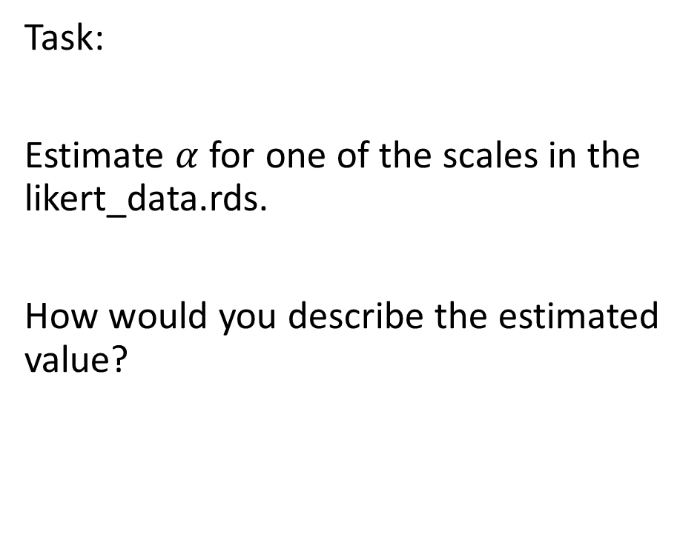
Task:
Estimate $α$ for one of the scales in the likert_data.rds.
How would you describe the estimated value?

Slide 8
Cronbach’s alpha summary
Weaknesses:
Dependent on the number of items
Assumes a single factor model with equal loadings for all items
A lower bound estimate of reliability as long as assumptions are met
Want to learn more about the use of Cronbach’s Alpha in education?
Taber, K.S. The Use of Cronbach’s Alpha When Developing and Reporting Research Instruments in Science Education. Res Sci Educ 48, 1273–1296 (2018). https://doi.org/10.1007/s11165-016-9602-2

Slide 9
Single factor model
{lavaan} and other tools are available in R.
We will focus on {lavaan} in this lab.
Review lecture 6 for a theoretical background about the single factor model.

Slide 10
Single factor mode: Spesifying a latent model
Example:
mymodel_spes <- “y =~ x1 + x2 + x3 + x4”
formula type operator meaning
latent variable definition =~ is measured by
regression ~ is regressed on
(residual) (co)variance ~~ is correlated with
intercept ~ 1 intercept

Slide 11
Single factor mode: Model estimation
Example:
mymodel <- cfa(mymodel_spes, data = mydata)
To evaluate the model, use
summary(mymodel, fit.measures=TRUE)
To get the model coeficients, use
coef(mymodel)
For more information about {lavaan}, see
https://lavaan.ugent.be/tutorial/index.html

Slide 12
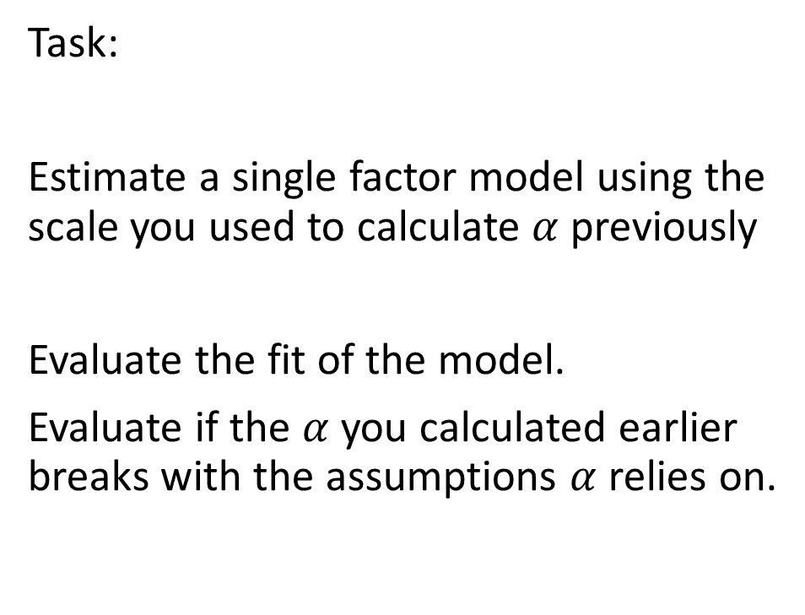
Single factor model
Task:
Estimate a single factor model using the scale you used to calculate $α$ previously
Evaluate the fit of the model.
Evaluate if the $α$ you calculated earlier breaks with the assumptions $α$ relies on.

Slide 13
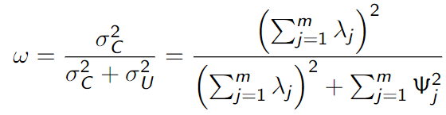


Omega ($ω$)
Coefficient $ω$is the ratio of the true score variance of Y to the total variance of Y.
Mathematical definition:
Why use omega instead of alpha?
Sijtsma, K. On the Use, the Misuse, and the Very Limited Usefulness of Cronbach’s Alpha. Psychometrika 74, 107 (2009). https://doi.org/10.1007/s11336-008-9101-0

Slide 14
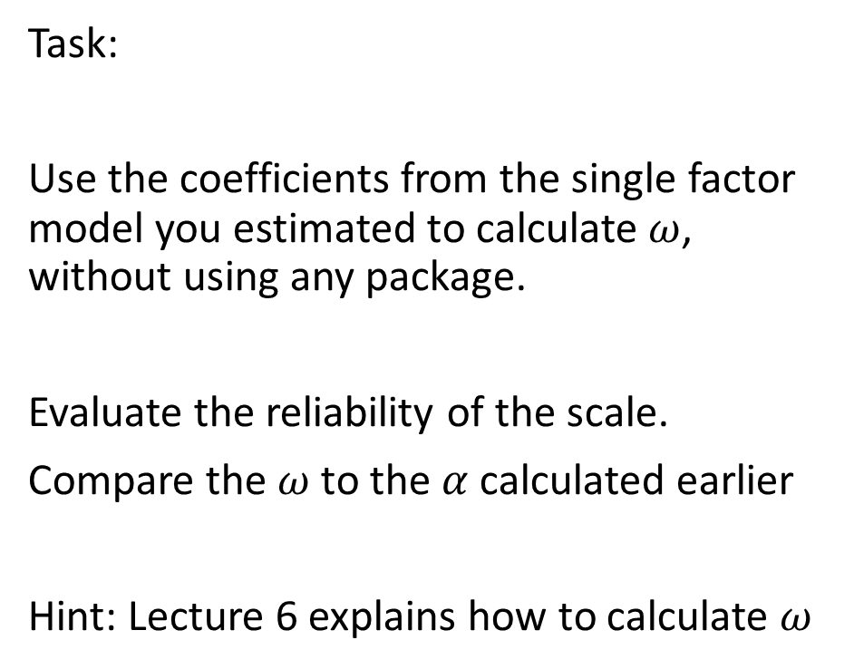
Omega ($ω$)
Task:
Use the coefficients from the single factor model you estimated to calculate $ω$, without using any package.
Evaluate the reliability of the scale.
Compare the $ω$ to the $α$ calculated earlier
Hint: Lecture 6 explains how to calculate $ω$

