Slide 1
Principals of Measurement, Lab 3
Henrik Raeder
Haakon Haakstad
University of Oslo

Slide 2
Learning goals for today
Estimating and interpreting:
Single factor models (repetition from lab 1)
Multidimensional factor models
In addition, we will learn how to draw and interpret Path Diagrams

Slide 3
Lavaan | Installing and Loading
Lavaan (Latent Variable Analysis) is an R package made for fitting a good variety of factor models to data.
install.packages("lavaan")
library(lavaan)
Useful companion package: semPlot
install.packages("semPlot")
library(semPlot)

Slide 4
Lavaan | Essential functions
Lavaan provides a number of functions specialized for fitting different types of models.
The most basic models are’t using either cfa() or sem().
cfa() (Confirmatory Factor Analysis) t measurement models.
sem() (Structural Equation Model) t structural models.
A CFA is a special case of a Structural Equation Model.
For this lab, we will be using the cfa() function.

Slide 5
Lavaan | Types of input data
Lavaan can’t models to the following types of input:
Raw data (e.g., data frames).
Covariance matrices.
Correlation matrices (i.e., standardized covariance matrices).
If matrices are provided, sample size must be specfied.

Slide 6
Lavaan | Recall the cfa() function
The following are the minimum required specifications to do CFA...
... using raw data:
model
data
... using covariance or correlation matrices:
model
sample.cov
sample.nobs

Slide 7
Lavaan | Recall the cfa() function
Example syntax for CFA using raw data:
cfa(model = mdl, data = dataframe)
Example syntax for CFA using matrices:
cfa(model = mdl, sample.cov = mat, sample.nobs = 123)
In addition, we often want standardized factor scores. E.g.:
cfa(model = mdl, data = dataframe, std.lv = TRUE)

Slide 8
Lavaan | Model specification
In lavaan, models are specified as character objects.
Examples of character objects:
charobj <- "Hello World!"
charobj <- "1234"
Not examples of character objects:
notcharobj <- Hello World!
notcharobj <- 1234

Slide 9
Lavaan | Model specification | Unidimensional
Basic lavaan model specification looks something like this:
modspec <- "Factor =~ var1 + var2 + ... + varn“
Where:
"Factor" is the name of the factor (latent variable).
"=~" can be read as "measured by".
"var1 ... varn" refer to variables in the dataset or matrix.
"+" separates the observed variables for lavaan.
Example:
modspec <- "Motivation =~ MotiVar1 + MotiVar2 + MotiVar3 + MotiVar4"

Slide 10
Lavaan | Model specification | Multidimensional
Examples of specifying several factors:
2 factors:
modspec <- "F1 =~ v1 + v2 + v3
F2 =~ v4 + v5 + v6"
3 factors:
modspec <- "F1 =~ v1 + v2 + v3
F2 =~ v4 + v5 + v6
F3 =~ v7 + v8 + v9"

Slide 11
Lavaan | Model fit
There are many different ways of evaluating model fit to the data. Here are some of them:
Residual covariances can be obtained using the residuals() function (base R).
Fit measures can be obtained using the fitMeasures() function (lavaan).
Factor loadings can be obtained using the summary() and coef() functions (base R).

Slide 12
Lavaan | Model fit | Residual covariance
Residual covariance is covariance among items left unexplained by our suggested factor structure.
The goal of factor analysis is to reproduce the observed-variable covariance matrix.
The residuals() function returns a matrix of the residual covariances between items.
Ideally, we want no residual covariance (i.e., all residuals == 0).

Slide 13
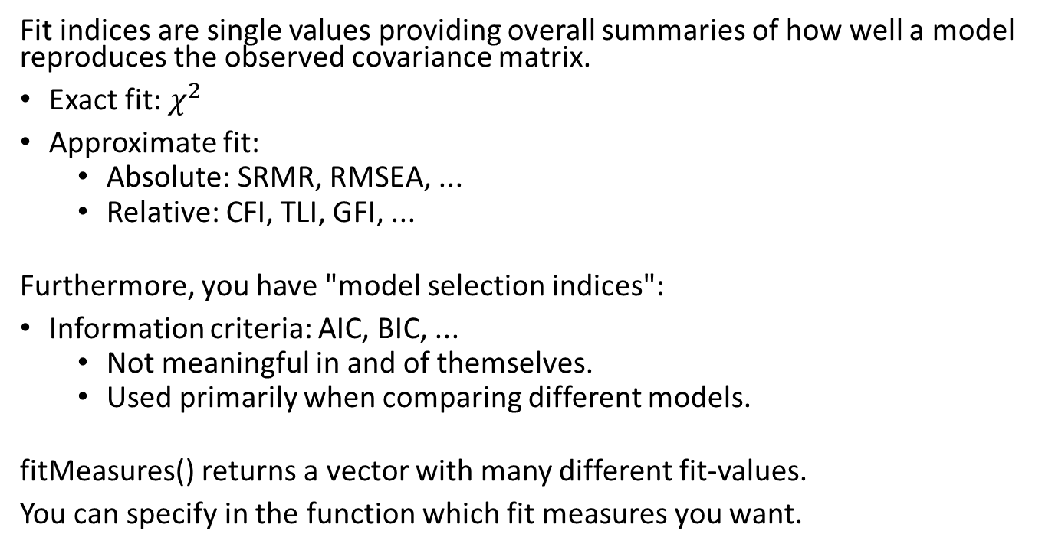
Lavaan | Model fit |Fit indices
Fit indices are single values providing overall summaries of how well a model reproduces the observed covariance matrix.
Exact fit: $χ^{2}$
Approximate fit:
Absolute: SRMR, RMSEA, ...
Relative: CFI, TLI, GFI, ...
Furthermore, you have "model selection indices":
Information criteria: AIC, BIC, ...
Not meaningful in and of themselves.
Used primarily when comparing different models.
fitMeasures() returns a vector with many different fit-values.
You can specify in the function which fit measures you want.

Slide 14
Lavaan | Model fit |Factor loadings
Factor loadings are important for determining reliability.
The coef() and summary() functions provide these.
Raw data or covariance matrix gives unstandardized loadings.
Can be interpreted as unstandardized regression coefficients.
"std.lv = TRUE" gives semi-standardized coefficients.
Z-scores or correlation matrix gives standardized loadings.
Can be interpreted as standardized regression coefficients.

Slide 15
semPlot | Making path diagrams
The semPlot package contains a function for producing what is known as a "path diagram": namely semPaths().
Path diagrams are graphic representations of models.
By convention:
Latent variables are represented by circles or ellipses.
Manifest variables are represented by squares or rectangles.
Regression paths are represented by single-headed arrows .
Correlations are represented by double-headed arrows.

Slide 16

Task 1: Satisfaction With Life Scale (SWLS)
Consider the covariance matrix for the SWLS (found in the R script pomlab03.R).
Replicate part of the analyses from the textbook (Test Theory, chapter 9), i.e. estimate:
A single-factor model
A two-factor model, with factors representing current (items 1-3) and past (items 4-5) satisfaction.
Evaluate which model fits the data best.

Slide 17
Task 2: Thurstone data
The textbook considers a covariance matrix with nine test scores that you can find in the workspace Thurstone.RData. N = 213.
Choose a model selection criterion (e.g., BIC, RMSEA). Fit the following models with lavaan:
A single-factor model.
A three-factor model with the following dimensions:
Factor: Verbal comprehension:
Items: Sentences, Vocabulary, Sent.Completion
Factor: Word fluency:
Items: First.Letters, Four.Letter.Words, Suffixes
Factor: Reasoning:
Items: Letter.Series, Pedigrees, Letter.Group
3. Bonus: A bifactor model with three uncorrelated subfactors dened by the same items as in 2.

Slide 18
Examples of multidimensional model structures:
Correlated simple structure
Investigates relationship between latent variables
Hierarchical structures
Investigates relationship between latent variables and a general factor
Bi-factor structure
Useful to evaluate unidimensionality
Learn more in MAE4110

