Slide 1
Tim Fütterer, Tony Tan, Rolf Vegar Olsen, and Sigrid Blömeke
Pre-registration of the study
Differential Effects of COVID-19-Related Lockdowns on Students’ Learning
04.05.2022 | CEMO Spring/Summer seminar | The Impact of Teaching in Schools

Slide 2
Background / Motivation
COVID-19: Sudden disruption of education settings (i.e., rapid transition from classrooms to homes; Thorn & Vincent-Lancrin, 2021)
Prior research: School closures had a negative effect on student achievement (d = −0.005 to −0.05 SD per week), especially for students with low socioeconomic status (SES; Hammerstein et al., 2021).
04.05.2022 | CEMO Spring/Summer seminar | 3

Slide 3
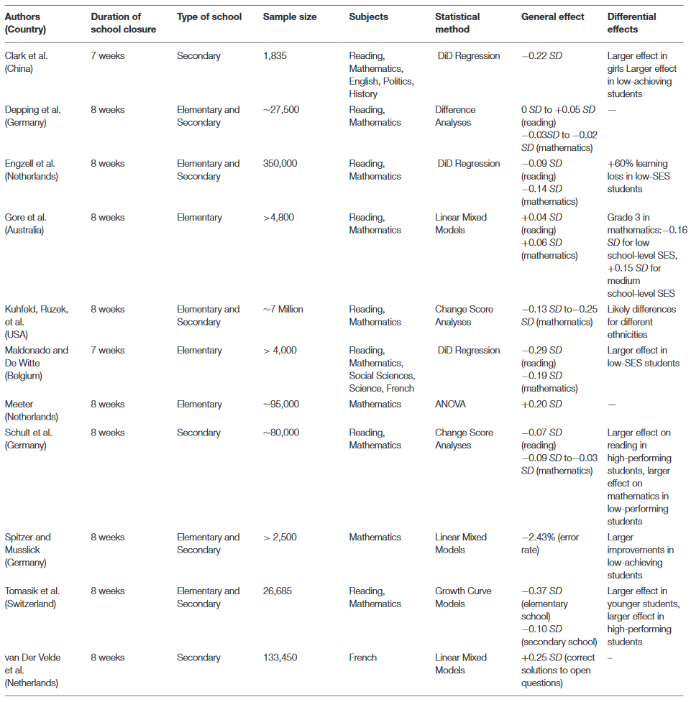


Background / Motivation
causal inference approaches (e.g., DiD)
large samples
administrative data
often convenience samples (e.g., Clark et al., 2021)
not representative (Kuhfeld et al., 2020)
reduced target population (e.g., web-based surveys) and low response rates (van der Velde et al., 2021; Thorn & Vincent-Lancrin, 2021)
Register Data
04.05.2022 | CEMO Spring/Summer seminar | 4

Slide 4
Research Questions
How did COVID-19-related school closures affect students' learning?
[RQ1] Under what conditions did Norwegian students study at home during school closures?
[RQ2] What impact has school closures had on students’ learning outcome?
[RQ3] How were students’ learning outcome related to household and family environment characteristics?
04.05.2022 | CEMO Spring/Summer seminar | 5

Slide 5
Instruments / Measures
Teacher-assigned grades (Norwegian, English, Religion, Social Sciences, Natural Sciences)
Exam grades (Norwegian, English, Religion, Social Sciences, Natural Sciences)
Duration of school closures
Socioeconomic status (SES; tax authority’s calculation of someone’s SES position)
Square meter of house / Members in household
Standard classification of occupation
Demographics (e.g., gender)
Dependent Variable Students‘ learning
Independent Variable School closures
Moderators
household and family environment
Control Variables / Covariates
04.05.2022 | CEMO Spring/Summer seminar | 6

Slide 6
Sample
Education attainment data for Year 10 students
Baseline amount of learning: Ten-year period (2010 to 2019) before school closures
2020: COVID-19 affected year
04.05.2022 | CEMO Spring/Summer seminar | 7
Notes:
We will use student attainment data (teacher-assigned grades, test scores) for the period between 2010 and 2019. This ten-year period would form a “baseline amount of learning” in the absence of school closure.
The 2006 Norwegian education reform introduced structural changes to curriculum and assessment practices. Small modifications were also introduced in 2009 in response to stakeholder feedback. Data sets from 2010 onwards, therefore, form a stable and comparable library conducive for statistical analyses.
We implicitly assume that curriculum designs, pedagogical practices and assessment strategies have remained comparable between 2010 and 2019. April 2020 witnessed the structural change due to COVID-induced shutdown.

Slide 7
Current Work
Familiarise with Norway’s school system (grunnskole, VGS)
Learn about the registry data structure (merging, reshaping)
Select variables (require variable descriptions)
Methodology design to address research questions
Operationalise “students’ learning outcome” (i.e., teacher-assigned grades only)?
Consider nesting structure?
Most appropriate method for causal inference?
Complete pre-registration
04.05.2022 | CEMO Spring/Summer seminar | 8

Slide 8

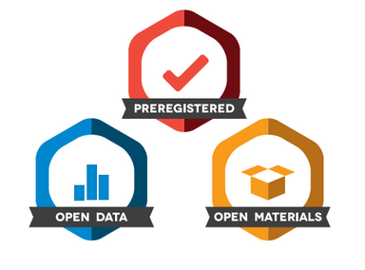
Current Step: Pre-Registration
https://osf.io/
04.05.2022 | CEMO Spring/Summer seminar | 9
Notes:
Preregistration requires submission of research plan.
Preregistration separates hypothesis-generating (exploratory) from hypothesis-testing (confirmatory) research

Slide 9
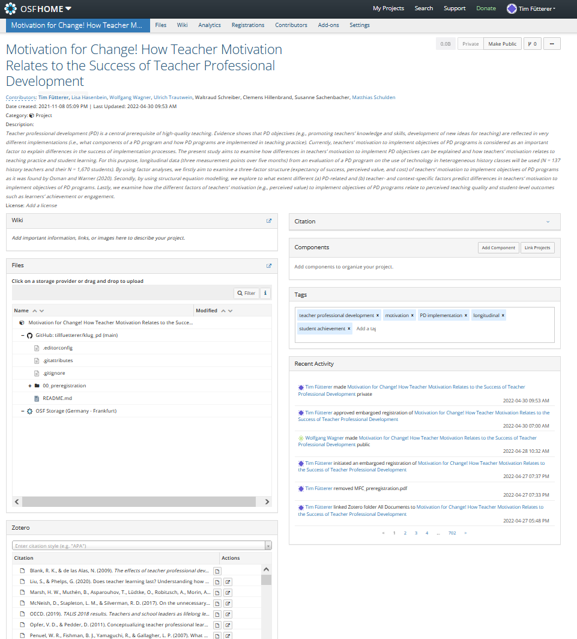
Current Step: Pre-Registration
private / public
description
changes tracked
git hub connection
Zotero connection
04.05.2022 | CEMO Spring/Summer seminar | 10
Notes:
When you preregister your research, you're simply specifying your research plan in advance of your study and submitting it to a registry.
Preregistration separates hypothesis-generating (exploratory) from hypothesis-testing (confirmatory) research.

Slide 10
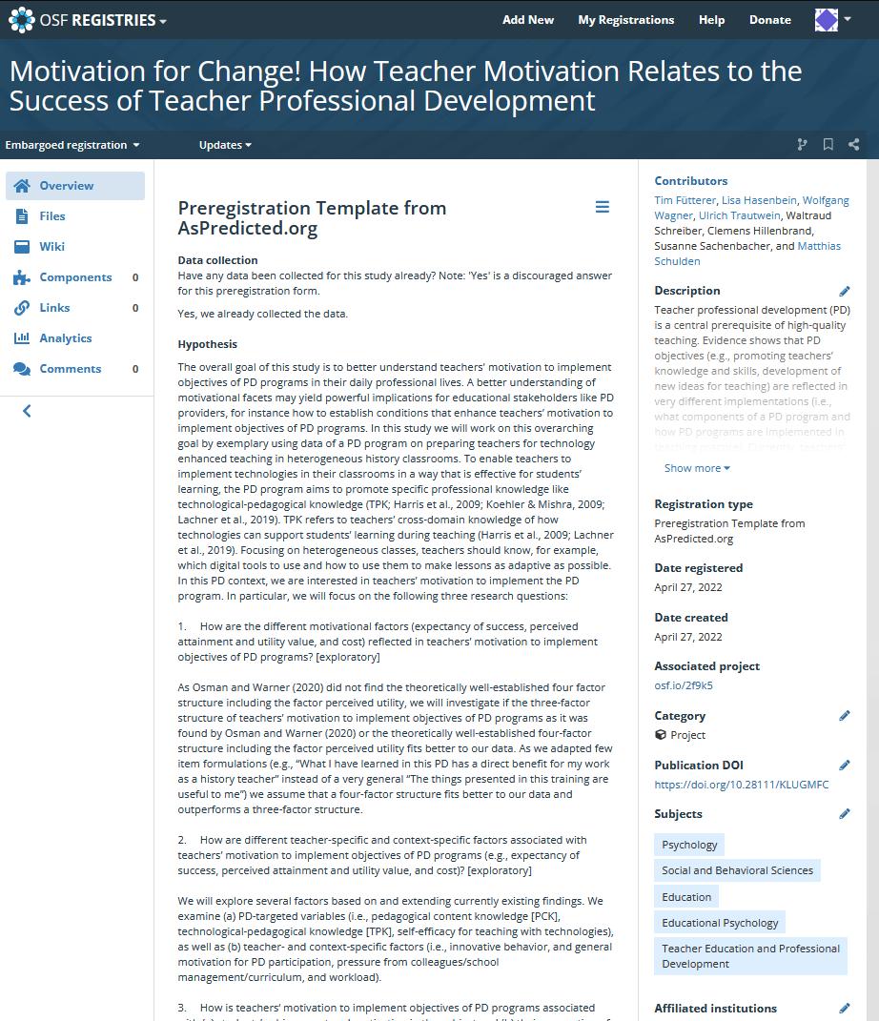
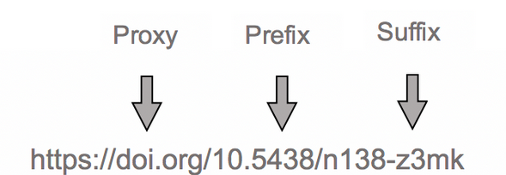
Current Step: Pre-Registration
embargo
different templates
files
doi
04.05.2022 | CEMO Spring/Summer seminar | 11
Notes:
DOI: digital object identifier (https://support.datacite.org/docs/doi-basics)

Slide 11
Next Steps / Open Questions
Until June/July: Data preparation, finalise pre-registration, literature review, paper preparation
August to October: Analyses
November onwards: Drafting
Expected findings? (i.e., sensitivity of instruments, treatment duration, variations in length of school closures)?
04.05.2022 | CEMO Spring/Summer seminar | 12

