Slide 1
Rolf Olsen, Astrid Sandsør, Tony Tan
Fairness in Grading Across Subjects:
Do GPA Subjects Differ in Difficulties?
Notes:
Good afternoon.
My name is Tony. I am a first-year PhD candidate under Rolf and Astrid’s supervision.
I wish to contribute to today’s session with some preliminary results from my first PhD project that asks whether GPA subjects differ in their difficulties.

Slide 2
Motivation
Completing grunnskole: High-stake
Inter-subject difficulty in grunnskolepoeng (GPA):
Fairness
Validity
Prior studies
Notes:
This question is important because assessment practices have significant impact on students’ lives, particularly when learners approach the end of their grunnskole (Year 10), where decisions must be made over vocational or academic trajectories.
In Norway and most Nordic countries, such high-stake decisions are made almost exclusively based on a single criterion: grunnskolepoeng, a Norwegian term equivalent to grade point averages (GPA) in English.
Although details vary across jurisdictions, GPA is largely a sum-score measure.
Understanding whether and how subject difficulties vary by student background or across different settings is important for both fairness and validity purposes.
Surprisingly few studies, however, have tried to answer this fundamental question in the Nordic context.
Studies that have looked into this questions in different countries, such as the UK and the Netherlands, find evidence challenge the assumption that subject have equal difficulty.
This study therefore wishes to contribute to the academic and policy debates by examining the inter-subject difficulties in Norway’s GPA computation.

Slide 3
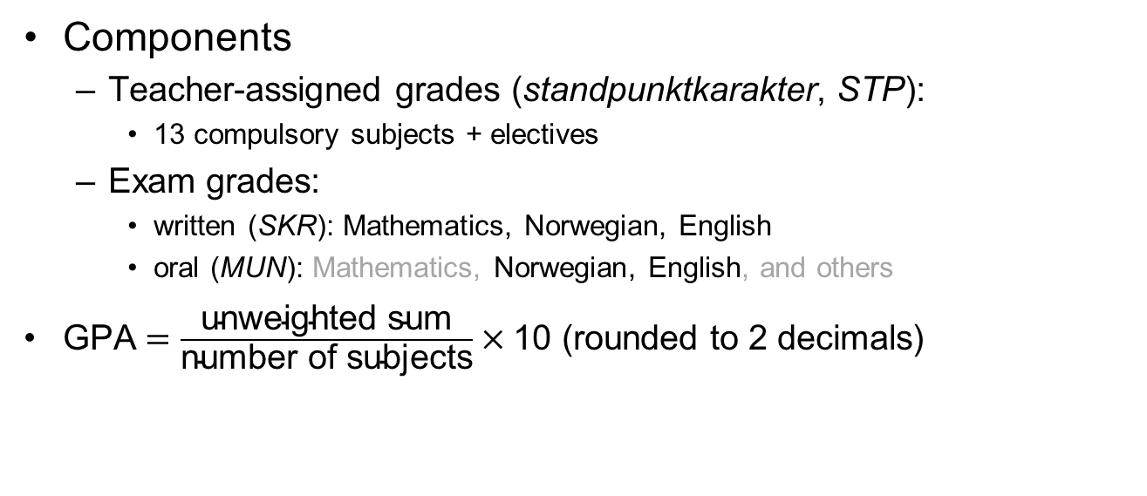
GPA
Components
Teacher-assigned grades (standpunktkarakter, STP):
13 compulsory subjects + electives
Exam grades:
written (SKR): Mathematics, Norwegian, English
oral (MUN): Mathematics, Norwegian, English, and others
$\text{GPA}=\frac{\text{unweighted} \text{sum}}{\text{number} \text{of} \text{subjects}}×\text{10}$ (rounded to 2 decimals)
Notes:
Under the Norwegian system, both teacher-assigned grades (standpunkt) and exam grades are included in the GPA calculation.
Both teacher-assigned and exam grades are integers between 1 and 6, with 6 being the top grade.
Students receive grades from their teachers on 13 compulsory subjects, such as Norwegian, English, mathematics, natural sciences and social sciences, etc, as well as one grade from electives.
Exams consist of both written and oral forms.
The written form covers Mathematics, Norwegian and English, and,
the oral form covers the same subjects as written, as well as other subjects.
At the end of Year 10, students are drawn to take one written and one oral exam.
Although 2/3 of the written exam grades are missing for each exam subject, this can be safely modelled under the missing completely at random (MCAR) assumptions due to random assignment. This is a particularly attractive feature of Rasch models
GPA is then computed as the unweighted sum divided by the number of subjects (ie, a simple average), multiplied by 10, then rounded to two decimal points.

Slide 4
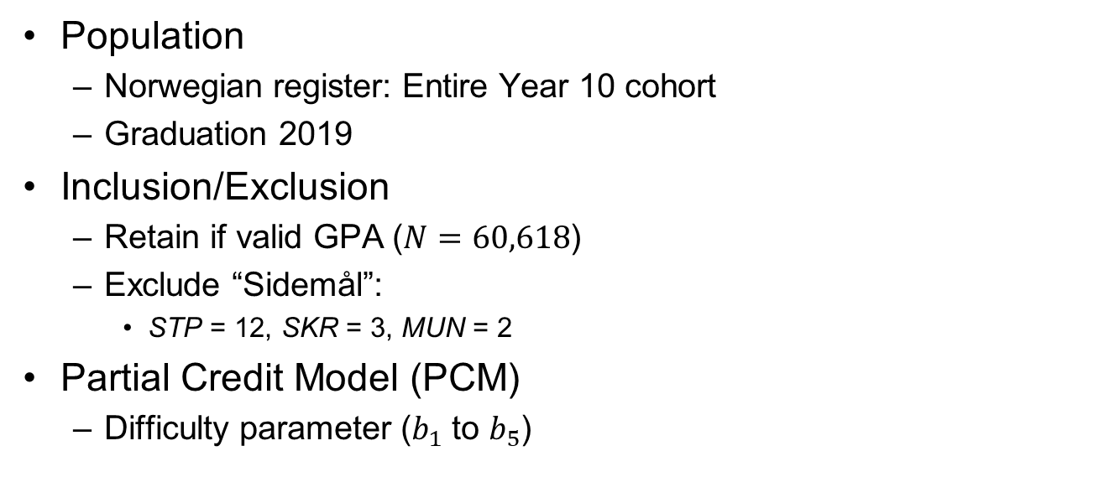
Current Study
Population
Norwegian register: Entire Year 10 cohort
Graduation 2019
Inclusion/Exclusion
Retain if valid GPA ($N=60,618$)
Exclude “Sidemål”:
STP = 12, SKR = 3, MUN = 2
Partial Credit Model (PCM)
Difficulty parameter ($b_{1}$ to $b_{5}$)
Notes:
With such background in mind, I may now describe the current study.
This study draws its data from Norway’s national register.
This data source is unique such that it is the population, not samples, that is the subject of analyses.
The targeted population is the Year 10 cohort in the administrative year 2019, whose academic records reached the government database in June 2019.
I excluded students without valid GPAs, and the subject “Norwegian as a Second Language” from my analyses, leading to a dataset of 60,618 observations and 12 teacher-assigned grades, 3 written- and 2 oral-exam grades.
I employed partial credit models (PCMs) for my analyses. PCMs are the polytomous analogous of Rasch models.
It is particularly suited for the current study because GPAs are constructed as unweighted sums, therefore requiring the same discrimination parameters.
A PCM generates a series of probability curves, as shown in this diagram.
The horizontal axis represents students’ competency (usually represented by the Greek letter θ), with low competency on the left and high on the right.
The vertical axis represents probabilities, ranging from 0 to 1.
Taking the red curve “P4” as an example:
Students with average competencies (θ = 0) are most likely to receive a grade of 4 in Written Norwegian.
As the competency increases to, say θ = 3, the probability of receiving 4 in Written Norwegian drops, while the probability of receiving a grade of 5 increases.
At certain point, the red curve “P4” crosses the yellow curve “P5”, signalling that students at this point is switching from being “more likely to be a 4” to “more likely to be a 5”. This switching point is marked as “b_4” in this study.

Slide 5
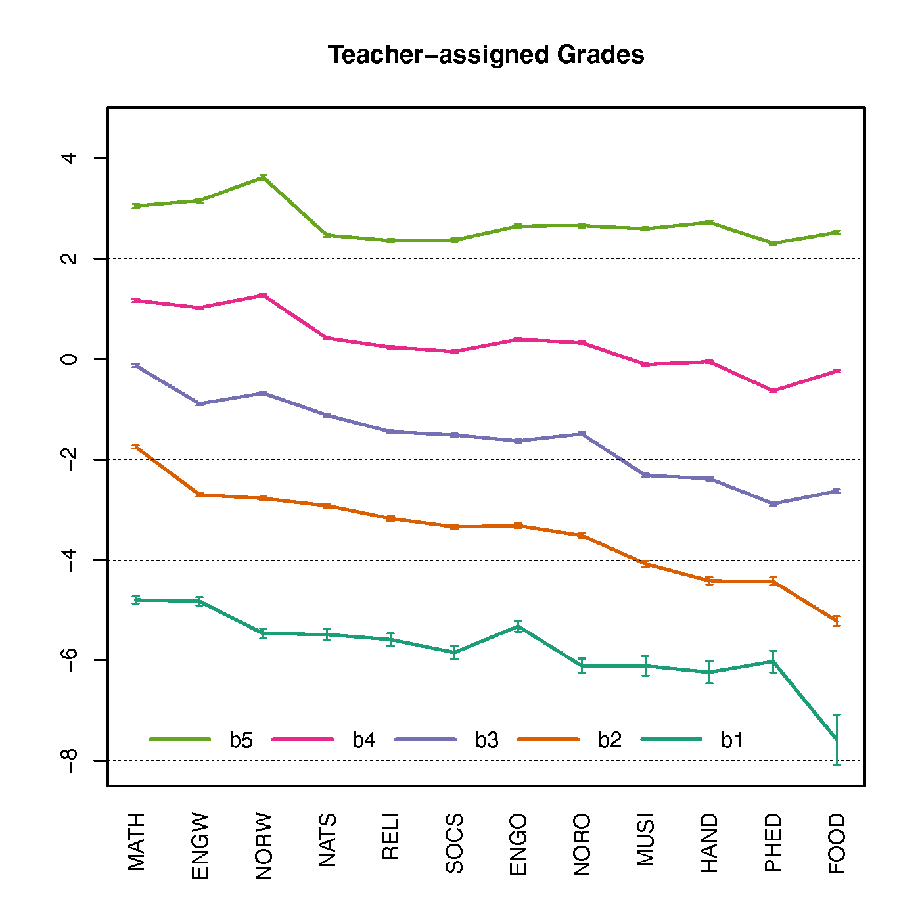
Preliminary Results 1
Visual Patten
Top grade: relatively flat*
Lower grades: increasingly downward-sloping
“Fanning out”
Easiest vs Hardest
Differ by 1 grade lower end
* Written Norwegian noticeably harder at top ends
Notes:
This following two slides present visual summaries of the “b” parameters derived from PCMs.
Difficulty parameters of the 12 compulsory subjects (ie, teacher-assigned grades) are presented first.
With the exception of Written Norwegian, the b_5 line on the top is relative flat, while the b_4, b_3, down to b_1 lines are increasingly downward-sloping.
This “fanning out“ effect suggests a partial answer to the research question:
“Yes, subjects difficulties did differ—more so for the lower grades.”
In fact, a Grade 2 in the easiest subject (Food and Health) shared similar “b” parameter with a Grade 1 in the hardest subject (Mathematics).

Slide 6
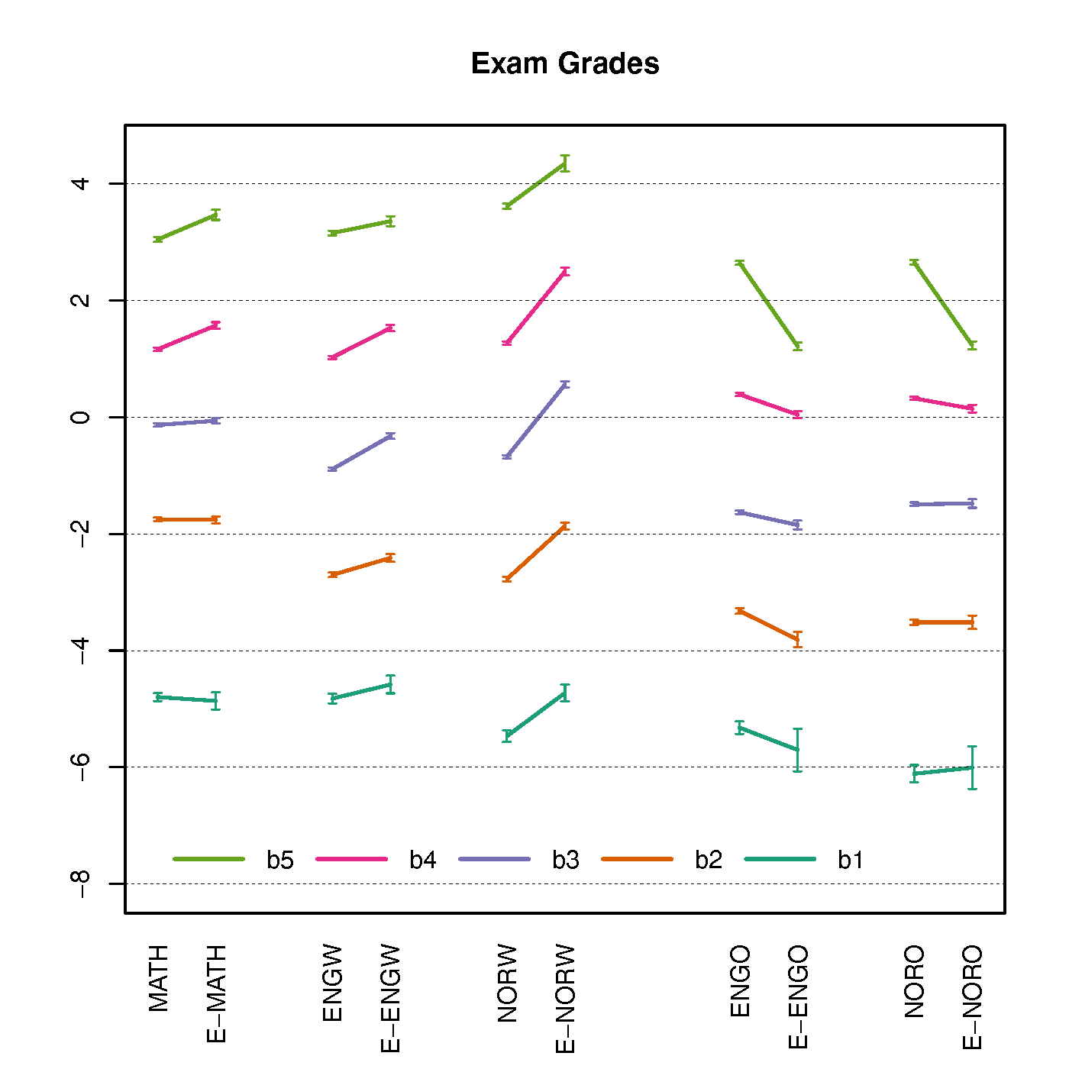
Preliminary Results 2
Inclusion
Written: MATH, ENG, NOR
Oral: ENG, NOR
Visual pattern
Written: upward-sloping
Oral: downward-sloping
Strict vs lenient
Written Norwegian
Largest teacher-examiner disagreement
Notes:
Now to exam grades.
All three written exams (mathematics, English, and Norwegian) were included in this study.
In order to match teacher-assigned grades, oral English and oral Norwegian were also included in this analysis.
Since oral exams have substantially less observations than teacher-assigned grades due to “planned missingness”, the 95% Cis for oral parameters are wider.
In this diagram, we re-produced teacher-assigned grades (left) to pair with exam grades (right) for comparison.
It is first of all noticeable that written exams all had upward-sloping curves, while oral exams had downward-sloping ones.
On the surface, this pattern suggests that examiners were stricter than teachers in marking written tests, but more lenient in oral exams.
The second strand of the answer to the research question therefore can be:
“Yes, exam grades differ from teacher-assigned grades, depending on the form of examination.”
Contrary to the previous observation form the left panel, slopes in the right panel were the steepest on the top end, suggesting larger disagreement between teachers and examiners for awarding grade 5s and 6s while disagreement remained minimum for lower grades.
Amongst the 5 exams, Written Norwegian stood out as the subject with the largest teacher-examiner disagreement.

Slide 7
Looking Forward
Research Question:
“Do GPA subjects differ in difficulties?”
Preliminary Answer:
“Yes, but it depends.”
Possible extensions:
Do these patterns remain consistent across
School locations (urban vs rural)
Students’ sexes
Parental socio-economic status
“Who carry the heaviest burden of grade difficulty differentials?”
Notes:
These preliminary results suggest great nuance among the GPA debates.
If divergence in grade difficulties signals potential unfairness or threats to measurement validity, it is the lower end in teacher-assigned grades, and higher end in exam grades, that are highlighted by this study for consideration.
The causes and practical implications of difficulty parameters remain open to interpretation:
If mathematics carries higher difficulty parameters, does it suggest
learners are inherently less capable in this subject, or
the measurement device for mathematics is less sensitive than that of other subjects?
It would be fruitful to dissect these results to see whether grade difficulties diverge more severely for, say rural schools, females and the left tails of the SES distribution.

