Slide 1
Mathematics

Slide 2
Reading

Slide 3
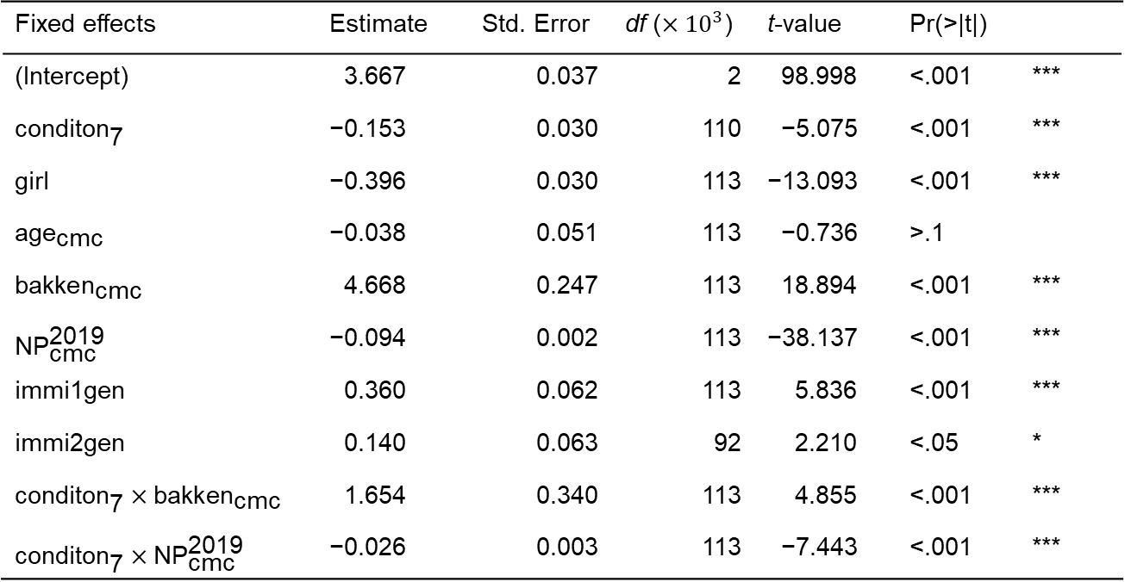
Mathematics
Fixed effects | Estimate | Std. Error | df ($×{10}^{3}$) | t-value | Pr(>|t|)
(Intercept) | +3.667 | 0.037 | 2 | 098.998 | <.001 | ***
$${\text{conditon}}_{\text{7}}$$ | −0.153 | 0.030 | 110 | 0−5.075 | <.001 | ***
girl | −0.396 | 0.030 | 113 | −13.093 | <.001 | ***
$${\text{age}}_{\text{cmc}}$$ | −0.038 | 0.051 | 113 | 0−0.736 | >.1
$${\text{bakken}}_{\text{cmc}}$$ | +4.668 | 0.247 | 113 | 018.894 | <.001 | ***
$${\text{NP}}_{\text{cmc}}^{\text{2019}}$$ | −0.094 | 0.002 | 113 | −38.137 | <.001 | ***
immi1gen | +0.360 | 0.062 | 113 | 005.836 | <.001 | ***
immi2gen | +0.140 | 0.063 | 92 | 002.210 | <.05 | *
$${\text{conditon}}_{\text{7}}×{\text{bakken}}_{\text{cmc}}$$ | +1.654 | 0.340 | 113 | 004.855 | <.001 | ***
$${\text{conditon}}_{\text{7}}×{\text{NP}}_{\text{cmc}}^{\text{2019}}$$ | −0.026 | 0.003 | 113 | 0−7.443 | <.001 | ***

Slide 4
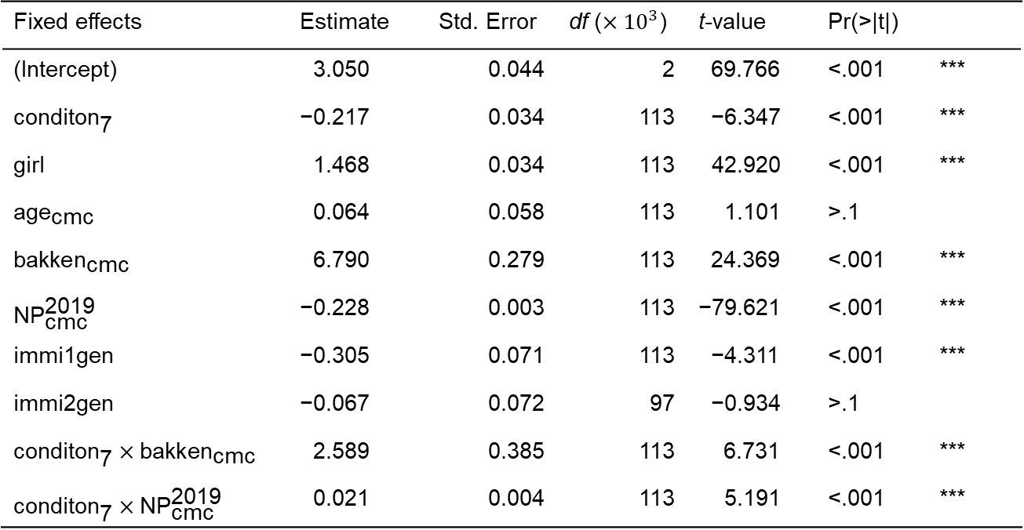
Reading
Fixed effects | Estimate | Std. Error | df ($×{10}^{3}$) | t-value | Pr(>|t|)
(Intercept) | +3.050 | 0.044 | 2 | 069.766 | <.001 | ***
$${\text{conditon}}_{\text{7}}$$ | −0.217 | 0.034 | 113 | 0−6.347 | <.001 | ***
girl | −1.468 | 0.034 | 113 | −42.920 | <.001 | ***
$${\text{age}}_{\text{cmc}}$$ | −0.064 | 0.058 | 113 | 0+1.101 | >.1
$${\text{bakken}}_{\text{cmc}}$$ | +6.790 | 0.279 | 113 | 024.369 | <.001 | ***
$${\text{NP}}_{\text{cmc}}^{\text{2019}}$$ | −0.228 | 0.003 | 113 | −79.621 | <.001 | ***
immi1gen | −0.305 | 0.071 | 113 | 0−4.311 | <.001 | ***
immi2gen | −0.067 | 0.072 | 97 | 0−0.934 | >.1
$${\text{conditon}}_{\text{7}}×{\text{bakken}}_{\text{cmc}}$$ | +2.589 | 0.385 | 113 | 006.731 | <.001 | ***
$${\text{conditon}}_{\text{7}}×{\text{NP}}_{\text{cmc}}^{\text{2019}}$$ | −0.021 | 0.004 | 113 | 0+5.191 | <.001 | ***

