Slide 1
Tony Tan, PhD Candidate
Fairness in grading across subjects:
Do GPA Subjects Differ in Difficulties?
Notes:
Good afternoon.
My name is Tony. I am a first-year PhD candidate under Rolf’s supervision.
I wish to contribute to today’s session with some preliminary results from my first PhD project that asks whether GPA subjects differ in their difficulties.

Slide 2
Motivation
Completing grunnskole: High-stake
Inter-subject difficulty in grunnskolepoeng (GPA):
Fairness
Validity
Prior studies
Notes:
This question is important because assessment practices have significant impact on students’ lives, particularly when learners approach the end of their grunnskole (Year 10), where decisions must be made over vocational or academic trajectories.
In Norway and most Nordic countries, such high-stake decisions are made almost exclusively based on a single criterion: grunnskolepoeng, a Norwegian term equivalent to grade point averages (GPA) in English.
Although details vary across jurisdictions, GPA is largely a sum-score measure.
Ensuring each component entering GPA computation is comparable in difficulties is, therefore, important not only for upholding assessment fairness, but also for enhancing measurement validity.
Surprisingly scarce studies, however, have been devoted into answering this fundamental question in the Nordic context, leaving both fairness and validity as untested assumptions.
Such concern is only exacerbated by reports from neighbouring countries, such as the UK and the Netherlands, with evidence challenging the equi-difficulty assumption.
This study therefore wishes to contribute to the academic and policy debates by examining the inter-subject difficulties in Norway’s GPA computation.

Slide 3
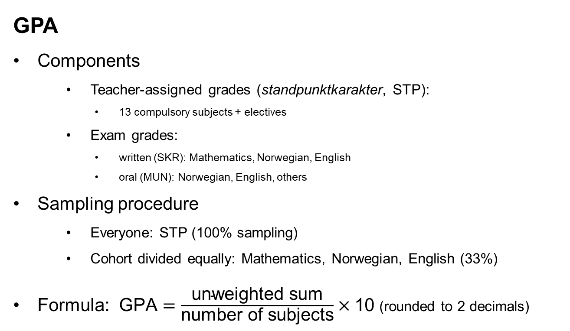
GPA
Components
Teacher-assigned grades (standpunktkarakter, STP):
13 compulsory subjects + electives
Exam grades:
written (SKR): Mathematics, Norwegian, English
oral (MUN): Norwegian, English, others
Sampling procedure
Everyone: STP (100% sampling)
Cohort divided equally: Mathematics, Norwegian, English (33%)
Formula: $\text{GPA}=\frac{\text{unweighted} \text{sum}}{\text{number} \text{of} \text{subjects}}×\text{10}$ (rounded to 2 decimals)
Notes:
Under the Norwegian system, both teacher-assigned grades (standpunkt) and exam grades are included in the GPA calculation.
Both teacher-assigned and exam grades are integers between 1 and 6, with 6 being the top grade.
Students receive grades from their teachers on 13 compulsory subjects, such as Norwegian, English, mathematics, natural sciences and social sciences, etc, as well as from a wide selection of electives.
Exams consist of both written and oral forms.
The written form covers Mathematics, Norwegian and English, and,
the oral form covers Norwegian, English, as well as other subjects.
While every student receives teacher-assigned grades (that is, 100% sampling), the student cohort is divided evenly between participating in mathematics, Norwegian and English tests, giving exam grades a 33% sampling probability.
Although 2/3 of the exam grades are missing for each exam subject, such situation can be safely modelled under missing completely at random (MCAR) assumptions due to random assignment.
GPA is then computed as the unweighted sum divided by the number of subjects (ie, a simple average), multiplied by 10, then rounded to two decimal points.

Slide 4
Current Study
Sample
Norwegian register: entire Year 10 populationn
Administrative year 2019 (avgangsdato = 201906)
Retain if valid GPA (N = 60,618)
Exclude “Norwegian as a Second Language”
STP = 12, SKR = 3, MUN = 2
Model: Partial credit model (PCM)
“Difficulty parameter (b)”:
where the curves cross
switching points to the next grade
Notes:
With such background in mind, I may now describe the current study.
This study draws its data from Norway’s national register.
This data source is unique such that it is the population, not samples, that is the subject of analyses.
The targeted population is the Year 10 cohort in the administrative year 2019, whose academic records reached the government database in June 2019.
I excluded students without valid GPAs, and the subject “Norwegian as a Second Language” from my analyses, leading to a dataset of 60,618 observations and 12 teacher-assigned grades, 3 written- and 2 oral-exam grades.
I employed partial credit models (PCMs) for my analyses. PCMs are the polytomous analogous of Rasch models.
It is particularly suited for the current study because GPAs are constructed as unweighted sums, therefore requiring the same discrimination parameters.
A PCM generates a series of probability curves, as shown in this diagram.
The horizontal axis represents students’ competency (usually represented by the Greek letter θ), with low competency on the left and high on the right.
The vertical axis represents probabilities, ranging from 0 to 1.
Taking the red curve “P4” as an example:
Students with a competency score of θ = 0 is most likely to receive a grade of 4.
As the competency increases to, say θ = 3, the probability of receiving 4 drops, while the probability of receiving a grade of 5 increases.
At certain point, the red curve “P4” crosses the yellow curve “P5”, signalling that students at this point is switching from being “more likely to be a 4” to “more likely to be a 5”. This switching point is marked as “b_4” in this study.
Geometrically, these “b” parameters mark where the probability curves cross each other.

Slide 5
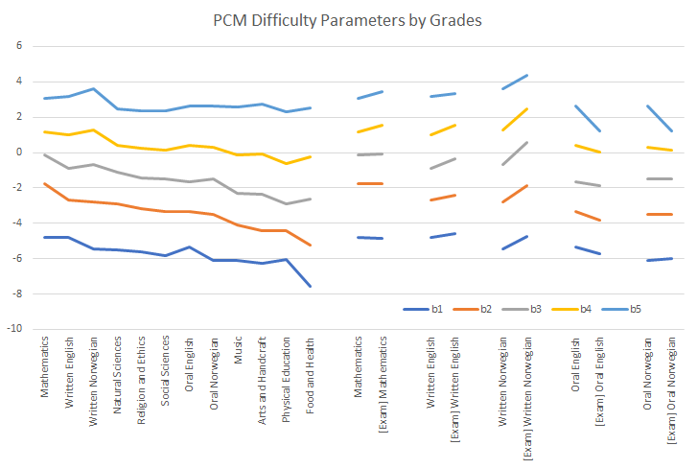
Preliminary Results
Notes:
This slide presents visual summaries of the “b” parameters derives from PCMs.
Difficulty parameters of the 12 compulsory subjects (ie, teacher-assigned grades) are grouped on the left panel in descending order.
For the purpose of enhancing comparability, difficulty parameters of the exam grades (with “[Exam]” in front) are presented on the right panel next to their teacher-assigned counterpart.
Let’s first of all examine the teacher-assigned grades:
The b_5 line is relative flat, while the b_4, b_3, down to b_1 lines are increasingly downward-sloping.

Slide 6
Looking Forward

