Slide 1



Achievement Effects of Extracurricular Homework Support and Remedial Education for Non-Native Speakers in Germany
WERA-IRN 2019
Dr. Isa Steinmann
isa.steinmann@tu-dortmund.de

Slide 2


Background
School-based extended education as additional learning opportunities, especially for disadvantaged students
Non-native speaking students in Germany (e.g., Autorengruppe Bildungsberichterstattung, 2016; Stanat et al., 2017)
On average fewer socioeconomic resources
Parents usually non-native speakers and school history abroad
Parents on average lower educational levels
🡪 Potential learning benefit from participating in extracurricular activities

Slide 3
Evidence from Germany I
Participation
Selectivity depending on type of extracurricular activity (e.g., Fischer & Klieme, 2013; Steiner, 2011; Wendt et al., 2016)
Extracurricular activities less socially selective than private tutoring (e.g., BMBF, 2012; Stecher & Maschke, 2013)

Slide 4
Evidence from Germany II
Effects on achievement
No general effects of participating in extracurricular activities on achievement after controlling for selection covariates (Bellin & Tamke, 2010; Fischer et al., 2016; Linberg et al., 2018; Lossen et al., 2016; Steinmann et al., 2019)
Only one study on effects for students with migration background (Bellin & Tamke, 2010)
Notes:
- Achievement in standardized tests

Slide 5
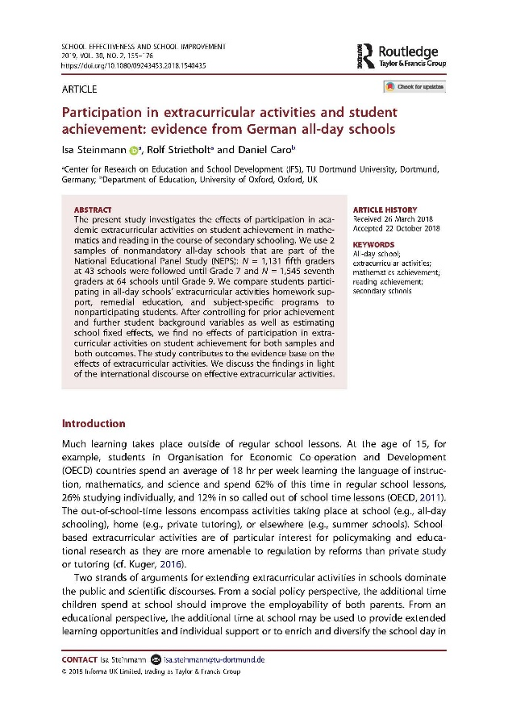
Research Question
Do homework support and remedial education offers affect the achievement of students who did not learn German as first language?
Notes:
- We therefore compare achievement developments between participating and nonparticipating students

Slide 6
Data
Non-native speaking students at schools with an at least weekly offer of both homework support and remedial education in Germany
Two samples from National Educational Panel Study (NEPS; Blossfeld, Roßbach, & von Maurice, 2011)
N = 315 students at 77 schools (grade 5 in 2010/2011 until grade 7 in 2012/2013)
N = 363 students at 94 schools (grade 7 in 2012/2013 until grade 9 in 2014/2015)

Slide 7
Instruments I
sample 5-7
sample 7-9
grade 5
grade 6
grade 7
grade 7
grade 8
grade 9
Dependent variables
Reading achievement
Mathematics achievement

Slide 8
Instruments II
sample 5-7
sample 7-9
grade 5
grade 6
grade 7
grade 7
grade 8
grade 9
Treatment variables
Participation vs. non-participation in homework support
Participation vs. non-participation in remedial education

Slide 9
Instruments III
sample 5-7
sample 7-9
grade 5
grade 6
grade 7
grade 7
grade 8
grade 9
Student-level control variables
Achievement & school grades (mathematics & reading/German)
Socioeconomic status, parental education, & parental employment
Homework help by parents and private tutors

Slide 10
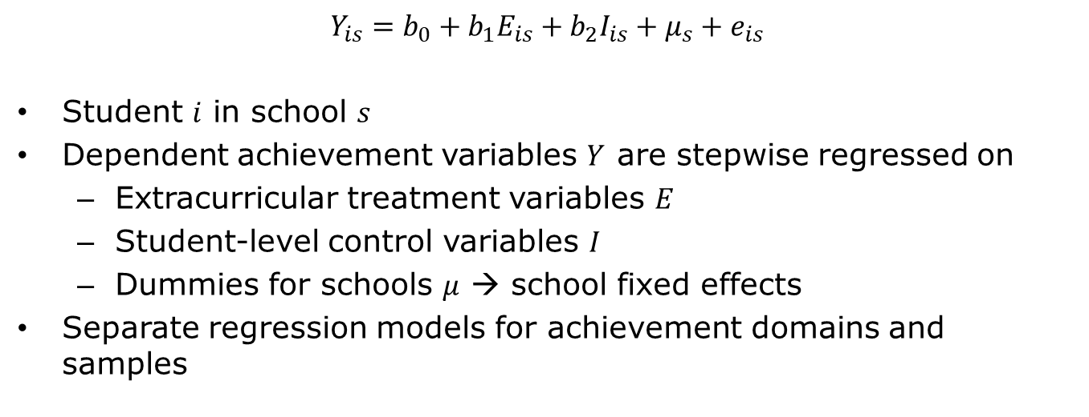
Analyses
Notes:
There is student and school level confounding

Slide 11
Descriptive Findings
Homework support
23% participants in sample 5-7
12% participants in sample 7-9
Remedial education
24% participants in sample 5-7
13% participants in sample 7-9
Participating and non-participating non-native speaking students had rather similar background characteristics

Slide 12
Inferential Findings
No significant effects once prior achievement is controlled
Achievement regressed on treatments
Achievement regressed on treatments and prior achievement
Achievement regressed on treatments and all student-level controls
Achievement regressed on treatments, student-level controls, and school fixed effects
Both treatments, both achievement domains, and both samples

Slide 13
Limitations
Treatment variables
Simple participation vs. non-participation at one point in time
Homework support and remedial education rather domain-overarching and broad terms
Dependent variables
Focus on mathematics and reading achievement in standardized tests
Summative approach
No investigation of mediating quality factors
No experimental data

Slide 14
Acknowledgment
This study uses data from the National Educational Panel Study (NEPS) Starting Cohort Grade 5; doi:10.5157/NEPS:SC3:7.0.1. From 2008 to 2013, NEPS data were collected as part of the Framework Program for the Promotion of Empirical Educational Research funded by the German Federal Ministry of Education and Research (BMBF). As of 2014, NEPS is carried out by the Leibniz Institute for Educational Trajectories (LIfBi) at the University of Bamberg in cooperation with a nationwide network.

Slide 15
Thank you very much!
WERA-IRN 2019
Dr. Isa Steinmann
isa.steinmann@tu-dortmund.de

Slide 16
References I
Autorengruppe Bildungsberichterstattung (2016): Bildung in Deutschland 2016: Ein indikatorengestützter Bericht mit einer Analyse zu Bildung und Migration. Bielefeld: W. Bertelsmann Verlag
Bellin, N. & Tamke, F. (2010): Bessere Leistungen durch Teilnahme am offenen Ganztagsbetrieb? Empirische Pädagogik, 24, 93–112
Blossfeld, H.-P., Roßbach, H.-G., & von Maurice, J. (Eds.) (2011). Education as a lifelong process – The German National Educational Panel Study (NEPS). Zeitschrift für Erziehungswissenschaft: Sonderheft 14
BMBF (2012). Ganztägig bilden: Eine Forschungsbilanz. http://www.ganztagsschulen.org/_media/121206_BMBF_GTS-Forschungsbilanz_bf_df.pdf
Fischer, N., & Klieme, E. (2013). Quality and effectiveness of German all-day schools. Results of the Study on the Development of All-Day Schools in Germany. In J. Ecarius, E. Klieme, L. Stecher, & J. Woods (Eds.), Extended education – an international perspective: Proceedings of the international conference on extracurricular and out-of-school time educational research (pp. 27–52). Opladen [i.a.]: Barbara Budrich Publishers

Slide 17
References II
Fischer, N., Sauerwein, M. N., Theis, D., & Wolgast, A. (2016). Vom Lesenlernen in der Ganztagsschule: Leisten Ganztagsangebote einen Beitrag zur Leseförderung am Beginn der Sekundarstufe I? Zeitschrift für Pädagogik, 62(6), 780–796
Linberg, T., Struck, O., & Bäumer, T. (2018). Vorzug Ganztagsschule? Zusammenhänge mit der Kompetenzentwicklung im Bereich Lesen und Mathematik. Zeitschrift für Erziehungswissenschaft, 14(2), 1–23
Lossen, K., Tillmann, K., Holtappels, H. G., Rollett, W., & Hannemann, J. (2016). Entwicklung der naturwissenschaftlichen Kompetenzen und des sachunterrichtsbezogenen Selbstkonzepts bei Schüler/-innen in Ganztagsgrundschulen: Ergebnisse der Längsschnittstudie StEG-P zu Effekten der Schülerteilnahme und der Angebotsqualität. Zeitschrift für Pädagogik, 62(6), 760–779
Rubin, D. B. (1987). Multiple imputation for nonresponse in surveys. New York, NY: Wiley
Stanat, P., Schipolowski, S., Rjosk, C., Weirich, S., & Haag, N. (2017). IQB-Bildungstrend 2016: Kompetenzen in den Fächern Deutsch und Mathematik am Ende der 4. Jahrgangsstufe im zweiten Ländervergleich. Münster, New York: Waxmann

Slide 18
References III
Stecher, L., & Maschke, S. (2013). Research on extended education in Germany – A general model with all-day schooling and private tutoring as two examples. International Journal for Research on Extended Education, 1(1), 31–52
Steiner, C. (2011). Teilnahme am Ganztagsbetrieb. Zeitliche Entwicklung und mögliche Selektionseffekte. In N. Fischer, H. G. Holtappels, E. Klieme, T. Rauschenbach, L. Stecher, & I. Züchner (Eds.), Ganztagsschule: Entwicklung, Qualität, Wirkungen: Längsschnittliche Befunde der Studie zur Entwicklung von Ganztagsschulen (StEG) (pp. 57–75). Weinheim [i.a.]: Beltz Juventa
Steinmann, I., Strietholt, R. & Caro, D. (2019). Participation in Extracurricular Activities and Student Achievement: Evidence from German All-Day Schools. School Effectiveness and School Improvement, 30(2), 155–176
Wendt, H., Goy, M., Walzebug, A., & Valtin, R. (2016). Bildungsangebote an Ganz- und Halbtagsgrundschulen in Deutschland. In H. Wendt, W. Bos, C. Selter, O. Köller, K. Schwippert & D. Kasper (Hrsg.), TIMSS 2015. Mathematische und naturwissenschaftliche Kompetenzen von Grundschulkindern in Deutschland im internationalen Vergleich (S. 225–246). Münster, New York: Waxmann Verlag

