Slide 1
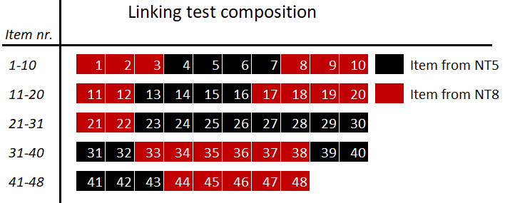
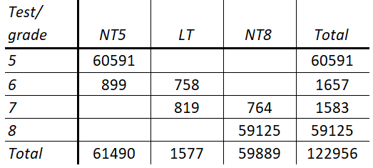
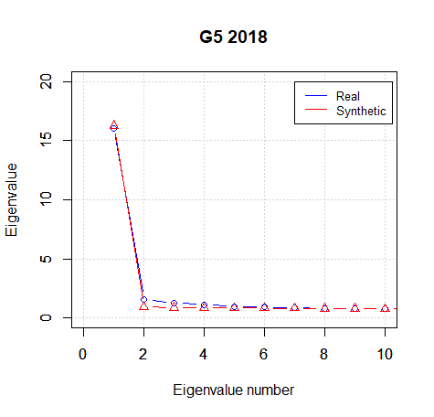
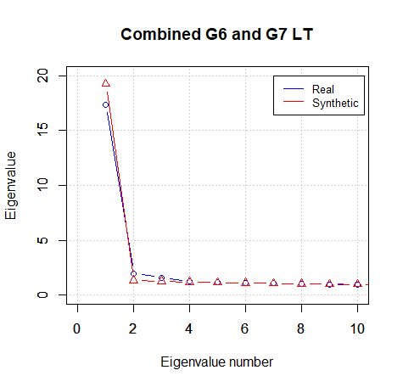

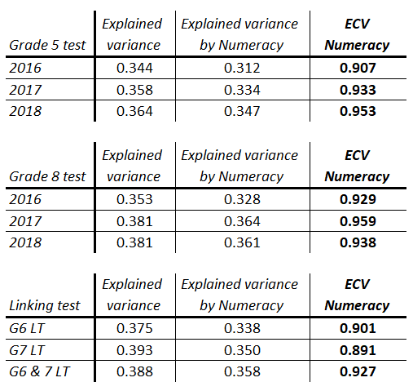


Numeracy as measured by the Norwegian National Tests is pretty much unidimensional as a construct.
Title: Subtitle
Leeroy Jenkins, author2, author3, author4
Henrik Galligani Ræder
University of Oslo
Björn Andersson
University of Oslo
Rolf Vegar Olsen
University of Oslo
A scale for Numeracy
Data collection design
CONTEXT
All Norwegian students take a standardized national numeracy test in grade 5, 8 and 9.
This study investigates the statistical validity of using a unidimensional scale when measuring numeracy as done by the Norwegian National Numeracy Tests (NNNT) within and across grades.
The work is part of a larger project aimed at vertically scaling the grade 5 and 8/9 tests.
Data used in this work is from an extended test administration done during the fall of 2018 of the NNNTs as part of the overarching project (figure 1-2 and table 1).
STATISTICAL APPROACH
Strict unidimensionality is tested using a Bootstrap Modified Parallel Analysis Test (BMPAT) as proposed by Finch and Monahan (2008) using a significance level of .01.
Potential subdimensions of the NNNTs are tested using a multidimensional item response theory model with a bi-factor structure, and evaluated with regards to the Explained Common Variance (ECV) by the general factor.
RESULTS
While the numeracy tests show a strong degree of unidimensionality, the BMPAT analysis shows that the tests exhibit statistically significant multidimensionality across grades and test iterations (figure 4-6).
Potential subdimensions such as content (within grade, figure 7) and grade specific dimensions (across grades, figure 8) are not strong enough to be considered prominent.
Conclusion
Evidence suggests we can use a unidimensional approach when vertically scaling the national numeracy tests from grade 5 to grade 8 with a minimal risk of scale distortion.
The bi-factor analysis of the Linking Test indicates that numeracy as measured by the tests designed for grade 5 and 8 measure the same construct at different difficulty levels in grades 6 and 7.
Further work is planed to investigate item invariance across grades.
Reference:
Finch, H., & Monahan, P. (2008). A Bootstrap Generalization of Modified Parallel Analysis for IRT Dimensionality Assessment. Applied Measurement in Education, 21(2), 119-140.
National numeracy test grade 5 (NT5)
G5
NP5
NT5
LT
G6
LT
NT8
LT
Figure 2: Distribution of items from NT5 and NT8 in the linking test.
G7
National numeracy test grade 8 (NT8)
G8
NP8
Figure 1: Overview of test-forms given at different grade levels during the expanded test administration fall 2018.
Table 1: Overview of number of students taking the different test-forms.
Testing strict unidimensionality
Figure 4: Eigenvalues for the grade 5 test. Analysis of the 2016 and 2017 tests (not shown here) shows the same pattern.
Figure 5: Eigenvalues for the Linking Test combining both the data from both grade 6 and grade 7. Analysis of the individual data sets (not shown here) shows the same pattern
Figure 6: Eigenvalues for the grade 8 test. Analysis of the 2016 and 2017 tests (not shown here) shows the same pattern
Testing potential subdimensions
…
Content area 1
Grade 5
Numeracy
…
Content area 2
Numeracy
…
Content area 3
…
Grade 8
…
Figure 7: Bi-factor structure used to analyse grade-specific subdimensions based on content classification. For grade 5 the three areas are 1) numbers, 2) statistics, and 3) geometry and measurement. For grade 8 the three areas are 1) numbers and algebra, 2) statistics and probability, and 3) geometry and measurement.
Table 2: Overview of variance explained by the main factor for the different structures.
Figure 8: Bi-factor structure used to analyse the Linking Test. The two dimensions are defined by items originating from the grade 5 and grade 8 NNNTs.
Take a picture for
more information
about the project

