Slide 1
Identifying school climate variables associated with financial literacy outcomes in PISA 2018 data
A multilevel structural equation modelling approach

Slide 2
Motivation
If you think education is expensive, try ignorance.
— Derek Bok

Slide 3
Framework
School Climate
(Input, X)
Academic
F Learning
(Process, M)
F familiarity
F Literacy
(Output, Y)
Community
Safety
Inst Env
F confidence
F problem-solving

Slide 4
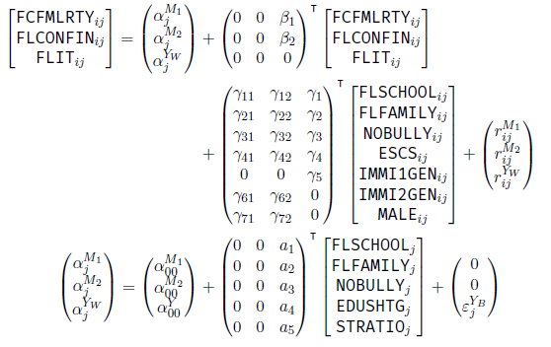
MSEM

Slide 5
Results
Model fit indices | Estimate | Cut-off (Hu & Bentler, 1999)
RMSEA | .009 | <.06
CFI | .968 | >.95
TLI | .903 | >.95
SRMR L1 | .015 | <.08
SRMR L2 | .030 | <.08
 | F Education | F Socialisation | Safety
Contextual effect | –0.163 | –0.144 | 0.144

Slide 6
Discussion
Research questions:
1: school climate ‹—› F literacy
2: school-level —› student-level
Negative pathways
Country differences

