Slide 1
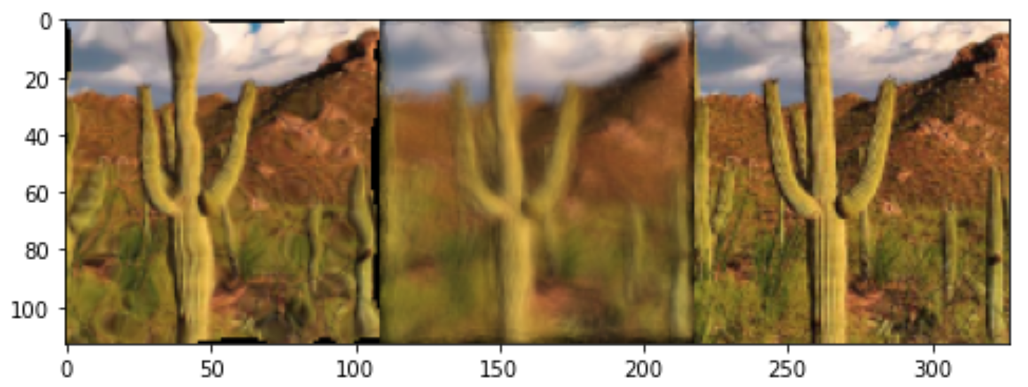
Unsupervised Non-Rigid Image Distortion Removal via Grid Deformation
Published results. Left to right: distorted image, mean image, reconstructed image (Li et. al)

Slide 2
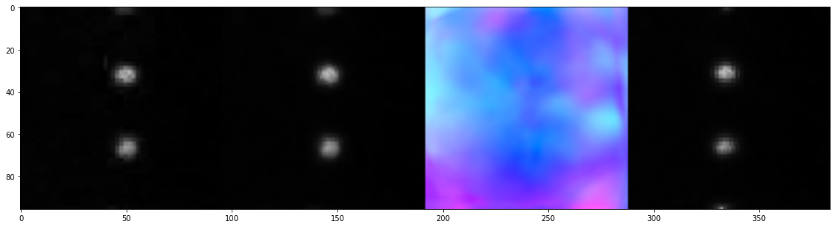
Collected data reconstruction
Collected tank images. Red/Blue channel differenced. Left to right: original image, reconstructed distorted image, reconstructed straightened image

Slide 3
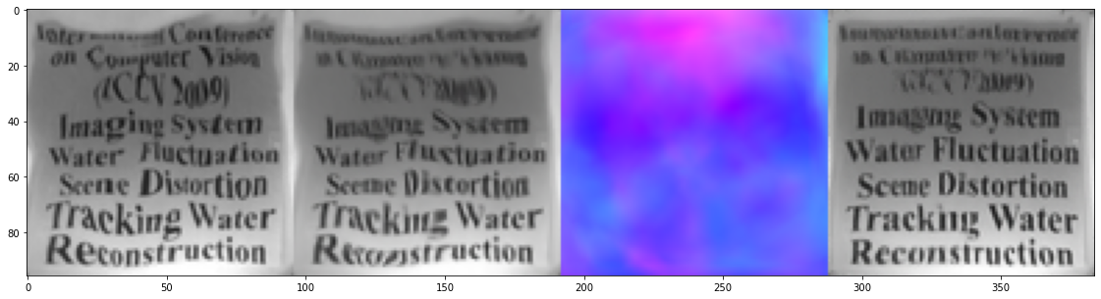
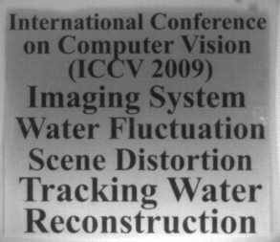
Using data from Thapa
Image from Thapa et al. Left to right: Original image, distorted image, reconstructed distorted image, reconstructed straightened image.

Slide 4
Using data from Thapa
Image from Thapa et al. Left to right: Distorted image, reconstructed distorted image, predicted distortion map, reconstructed straightened image.

