Slide 1
HP Mobile Workplace Services Mobile Management Services
EMEA ITO Production Engineering WPS
Mobility Competency Centre
Galway, Ireland

Slide 2
HP Mobile Workplace Services
Mobile Management Service (MMS)
Mobile Messaging
Telecom Expense Management
Mobile Applications
Mobile Service Desk
Infrastructure Monitoring & Management
Over 250,000 Mobile Device Users Supported
Service Design & Integration
2 million + Workplace Services Users Supported

Slide 3





HP Mobile Management Service
Latest Service Release:
Cloud Based Solutions
Multi-Platform Environments
Bring Your Own Device (BYOD) Support
Managed Diversity Strategies
Advanced Data Protection Measures
Enterprise App Catalogs

Slide 4
MMS Key Components
Configuration Management:
Application Management:
Infrastructure Management:
Ensures that all managed devices are configured in line with set corporate guidelines
Centrally distribute, install, maintain, and support frontline applications
Management of the Mobility server infrastructure and the overall operation of the Mobility application
Security Management:
Provides security at each point of the Mobility service in line with corporate security policies
Inventory Management:
Automatically captures details on hardware under management and software contained on those devices
Support Management:
Dedicated mobility support desk for Incident management and proactive troubleshooting allowing for first time diagnosis and resolution
Service Management
E2E Governance

Slide 5
Security Management
On The Device
Data in Transit
Edge
Behind The Firewall
Enhanced Protection via Policy Enforcement
Encryption of control Link
DMZ Proxy as first line of defence
Policy Administration aligned to best practices
Data Protection – Encryption of Data at Rest on the device and removable storage
Device Access Protection – Password Policy Enforcement
Encryption of data link
Restriction of devices: Authorisation and Authentication during enrolment
Compliance Monitoring and Proactive Management
Protect via certificate authentication of both the device and the server
Protection via use of DMZ
Remote Wipe & Lock for lost devices

Slide 6
Configuration Management
Corporate Mail Settings
Corporate Device Security Policies
Corporate VPN & Wi-fi settings
App restrictions and activities
Over The Air Configuration
Configuration Lock down on Device
CORPORATE & BYO DEVICES
Notes:
Corporate and BYO devices are configured in line with set corporate guidelines

Slide 7
Application Management
In House & 3rd Party Apps
Enterprise App Catalogues
App Life Cycle Management
App Compliance Reporting
Push & Pull Deployments
White/Black List Capabilities
OTA Auto Configuration
Notes:
Centrally distribute, install, maintain, and support frontline applications

Slide 8
Inventory Management
Purpose
Method
Details
Detailed Device Report
Managed Application reports
Compliance Reports
Finer visibility of hardware and software estate on the device
Inventory is automatically and silently retrieved from Managed Devices
Reporting & Auditing trails
Customisable
Created on an agreed schedule and made available for customer in CSV format
Provides greater input into device usage and compliance
Stored to the MDM database
Notes:
”

Slide 9
Support & Infrastructure Management
Support Management
On-Site Support
Steady State Delivery
Infrastructure Management
Transport and Network Layer governance
Application and Server Hosting
Integration with on-site support
Training for device break/fix scenarios
Installations/provisioning of client devices
L1/L2/L3 support structure
Integration with existing GSD personnel, infrastructure and mail & messaging
Dedicated L2 Mobility
Full operation reviews and governance of the Mobility service
Single MDM software solution for Service Desk agents reduce the time to fix an issue
Key : Mobility Server Admin, Mobility Topology Admin and Mobility Database Backup and Restore

Slide 10
Mobility Transformation
Scope
Design and
Implementation
Delivery
Workshop
Consultancy
Takeover
Green Field
POC
Standards Solutioning
Architecture
Cross Platform Integration
Testing
Knowledge Transfers
POC and Pilots
SPOC and Governance
Reporting
Service Requests
Change Management
Incident Management
Problem Management
Escalation Management
End to End Governance Model

Slide 11

HP Mobility Services Lifecycle
Service Request
Device Ordering
Service enablement
Certification
Service enhancement
End of Life
Asset Disposal
Decommissioning of users
1
6
Support Management
Help desk management
SW Distribution
Asset Management
MDM Server management
HP Mobile Management Service
2
Procurement
HW/Service Procurement
HW/Service Provisioning
5
3
Staging & Configuration
Management of devices & configurations
Delivery & Start up
Delivery to end user
Automatic install
End user training
4

Slide 12
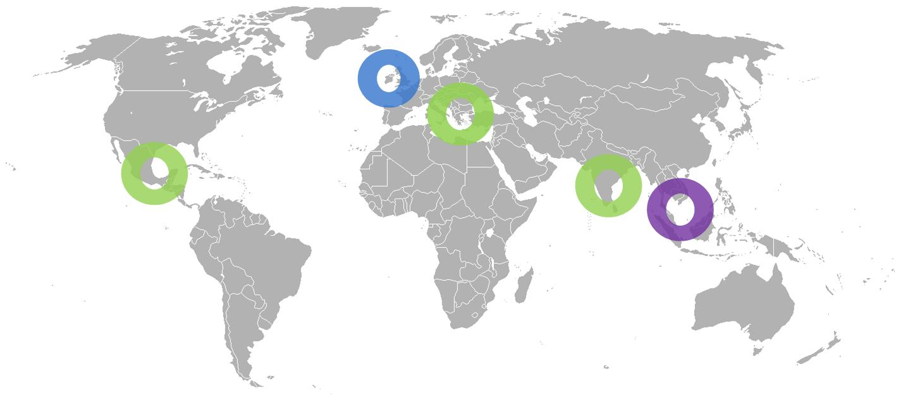
HP Mobile Workplace Services Delivery
Mobility Center Of Expertise
Design & Implementation
Standards, best practices, processes
Delivery Governance
Customization
Right Shore Delivery Centers
Infrastructure Management
Mobile Device Management (level 2, level 3 support)
ITIL Compliant, Enforcement of standards and repeatable processes
Global Mobility Services Center Of Expertise
Galway, Ireland
Global Level 2 Mobility Help Desk Support
Kuala Lumpur Malaysia
Infrastructure Management and support
Sofia, Bulgaria
Bangalore, India
Costa Rica

Slide 13
More Information
Mobile Management Services Team
EMEA ITO PE WPS
Mobility Competency Centre
Galway, Ireland
Sharepoint
http://teams1.sharepoint.hp.com/teams/MobilityServices/default.aspx
Notes:
.

Slide 14
Thank You

