Slide 1


Natural Language Generation for Spoken Dialogue System using RNN Encoder-Decoder Networks
Van-Khanh Tran and Le-Minh Nguyen
Japan Advanced Institute of Science and Technology, JAIST
1-1 Asahidai, Nomi, Ishikawa, 923-1292, JAPAN

Slide 2
Content
Introduction
The Neural Language Generator
Attention-based RNN Encoder-Decoder
RALSTM cell
Experiments
Conclusion

Slide 3
Content
Introduction
The Neural Language Generator
Attention-based RNN Encoder-Decoder
RALSTM cell
Experiments
Conclusion

Slide 4
NLG Task
Mapping a MR (meaning representation) to a natural language utterance.
Dialogue Act
inform(name=Bar Crudo, food=Mexican)
Realizations
Bar Crudo is a Mexican restaurant.
Bar Crudo serves Mexican food

Slide 5
NLG processes
Bar Crudo serves Mexican food
Lexicalization Step
SLOT_NAME serves SLOT_FOOD food
RNN-based
LSTM-based
GRU-based
Encoder-Decoder based
…
Natural Language Generator
SLOT_NAME serves SLOT_FOOD food
Delexicalization Step
Bar Crudo serves Mexican food
inform(name=Bar Crudo, food=Mexican)

Slide 6
Content
Introduction
The Neural Language Generator
Attention-based RNN Encoder-Decoder
RALSTM cell
Experiments
Conclusion

Slide 7
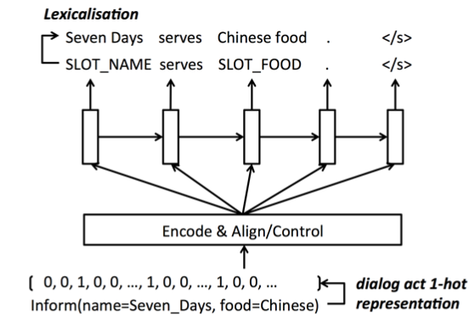
The Neural Language Generator
Wen et. al, Toward multi-domain language generation
using recurrent neural networks, 2016.

Slide 8
Content
Introduction
The Neural Language Generator
Attention-based RNN Encoder-Decoder
RALSTM cell
Experiments
Conclusion

Slide 9
Attention-based RNN Encoder-Decoder
…
RNN
RNN
RNN
…
Aligner
w_{t}
d_{t}
e₁
e₂
…
e_{T}
Separate parameterization
of Slot-Value pair
e₁
e₂
…
e_{T}
inform
name=
Bar Crudo
price-range=
moderate
food=
Mexican

Slide 10
Attention-based RNN Encoder-Decoder
s_{t-1}
s_{t}
s_{t+1}
…
…
Dialog Act 1-hot
representation
…
RALSTM
RALSTM
RALSTM
…
Aligner
w_{t}
d_{t}
e₁
e₂
…
e_{T}
Separate parameterization
of Slot-Value pair
e₁
e₂
…
e_{T}
inform
name=
Bar Crudo
price-range=
moderate
food=
Mexican

Slide 11
DA feature vector s controlling

Slide 12
RALSTM Cell
LSTM Cell
h_{t}
w_{t}
w_{t}
d_{t}
d_{t}
i_{t}
o_{t}
h_{t-1}
h_{t-1}
tanh
w_{t}
w_{t}
c_{t}
d_{t}
d_{t}
tanh
f_{t}
h_{t-1}
h_{t-1}
Refinement Cell
tanh
x_{t}
r_{t}
d_{t}
h_{t-1}
w_{t}

Slide 13
RALSTM Cell
s_{t-1}
s_{t}
h_{a}
h_{t}
x_{t}
a_{t}
tanh
Adjustment Cell
LSTM Cell
h_{t}
x_{t}
x_{t}
d_{t}
d_{t}
i_{t}
o_{t}
h_{t-1}
h_{t-1}
tanh
x_{t}
x_{t}
c_{t}
d_{t}
d_{t}
tanh
f_{t}
h_{t-1}
h_{t-1}
Refinement Cell
tanh
x_{t}
r_{t}
d_{t}
h_{t-1}
w_{t}

Slide 14
Content
Introduction
The Neural Language Generator
Attention-based RNN Encoder-Decoder
RALSTM cell
Experiments
Conclusion

Slide 15
Experiments
Datasets collected by Wen et. al 2015a,b, 2016
Finding a restaurant
Finding a hotel
Buying a Laptop
Buying a TV
Training: BPTT, SGD with Early stopping, L2 reg, Hidden size 80, Keep Dropout 70%.
Evaluation metrics:
BLEU
Slot error rate ERR

Slide 16
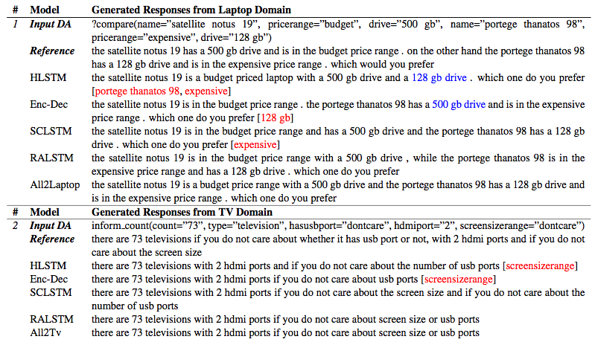
Generated Outputs

Slide 17
Content
Introduction
The Neural Language Generator
Attention-based RNN Encoder-Decoder
RALSTM cell
Experiments
Conclusion

Slide 18
Conclusion
Proposed RALSTM architecture
Training NLG N2N using Attentional RNN Encoder-Decoder Networks
Evaluation metrics

Slide 19
Thanks for your attention!
Question?

Slide 20
References
Tsung-Hsien Wen, Milica Gasˇic ́, Dongho Kim, Nikola Mrksˇic ́, Pei-Hao Su, David Vandyke, and Steve Young. 2015a. Stochastic Language Generation in Dialogue using Recurrent Neural Networks with Convolutional Sentence Reranking. In Proceedings SIGDIAL. Association for Computational Linguistics.
Tsung-Hsien Wen, Milica Gasic, Nikola Mrksic, Lina M Rojas-Barahona, Pei-Hao Su, David Vandyke, and Steve Young. 2016a. Multi-domain neural network language generation for spoken dia- logue systems. arXiv preprint arXiv:1603.01232 .
Tsung-Hsien Wen, Milica Gasˇic, Nikola Mrksˇic, Lina M Rojas-Barahona, Pei-Hao Su, David Vandyke, and Steve Young. 2016b. Toward multi- domain language generation using recurrent neural networks .
Tsung-Hsien Wen, Milica Gasˇic ́, Nikola Mrksˇic ́, Pei- Hao Su, David Vandyke, and Steve Young. 2015b. Semantically conditioned lstm-based natural lan- guage generation for spoken dialogue systems. In Proceedings of EMNLP. Association for Computtional Linguistics.
Tsung-Hsien Wen, David Vandyke, Nikola Mrksic, Milica Gasic, Lina M Rojas-Barahona, Pei-Hao Su, Stefan Ultes, and Steve Young. 2016c. A network- based end-to-end trainable task-oriented dialogue system. arXiv preprint arXiv:1604.04562 .

