Slide 1

Austin Copenhagen Dubai London Madrid
Welcome to
Melbourne
Munich New York Nice Raleigh
IBM Cloud Garage
MVP Options
San Franci Sao Paulo Singapore Tokyo Toronto

Slide 2
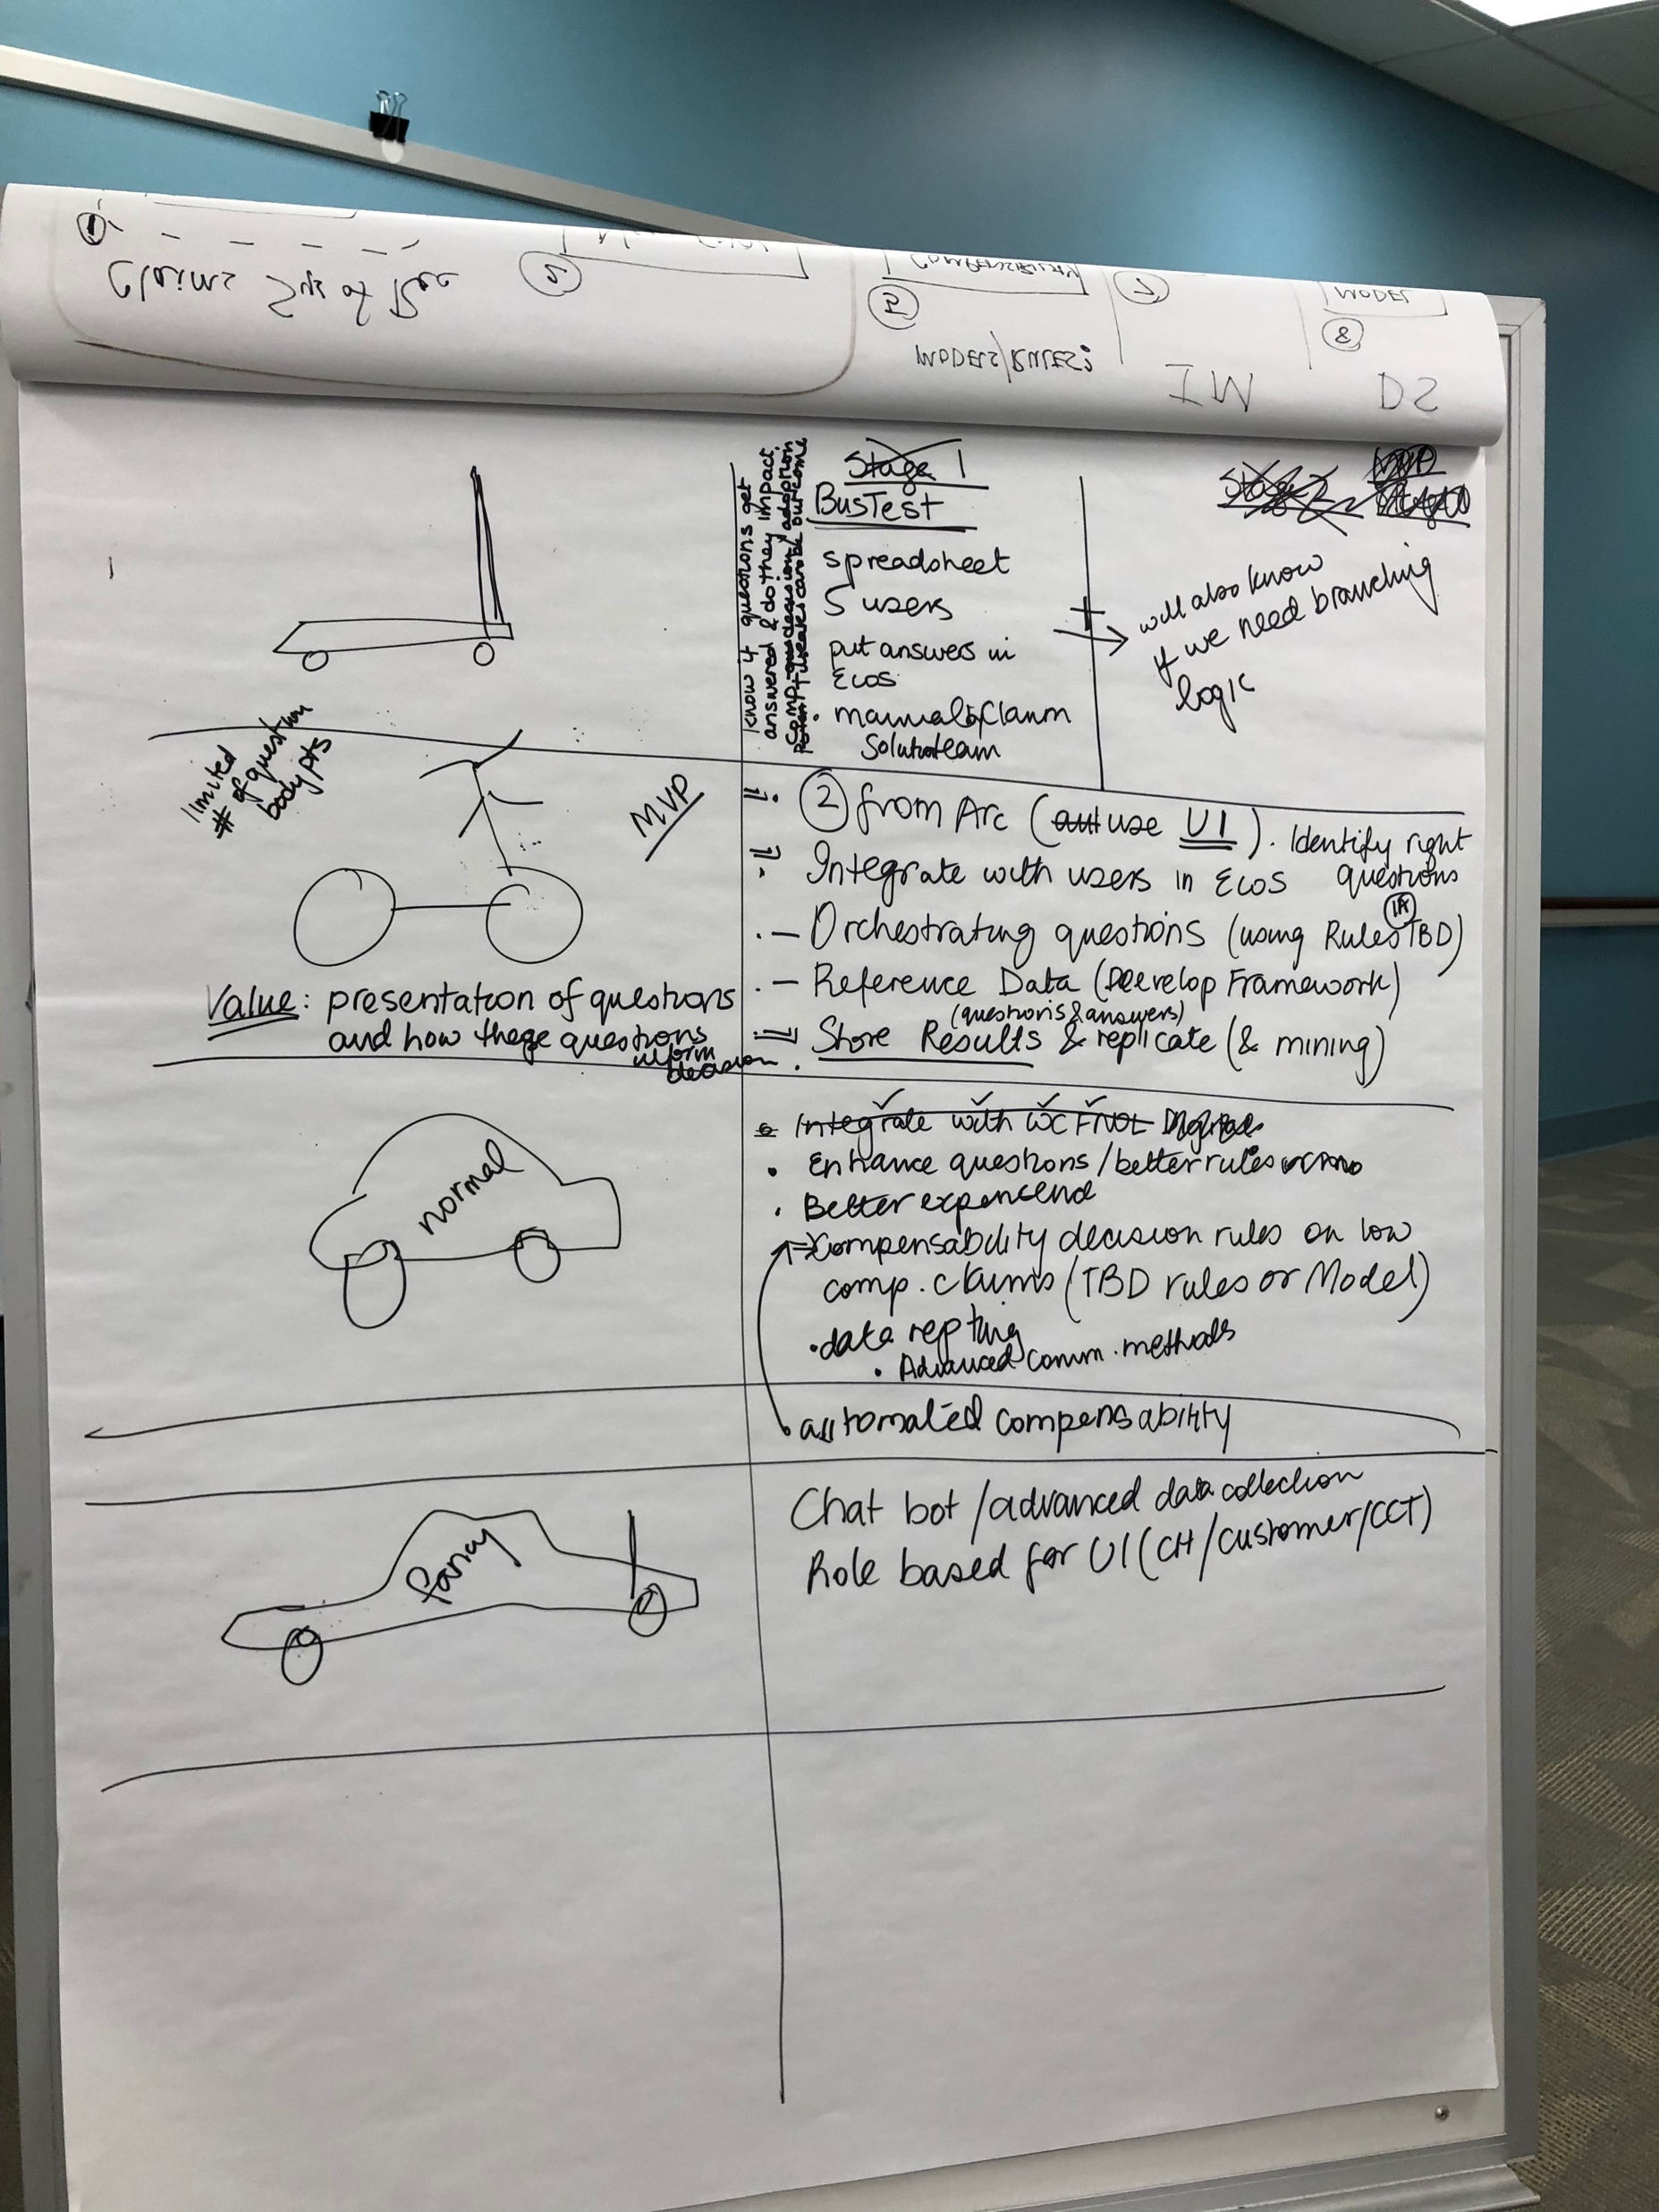

Slide 3
"scooter" | BusTest
 | spreadsheet
 | 5 users
 | put answers in ECOS
 | manual claim solution
 | will also know if we need branching logic
 | know if questions get answered and do they impact comp decision / adoption - tweaks can be outcome
"bike" | limited number of questions body parts
 | Value: presentation of questions and how they inform decisions
 | 2 From Arc (use UID)
 | Identify right questions
 | Integrate with users in ECOS
 | Orchestrating questions (using Rules (1A) TBD
 | Reference data (Develop Framework)
 | questions and answers
 | shore results and replicate ( and mining)

Slide 4
"Normal car" | enhance questions / better rules
 | better experence
 | compensbilitility decision rules on how comp. claims (TBD Rules or Model)
 | Data reporting
 | advanced communication methods
 | automated compensbility
"Fancy car" | Chatbot/advanced data collection
 | Role based for UI( CH/Customer/CCT)

Slide 5


