Slide 1
People & Cultural AI
AI Empowering

Slide 2
Agenda
Business Objective
Design & Infrastructure
Benefit
AI Governance
Future Roadmap

Slide 3
Business Objective
The proposal outlines the development and implementation of an in-house AI tool specifically designed for the People & Culture (P&C) Team. This AI tool aims to enhance response times and accuracy when addressing queries related to HR policies. The tool will initially function as a chatbot, providing immediate and precise answers to policy-related questions. In the future, its capabilities can be expanded to include email generation, predictive analytics, and handling general inquiries, ultimately making it accessible to all employees.
What we want to achieve
- Increase Efficiency: Reduce the time P&C team members spend on answering routine HR policy queries.
- Improve Accuracy: Ensure that responses to HR policy queries are accurate and consistent.
- Future Expansion: Lay the groundwork for future functionalities such as email generation, predictive analytics, and broadening the tool’s usage across all employees.

Slide 4
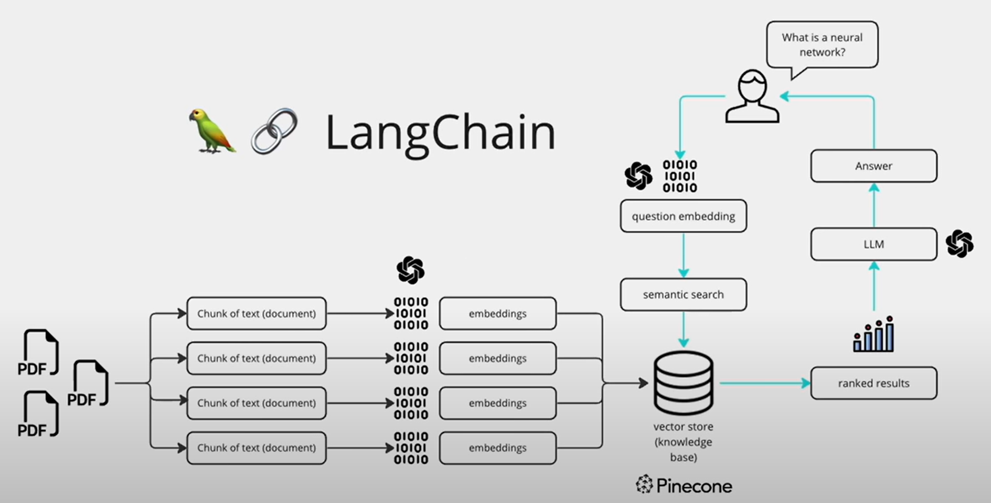
Constructing the BRAIN

Slide 5
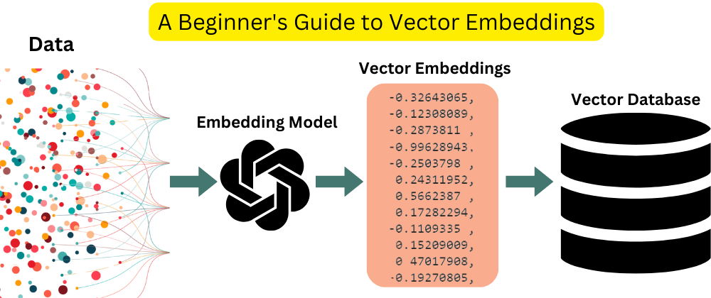
Vector store embedding is a method of representing unstructured text data in a high-dimensional vector space, making it suitable for machine learning and AI tasks.
Then we facilitates the storage and retrieval of data in a way that makes it easy to perform similarity searches, clustering, and other analyses.

Slide 6
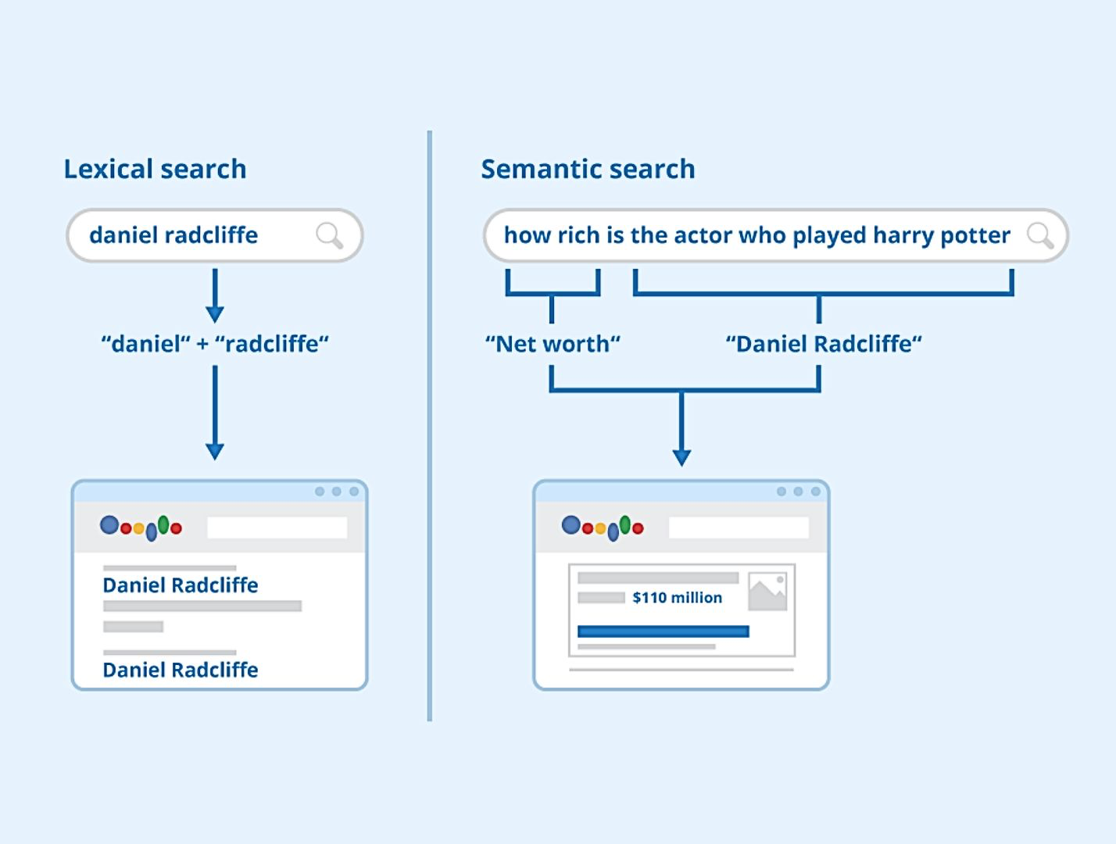
What is Semantic Search
Semantic search is a search technique that understands the meaning and context of search queries rather than relying solely on keyword matches.

Slide 7
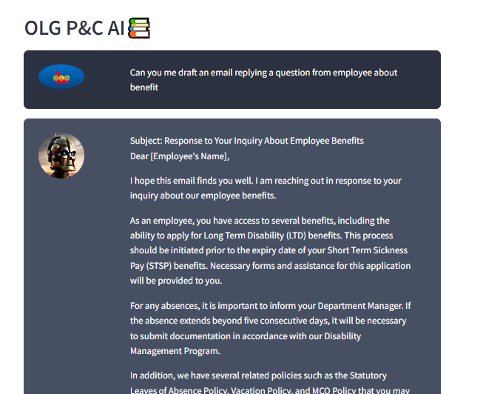
Sample Result
Can interpret questions and retrieve information automatically
Accept grammar error

Slide 8
How can OLG benefit from P&C AI
Immediate Benefits
1. Time Savings: Automating responses to routine queries will allow P&C team members to focus on more strategic tasks.
2. Consistency: Standardized responses to HR policy questions will ensure uniformity and reduce the risk of misinformation.
3. Accessibility: A chatbot can provide 24/7 support, enabling employees to get answers outside of regular office hours.
Long-term Benefits
1. Scalability: The AI tool can evolve to handle more complex inquiries and tasks, such as generating emails and performing predictive analytics.
2. Employee Satisfaction: Quick and accurate responses to HR queries can improve overall employee satisfaction and reduce frustration.
3. Data Insights: The tool can collect and analyze data on frequently asked questions, providing insights for policy improvements and training needs.

Slide 9
AI Governance: Mitigating potential risk
Potential AI Risk identified by DIRA (Data Impact Risk Assessment) | P&C AI Solution
Unpredictable outputs | Ground Answer within provided documents. No hallucination
Lack of transparency | In house developed framework allows for full transparency.
Bias and discrimination | No infers allowed by design.
Privacy & Security Concerns | Data stored in OLG owned private server. Security log in through App portal.
9

Slide 10
Looking into future: Development Roadmap
Need Assessment Planning
- Conduct a detailed analysis of the types of queries received by the P&C team.
Development and Training
- Partner with AI developers to build the chatbot.
Testing and Feedback
- Conduct thorough testing with a small group of P&C team members.
- Define clear objectives and success metrics.
- Gather and prepare training data from existing HR documents and queries.
- Collect feedback and refine the tool accordingly.
Deployment and Training
- Roll out the chatbot to the entire P&C team.
- Provide training sessions to ensure team members are comfortable using the tool.
Evaluation and Expansion
- Monitor usage and performance.
- Plan and implement additional features based on initial feedback and evolving needs.
Complete
In Progress

