Slide 1
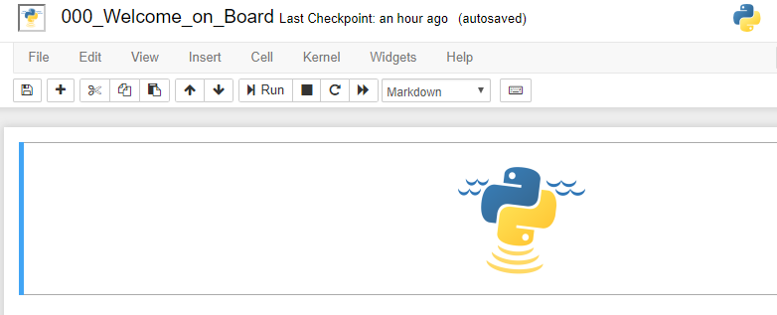
Notebook name
Menu bar
Toolbar
Active Cell

Slide 2
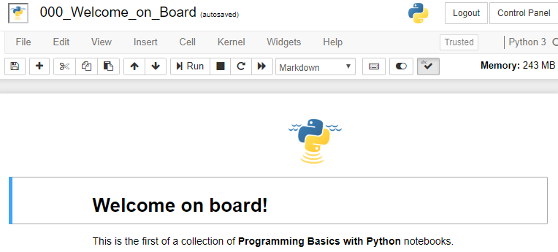
Notebook name
Menu bar
Toolbar
Cell
Active Cell
Cell

Slide 3
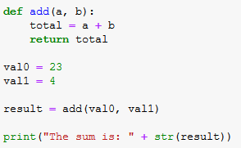
function parameters
function name
function body
local variable
function definition
return statement
function call
function arguments

Slide 4
Congratulations !

