Slide 1
Kaggle Competition - Walmart Sales Forecasting
Analyze what impacts Weekly Sales
Predict Weekly Sales using Multiple Linear Regression
Compare with KNN, Decision Tree Regressor and Random Forest Regressor

Slide 2
Overview of Problem
Walmart Inc. is an American multinational retail corporation that operates a chain of hypermarkets, discount department stores, and grocery stores. It is the world’s largest company by revenue as well as the largest private employer and grocery retailer.
Aim was to predict Weekly Sales with Multiple Linear Regression. The dataset was obtained from Kaggle and contains historical sales data for 45 stores located in different regions. Each store contains many departments.
Later KNN Regressor, Decision Tree Regressor and Random Forest Regressor added for model comparison

Slide 3
Data Description
Dataset consisted of 4 .csv files (tables): train.csv, test.csv, features.csv and stores.csv
Merged train, features and stores over with Store as the primary key
Had 45 stores and 81 departments
MarkDown1-5 contained around 60-70% of missing values
Weekly Sales is the target variable

Slide 4
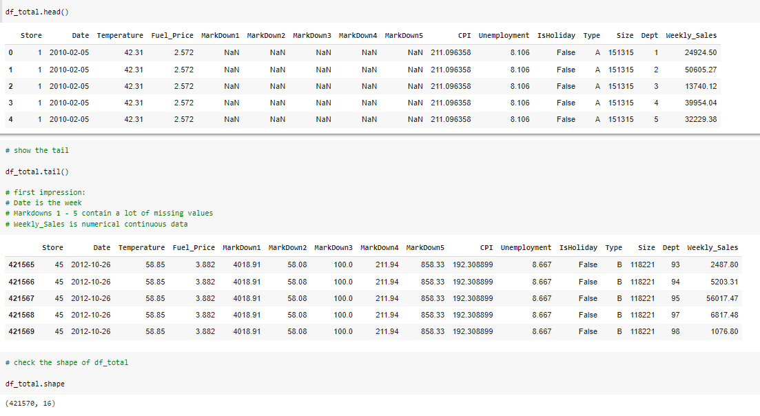

Slide 5
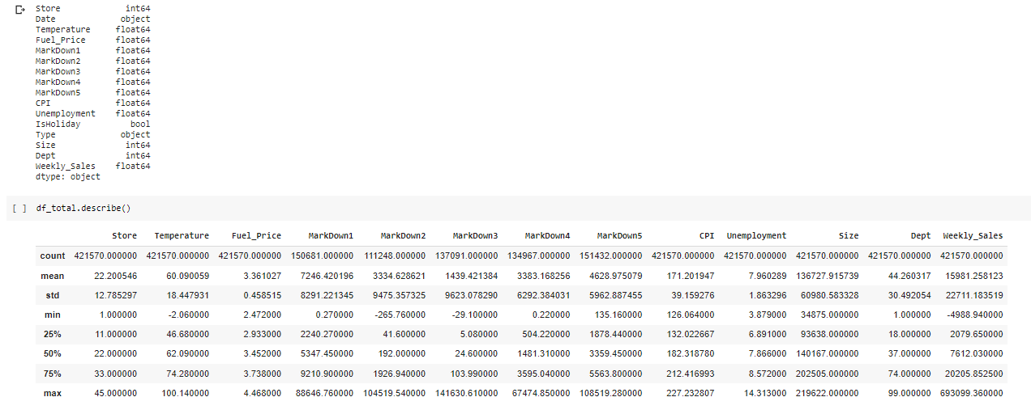

Slide 6
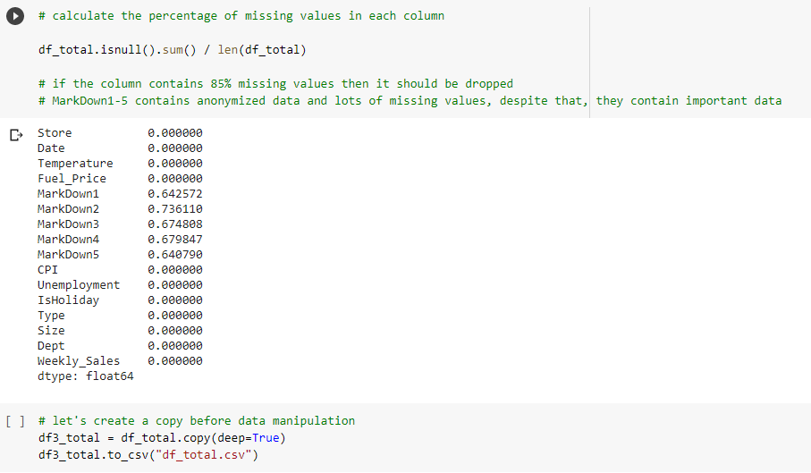

Slide 7
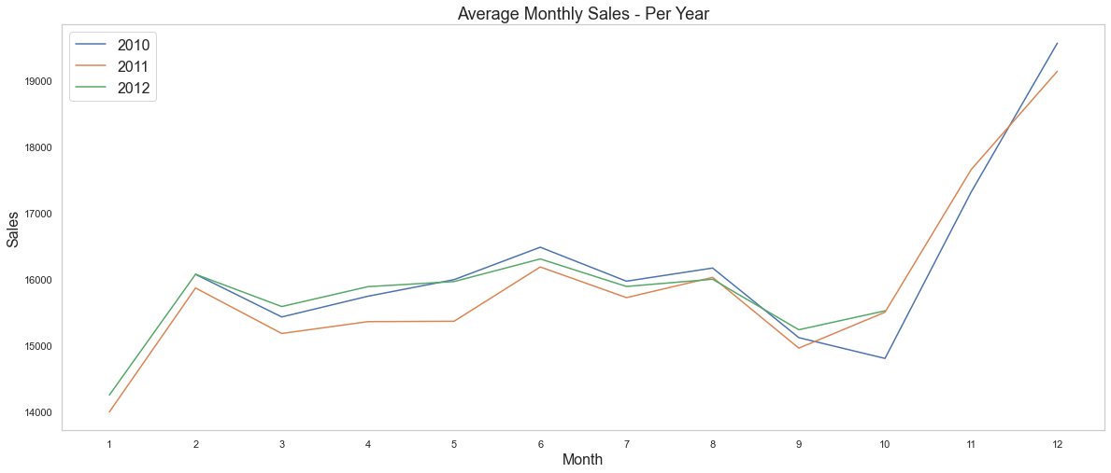
EDA

Slide 8
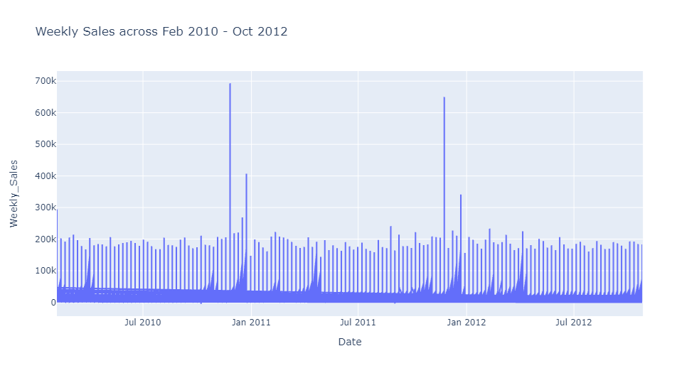

Slide 9
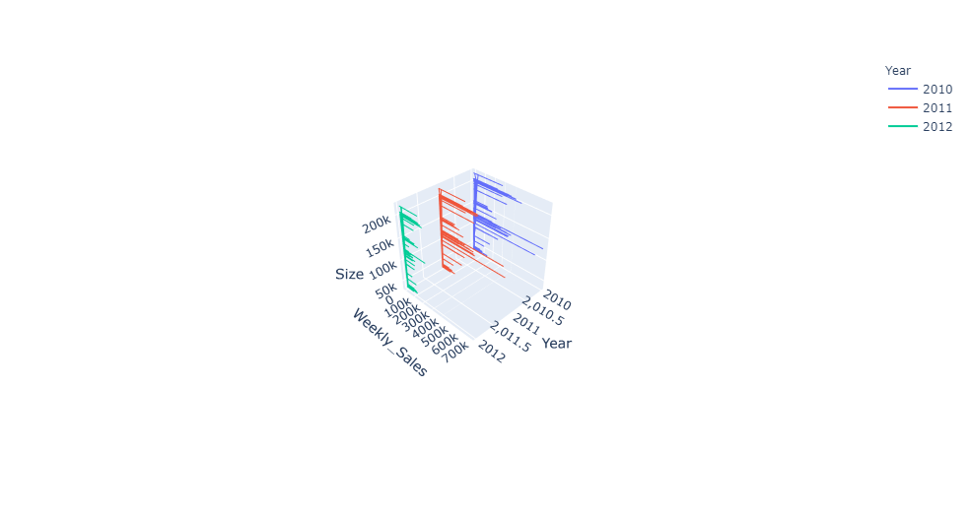
Weekly Sales x Size x Year

Slide 10
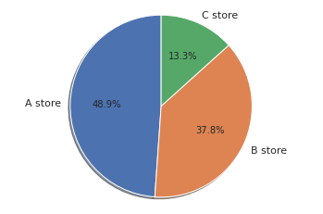
3 types of stores grouped by size: Type A, B and C. There are 45 stores in total.

Slide 11
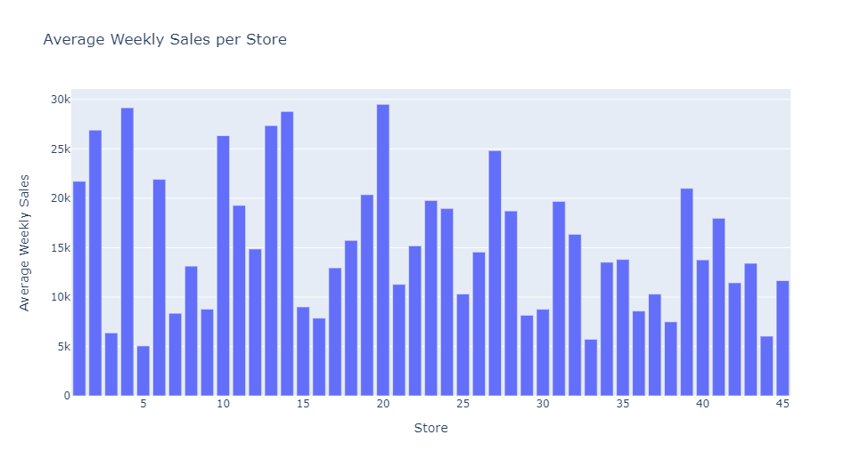

Slide 12
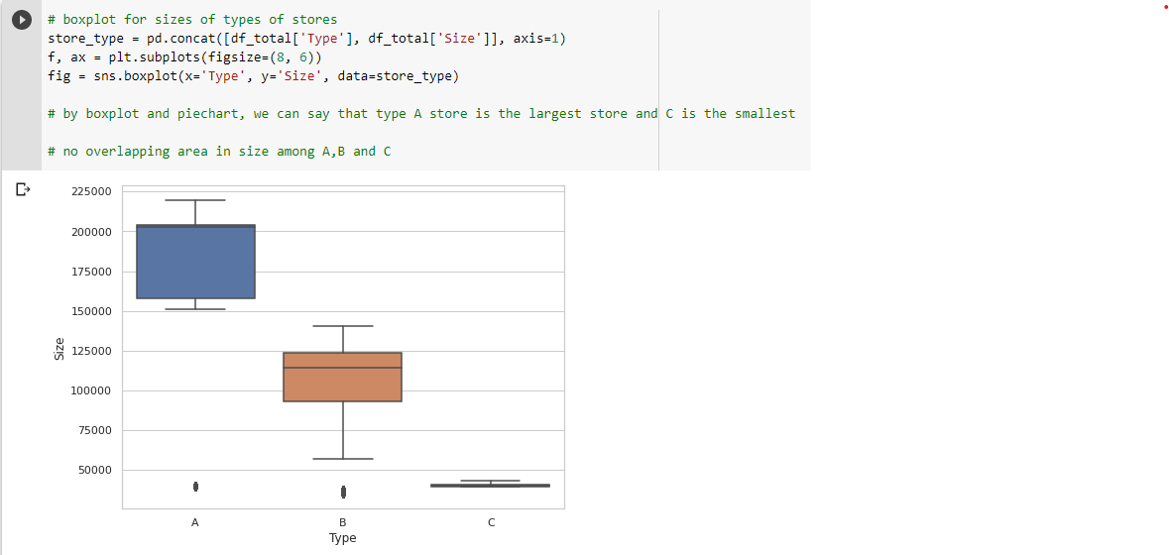

Slide 13
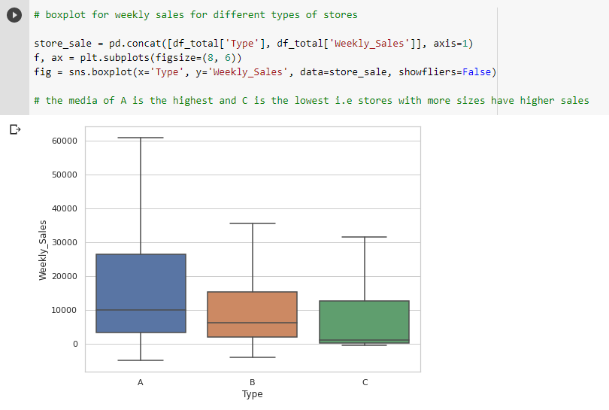

Slide 14
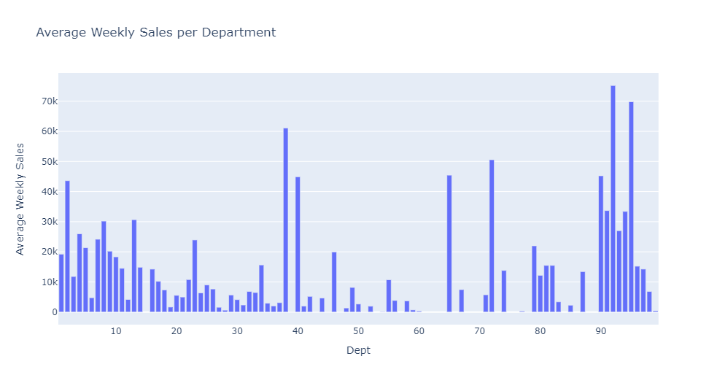

Slide 15
Explore correlation with Weekly Sales

Slide 16
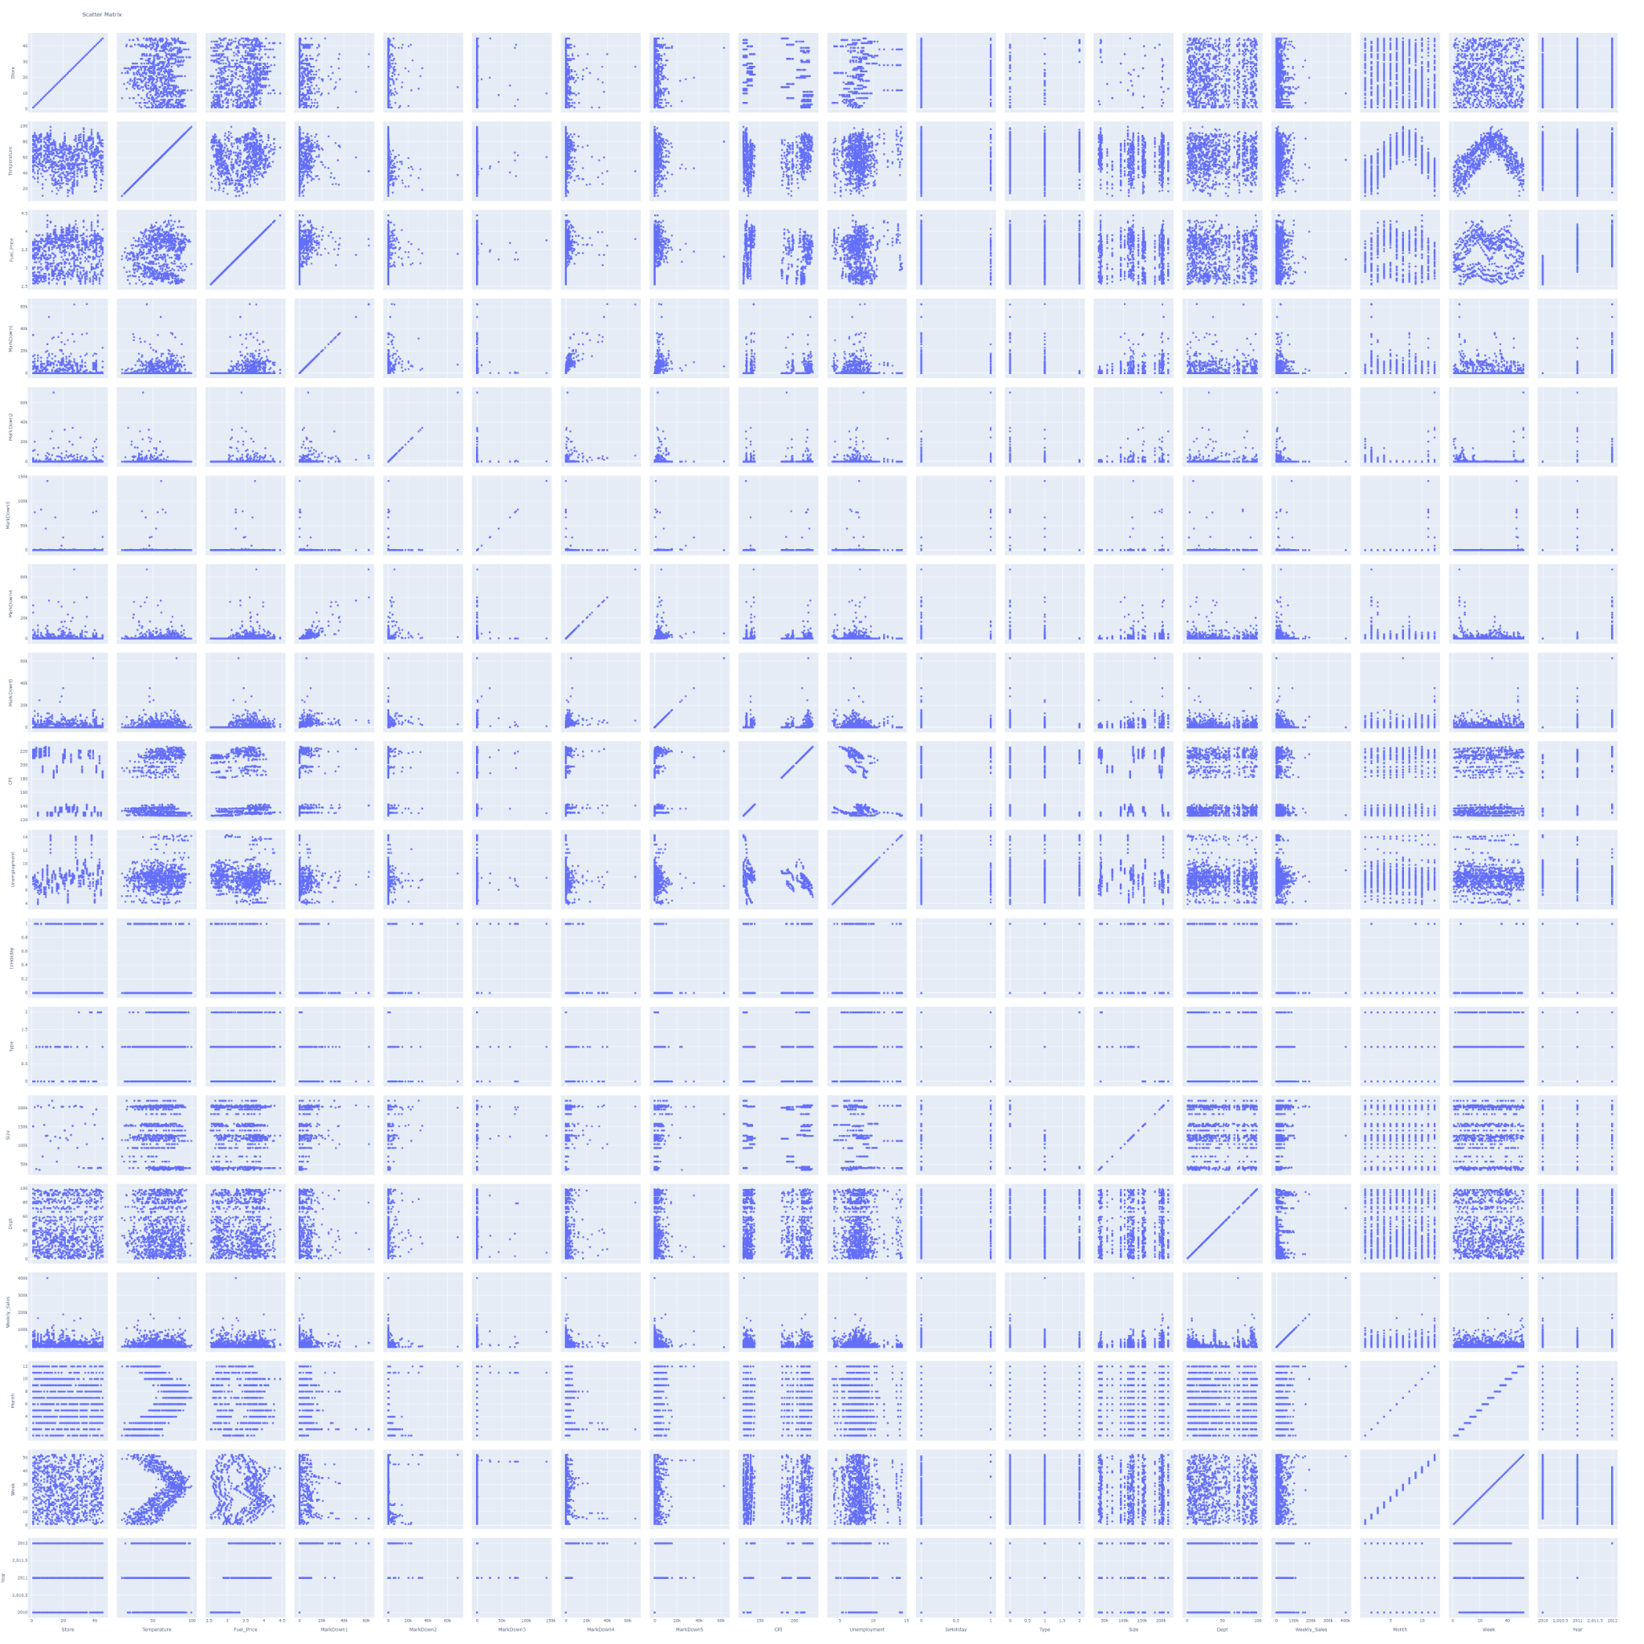

Slide 17
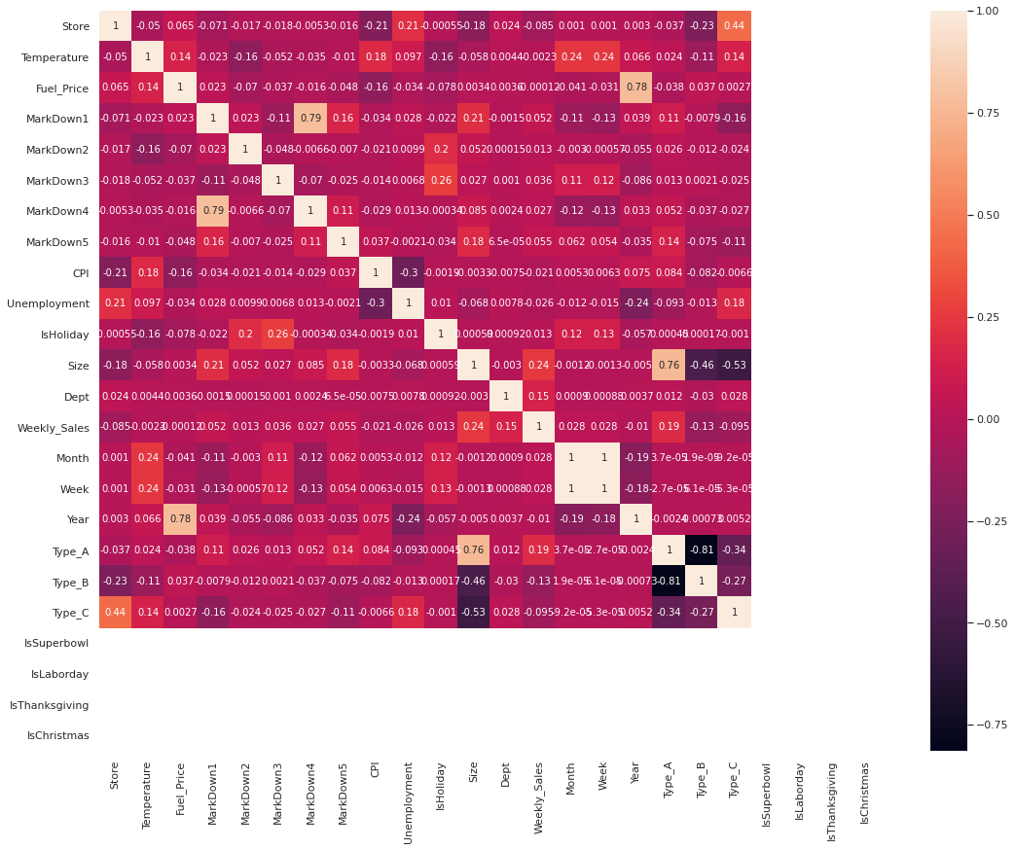

Slide 18
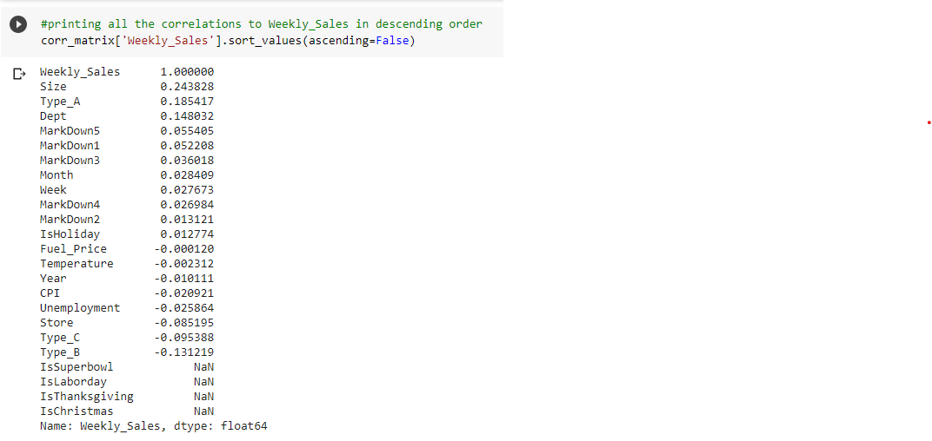

Slide 19
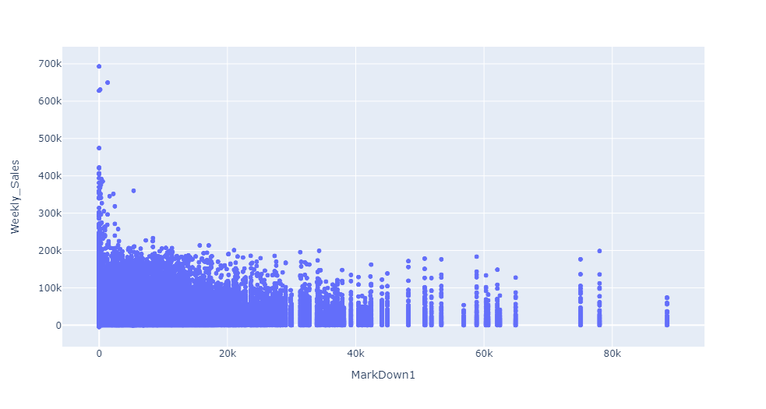

Slide 20
ML - Multiple Linear Regression
Data Pre-processing
Mean imputation for MarkDown1-5
Dropped Date, MarkDown4 and Fuel Price
Treated outliers with Binning
Scaled features against Weekly Sales using MinMax scaler

Slide 21
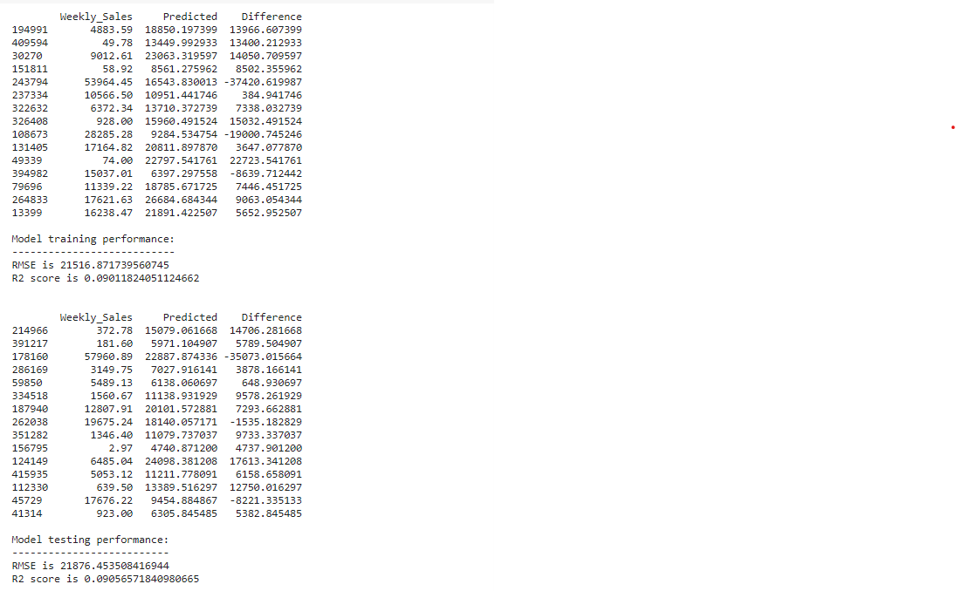

Slide 22
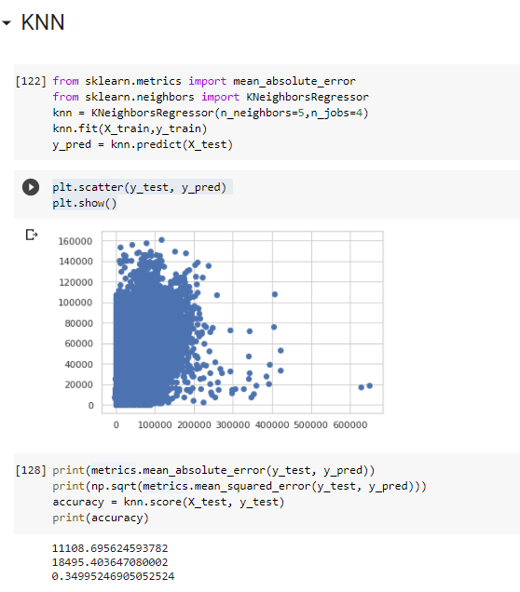

Slide 23
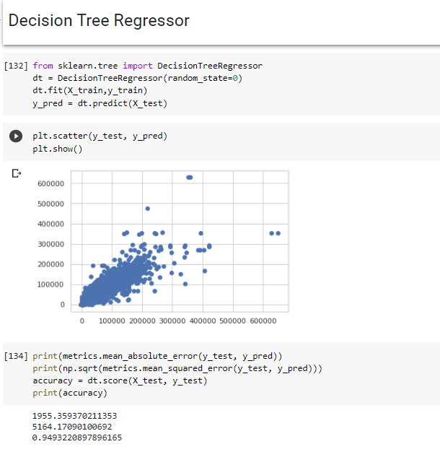

Slide 24
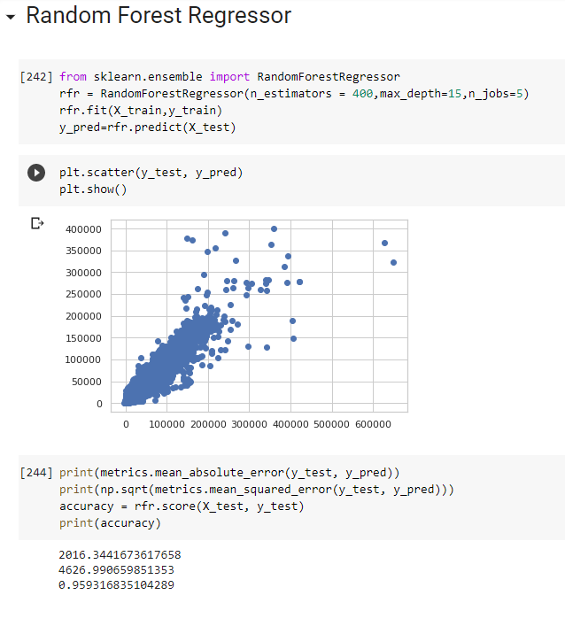

Slide 26
Model Comparison
Model | MAE | MSE | Accuracy
Linear Regression (Baseline) | 212586.233 | 423658.986 | 9%
KNNRegressor | 1108.6956 | 18495.40364 | 34.99%
DecisionTreeRegressor | 1955.3593 | 5164.1709 | 94.93%
RandomForestRegressor | 2016.3441 | 4626.9906 | 95.93%

Slide 27
Conclusion
The R2 score of MLR is just 0.09 and the difference between the actual and predicted value is high.
Why is this happening?
The features have no linear relationship with Weekly_Sales.
Features need to be further cleaned and engineered.
Thus Multiple Linear Regression is not the right model for this prediction.
Random ForestRegressor wins as it generally produces better results and work well on large dataset and is able to work with missing data by creating estimates for them.

