Slide 1


TOSCA
Tosca Best Practices

Slide 2
TOSCA BEST PRACTICES
1.New Project Process Overview 2.Prerequisites
Project Structure
Configuration Parameters
Mandatory Local Settings
Test Case Folder Structure
Modules Folder Structure
TestCaseDesign Folder Structure
Sandbox Test Case Creation & Review Process
Best Practice Guidelines
Test case best practices
Test case Recovery/Cleanup Scenarios
Module Best Practices
Test Case Design Best Practices
TDS Best Practices
High Level Test case Creation Process
Execution Process

Slide 3

TOSCA
New Project Process Overview
3

Slide 4
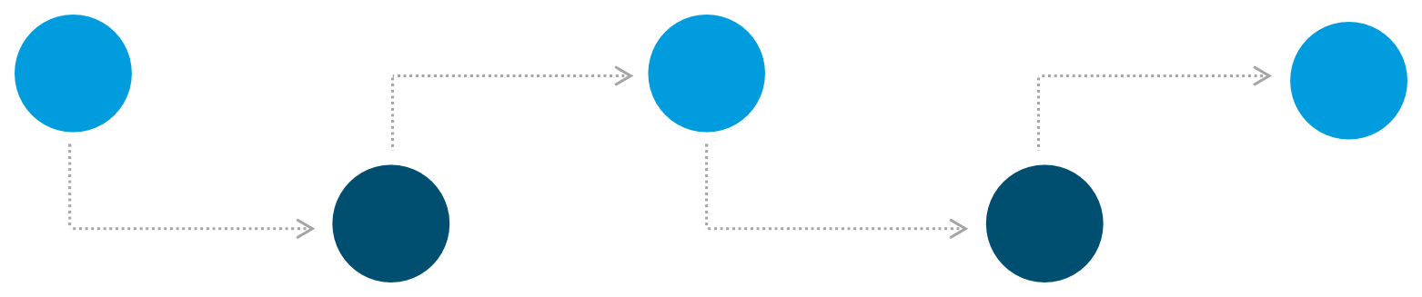
TOSCA SETUP
High Level Overview of Initial Tosca Project Setup: Phase 1
PREREQUISITES IN PLACE
Software Pre-requisites, Project Setup, Training
BEST PRACTICE GUIDELINES
Review and understand best practice guidelines for test case creation
IMPLEMENTATION REVIEW
Guided review of initial set of test cases. Implement ongoing review process
01
03
05
02
04
PROJECT STRUCTURE
Review and implement project template
AUTHOR INITIAL TEST CASES
Scope and develop an initial set of test cases according to best practices
6/24/2024 | 4

Slide 5
TOSCA
Prerequisites
5

Slide 6
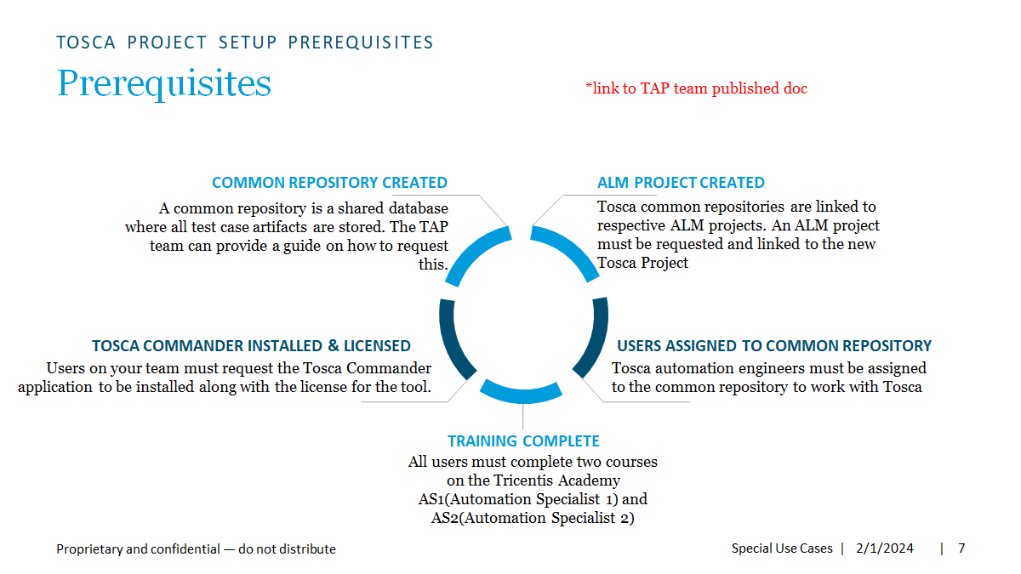
TOSCA PROJECT SETUP PREREQUISITES
Prerequisites
*link to TAP team published doc
COMMON REPOSITORY CREATED
A common repository is a shared database where all test case artifacts are stored. The TAP team can provide a guide on how to request this.
ALM PROJECT CREATED
Tosca common repositories are linked to ALM projects. An ALM project must be requested and linked to the new Tosca Project
TOSCA COMMANDER INSTALLED & LICENSED
Users on your team must request the Tosca commander application to be installed along with licenses for the tool
USERS ASSIGNED TO COMMON REPOSITORY
Users must be assigned to the common repository to work with Tosca
TRAINING COMPLETE
All users must complete two courses on the Tricentis Academy AS1(Automation Specialist 1) and AS2(Automation Specialist 2)
6/24/2024

Slide 7
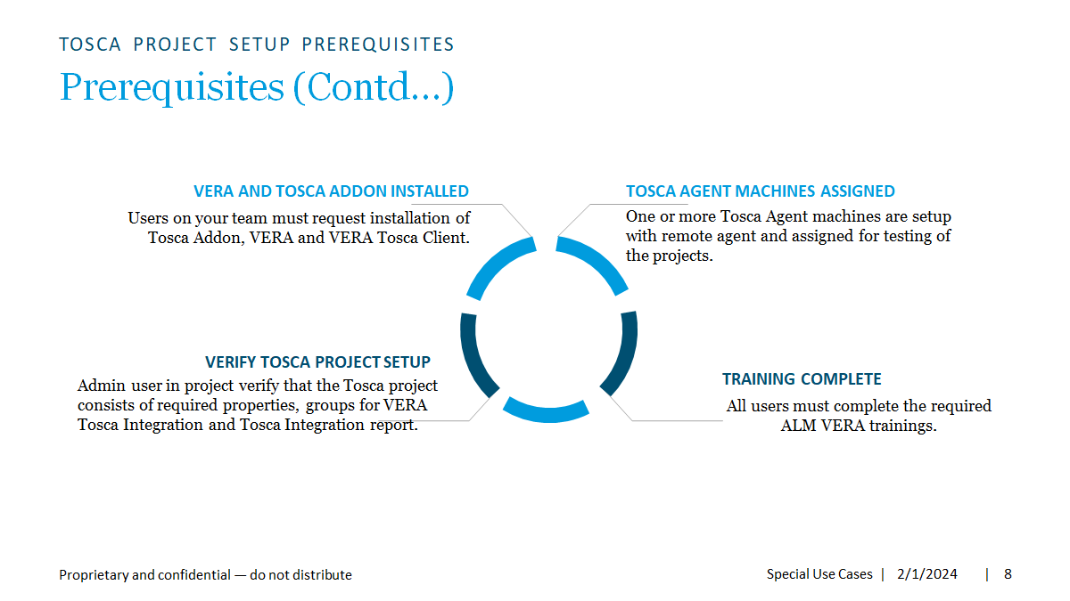
TOSCA PROJECT SETUP PREREQUISITES
Prerequisites
*link to TAP team published doc
COMMON REPOSITORY CREATED
A common repository is a shared database where all test case artifacts are stored. The TAP team can provide a guide on how to request this.
ALM PROJECT CREATED
Tosca common repositories are linked to ALM projects. An ALM project must be requested and linked to the new Tosca Project
TOSCA COMMANDER INSTALLED & LICENSED
Users on your team must request the Tosca commander application to be installed along with licenses for the tool
USERS ASSIGNED TO COMMON REPOSITORY
Users must be assigned to the common repository to work with Tosca
TRAINING COMPLETE
All users must complete two courses on the Tricentis Academy AS1(Automation Specialist 1) and AS2(Automation Specialist 2)
6/24/2024

Slide 8
Project Structure
TOSCA
8

Slide 9
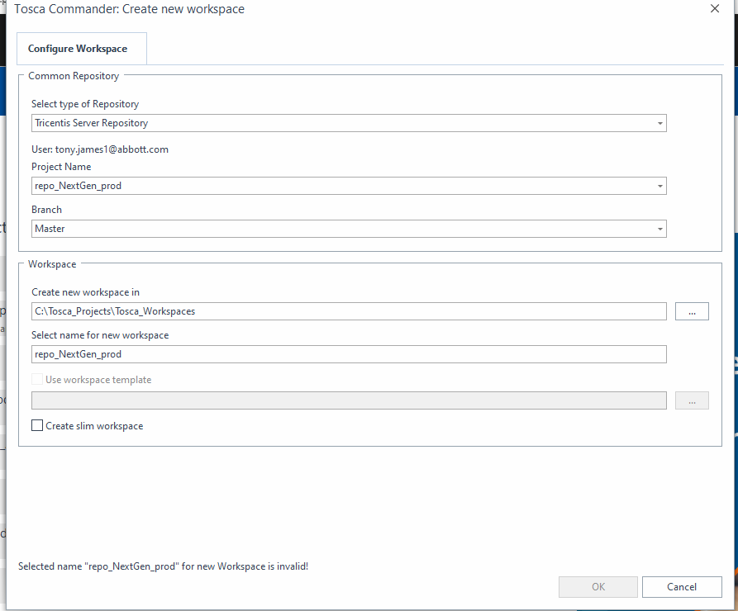
TOSCA PROJECT SETUP PROJECT STRUCTURE
Project Structure : Overview
Project Creation
Important Note: When Creating a new workspace
Ensure that “Create Slim Workspace” Is not
checked
9

Slide 10

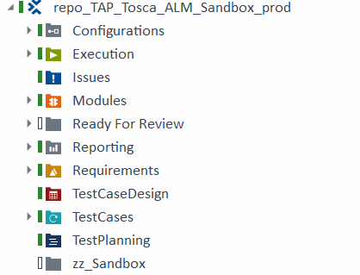
TOSCA PROJECT SETUP PROJECT STRUCTURE
Project Structure : Overview
Project Structure
Projects are organized on the root level with folders for each function in Tosca
The Key Folders Include:
TestCases
Modules
Execution Lists
TestCaseDesign
Ready For Review Folder
Sandbox working folders
Configurations
Mandatory (required)
TestDataService (optional)
Newly created projects will have example folder structures and configuration parameters aligned to this best practice documentation

Slide 11
Test Case Folder Structure
BEST PRACTICES GUIDELINES

Slide 12
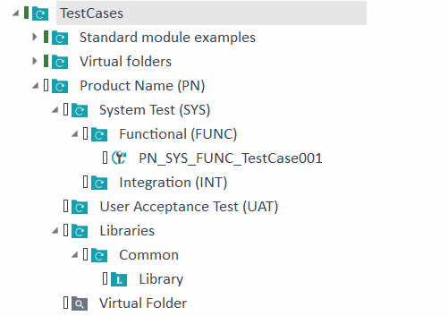
TOSCA PROJECT SETUP PROJECT STRUCTURE
Project Structure : Test Case Structure
Test Case Structure
Test Cases Are Organized In a Folder by Product with sub folders for testing type.
Test Case names should be prefixed with the paths from
the parent folders for reporting purposes.
A Libraries folder should exist containing sub folders with common and any additional required libraries.

Slide 13
Modules Folder Structure
BEST PRACTICES GUIDELINES

Slide 14

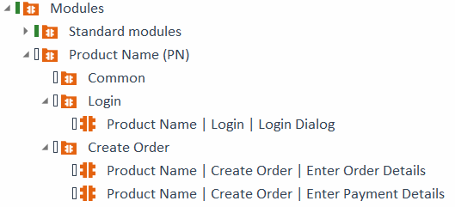
TOSCA PROJECT SETUP PROJECT STRUCTURE
Project Structure : Modules Folder Structure
Modules Folder Structure
Modules should be organized under an
application name folder.
Each application area and sub area should be child folders of the application folder.
Individual modules should use pipe (|) delimiters with the application name and subfolder names as part of the module name with the screen area name at the end

Slide 15
Test Case Design Folder Structure
BEST PRACTICES GUIDELINES

Slide 16
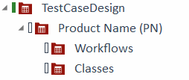
TOSCA PROJECT SETUP PROJECT STRUCTURE
Project Structure : Test Case Design Structure
Test Case Design Structure
Test Case Design should be organized under an application name folder.
The Workflows folder will contain test sheets associated with test cases
The Classes folder will contain reusable
classes used across multiple test sheets

Slide 17
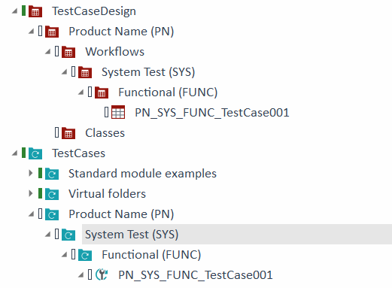
TOSCA PROJECT SETUP PROJECT STRUCTURE
Project Structure : Test Case Design Structure
Test Case Design Structure
Individual test sheets will follow the same folder structure and naming convention of the associated test case template.

Slide 18

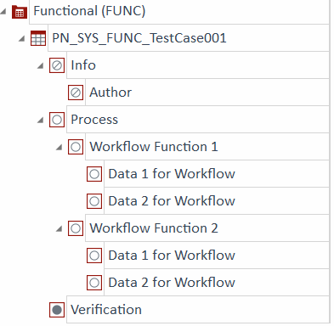
TOSCA PROJECT SETUP PROJECT STRUCTURE
Project Structure : Test Sheets
Test Sheets Structure
Individual test sheets should be split into these
sections:
Info – contains author name. Additional info attributes may be placed here
Process – any data associated with the
workflow of the test cases
Verification – any data that needs to be verified in the test case
Business relevance state of these should be toggled to match the screenshot on the right. This determines whether the data is relevant to the workflow of a test case, part of a verification or informational. The icons represent the state:

Slide 19
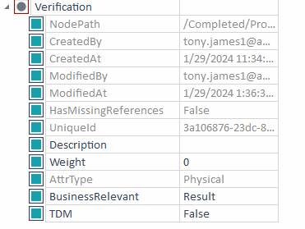
TOSCA PROJECT SETUP PROJECT STRUCTURE
Project Structure : Test Sheets
Test Sheets Structure
Business relevance types:
No (Not Relevant): Attributes used for informational nodes
Yes (Relevant) : Attributes which impact the workflow of a test case. These will be taken into account if you use “Generate Instances” for automated test data combination generation Result (Verification) : Attributes used for validation in your test case. These are not taken into account for combinations when generating instances
You may also View business relevance in the attribute properties

Slide 20
BEST PRACTICES GUIDELINES
Sandbox Test Case Creation & Review Process

Slide 21
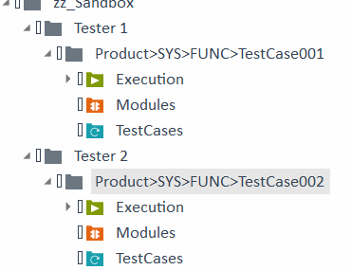
TOSCA PROJECT SETUP PROJECT STRUCTURE
Sandbox folder : Test Case Creation
Individual Sandbox Folders
Each tester will create their test cases/modules/execution lists in a sandbox folder with their name. The folder name should match the destination production folder path as outlined here.
This will contain a component folder for each test case they are working on. This component folder will be moved into the ready for review folder once it is ready to be reviewed.

Slide 22

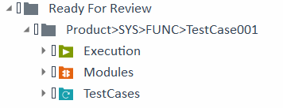
BEST PRACTICE GUIDELINES
Test Case Creation Process: Artifact Review
Artifact Review
Once artifacts are ready for review, all new associated artifacts will be put into a new review bundle component folder in the appropriate review folder.

Slide 23

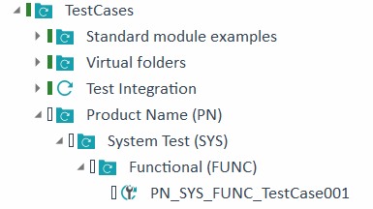

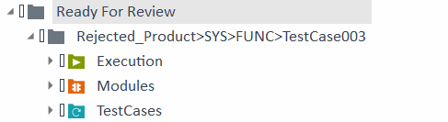
BEST PRACTICE GUIDELINES
Test Case Creation Process: Approval/Rejection
Approval / Rejection
Responsible lead/reviewer will review the artifacts in the review folders and promote them into the production folders once the artifacts are reviewed and approved.
Rejected bundles will be marked as
rejected.

Slide 24
Best Practice Guidelines
TOSCA
30

Slide 25
Test case best practices
BEST PRACTICES GUIDELINES

Slide 26

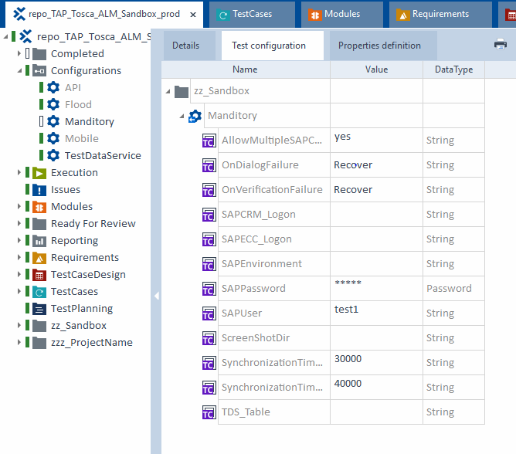
BEST PRACTICE GUIDELINES
Test Case Creation Process: Configuration Parameters
Configuration Parameters
Ensure that the mandatory configuration parameters are being applied to all areas within your project where test cases are stored.
If it is missing, you can drag it from the Configurations section into your gray component folders

Slide 27

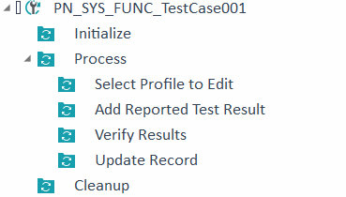
BEST PRACTICE GUIDELINES
Test Case Creation Process: Overall Folder Structure
Test Case Folder Structure
Individual Test Cases should have folders for the following Initialize – Execute any precondition steps to start the workflow such as opening a browser
Process – Core testing steps. Sub folders should be
descriptive of the business process.
Cleanup – Any cleanup activities such as closing an application to set the system under test back to the initial state
Within each of these folders, sub folders should be created
with descriptive names to describe business processes

Slide 28



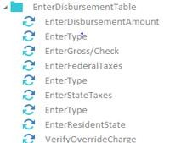
BEST PRACTICE GUIDELINES
Test Case Creation Process: Naming Conventions
Naming Conventions
It is important to Use Descriptive Names for Test Steps. A human should be able to look at a test step and immediately understand what it is doing. This helps when validating this step during approvals and understanding the workflow.
When more than one Test Step is used in a certain area, group together in a folder and rename to the action.

Slide 29
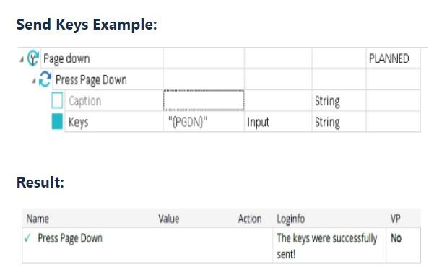
TOSCA PROJECT SETUP PROJECT STRUCTURE
Test Case Creation: TestCase Send Keys
Send Keys
Although the use of SEND KEYS is generally discouraged, there may be cases where it must be used. In order to have the SENDKEYS display properly in the report, the test step must be renamed to reflect the operation that is being performed (ex. Press Page Down).

Slide 30
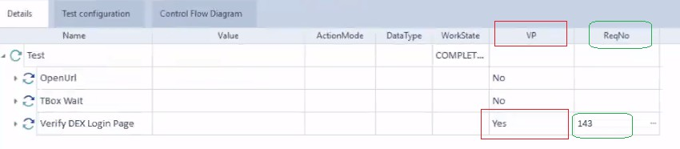
BEST PRACTICE GUIDELINES
Test Case Creation Process: VP and ReqNo
Test Step Properties
The VP property must be set to Yes for any steps which is being performed to verify a requirement. Specify the ALM Requirement ID the step is verifying in ReqNo field.
This Requirement (ReqNo) update at test step level will be displayed in ALM but as a best practice once the test is synchronized to ALM, Test Designer will link the requirement to test using ALM Requirement Traceability feature.

Slide 31
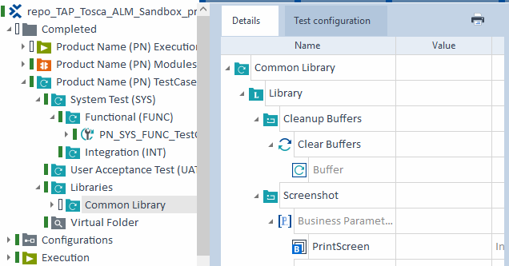
BEST PRACTICE GUIDELINES
Test Case Creation Process: Screenshots
Handling Screenshots
The initial project should include a screenshot reusable test step block. This uses the configuration parameter {CP[ScreenShotDir]} to store a screenshot of the verification step, using the test case name, the description you pass into this block as well as a timestamp
Make sure that the overall path should be less than 265 char to capture the screenshot in Tosca Integration Report

Slide 32
BEST PRACTICE GUIDELINES
Test Case Creation Process: Screenshots
Screenshot Dir Path
Tosca user should request and have access to the shared folder path for the project
Open the Run window from the start menu or by pressing the Win+R button.
Input the UNC paths below and click OK. Folders should look like below.
PROD: \\CWF105968P\data02$\Tosca-Test-Execution-Data-Prod\<Project_Name>
QA: \\CWF105968P\data02$\Tosca-Test-Execution-Data\<Project_Name>

Slide 33
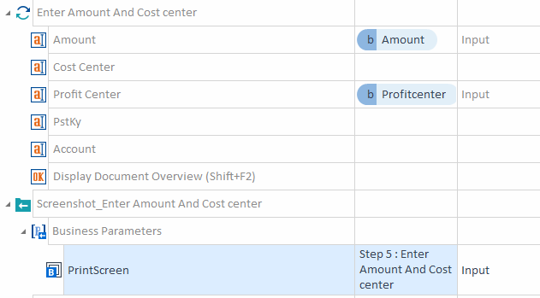
BEST PRACTICE GUIDELINES
Test Case Creation Process: Screenshots cont.
Handling Screenshots
When VP is set to Yes, a screenshot should be taken. The standard module, Tbox Take Screenshot should be used.
Any step that verifies a requirement should include a screenshot immediately after the step which needs to be validated.
You should use the provided Reusable Test Step Block for recording screenshots
Screenshot steps should be named “Screenshot_ description of verification”
A description of what is being validated should be
passed into the screenshot as a business parameter

Slide 34
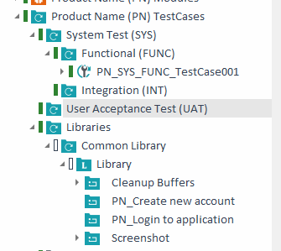
BEST PRACTICE GUIDELINES
Test Case Creation Process: Reusable Test Step Blocks
Reusable Test Step Blocks
Reusable Test Step blocks should be used for any functionality used in more than one test case.
There should be a Common Library in the Libraries folder with common functions such as login, screenshot etc.
Library blocks should be prefixed with app prefix and be descriptive of the step being performed
Additional Library folders may be created in the “Libraries” folder to group associated blocks.

Slide 35

BEST PRACTICE GUIDELINES
Test Case Creation Process: Action Mode WaitOn
Action Mode WaitOn
Use dynamic wait with action mode WaitOn rather than static waits whenever possible to maximize the speed of execution

Slide 36
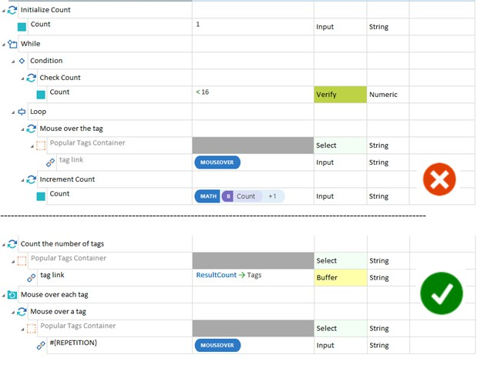
Test Case Creation Process: Repetitions
BEST PRACTICE GUIDELINES
Action Mode WaitOn
Use ResultCount step and Repetitions folder instead of FOR Loop structure (Combining counter variable with WHILE or DO statement).

Slide 37
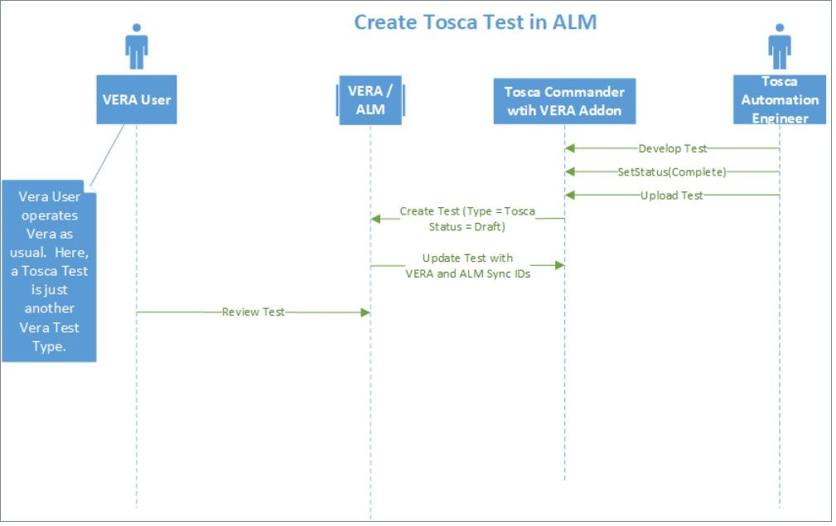
BEST PRACTICE GUIDELINES
ALM VERA Tosca Test Case
Once uploaded, VERA and ALM ID's are saved to the Tosca Item and the Tosca ID is saved to the ALM item. When action is completed, items are considered "linked" and the Tosca Item can now be controlled by ALM.

Slide 38
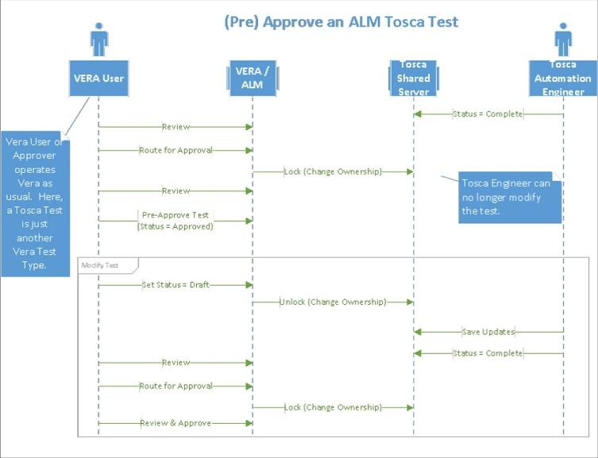
ALM VERA Tosca Test Case
BEST PRACTICE GUIDELINES

Slide 39
TOSCA SETUP
High Level Overview of Test Case Approval
CREATE IN SANDBOX
Initial test case/module/execution list created in sandbox folder
INTEGRATE APPROVED TEST CASES
Automation Lead marks the Status property to COMPLETE. Approved test cases are linked to ALM.
01
03
02
04
TEST CASE REVIEW
Lead/approver reviews all artifacts and moves them from the ready for review folder to the completed folder if approved or marks them as rejected if rejected
VALIDATE TEST CASES WITH DEX
Validate test cases on an execution list with
Distributed Execution

Slide 40
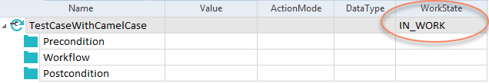
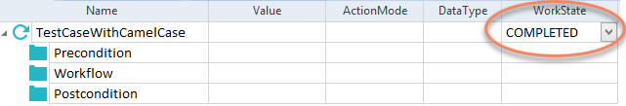
BEST PRACTICE GUIDELINES
Test Case Creation Process: Workstate
WorkState Property
Test Case Work State field needs to be utilized. While being worked on,
“IN_WORK” is to be used
When work is done, it is to be marked “COMPLETED”:

Slide 41
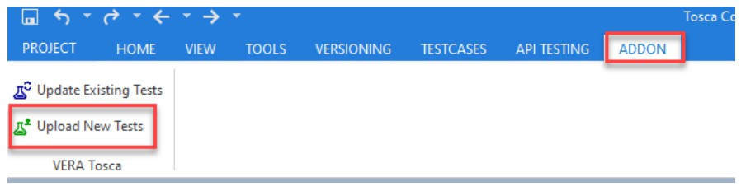
BEST PRACTICE GUIDELINES
Test Case Creation Process: Upload Test to ALM
Approval / Rejection
Responsible lead/reviewer will
set the reviewed test case property Status as "COMPLETE" in production folders.
The Completed folder should be comprised only of those Test Cases that have been through the review process and have been deemed to meet established standards and best practices, then synchronized to ALM. When ExecutionLists are created, these are the only tests that are eligible for inclusion.

Slide 42
BEST PRACTICE GUIDELINES
Test Case Creation Process: Upload Test to ALM
TQL Query
The test uploaded to ALM will be linked within both systems and VERASyncID & ALMTestID will be populated within Tosca and VERASyncID & Tosca ID will be populated in
ALM. Make sure that user should not edit the values for properties mentioned above in Tosca.
It is recommended that a TQL query be used to monitor tests that have been moved into Completed folder, but the required synchronization or updates/re-synchronization has not yet been performed.
This query should be performed regularly.

Slide 43
Test Case Creation Process: Upload Test to ALM
BEST PRACTICE GUIDELINES
Default Filtering
Tests will only appear in the list if all conditions are true:
Vera Sync ID property value is blank
ALM Test ID property value is blank
Status property value is set to Completed
Owning Group property value is NOT set to the ALM Locking Owner Group
Test Case is currently checked in
Example TQL Query:
=>SUBPARTS:TestCase[(ALMTestID=="") AND (VeraSyncId=="") AND
(TestCaseWorkState=="COMPLETED") AND (OwningGroupName!="ALM Lock")
AND (CheckOutState!="CheckedOut")]

Slide 44
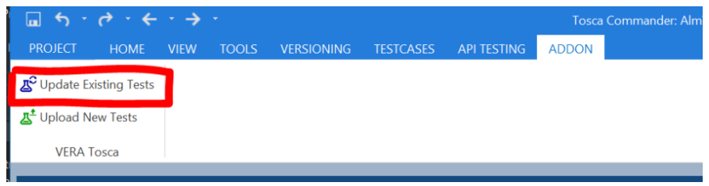
BEST PRACTICE GUIDELINES
Test Case Creation Process: Update ALM Tosca Test
Reviewer/Lead will change the status of the test case in Tosca to "IN_WORK" and move the test to the respective IN_WORK folder for automation engineer to update the test case.
Once the automation engineer completes the process and reviewer moves the updated test case
back to COMPLETED folder and change the status to "COMPLETE"
Use the "Update Existing Tests" button in Tosca Addon to sync the updated test to ALM

Slide 45
Test Case Creation Process: Update ALM Tosca Test
BEST PRACTICE GUIDELINES
Default Filtering
Tests will only appear if all the conditions are true:
Vera Sync ID property value is NOT blank
ALM Test ID property value is NOT blank
Status property value is set to Completed
Owning Group property value is NOT set to the ALM Locking Owner Group
Test Case is currently checked in
Example TQL Query:
=>SUBPARTS:TestCase[(ALMTestID!="") AND (VeraSyncId!="") AND
(TestCaseWorkState=="COMPLETED") AND (OwningGroupName!="ALM Lock")
AND (CheckOutState!="CheckedOut")]

Slide 46
BEST PRACTICE GUIDELINES
Test Case Creation Process: Approve ALM Tosca Test
Start Approval Route
Login to ALM as a user with permissions to create test and able to access the associated Tosca Test Case. (i.e. has a Tosca account, as the user is prompted for Tosca credentials.)
In the Test Plan module, navigate to the appropriate folder and select a TOSCA Test. View the TOSCA Test Steps memo field to view the Tosca Test in ALM.
Route the Test for Approval by clicking VERA's "Go" button then the "Start Approval Route(s) button"

Slide 47
BEST PRACTICE GUIDELINES
Test Case Creation Process: Approve ALM Tosca Test
Approve a VERA Tosca Test in ALM
Tosca automated steps are stored and displayed in the 'TOSCA Test Steps' tab in ALM.
Once a test is routed for approval the test will be in "Routing for Approval" state in ALM and locked in Tosca and ALM for any updates.
View the TOSCA Test Steps memo field to view the Tosca Test in ALM. To Approve a VERA-Tosca Test:
Login to the project as an Approver
Navigate to, and select the Test
Review the Details tab, comments, etc.
Click the 'TOSCA Test Steps' tab to review the Tosca Test steps created for this test.
Once reviewed, click the VERA "Go" toolbar button to perform the appropriate action.

Slide 48
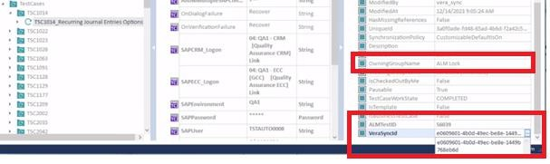
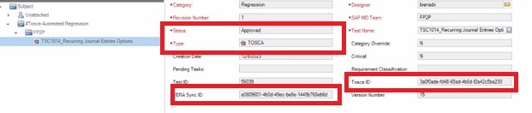
BEST PRACTICE GUIDELINES
Test Case Creation Process: Approve ALM Tosca Test
Approved ALM VERA-Tosca Test
Once the final approval is applied to ALM VERA Tosca test in ALM, the Test status becomes "Approved".
The test will be in "Approved" state in ALM and locked in Tosca and ALM for any updates.

Slide 49
BEST PRACTICE GUIDELINES
Test Case Creation Process: Copy Test Case
Copy Tosca Test Case
In the VERA-Tosca Integration, there is a one-to-one correspondence between VERA entities and Tosca entities. That is, a Tosca Test can be associated with one, and only one, Tosca Test Case
Automation engineers should avoid copying a test case object. Instead, create a new Test
Case object, then copy the Test Steps in the source Test Case to the new Test Case. This will ensure all control fields in the new Test Case are at their initial states, ready to be associated with a new VERA Test.

Slide 50
BEST PRACTICE GUIDELINES
Test Case Creation Process: Revise Test Case
Revise ALM Linked Tosca Test
To update the approved linked ALM Tosca test, User with Test Designer/Test Manager permissions in ALM will use VERA Revise operation to set the Tosca test back to "Draft" state. Revise action will unlock the Tosca test and change the Owning Group property for Tosca test from ALM Lock in Tosca.
Once test is revised and editable, Follow the process for Update ALM Tosca Test.
Test must be re-routed through the full approval process before becoming Approved again in VERA.

Slide 51
BEST PRACTICE GUIDELINES
Test Case Creation Process: ALM VERA Actions
VERA Actions
Cancel/Uncancel Test Case:
Use the VERA Go button to 'Cancel' a Test Case. This prevents further operations to be performed on the Test Case.
Undo a Cancel operation by clicking the VERA Go button and select 'Uncancel'. This sets the
Test Case status back to 'Draft'.
Smart Delete Test Case:
This option is available in cases when test case has not been executed but as a best practice users should avoid deletion of test case since extra steps need to be performed in Tosca as it leaves associated Tosca object locked.
Before deleting the ALM Test Case, note its "Tosca ID" value. After deleting the ALM Test, have an Admin log in to Tosca and clear the associated Test Case ALM ID & Vera Synchronization values, and set its owning group back to a group that allows editing. Alternatively, have the Admin delete the Test Case in Tosca, if desired.

Slide 52
BEST PRACTICES GUIDELINES
Test case Recovery/Cleanup Scenarios

Slide 53
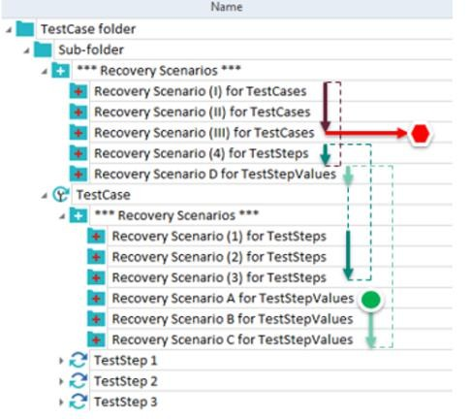
BEST PRACTICE GUIDELINES
Test Case Creation Process: Recovery Scenario
Recovery Scenario
Recovery Scenario is a collection of TestSteps that Tosca executes if a test case or test step fails.
They can be set to execute on the Test Case, Test Step or Test Step Value level. Typically Test Step is used for recovery scenarios.
Recovery Scenarios are executed from the Test Case and then proceed up the directory chain for each Recovery Type. Lower-level directory scenarios are executed first. Test Step Value Scenarios are executed first then Test Step and then Test Case scenarios.

Slide 54
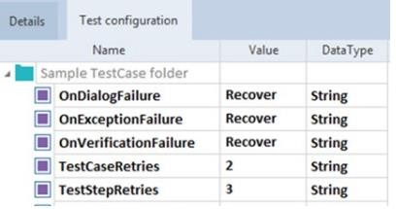
BEST PRACTICE GUIDELINES
Test Case Creation Process: Recovery Scenario
Recovery Scenario
Recovery scenarios are only triggered in Execution Lists. They will not trigger in scratchbook.
Triggering only happens if OnDialogFailure, OnExceptionFailure, or OnVerificationFailure Configuration parameters are set to Recover

Slide 55
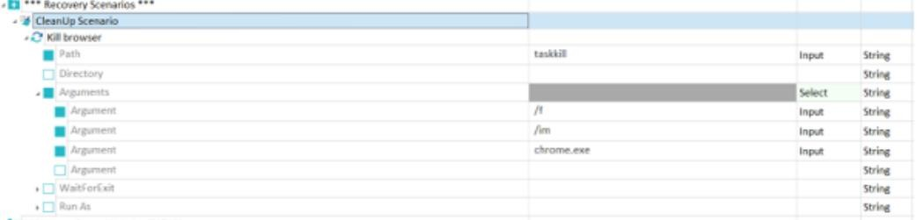
BEST PRACTICE GUIDELINES
Test Case Creation Process: Cleanup Scenario
Cleanup Scenario
CleanUp Scenarios are executed when all Recovery Scenarios have attempted to execute but have failed. The purpose of CleanUp scenarios are to reset the application/environment to a state where the next test case can begin execution.

Slide 56
Test Case Creation Process: Recovery/Cleanup Scenario
BEST PRACTICE GUIDELINES
Naming Convention
For recovery scenario the name should be descriptive and have one of below Prefixes:
TestCase Recovery - TC_ (For Test case retry level)
TestStep Recovery - TS_ (For Test Step retry level)
TestStepValue Recovery - TSV_ (For Test Step Value retry level) Cleanup Scenario
The name for Cleanup scenario should be descriptive of what it does

Slide 57
Module best practices
BEST PRACTICES GUIDELINES

Slide 58
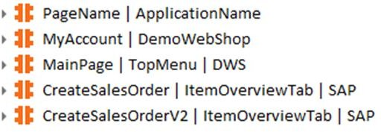
TOSCA SETUP
Module Modification Workflow
Use the following process to modify existing modules:
COPY EXISTING MODULE
Copy and Paste the existing module into your sandbox working folder
MAKE UPDATES & SUBMIT FOR APPROVAL
Once module updates have been made/tested, submit the module for approval in the ready for review folder
01
03
02
04
ADD VERSION NUMBER
Add a version number to the name of the
Module, such as V2 or v1.2
APPROVE / REJECT MODULES
Approver merges the module with the original module if approved or marks the folder as rejected if the module is rejected.

Slide 59
Module Best Practices
BEST PRACTICE GUIDELINES
General Guidelines
Use only unique technical properties which are not likely to change between runs
Avoid any dynamic values
Use descriptive naming conventions
Module name structure needs to consist of the application it’s used for, when applicable the section or functionality group used, and what the module drives.

Slide 60
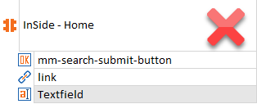
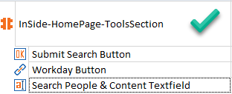
Module Best Practices
BEST PRACTICE GUIDELINES
General Guidelines
Module Attributes should be renamed to the element they steer. Should not say “Link”, “Textfield”, or left with programmed details instead should say “Workday Button”, “Search People & Content Textfield” or “Submit Search Button”. See Below:

Slide 61
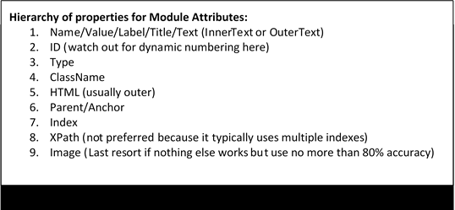
Module Best Practices
BEST PRACTICE GUIDELINES
General Guidelines
Module Attributes need to be uniquely identified. See hierarchy of properties below. The lower number properties should be prioritized

Slide 62
Module Best Practices
BEST PRACTICE GUIDELINES
General Guidelines
Importing subsets into the repository should be avoided as the process creates several duplicate standard modules.
If importing subsets can not be avoided, make sure to click the Merge button when prompted so that you eliminate any duplicate standard modules.
Duplicate modules should not exist, likewise unused modules should not be in the repository. Duplicate modules need to be merged, then if this does not delete the duplicate module, it needs to be deleted if not needed.

Slide 63
Test Case Design best practices
BEST PRACTICES GUIDELINES

Slide 64


TOSCA PROJECT SETUP PROJECT STRUCTURE
Test Case Design best practices
TCD General Best Practices
Process
Each Test Sheet should only be used for one template.
Make sure the number of Test Sheet Instances is no more than what is necessary.
If applicable, fill out any needed Custom Fields for any new Test Sheets you create:

Slide 65
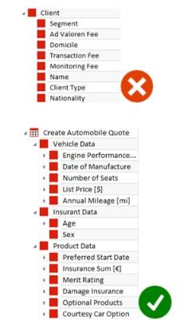
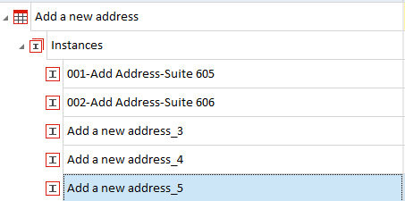
TOSCA PROJECT SETUP PROJECT STRUCTURE
Test Case Design best practices
TCD General Best Practices
Use high-level attributes to organize if you have many attributes.
Do not try to keep all your attributes at the same structural level
Do not leave Test Instances with default name, provide them with a meaningful name based on the scenario

Slide 66
TDS Best Practices
BEST PRACTICES GUIDELINES

Slide 67
BEST PRACTICE GUIDELINES
TDS Best Practices
General Guidelines
Tricentis Tosca Test Data Service (TDS) is a web-based application that enables you to manage your test data in distributed environments. TDS has tables similar to a database and can store persistent data between test case runs.
Typically used for:
Data needs to be shared between test cases
Data needs to be preloaded
System data/Master data that varies between environments
Consumable data
Alternative to Excel, faster runtime. Excel can be loaded into TDS and it is faster.

Slide 68
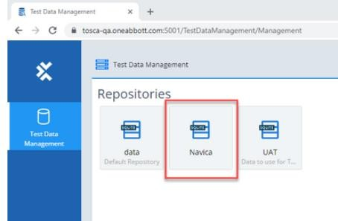
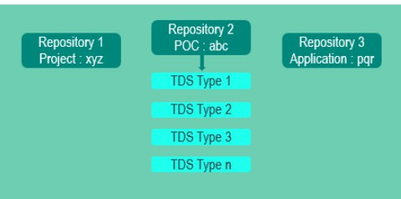
BEST PRACTICE GUIDELINES
TDS Best Practices
TDS Repositories
To use TDS a repository needs to be created on Tosca Server. There can be a repository created on an
application level or business unit level depending on the size of the application:
Each repository can contain multiple “Types” which are equivalent to tables. These can store test data for your test cases

Slide 69
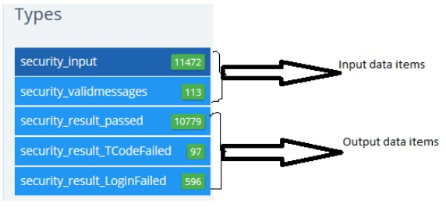
BEST PRACTICE GUIDELINES
TDS Best Practices
TDS Repositories
Always Label the TDS Types between the Input data items and the Output data items. When the data
type is used for both input and output, then Input and Out labels are not required

Slide 70
BEST PRACTICE GUIDELINES
TDS Best Practices
General Guidelines
Standard Modules in TDS:
TestData - Find & provide record: This module can be used to Find particular record/s based on the requirement criteria
TestData - Create & provide new record: This module can be used to create a New TDS Type and insert record/s
TestData - Update Record: This module can be used to update an existing record in TDS
TestData - Move record to TDS type: This module can be used to have a similar TDS type to serve the different purpose
TestData - Delete Record: This module can be used to delete specific record/s based on the requirement criteria
TestData - Expert Module: DO NOT USE THIS METHOD. This module can be used to perform above listed all activities with the help of a single module and property which is 'Test Data Task*' , The use of 'DeleteAll' module is prohibited in the Production environment as this will delete the entire TDS content
TestData - Import items: Use whenever you want to import any csv/excel input data file TestData - Export items: Use whenever you want to export TDS Result set into any csv/excel file TestData - Update Type: Use whenever you want to update an already existing TDS Type

Slide 71

BEST PRACTICE GUIDELINES
TDS Best Practices
Repositories
Naming Convention of Types
Naming convention for any TDS Type to be followed as below:
<Shortname of the Project><Input/Output><Functionality of the TDS Type)
Required columns (e.g. State_Status)
Keep the column 'State/Status' to traverse through the TDS Input/Source Data along with all the
columns
Initial value of the column 'State/Status' should be 'New' as it is newly loaded data to TDS and not yet processed
Once after the record has been executed by TDS, status needs to be changed to 'Processed'

Slide 72
BEST PRACTICES GUIDELINES
High Level Test case creation process

Slide 73
BEST PRACTICE GUIDELINES
Test Case Creation Process: General guidelines
General guidelines
Plan well. Follow standards for organizing Test Cases, Test Steps, and Input Data.
In general, author tests in smaller, rather than larger, reusable chunks.
Use VERA ADDON in Tosca to create Tests, associating each with the corresponding Tosca
item. (Tosca Account required: Yes)

Slide 74
High Level Test Case Creation Process
BEST PRACTICES GUIDELINES
TEST CASE CREATION WORKFLOW
Scope out testing on a whiteboard and organize into workflows and functions that are used in your tests
Create a test case and create folders for the various functions your tests will perform and test them using sample data
Remove the data from the Blocks and replace them with Business Parameters by dropping the Module Attributes on the Business Parameter group
Create Test Case Templates based on your workflows using the Library Blocks you created to represent the functions of the system
Create Test Sheets with one instance of Straight Through (“Happy Path”) data using the Business Parameters from
the Templates to create the Attributes for each test sheet
Drop the test sheets on their respective Templates and the Attributes from the Test Sheets will be automatically referenced by the Business Parameters in the Templates
Instantiate the Templates to create the first Test Case Instance for each Template
Add additional Instances to the Test Sheets using data provided by business SMEs and then re-instantiate the
Instance folders and the new Test Case Instances will automatically be generated
24-Jun-24 | 82

Slide 75
Test Case Creation Process: 1. Design
BEST PRACTICE GUIDELINES
Design
Scope out testing on a whiteboard/workflow tool and organize into workflows and functions that are used in your tests
Let's take an example test case which seeks to open an application, add a new address and then delete the address
First, we need to design the flow so we can define our functions
Open Browser and Launch Website
Login as Registered User
Navigate to My Account
Click Address and Add New
Enter Address Data and Save
Verify New Address and Delete
Logout and Close Browser

Slide 76

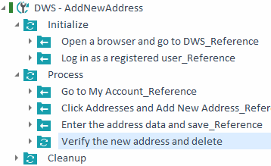
BEST PRACTICE GUIDELINES
Test Case Creation Process: 2. Process Folders
Process Folders
Create a test case and create folders for the various functions your tests will perform and test them using sample data.
Test should be organized on the highest level
by:
Initialize, Process and Cleanup
Reusable blocks may be used for control flow through the application, but verification steps may not be RTBs. This is because RTBs cannot be linked to requirements.
Ensure screenshots are added for validation steps as described in the best practices section of this document
Verify the test case works with hard coded data by running in scratchbook before proceeding

Slide 77
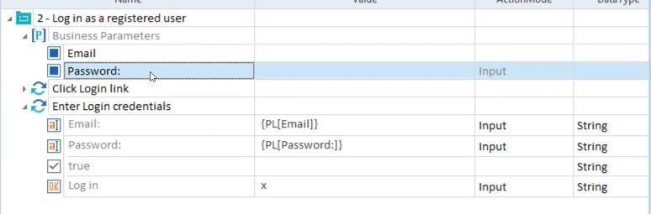
BEST PRACTICE GUIDELINES
Test Case Creation Process: 3. Business Parameters
Business Parameters
For any reusable test step blocks, remove the data from the Blocks and replace them with Business Parameters by dropping the Module Attributes on the Business Parameter group

Slide 78

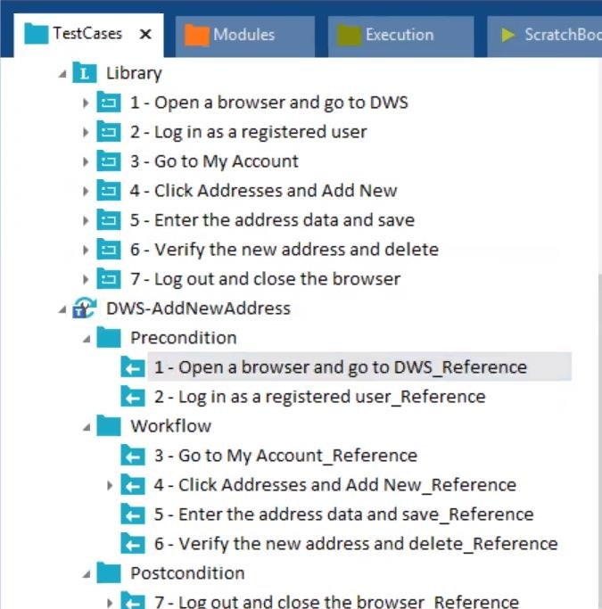
BEST PRACTICE GUIDELINES
Test Case Creation Process: 4. Test Case Templates
Test Case Templates
Convert your test case into a test case template so that it can be data driven with Test Case Design sheets.

Slide 79

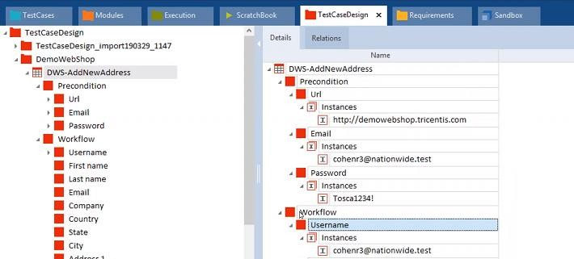
BEST PRACTICE GUIDELINES
Test Case Creation Process: 5. Happy Path
Happy Path
Create Test Sheets with one instance of Straight Through (“Happy Path”) data using the Business Parameters from the Templates to create the Attributes for each test sheet

Slide 80
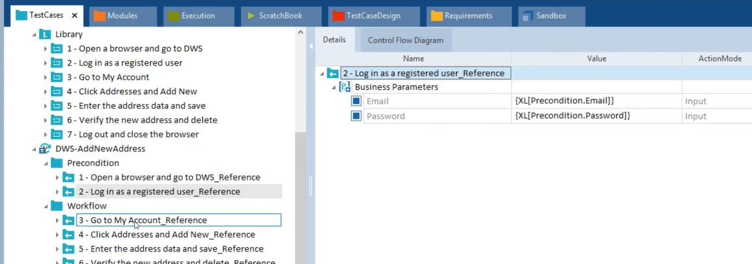
BEST PRACTICE GUIDELINES
Test Case Creation Process: 6. Link Test Data Sheets
Link Test Data Sheets
Drop the test sheets on their respective Templates and the Attributes from the Test Sheets will be automatically referenced by the Business Parameters in the Templates

Slide 81
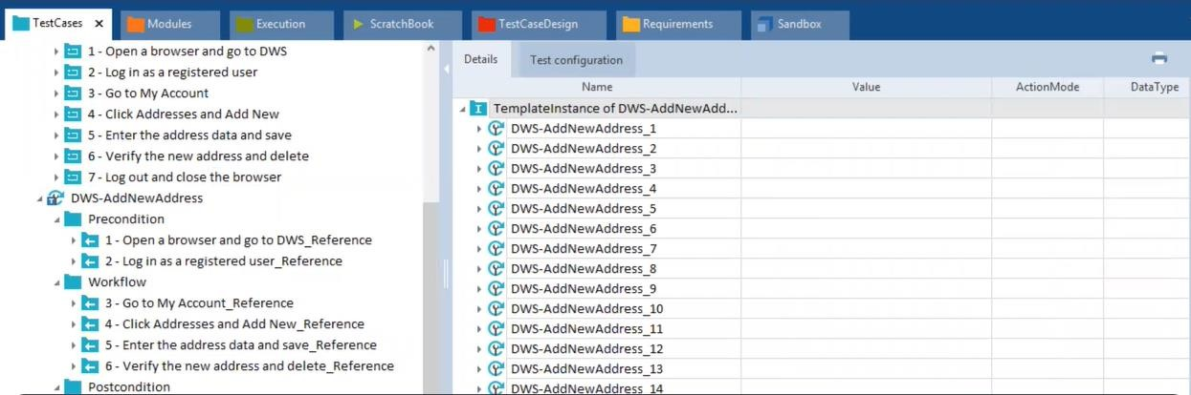
BEST PRACTICE GUIDELINES
Test Case Creation Process: 7. Instantiate Templates
Link Test Data Sheets
Instantiate the Templates to create the first Test Case Instance for each Template

Slide 82

BEST PRACTICE GUIDELINES
Test Case Creation Process: 8. Add Data Variations
Add Data Variations
Add additional Instances to the Test Sheets using data provided by business SMEs and then re- instantiate the Instance folders and the new Test Case Instances will automatically be generated

Slide 83
Execution best practices
BEST PRACTICES GUIDELINES

Slide 84


BEST PRACTICE GUIDELINES
Execution Best Practices
Execution Best Practices
The Execution Directory Structure will be created by the Ops Admin when the Tosca Project is created. The Execution Directory Structure must be recreated by the Test Lead for each subsequent Release.
Folders and Execution Lists must be organized by functionality with a meaningful name.
Only Testcases/Instances with “COMPLETED” Work State are to be used within Execution Lists, and every Test Case/TestCase-Instance should be put into an Execution List.

Slide 85
BEST PRACTICES GUIDELINES
Tosca Execution List/ALM Test Set

Slide 86

TOSCA SETUP
High Level Overview of Initial Tosca Project Setup: Phase 2 (WIP)
VALIDATE TEST CASES ON UNATTENDED
EXECUTION VIA ALM
Sync Execution Lists to ALM, Review the execution flow and execute tests with ALM VERA Tosca.
SYNC TEST CASES TO ALM/VERA
Ensure all test cases are synced with Vera and
are set up to follow Vera approval workflow
01
03
02
04
VALIDATE AUDIT REQUIREMENTS
Validate required audit requirements such as screenshots are attached for tests and approve tests with VERA.
VALIDATE EXECUTION
Review executed tests and ensure that linked requirements are met.
6/24/2024 | 94

Slide 87

Tosca Execution List: Create and Execute
BEST PRACTICE GUIDELINES
Sequence Diagram

Slide 88

BEST PRACTICE GUIDELINES
Tosca Execution List: Approve
Sequence Diagram

Slide 89
BEST PRACTICE GUIDELINES
Tosca Execution List: Test Event
Create Tosca Test Event
To execute the execution list on DEX, The test event should be created in the Test Event folder under the same parent Execution folder as the Execution List folder where the execution list resides.
From Commander, on your local desktop, create a Test Event, drag the Execution List
into it, along with a Configuration for the project, and verify it remotely executes.
The Integration requires a Test Event to be named the same as the ExecutionList. The Test Event is required to include the ExecutionList
Verify that ALMProject and HostName configurations are populated.

Slide 90
BEST PRACTICE GUIDELINES
Tosca Execution List: Tosca Agent (DEX)
Prepare DEX for Execution
Make sure execution list runs on target Tosca Agent machines.
If just setting up target machines for a project, log on to each. Answer first time Windows prompts such as asking about security choices in Internet Explorer. In Tosca Commander, run a representative Execution List for the target project on agent machine.
ToscaRemoteAgent.exe does not run as a service. It runs as a standard Windows executable and, therefore, requires an active Windows session to run Tosca Test Events.
Make sure the Agent machine has:
All required software, files, access to data, etc.
Workspace configured for the target project
Parameter configured identifying the machine as able to run the project
Status indicator in the System Tray showing as green – any other color indicates that a script may not run remotely on the machine.

Slide 91



BEST PRACTICE GUIDELINES
Tosca Execution List: ExecListWorkstate
COMPLETED state
In Tosca, create an Execution List. The Execution List contains any number of Tosca Test cases to run and achieve an objective.
Execution List Work State field needs to be utilized. While being worked on, “IN_WORK” is to be used.
When work is done, it is to be marked “COMPLETED” by Automation Lead/Reviewer and ExecutionLists marked as completed can be synchronized to ALM

Slide 92
BEST PRACTICE GUIDELINES
Tosca Execution List: Preparation
Best Practices – Execution
Before creating a VERA-Tosca Test Set and associating it with a Tosca Execution List, fully test the Execution List, verifying it runs successfully on target Tosca Agent machines. Then, set the ExecListWorkstate field to "COMPLETED".
To prepare for controlling a Test Set from VERA so that VERA can run and collect results
for formal review/approval, perform the following steps:
Make sure included tests abide by Best Practices
Develop the Execution List and make sure it runs on your local desktop before sync'd to ALM.
Make sure it runs repeatedly, over time on agent machines (i.e. it runs repeatedly
today, it runs tomorrow, and the next day).
Make sure that Execution Lists are created to execute a business process. Avoid creating 1 execution list for the complete regression, sprint or release suite.

Slide 93
BEST PRACTICE GUIDELINES
Tosca Execution Lists: Upload to ALM
Create Test Set
With VERA-Tosca Test Sets, do not drag tests, from the Test Plan module, into a Test Set to build a list of Test Instances – the Test Sets are built and synchronized from Tosca Execution Lists.
The execution list uploaded to ALM will be linked within both systems and VERASyncID & ALMTestSetID will be populated within Tosca and VERASyncID & Tosca ID will be populated in ALM.
Do not edit the VERASyncID and ALMTestSetID properties value from Tosca.
IMPORTANT: a VERA Test must exist in ALM's Test Plan module before the VERA Tosca Test
Set can be created containing that test reference.

Slide 94

BEST PRACTICE GUIDELINES
Tosca Execution Lists: Upload to ALM
Tosca Interface in Test Lab
Once verified that the Execution List runs successfully in Tosca, and its ExecListWorkstate field is set to "COMPLETED", log into ALM and create a Tosca Test Set by performing these steps:
Select the target Test Lab folder and click the Tosca tool bar button. The Tosca Action Menu displays.
Click 'Create Test Set'. If this button is disabled, hover the move over it to see why.
Enter Tosca credentials, if prompted. In the selection dialog, select the Execution List to associate with the VERA Test Set. The Test Set is created along with Test Instances for each Test in the Execution List.
Click the ALM 'Refresh' button to view the test set.
A screen refresh is required, to see updates. Click 'Refresh' to update the screen

Slide 95

BEST PRACTICE GUIDELINES
Tosca Execution Lists: Upload to ALM
Test Set Fields/Properties
The Test Set status is set to 'Draft' and it is now associated with the Execution List in Tosca.
Additionally, its name and Description field values are copied from the Execution List's Name and Description field.
Before executing a Test Set from ALM, make sure that, in Tosca, there is a Test Event by the same name in the closest "Test Events" root folder.
To execute/run the Test Set its status must be set
to "Ready for Execution". Use the VERA "Go" toolbar button to change the Test Set status to allow Test Set execution.

Slide 96

BEST PRACTICE GUIDELINES
Tosca Execution List: Update Tosca Test Set
To update the Tosca Execution List change the ExecListWorkState to 'IN_WORK'. Once the automation engineer completes the change, update the state to "COMPLETED"
To reflect Tosca changes in ALM, select the Test Set and click the Tosca toolbar button. In the Tosca Action Menu, click "Update Test Set". Enter Tosca credentials, if prompted.
If the "Update Test Set" button is disabled, hover the mouse over it to see why.

Slide 97

BEST PRACTICE GUIDELINES
Tosca Execution List: Ready for Execution
Start Test Set
Login to ALM as a user with permissions to create test set and able to access the associated Tosca Test Set. (i.e. has a Tosca account, as the user is prompted for Tosca credentials.)
In the Test Lab module, navigate to the appropriate folder and select a TOSCA Test Set. View the Test Instances, Execution List fields to review.
Change the status of Test Set to Ready for Execution by clicking VERA's "Go" button then the "Start Test Set(s) button"

Slide 98
BEST PRACTICE GUIDELINES
Tosca Execution List: Prepare for Execution
Tosca Configurations
Verify that Execution List executes as expected on one or more target machines.
Instruct Tosca to send ExecutionLists to specific machines by using Tosca "Configurations". If you do not include a Configuration in the target Test Event, Tosca sends the ExecutionList to ANY available remote Agent for execution.
Tosca attempts to find machines that match the parameters in your Test Event's Configuration with parameter settings on the Remote Agent machine. Make sure that "ALMProject" and "HostName" configurations are set correctly.
Verify target remote machines are up and running. Typically, this is done in Tosca Commander, navigating to the correct "Configurations" object, right-clicking, and selecting "Refresh Agents". If your target Agent machine shows Green (Idle) or Orange (Executing), your Agent is ready to accept your request to Run a Test Set.

Slide 99
BEST PRACTICE GUIDELINES
Tosca Execution List: Execution
Execute from ALM
VERA user, with permission to run Test Sets, runs a test on a remote Tosca machine. The integration then updates ALM Run Execution status and attaches a Tosca generated run results report to the Test Set. Approvers approve the Test Set/Test Run after inspecting the Run results report.
Neither of these user roles requires a Tosca account.
VERA verifies the Test Event and Execution List Name before executing the test set on DEX machine. If the Test Event matches a Test Set name in VERA, you can run the Test Event from VERA.
Additionally, note that, post execution, a Tosca Test Set will have Run instances with Execution Status, but will not have Step results. All step results are contained in the attached Run report.

Slide 100
BEST PRACTICE GUIDELINES
Tosca Execution List: Execution (Contd...)
Execute from ALM
In ALM/VERA, execute a Test Set by selecting it, then:
Click the Tosca toolbar button. A Tosca Action Menu displays.
Click 'Run Test Set'. The Tosca Test Set Execution dialog displays. If this button is disabled, hover the mouse over it to see why.
Make sure it is the correct Test Set and click the 'Run' button.
In the Status window, messages are logged, as the Run progresses. To see detailed progress on the remote Agent, use Tosca's Monitor screen from a browser.
When the run has completed, dismiss the dialog.
Click the Refresh button and inspect the attached Run report in the 'Attachments' tab.

Slide 101

BEST PRACTICE GUIDELINES
Tosca Execution List: Execution Results
Test Execution Report
A run report of the execution list is attached to the Test Set and Test Run, as a PDF. The Report name is of the format: Run_MM-DD_HH-MM-SS_UserID.pdf, where:
MM-DD are the numeric month and day values
HH-MM-SS are the numeric hour, minute, second of the Agent machine
UserID is the VERA user that executed the Run
There must be one and only one ToscaIntegrationReport installed in a Repository. Otherwise, error occur, producing results in ALM. Avoid copying this report.
Since the Tosca Integration Report is generated as a PDF file, the print spooler service must be
active on the client machine requesting test set execution.

Slide 102
BEST PRACTICE GUIDELINES
Tosca Execution List: Review Results
Approve Test Set/Test Run
Once test set is executed, Tester should route the test run(s) within a test set for approval.
Approver(s) will review the test set as a business process and review the results in the attached report at test set/test run level.
Note – The attached report consists of all the test instances in the execution list. The reviewer can search for a specific test in report to review the results. In most scenarios, Business Process flows in the same order the test instances were executed and will be reviewed accordingly.
Once the review is complete, Approver can bulk approve all the test runs associated within test
set and test set can be marked as Complete.

Slide 103
BEST PRACTICE GUIDELINES
Tosca Execution List: Copy Test Set
Copy a Tosca test set
In the VERA-Tosca Integration, there is a one-to-one correspondence between VERA entities and Tosca entities. That is, a Tosca Test Set can be associated with one, and only one, Tosca Execution List
Automation engineers should avoid copying a execution list object. Instead, create a new Execution List object, then copy the Test Cases in the source Execution List to the new Execution List.
This will ensure all control fields in the new Execution List are at their initial states, ready to be associated with a new VERA Test Set.

Slide 104
BEST PRACTICE GUIDELINES
Tosca Execution List: Revise
Revise ALM Linked Tosca Test Set
Once a Test Set has runs, it cannot be updated – a VERA "Revise" operation is no longer allowed. This is to maintain CFR 21 Part 11 compliance in ALM, as a revision risks removing a Test Instance which causes ALM to automatically delete all associated runs.
Test Set can be moved back to "Draft" state within ALM, if test set consists of no linked runs
(Test Set not executed via ALM).
Additionally, note that, post execution, a Tosca Test Set will have Run instances with Execution Status, but will not have Step results. All step results are contained in the attached Run report.

Slide 105
BEST PRACTICE GUIDELINES
Tosca Execution List: ALM VERA Actions
VERA Actions
Cancel/Uncancel Test Run(s)
Use the VERA Go button to 'Cancel' a Test Run. This prevents further operations to be performed on the Test Run.
Undo a Cancel operation by clicking the VERA Go button and select 'Uncancel'. This sets the
Test Run status back to 'Draft'.
Smart Delete Test Set
This option is available in cases when test set has not been executed but as a best practice users should avoid deletion of test set since extra steps need to be performed in Tosca as it leaves associated Tosca object locked.
Before deleting the ALM Test Set, note its "Tosca ID" value. After deleting the ALM Test, have an Admin log in to Tosca and clear the associated Execution List's ALM ID & Vera Synchronization values, and set its owning group back to a group that allows editing. Alternatively, have the Admin delete the Execution List in Tosca, if desired.

Slide 106
BEST PRACTICES GUIDELINES
How to Disable Auto-Exclusion and Bring in Excluded Artifacts

Slide 107

BEST PRACTICE GUIDELINES
Settings: Auto Exclusion
To disable Auto Exclusion, click Settings from the Project tab and go to Commander->General->Auto Exclusion and choose “Off” from the drop-down menu for the Enabled property.

Slide 108

BEST PRACTICE GUIDELINES
Auto Exclusion: Excluded Artifacts
Test Case Folder Structure
You many find that some important artifacts have already been excluded from synchronization due to the default setting for Auto Exclusion being “On”. The excluded artifacts will have a peculiar “cloud” icon next to the name instead of the normal icon that indicates the type of artifact (i.e. TestCase, Module, etc.).

Slide 109


BEST PRACTICE GUIDELINES
Exclude Tree and Include to Bring in Artifacts
Test Case Folder Structure
To bring in all excluded artifacts in a particular folder, first you can right-click on the folder and choose “Exclude tree from Synchronization” from the context menu. This will turn the folder gray. Then you can right-click on the folder again and this time choose “Include for Synchronization” from the context menu and that will bring in the folder and everything in it.
Exclude tree from Synchronization
Include for Synchronization

