Slide 1
GPU Accelerated Sequence Alignment with Triton
Jiajie Li
10/22/2025

Slide 2
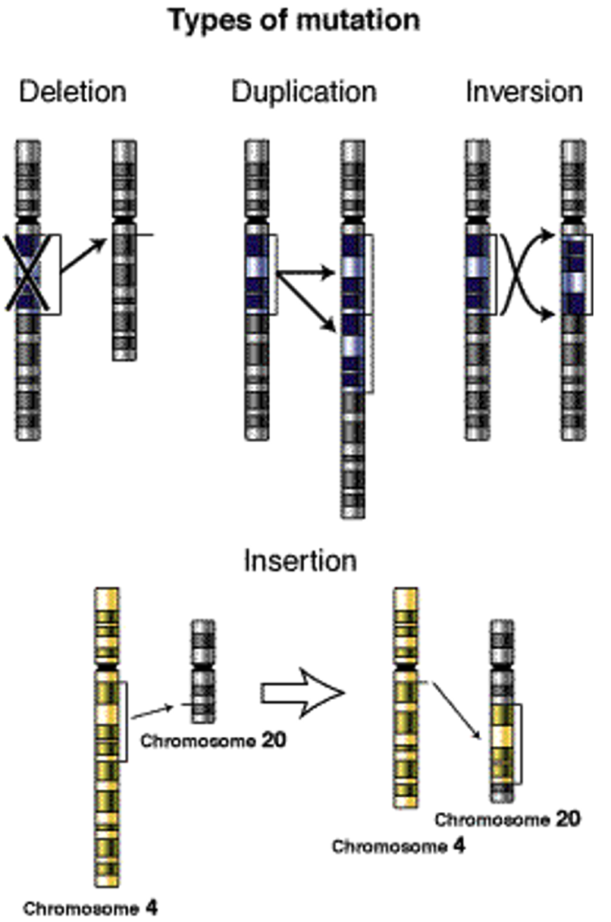
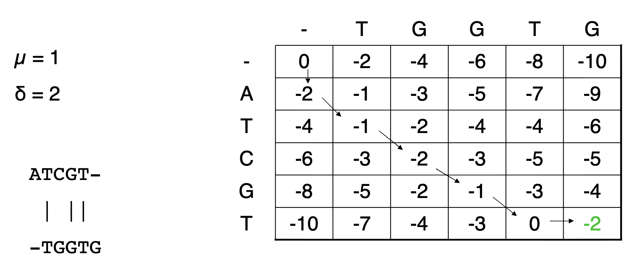
Sequence Alignment is the Cornerstone of Bioinformatics
Over time, genes (DNAs) accumulate mutations
Deletions, insertions, substitutions, …
Comparing two DNA sequences

Slide 3
Tasks Related to Sequence Alignment
Read Mapping: align millions of reads to a reference genome
Short-read mapping: 100-300bp from Illumina
Aligner: BWA-MEM^{[1]}
Long-read mapping: 1000-10000bp from Oxford Nanopore, PacBio
Aligner: minimap2^{[2]}
Whole-genome alignment (WGA)
Whole genomes have billions of bp
Find conserved regions between species; map a new assembly against a reference for variant analysis
Aligner: LastZ^{[3]}, wfmash^{[4]}, FastGA^{[5]}, minimap2
Similarity Search
A few query sequences vs. a huge database
Aligner: BLAST^{[6]}, MMseqs2^{[7]}
[1] Li, H. (2013). Aligning sequence reads, clone sequences and assembly contigs with BWA-MEM. arXiv preprint arXiv:1303.3997.
[2] Li, H. (2018). Minimap2: pairwise alignment for nucleotide sequences. Bioinformatics, 34(18), 3094-3100.
[3] https://lastz.github.io/lastz/ [4] https://github.com/waveygang/wfmash [5] Myers Jr, E. W., Durbin, R., & Zhou, C. (2025). FastGA: Fast Genome Alignment. bioRxiv, 2025-06. [6] https://blast.ncbi.nlm.nih.gov/Blast.cgi [7] Steinegger, M., & Söding, J. (2017). MMseqs2 enables sensitive protein sequence searching for the analysis of massive data sets. Nature biotechnology, 35(11), 1026-1028.

Slide 4
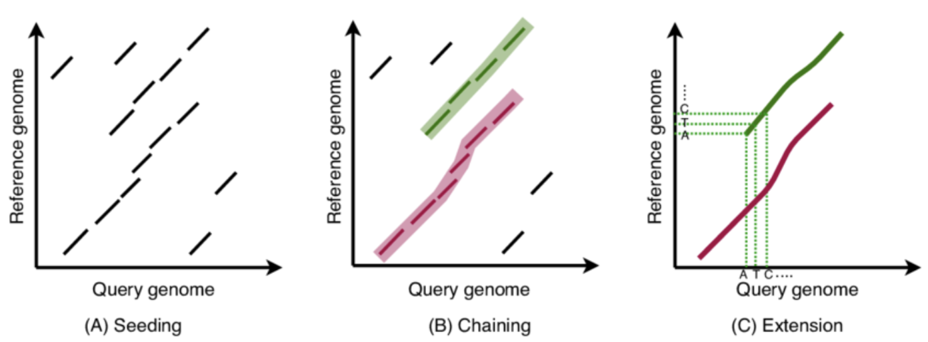
Each Aligner is a Pipeline
Mostly follow the seed-chain-extend style
a filter to limit the search space + a deterministic alignment algorithm
Key Dynamic Programming (DP) kernels used are different as well
[1] Chandra, G., Vasimuddin, M., Misra, S., & Jain, C. (2024). Accelerating whole-genome alignment in the age of complete genome assemblies. bioRxiv, 2024-11.

Slide 5
Different DP Kernel Variants are Used
Aligner Tool | Key DP Kernel Used | GPU Acceleration Work
BWA-MEM | Affine-gap DP | BWA-MEM-GPU^{[1]}
Minimap2 | Banded affine SW | AGATHA^{[2]}
LastZ | SW | FastZ^{[3]}, SegAlign^{[4]}
wfmash | WFA | WFA-GPU^{[5]}
FastGA | Custom wavefront DP kernel | N/A
BLAST | SW | GPU-BLAST^{[6]}
MMseqs2 | SIMD SW, profile SW | MMseqs2-GPU^{[7]}
Each GPU work requires some optimized CUDA kernel implementation! (Thousands of LoC)
Can we ease the programming effort?
[1] Pham, M., Tu, Y., & Lv, X. (2023, June). Accelerating bwa-mem read mapping on gpus. In Proceedings of the 37th international conference on supercomputing (pp. 155-166).
[2] Park, S., Hong, J., Song, J., Kim, H., Kim, Y., & Lee, J. (2024, March). Agatha: Fast and efficient GPU acceleration of guided sequence alignment for long read mapping. In Proceedings of the 29th ACM SIGPLAN Annual Symposium on Principles and Practice of Parallel Programming (pp. 431-444).
[3] Gundabolu, S. C., Vijaykumar, T. N., & Thottethodi, M. (2021, November). FastZ: accelerating gapped whole genome alignment on GPUs. In Proceedings of the International Conference for High Performance Computing, Networking, Storage and Analysis (pp. 1-13).
[4] Goenka, S. D., Turakhia, Y., Paten, B., & Horowitz, M. (2020, November). SegAlign: A scalable GPU-based whole genome aligner. In SC20: International Conference for High Performance Computing, Networking, Storage and Analysis (pp. 1-13). IEEE.
[5] Aguado-Puig, Q., Doblas, M., Matzoros, C., Espinosa, A., Moure, J. C., Marco-Sola, S., & Moreto, M. (2023). WFA-GPU: gap-affine pairwise read-alignment using GPUs. Bioinformatics, 39(12), btad701.
[6] Vouzis, P. D., & Sahinidis, N. V. (2011). GPU-BLAST: using graphics processors to accelerate protein sequence alignment. Bioinformatics, 27(2), 182-188.
[7] Kallenborn, F., Chacon, A., Hundt, C., Sirelkhatim, H., Didi, K., Cha, S., ... & Steinegger, M. (2025). GPU-accelerated homology search with MMseqs2. Nature Methods, 1-4.

Slide 6
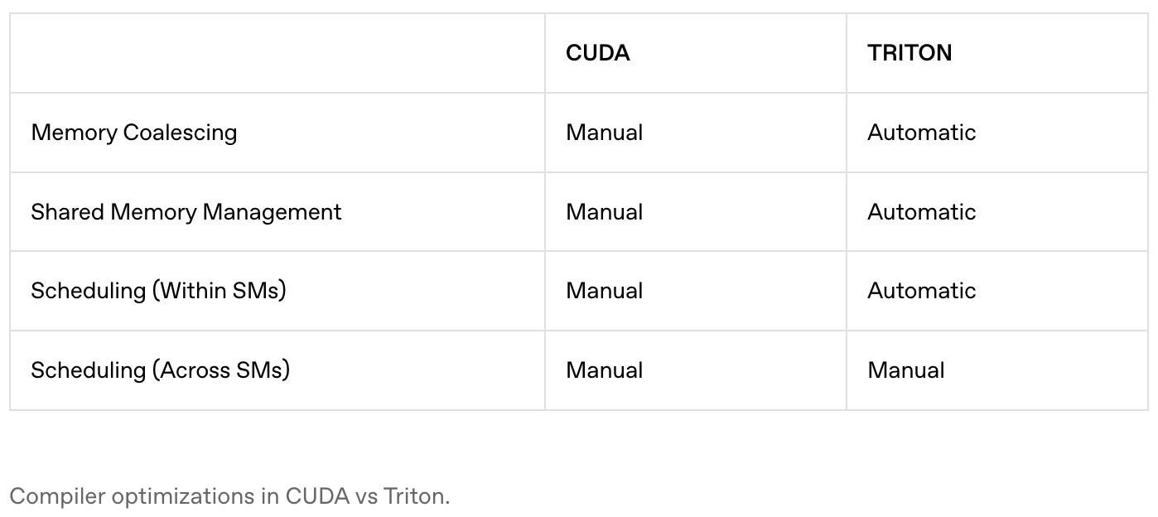
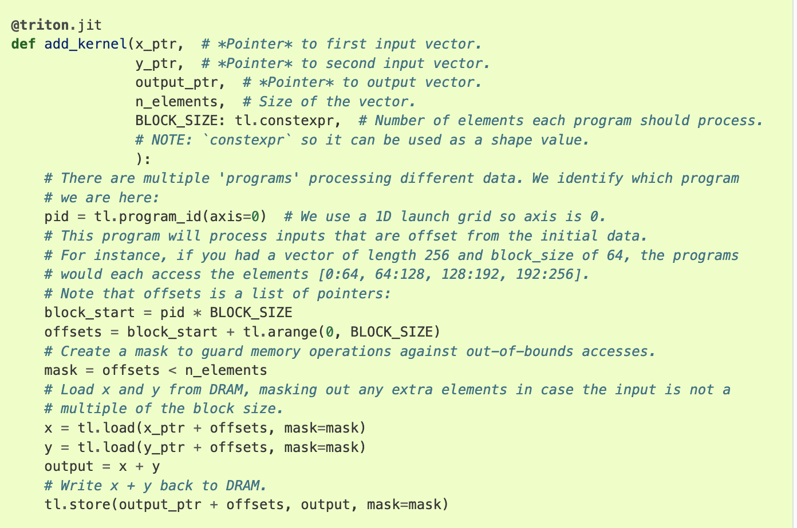
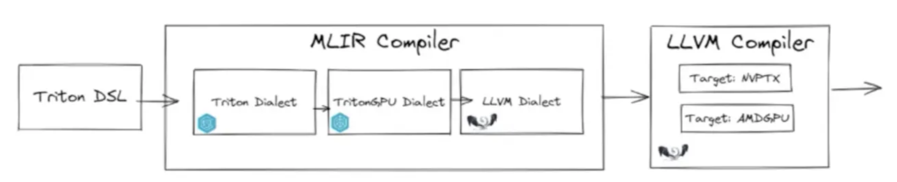
Triton: write Python to get optimized GPU kernel for ML Ops

Slide 7
Triton for Sequence Alignment Kernels?
Can those optimizations also work for genomic kernels?
Not GEMM
Different parallel schemes
Sometimes irregular memory access (especially with some pruning heuristics)

Slide 8
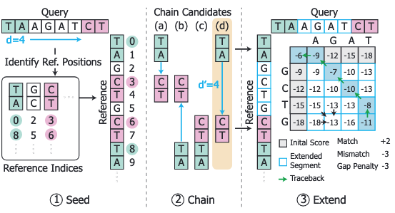
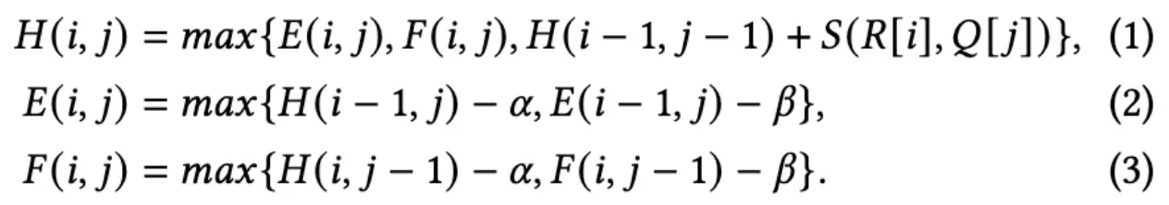
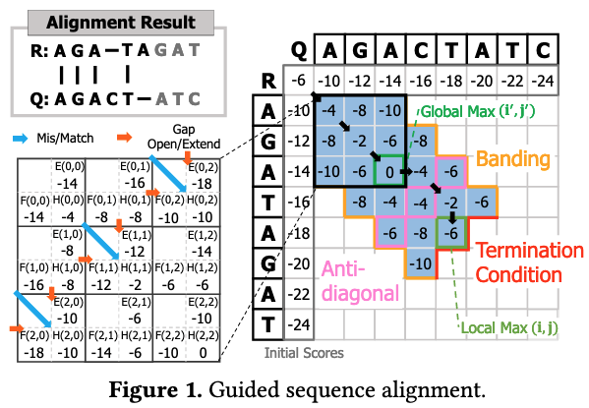
Guided DP: Extending Alignment in Minimap2
Guided DP kernel is used in the extend stage of minimap2
Affine gap penalty
Banding
Z-drop for termination condition
If the difference between local max and global max is too large, termination condition is met
Minimap2 uses optimized SIMD kernel on CPU

Slide 9
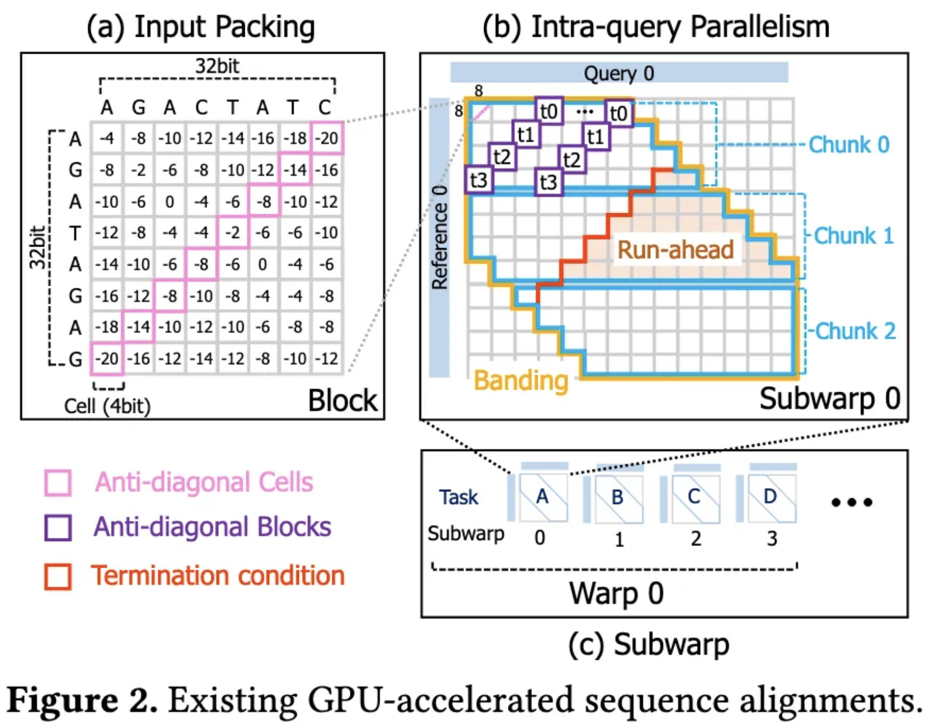
GPU SOTA: AGATHA
Parallel scheme
Inter-query: independent task
Intra-query: 4 threads cooperatively working on the anti-diagonal
Input packing
4-bit to store one literal
Challenges (closely related to Z-drop)
Random memory access
Severe workload imbalance
[1] Park, S., Hong, J., Song, J., Kim, H., Kim, Y., & Lee, J. (2024, March). Agatha: Fast and efficient GPU acceleration of guided sequence alignment for long read mapping. In Proceedings of the 29th ACM SIGPLAN Annual Symposium on Principles and Practice of Parallel Programming (pp. 431-444).

Slide 10
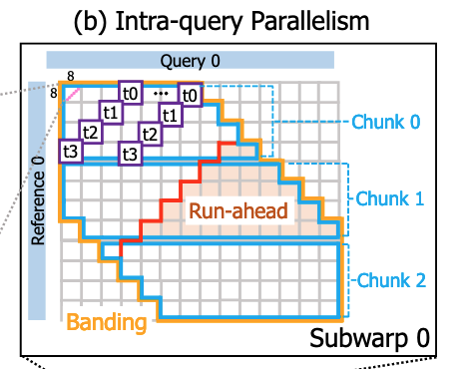
AGATHA: Challenges
Threads progress horizontally chunk by chunk
[C.1] Storing local maximum values
Local max values are to be preserved until the entire anti-diagonal is processed and tested against the termination cond.
As threads progress horizontally, processing a chunk leaves many incomplete local maximum
Must store partial maximum values in the memory -> huge performance burden
[C.2] Problem of run-ahead processing
A huge run-ahead region is unnecessarily executed
Workload imbalance
[C.3] Static imbalance: different sequence length
[C.4] Dynamic imbalance: early termination

Slide 11
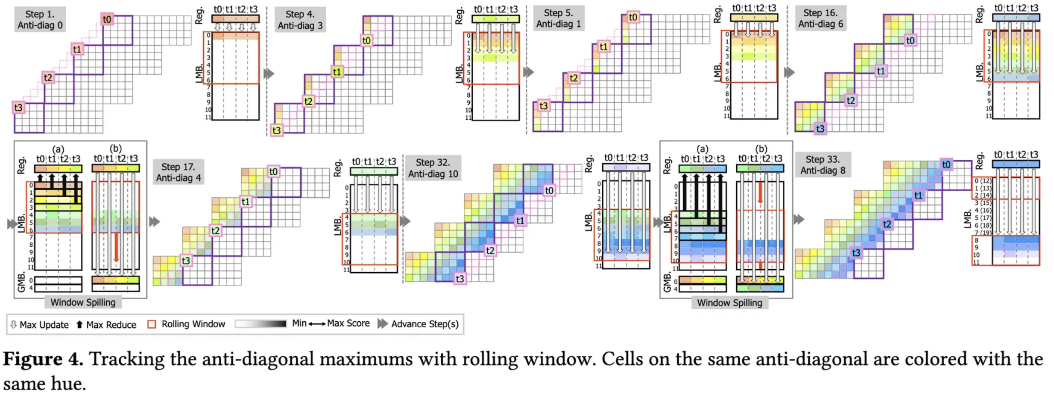
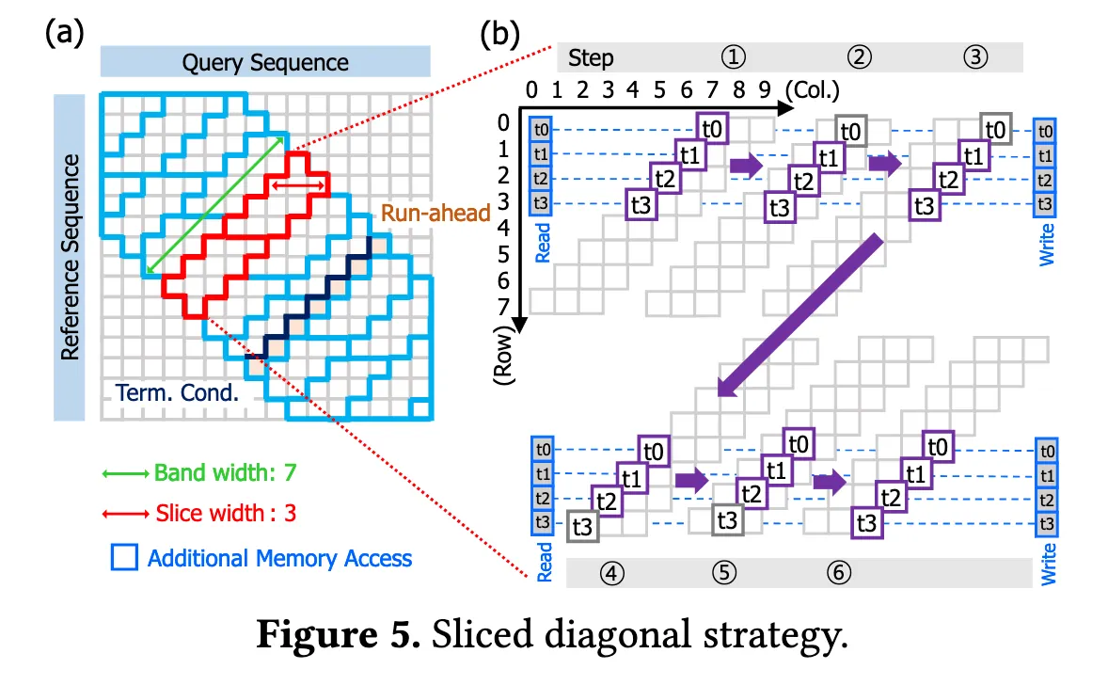
AGATHA: Optimization
[O.1] Track local max with rolling window in shared memory
[O.2] Sliced Diagonal Strategy
Change the compute order from horizontal to anti-diagonal
[O.3] Subwarp rejoining
Work stealing method to let idle subwarp help busy subwarp
[O.4] Uneven bucketing
Sort and redistribute workload evenly

Slide 12
Triton kernel for guided DP
Parallel Scheme
Inter-sequence: each pair is mapped to a block
Intra-sequence: within a block, threads work collaboratively on the same anti-diagonal wavefront
Progress towards the direction of anti-diagonal
Input packing
Ring-buffer to store part of DP matrices

Slide 13
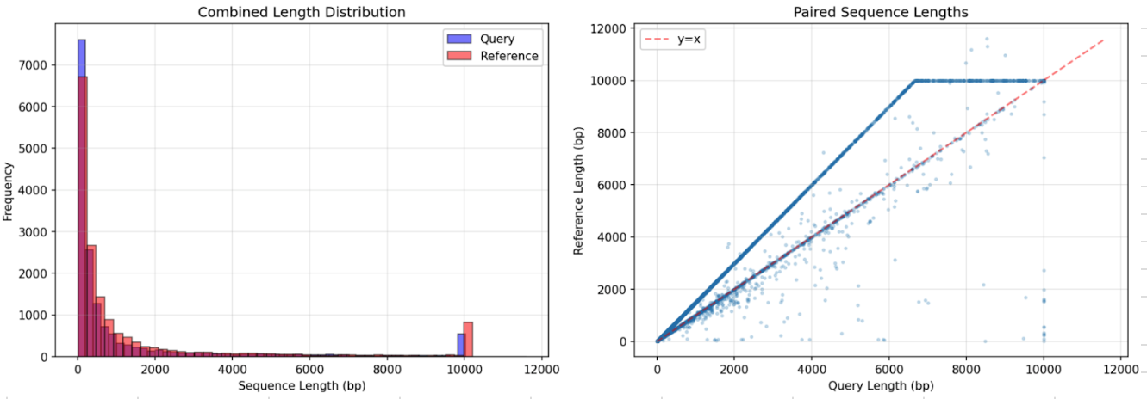
Result: Performance & Programming Effort
GPU: A100
Dataset: 16384 pairs (HiFi HG005 sample), used by AGATHA in their paper.
 | Kernel Time (ms) | Total Time (ms) | Kernel LoC | Total LoC
AGATHA | 126 | 268 | ~1000 | ~2000
Triton-seq | 138 (+9%) | 182 (-32%) | ~200 | 400
Notes:
(green/red +/-)
Good or bad

Slide 14
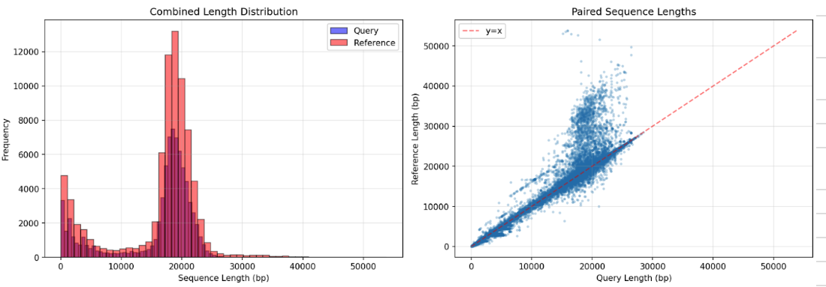
Result: on a larger & imbalanced dataset
A larger and more imbalanced dataset (extracted using minimap2)
78035 pairs with longer sequence length
 | Kernel Time (ms) | Total Time (ms)
AGATHA | 5620 | 7096
Triton-seq | 7719 (+37%) | 10085 (+42%)

Slide 15
PTX hack to use shared memory instead of global memory
Triton gives no explicit control of shared memory
Manual hack PTX code
 | Kernel Time (ms) small dataset | Kernel Time (ms) larger dataset
AGATHA | 126 | 5620
Triton-seq (native) | 138 (+9%) | 7719 (+37%)
Triton-seq (shared memory hack) | 118 (-6%) | 6500 (+16%)

Slide 16
Next steps
Performance optimization of Triton kernel
Address the workload imbalance issue
Support other sequence alignment variants
And try to match SOTA kernel performance

