Slide 1
FastGA Deep Dive & Vibe Optimization
Reducing Storage Footprint for Whole-Genome Alignment on HPC Jiajie Li | March 2026

Slide 2
Introduction to FastGA

Slide 3
Whole-Genome Alignment Is Hard
Goal: find all local alignments between two genome assemblies
Scale: human genomes have ~3 billion base pairs each
Existing tools (minimap2, MUMmer) use hash-table lookups for seed finding
Hash tables cause random memory access → CPU cache misses
At genome scale, the CPU spends most time waiting for RAM (~200 cycles/miss)

Slide 4
FastGA: Cache Coherence Over Hash Tables
By Gene Myers, Richard Durbin, and Chenxi Zhou
Core principle: replace hash-table lookups with sorted arrays + linear merges
Pre-sort all k-mers (K=40) using MSD radix sort (not comparison-based)
Find seeds by merging two sorted indices in a single linear sweep
Every memory access is sequential and predictable → CPU cache stays warm
Compact output: .1aln trace-point format is 15–16× smaller than PAF+CIGAR

Slide 5
FastGA's Pipeline

Slide 6
4-Stage Pipeline
Stage 1: Compress — FASTA → GDB (2-bit packed DNA)
• 4 bases per byte. ~750 MB for a human genome (vs ~3 GB FASTA)
Stage 2: Index — GDB → GIX (sorted k-mer index, syncmer-filtered)
• ~10 GB/Gbp. 15 bytes/entry: 7B suffix + 1B mask + 1B LCP + 4B pos + 2B contig
Stage 3: Seed Merge — linear merge of two sorted GIX indices
• Longest prefix match + frequency filter (≤ 10 occurrences)
Stage 4: Sort, Chain, Align — radix sort seeds → chain → wave-front alignment
• O(nd) wave-front algorithm within diagonal band defined by chain

Slide 7
Pipeline Sub-Phases & Output Files
Sub-phase | Tool | What it does | Output files | Threading
Compress | FAtoGDB (×2) | FASTA → 2-bit packed binary | .1gdb + .bps | Single
Index | GIXmake (×2) | Syncmer k-mers → MSD radix sort | .gix + .ktab.* | Multi (max 32)
Seed Merge | FastGA ph.1 | Linear merge of two sorted GIX | _pair.*.N/.C (temp) | Multi
Sort + Align | FastGA ph.2–4 | Radix sort → chain → align → merge | .1aln (final output) | Multi
Convert | ALNtoPAF | Decode trace points → PAF text | PAF to stdout | Single
File | Size (human, per genome) | Created by | Read by | Deleted
.1gdb + .bps | ~750 MB | FAtoGDB | FastGA (base fetching) | At exit (-k keeps)
.gix + .ktab.* | ~32 GB | GIXmake | FastGA (seed merge only) | At exit
_pair.* (temp) | ~3.5 GB | Seed merge | Sort+align | Unlinked after open
.1aln | 157 MB | Sort+align | ALNtoPAF | Persistent output

Slide 8
Key Data Structures & File Sizes
Format | Contents | Size Scaling | Lifetime
GDB (.1gdb + .bps) | 2-bit compressed DNA | ~0.25 GB/Gbp | Entire run
GIX (.gix + .ktab.*) | Sorted k-mer index + LCP | ~10 GB/Gbp | Seed merge only
_pair.* (temp) | Seed position pairs | ~2.3 GB/Gbp | Sort+align only
.1aln (output) | Trace-point alignments | ~0.05 GB/Gbp | Persistent
GIX dominates storage: 62.7 GB for two human genomes (88% of peak disk). Temp files are invisible to ls (unlinked immediately after open).

Slide 9
Benchmark Results

Slide 10
Human Genome Performance (GRCh38 vs CHM13, T=32)
Metric | Value
Wall clock | 9 min 48s
Peak RSS | 19.0 GB
Total seeds found | 1.3 billion
Non-redundant alignments | 518,037 (avg 28.4 Kbp)
CPU utilization | 638% (of 3200%)
Phase | Wall Time | % Total
GDB creation | 18s | 3%
GIX build | 82s | 14%
Seed merge | 5.3s | 1%
Sort + align | 482s (8 min) | 82%
Sort+align dominates at human scale (82% of runtime). Seed merge is extremely fast (5.3s) thanks to the cache-coherent linear sweep.

Slide 11
The Storage Problem
Peak disk usage: 71 GB for one human-vs-human comparison
GIX indices: 62.7 GB = 88% of peak storage
GIX is only read during the 5.3-second seed merge phase
But GIX stays on disk through the entire 8-minute sort+align phase
Two concurrent runs on one HPC node: 142 GB of scratch needed
Key insight: 88% of storage is held for 98% of runtime unnecessarily

Slide 12
Design Tradeoff: minimap2 vs FastGA
Aspect | minimap2 | FastGA
Index type | Hash table (minimizers) | Sorted k-mer table + LCP
Index size (human) | ~6–8 GB | ~32 GB/genome
Index location | In memory | On disk
Seed finding | Hash lookup (random access) | Linear merge (sequential)
Match type | Fixed k-mer length only | Variable-length (adaptamers)
Cache behavior | Cache misses on every lookup | Cache-friendly sequential scan
Reusable index | No (rebuilt each run) | Yes (-k flag)
Output format | PAF (text) | .1aln trace-points (15–16× smaller)
FastGA trades ~4× larger index for cache-coherent seed finding and free variable-length matching. The extra bytes (k-mer suffix + LCP) are the structural cost of the sorted-merge design.

Slide 13
What’s Inside the 63 GB GIX? (Human, Both Genomes)
Field | Bytes/entry | Total (GB) | % of GIX | Purpose
K-mer suffix | 7 | ~32 GB | 52% | Sorted DNA sequence for merge comparison
Position | 4 | ~18 GB | 29% | Where in the contig this k-mer starts
Contig+Strand | 2 or 1 | ~7 GB | 11% | Which contig, which strand
Mask byte | 1 | ~5 GB | 7% | Soft-masking (always 0 when off — waste)
LCP | 1 | ~5 GB | 7% | Longest common prefix with previous entry
Prefix tables | fixed | 0.3 GB | <1% | Two 128 MB jump tables
K-mer suffix + Position = 81% of GIX — fundamentally required by the algorithm. Optimization targets: mask byte (removed in Opt 3, −4.6 GB), LCP (could recompute on-the-fly), k-mer suffix (hard to compress — Opt 5 failed).

Slide 14
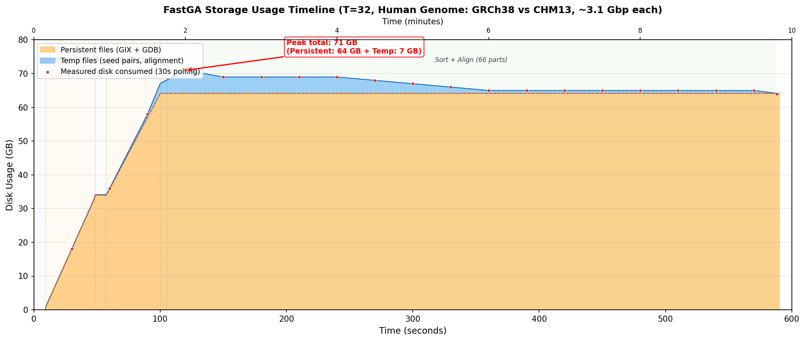
Storage Timeline: Human Genomes (T=32)

Slide 15
Storage Optimization Attempts

Slide 16
6 Identified Optimization Opportunities
# | Optimization | Est. Impact (Human) | Quality | Status
1 | Early GIX deletion | Frees 63 GB in sort+align | Bit-exact | ✅ Done
2 | Sparse prefix index | ~254 MB | Bit-exact | Not started
3 | Eliminate mask byte | -4.6 GB (-7.7% ktab) | Bit-exact | ✅ Done
4 | On-the-fly LCP | ~4.4 GB (~7% ktab) | Bit-exact | Deferred
5 | Ktab compression | ~14% ktab | Bit-exact | ❌ Failed
6 | Aggressive syncmer filter | ~40% ktab | Trade-off | Not started

Slide 17
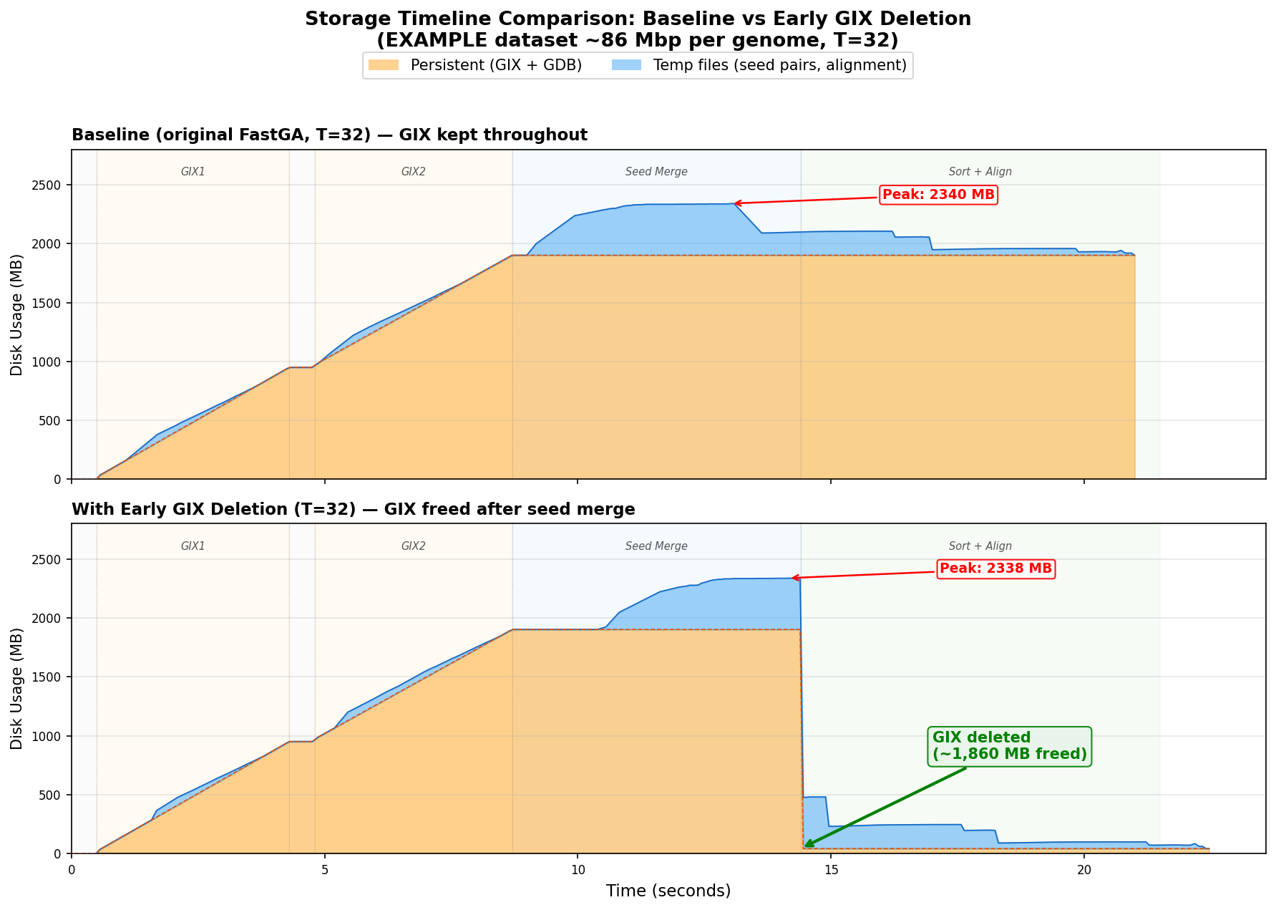
Opt 1: Early GIX Deletion (Zero Cost)
Delete GIX immediately after seed merge, not at program exit
Sort+align disk: 64 GB → 7 GB (–89%)
Two concurrent human runs: 128 GB → 14 GB
Zero performance impact, bit-exact output
Only ~35 lines changed in FastGA.c

Slide 18
Opt 3: Eliminate Mask Byte | Opt 5: Compression
Opt 3: Eliminate Mask Byte ✅ Implemented
Remove unused 1-byte mask field from ktab entries (15B → 14B)
Result: 7.7% ktab reduction, bit-exact output
Human genomes: −4.6 GB total GIX savings
Opt 5: Ktab Compression ❌ Failed
Attempted zstd block compression of ktab partitions
Only 14% compression (position data nearly random)
Decompression round-trip bug: 53.6M vs 51.1M seeds
All code reverted — adds dependency for modest savings
Lesson: Not all optimizations work out. The position payload in ktab entries contains coordinate data that is effectively random — compression algorithms can't exploit patterns that don't exist.

Slide 19
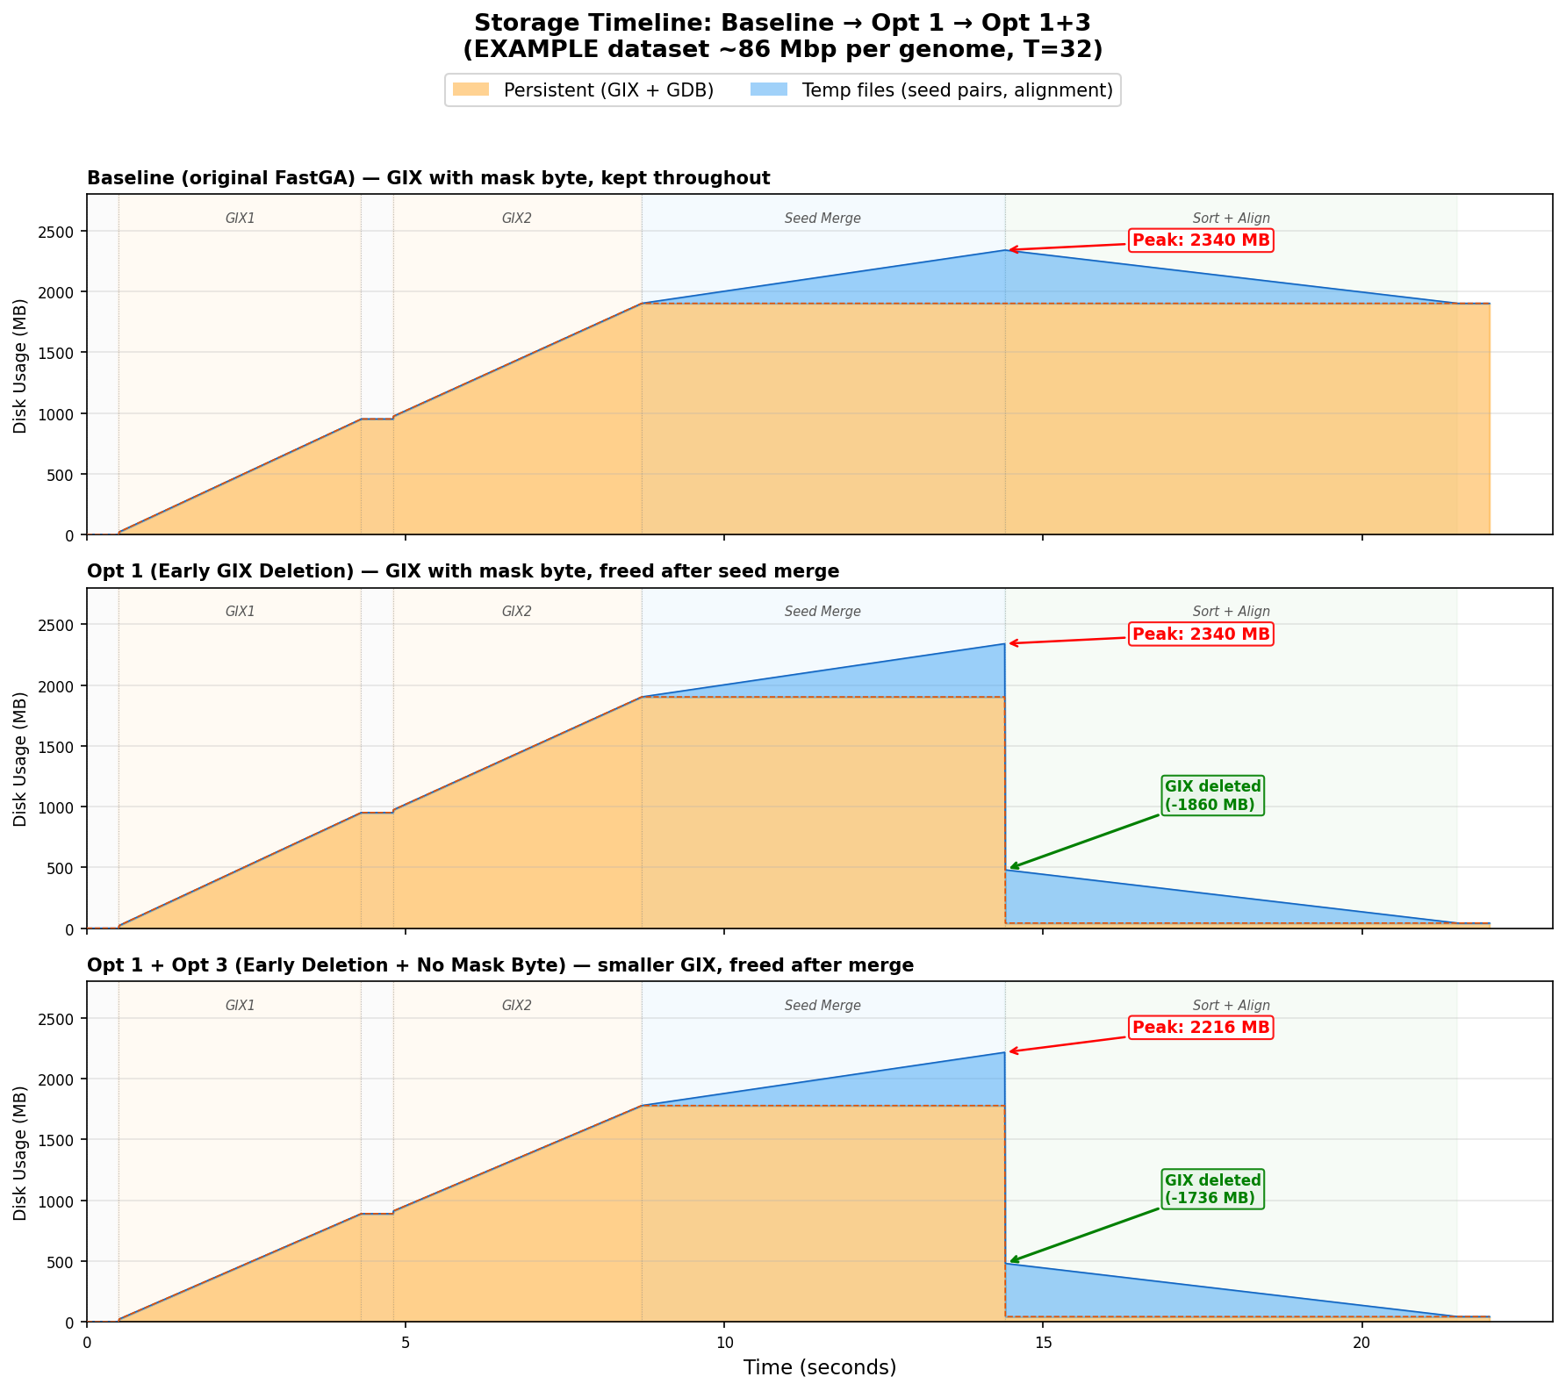
Cumulative Results: Opt 1 + Opt 3
Metric | Baseline | Opt 1+3 | Savings
GIX size (human, both) | 62.7 GB | 58.1 GB | -4.6 GB (-7.3%)
Peak total disk (human) | 71 GB | 66.4 GB | -4.6 GB (-6.5%)
Sort+align disk (human) | 64 GB | 7 GB | -57 GB (-89%)
GIX size (EXAMPLE, both) | 1,864 MB | 1,740 MB | -124 MB (-6.6%)
Sort+align disk (EXAMPLE) | 1,905 MB | 438 MB | -1,467 MB (-77%)

Slide 20
Reflections & Next Steps

Slide 21
Reflections: What We Actually Did
What we did: removed low-hanging fruit
Opt 1: moved a delete() call earlier — trivial code change, huge practical impact
Opt 2: changed KBYTES+1 to KBYTES when masking is off — one line of logic
Both are bit-exact, zero performance cost, zero risk
Honest assessment
These optimizations are trivial — we found waste and removed it
We didn’t make any fundamental algorithmic tradeoffs
Our one non-trivial attempt (ktab compression) failed
The real optimization space — trading sensitivity, compute, or quality for storage — remains unexplored

Slide 22
Next Steps: Exploring the Tradeoff Space
Sensitivity ↔ Storage
Aggressive syncmer filtering: select ~40% instead of ~75% of positions → ~40% smaller GIX
Tune frequency threshold (-f): higher = fewer seeds = less temp storage, but miss repeat-flanking matches
Compute ↔ Storage
On-the-fly LCP: recompute during merge instead of storing (~7% GIX reduction, adds CPU cost)
Streaming seed consumption: chain and align seeds as they’re produced, avoid materializing all at once
Toward autonomous optimization
Define clear objectives: storage budget, sensitivity floor, runtime ceiling
Let an AI agent explore the parameter/design space systematically
Auto-benchmark, auto-evaluate, auto-iterate — à la Karpathy’s AutoResearch vision

