Slide 1
Introduction to Halide
Sander Vocke – 5LIM0 – 17-03-2016

Slide 2
What?
Two guest lectures about the Halide language and compiler.
Today, using a 3x3 Blur algorithm as leading example, we answer:
What is it?
How to use it?
Why to use it?
Next time (March 31st):
How does the Halide compiler work?

Slide 3
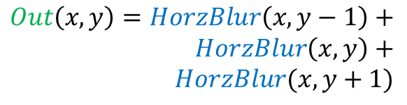
Leading Example
A simple, two-stage imaging pipeline: 3x3 blur.
Basic function: a summation over a 3x3 area:
We leave out the averaging step.
Horizontal
blur
Vertical
blur
$$HorzBlur\left(x,y\right)=in\left(x−1, y\right)+in\left(x,y\right)+in(x+1,y)$$
$$Out\left(x,y\right)=HorzBlur\left(x, y−1\right)+ \\ HorzBlur\left(x, y\right)+ \\ HorzBlur(x, y+1)$$

Slide 4
3x3 Blur: Inlined Implementation
int in[W*H];
int out[W*H];
for(int y=1; y<(H-1); y++){
for(int x=1; x<(W-1); x++{
out[x + y*W] = in[(x-1) + (y-1)*W] + in[(x-1) + y*W] + in[(x-1) + (y+1)*W] +
in[x + (y-1)*W] + in[x + y*W] +in[x + (y+1)*W] +
in[(x+1) + (y-1)*W] +in[(x+1) + y*W] +in[(x+1) + (y+1)*W];
}
}
9 loads per output pixel
8 additions per output pixel
Completely parallelizable (independent pixels)
Unnecessary recomputation

Slide 5
3x3 Blur: Naïve Stored Implementation
int in[W*H];
int hblur[W*H];
int out[W*H];
for(int y=0; y<H; y++){
for(int x=1; x<(W-1); x++{
hblur[x + y*W] = in[x-1 + y*W] + in[x + y*W] + in[x+1 + y*W];
}
}
for(int y=1; y<(H-1); y++){
for(int x=1; x<(W-1); x++{
out[x + y*W] = hblur[x + (y-1)*W] + hblur[x + y*W] + hblur[x + (y+1)*W];
}
}
3 loads,
2 adds,
1 store
3 loads,
2 adds
6 loads, 1 store per output pixel
4 additions per output pixel
Very low locality (big buffer)
No recomputation
Still parallelizable

Slide 6
3x3 Blur: Fused Implementation
int in[W*H];
int hblur[W*H];
int out[W*H];
for(int y=0; y<2; y++){
for(int x=1; x<(W-1); x++{
hblur[x + y*W] = in[x-1 + y*W] + in[x + y*W] + in[x+1 + y*W];
}
}
for(int y=1; y<(H-1); y++){
for(int x=1; x<(W-1); x++{
hblur[x + (y+1)*W] = in[x-1 + (y+1)*W] + in[x + (y+1)*W] + in[x+1 + (y+1)*W];
out[x + y*W] = hblur[x + (y-1)*W] + hblur[x + y*W] + hblur[x + (y+1)*W];
}
}
Disregard the prologue
(no impact for big images)
6 loads,
1 store,
4 adds
6 loads, 1 store per output pixel
4 additions per output pixel
High locality (producer, consumer moved together)
No recomputation
Not directly parallelizable

Slide 7
3x3 Blur: Fused with Storage Folding
int in[W*H];
int hblur[W*H]; → int hblur[W*3];
int out[W*H];
for(int y=0; y<2; y++){
for(int x=1; x<(W-1); x++{
hblur[x + y*W] = in[x-1 + y*W] + in[x + y*W] + in[x+1 + y*W];
}
}
for(int y=1; y<(H-1); y++){
for(int x=1; x<(W-1); x++{
hblur[(x + (y+1)*W)%3] = in[x-1 + (y+1)*W] + in[x + (y+1)*W] + in[x+1 + (y+1)*W];
out[x + y*W] = hblur[(x + (y-1)*W)%3] + hblur[(x + y*W)%3] + hblur[(x + (y+1)*W)%3];
}
}
Note: animation does not show folded storage ☹
But computation order is the same!
Same results as last slide, but:
With a smaller intermediate buffer (W*3 instead of W*H)

Slide 8
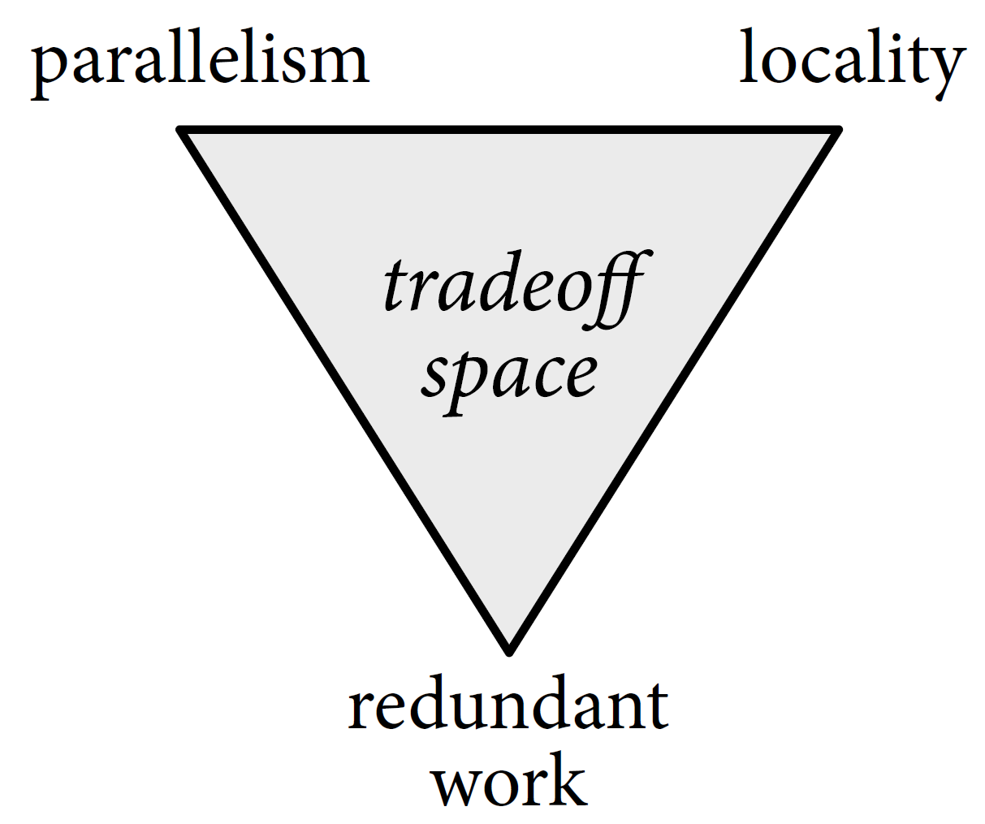
Some Observations
We are dealing with a trade-off space when doing these kinds of transformations:
C allows us to very specifically program the execution order we want.
Loop fusion, storage folding can give us performance and storage size advantages.
(Also other changes: re-ordering, tiling, multithreading, vectorizing…)
…But: transformations obscure the functionality.
…And: may be better only on (a) certain architecture(s).
For example: what if there is no cache?
…And: it takes a lot of rewriting and debugging to get this done.
High-level design-space exploration is discouraged by increasingly complex code.
More stages → even more complex, unreadable code! ☹

Slide 9
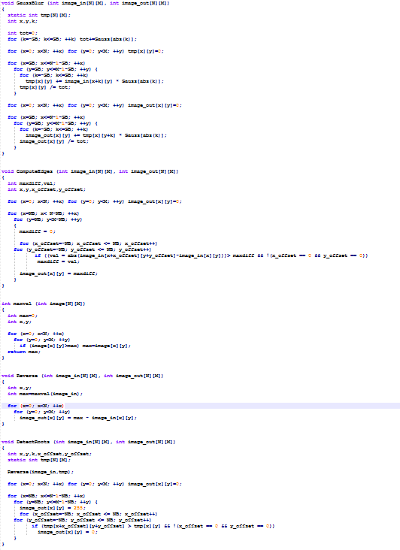
A Real-World Example: Last Year’s DMM @ ECA
This was part of ECA last year.
Simple imaging pipeline:
Gaussian Blur
Edge Detection
Root Detection
Task: Fuse and tile loops for locality so that hardware buffers can be reduced in size.
Similar to our Blur fusion, but on multiple stages.
The naïve code shown here:
Gauss Blur
Edge Detect
Root Detect

Slide 10
A Real-World Example: Last Year’s DMM @ ECA
Fusing those loops together required some prior work:
Re-ordering nested loops to match the direction of computation
Each loop had different boundary conditions due to edge pixel dependencies
As many imaging algorithms do!
Leads to a multitude of nested pro- and epilogues when fusing.
Tiling makes the boundary condition problem even worse
Boundary conditions of tiles in image
Boundary conditions of pixels in tiles
So, what did the code look like after fusing?

Slide 11
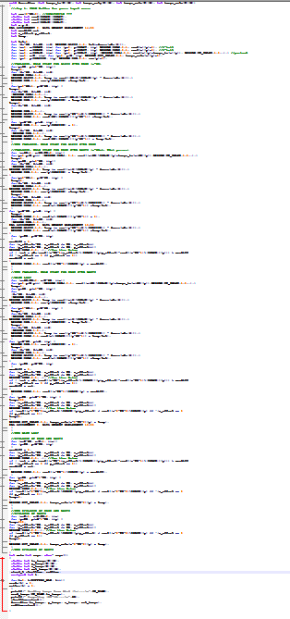
A Real-World Example: Last Year’s DMM @ ECA
Original: 60 LOC
Nicely separated functionality
Fused: 180 LOC
A mixed mess of interleaved functionality
And very high debugging effort per line!

Slide 12
A Real-World Example: Last Year’s DMM @ ECA
After that effort, if someone told me my fusion strategy was bad to begin with:
…I might have sold my PC and stopped studying ES. ☺
(changing it now would be too hard!)
This situation discourages high-level design space exploration, which is essential in imaging pipelines!
Many real-world imaging pipelines are a lot more complex than this.
And this does not yet include parallelization (multithreading, vectorization), both of which:
Make the code even more complex
Again, typically require debugging to get working correctly.
Isn’t there a better way to express our optimization ideas in code?

Slide 13
Halide (Ragan-Kelley et al, 2013)
A Domain-Specific Language (DSL) and compiler for image processing pipelines.
The essence:
Apply the tranformations we saw (and more) without complicating the core functionality (by decoupling algorithm definition from execution schedule).
Offer concise, functional-style definition of the algorithm.
Offer a concise, readable and easily changeable syntax for scheduling.
Because of the above:
Eases the process of design-space exploration
Delivers equal or better performance than C, and performance-portability.

Slide 14
3x3 Blur in Halide
Remember the mathematical relationship?
$$HorzBlur\left(x,y\right)=in\left(x−1, y\right)+in\left(x,y\right)+in(x+1,y)$$
$Out\left(x,y\right)=HorzBlur\left(x, y−1\right)+$ $HorzBlur\left(x, y\right)+HorzBlur(x, y+1)$
In Halide, we write the algorithm in the same style:
Func in, hblur, out;
Var x, y;
hblur(x,y) = in(x-1,y) + in(x,y), + in(x+1,y);
out(x,y) = hblur(x,y-1) + hblur(x,y) + hblur(x,y+1);
out.realize(10,10); //← build and execute the loop nest over a 10x10 area
This style is commonly known as functional programming.

Slide 15
3x3 Blur in Halide
Note that in the body, there is no notion of:
time (execution order).
space (buffer assignment, image size, memory allocation)
hardware (because no time and space)
Result 1: a very clear, concise and readable algorithm.
Result 2: we have not implicitly chosen any optimization strategy yet.
eg. we can use this same starting point on any target architecture.
(in C, a naïve implementation would already require scheduling decisions)
Func in, hblur, out;
Var x, y;
hblur(x,y) = in(x-1,y) + in(x,y), + in(x+1,y);
out(x,y) = hblur(x,y-1) + hblur(x,y) + hblur(x,y+1);
out.realize(10,10); //← build and execute the loop nest over a 10x10 area

Slide 16
Loop Nest Generation: Inlined version
Internally, Halide converts this functional representation to a C-like loop nest.
By default, if nothing else is done, everything is inlined.
(…) //algorithm definition with in, hblur, out
//Schedule:
//nothing for now
Equivalent to our inlined version!

Slide 17
Loop Nest Generation: Root Storage
compute_root(): compute and store all outputs of a function before starting computation of the next.
(…) //algorithm definition with in, hblur, out
//Schedule:
hblur.compute_root(); //compute and store all hblur into a big buffer first.
Equivalent to our naïve stored version!

Slide 18
Loop Nest Generation: Fused
compute_root() is actually a special case of compute_at().
hblur.compute_at(out, y) means: “Whenever stage out starts an iteration of the y loop, first calculate the pixels of stage hblur that will be consumed.”
In other words: computation of hblur is interleaved at the loop over y of out.
(…) //algorithm definition with in, hblur, out
//Schedule:
hblur.compute_at(out, y); //see above

Slide 19
Loop Nest Generation: Fused
//Schedule:
hblur.compute_at(out, y);
Elaboration:
Consider the loop nest that computes out, without the computation of hblur.
compute_at() points at the place where hblur computation should be injected:
At this point in the nest:
Allocate a buffer for hblur
Fill it with the required 3 lines.
for(int y=1; y<(H-1); y++){
for(int x=1; x<(W-1); x++{
out[x + y*W] = hblur[x + (y-1)*W] + hblur[x + y*W] + hblur[x + (y+1)*W];
}
}

Slide 20
Loop Nest Generation: Fused
//Schedule:
hblur.compute_at(out, y);
Resulting loop nest:
for(int y=1; y<(H-1); y++){
int hblur[W*3];
for(int hy = 0; hy<2; hy++){
for(int hx = 0; hx<W-1; hx++) {//omitted: compute hblur[hx + hy*W] }
}
for(int x=1; x<(W-1); x++{
out[x + y*W] = hblur[x + 0*W] + hblur[x + 1*W] + hblur[x + 2*W];
}
}
NEW PART

Slide 21
Loop Nest Generation: Fused
This was not equivalent to our fused implementation yet, because the hblur pixels are not being re-used but instead re-calculated.
For this, we can separate computation from storage using store_at() and store_root().
hblur.store_root() means: “Allocate the buffer for hblur outside the loop nest.”
(…) //algorithm definition with in, hblur, out
hblur.compute_at(out, y); //as before
hblur.store_root(); //see above
Allocate the buffer here
Perform the computation here, checking for re-use possibilities from the buffer
for(int y=1; y<(H-1); y++){
for(int x=1; x<(W-1); x++{
out[x + y*W] = hblur[x + (y-1)*W] + hblur[x + y*W] + hblur[x + (y+1)*W];
}
}

Slide 22
Loop Nest Generation: Fused
This gives us a nest equivalent to our own fused implementation, and Halide automatically recognizes and applies the storage folding as well!
(…) //algorithm definition with in, hblur, out
hblur.compute_at(out, y); //as before
hblur.store_root(); //see above

Slide 23
More Scheduling Features
We have looked only at the syntax which interleaves computation between stages.
There is also syntax which changes the order of computation within a single stage:
Reorder loop variables → out.reorder(y,x);
Split loop variables into inner and outer → out.split(x, xout, xin, 4);
Tiling is a just combination of the above:
out.split(x, xout, xin, 4);
out.split(y, yout, yin, 4);
out.reorder(xin, yin, xout, yout);
Because this is so common, syntactic sugar (a “shortcut”) is offered:
out.tile(x, y, xout, xin, yout, yin, 4, 4);
Execute loop iterations in parallel using multi-threading:
out.parallel(x); //executes each x iteration simultaneously in threads
Turn a loop into a (series of) vector operation(s):
out.vectorize(xin); //loop over xin, which has 4 iterations, is vectorized
out.vectorize(x, 4); //shortcut: split x into out and in of 4, then vectorize in

Slide 24
Some Examples of Intra-Stage Scheduling
Func gradient;
Var x, y, xout, xin, yout, yin;
//1-line algorithm definition:
gradient(x,y) = x+y;
//this is equivalent to
//gradient.tile(x, y, xout, xin, yout, yin, 2, 2):
gradient.split(x, xout, xin, 2); 1st →
gradient.split(y, yout, yin, 2); 2nd →
gradient.reorder(xin, yin, xout, yout); 3rd →
gradient.vectorize(xin);
gradient.parallel(yout).parallel(xout);
Result:
Result:
Result:

Slide 25
Observations
With Halide, the algorithm definition is clearer and conciser than with C.
Not polluted by being mixed with an optimization strategy
With Halide, transformations that would normally take a lot of rewriting effort are done in just a few, separate scheduling statements.
Saves time
Guaranteed correctness
Automatic handling of edge conditions (pro-, epilogues) and storage folding, among other optimizations
With Halide, we can easily port the algorithm to a different architecture
As long as a Halide back-end exists for that architecture
Code is not hardware-dependent
For good performance on the new architecture, only re-write the schedule
Good results have also been obtained using a search algorithm which finds a good schedule automatically!

Slide 26
Halide Limitations
As mentioned it is domain-specific to image processing. It is less suitable for other workloads because:
Not Turing-complete (no full recursion)
Only iterates over rectangular domains
Scheduling model only covers typical image processing optimizations
But this is the point of domain-specific languages:
if we aim to cover everything, we get something like C again!

Slide 27
DSL’s in General
A trend can be seen of domain-specific languages appearing all over the place.
Example domains:
Neural Networks
Graphics
Cryptography
VLSI design
…
Such languages offer great benefits in productivity…
The effort of few (on the compiler) saves the effort of many (on the application)
Highly optimized code can be thus produced by non-expert programmers
Scientists and domain specialists
…And performance-portability.

Slide 28
Halide’s Status
An open-source project.
Because of that, there is ongoing work in many directions:
New architectures (DSPs, supercomputers…)
Extensions to suit (sub-)domains
Auxiliary efforts:
Automatic tuning of Halide schedules
Automatic generating of Halide schedules
Automatic de-compilation of x86 binaries into Halide for easy porting
Support from Google in the industry

Slide 29
Preview of next time (March 31st)
How does the Halide compiler leverage LLVM and C++?
What does Halide’s IR look like? How to operate on it?
What do Halide’s code generator back-ends look like?
How does Halide move from functional-style input to imperative (assembly-style) output?
…And more (TBD)

Slide 30
?

