Slide 1
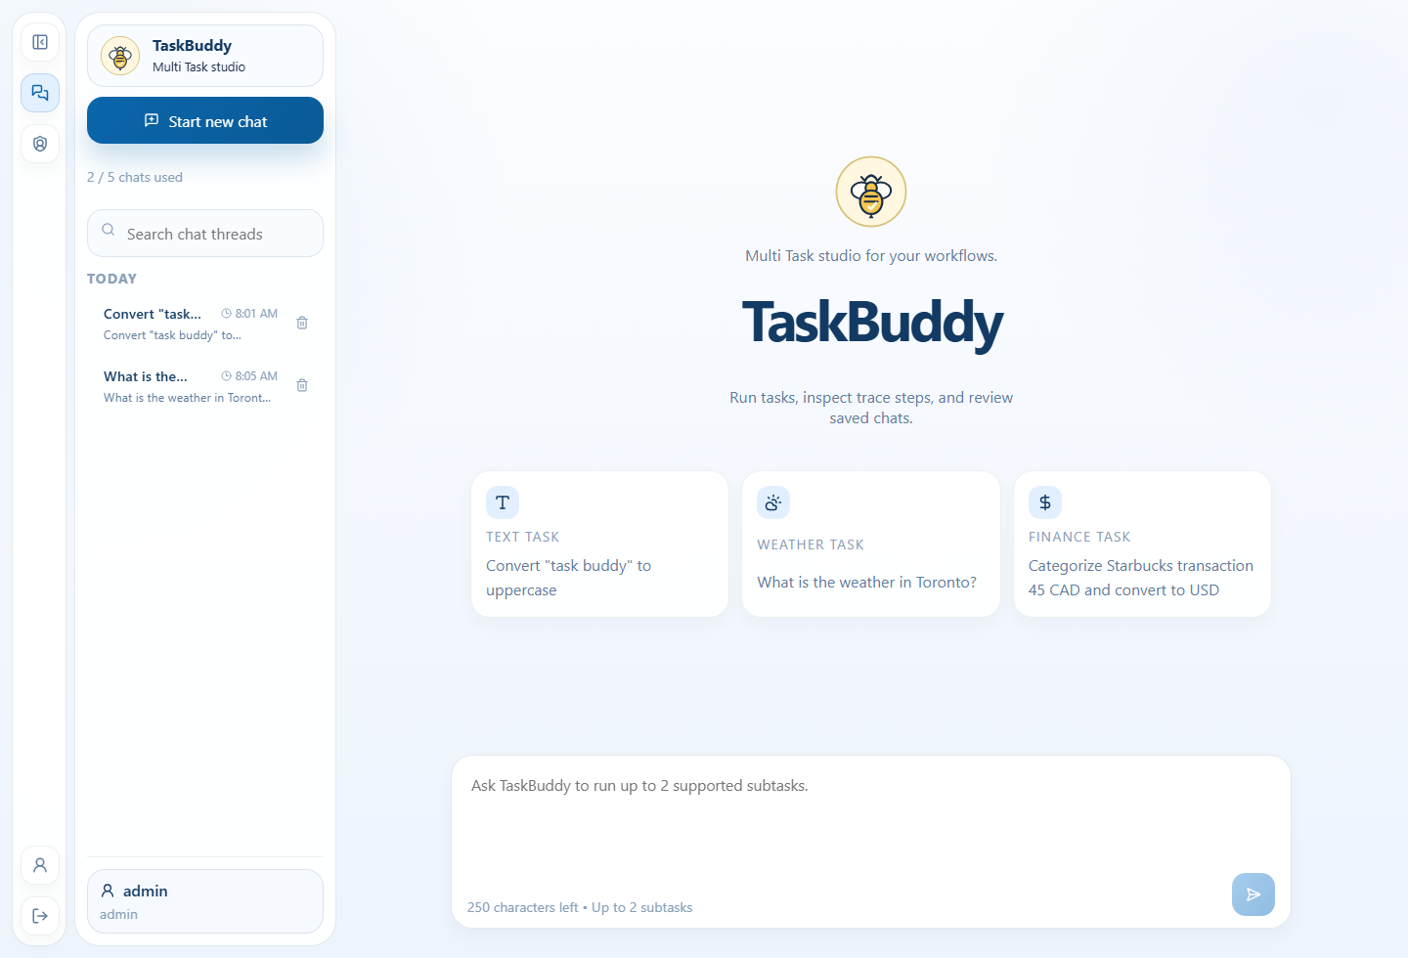
TaskBuddy
Product walkthrough, technical design, and documentation pack
Prepared by Tony Joseph Sebastian
FastAPI-served React workspace
Deterministic tools with LangGraph orchestration
Five-minute business and technical walkthrough
Workspace home view
Generated from the repo sources and the local FastAPI-served UI.
TaskBuddy documentation pack
1
Notes:
TaskBuddy is a locally runnable FastAPI application with a React interface, deterministic tool routing, persistent chat threads, and an execution trace for every saved task. This five-minute walkthrough covers the product from both business and technical angles. I will show how a user accesses the app, how supported prompts are handled, how the architecture is organized, and how the supporting documentation pack helps explain the build.

Slide 2
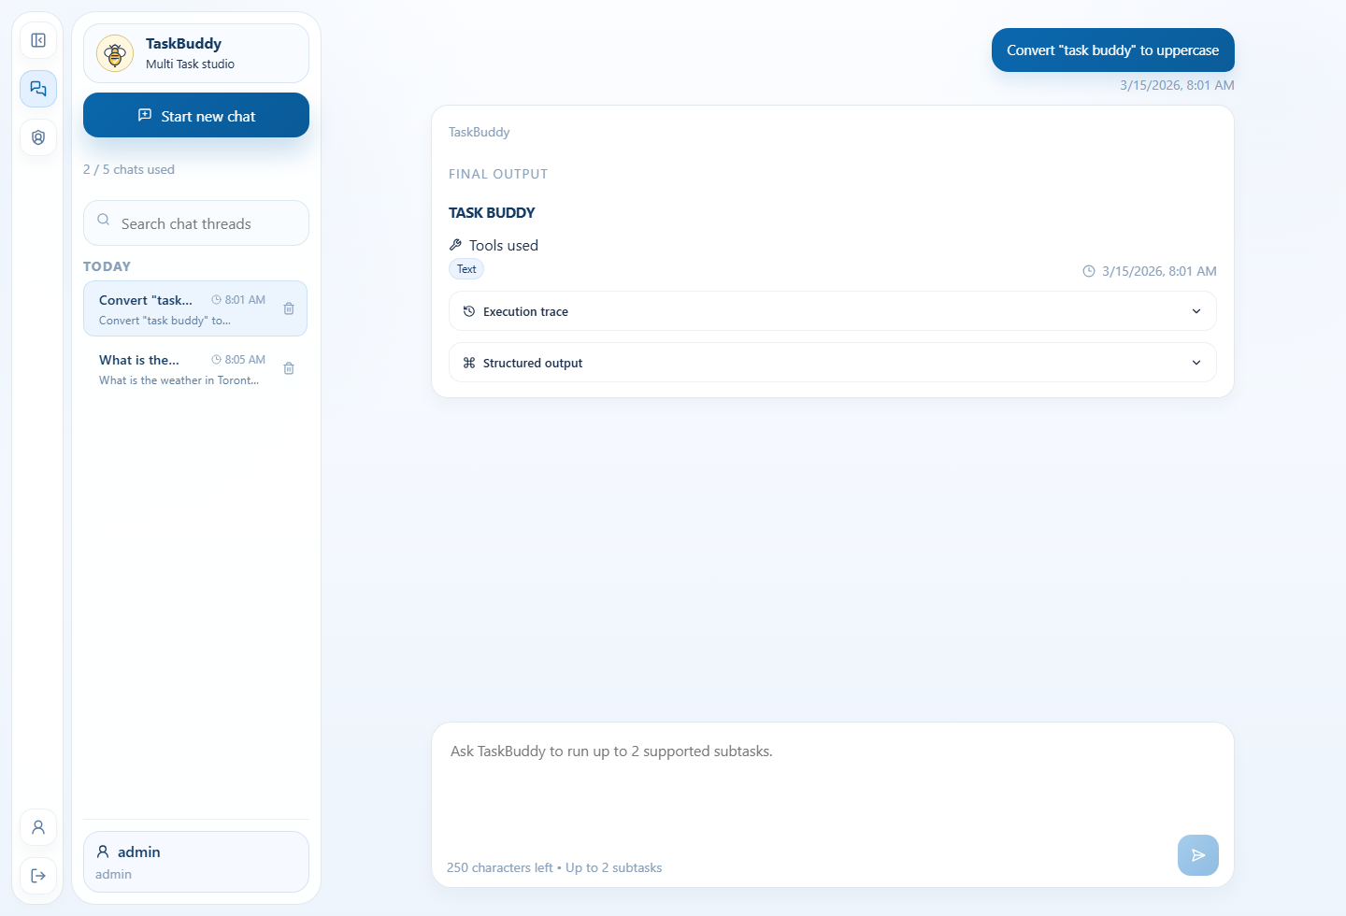
What TaskBuddy does
Target 20s
Signs users in with a cookie session
Lets each user create and revisit chat threads
Returns final output first with a visible execution trace
Completed text task
TaskBuddy documentation pack
2
Notes:
At the user level, TaskBuddy behaves like a focused productivity workspace. A signed-in user creates a chat, enters a supported prompt, and receives a response card that shows the final output first, followed by the tool used, structured output, and a trace of the execution steps. That flow matters because it makes the app easy to understand for a business audience while still exposing enough detail for technical validation and manual testing.

Slide 3
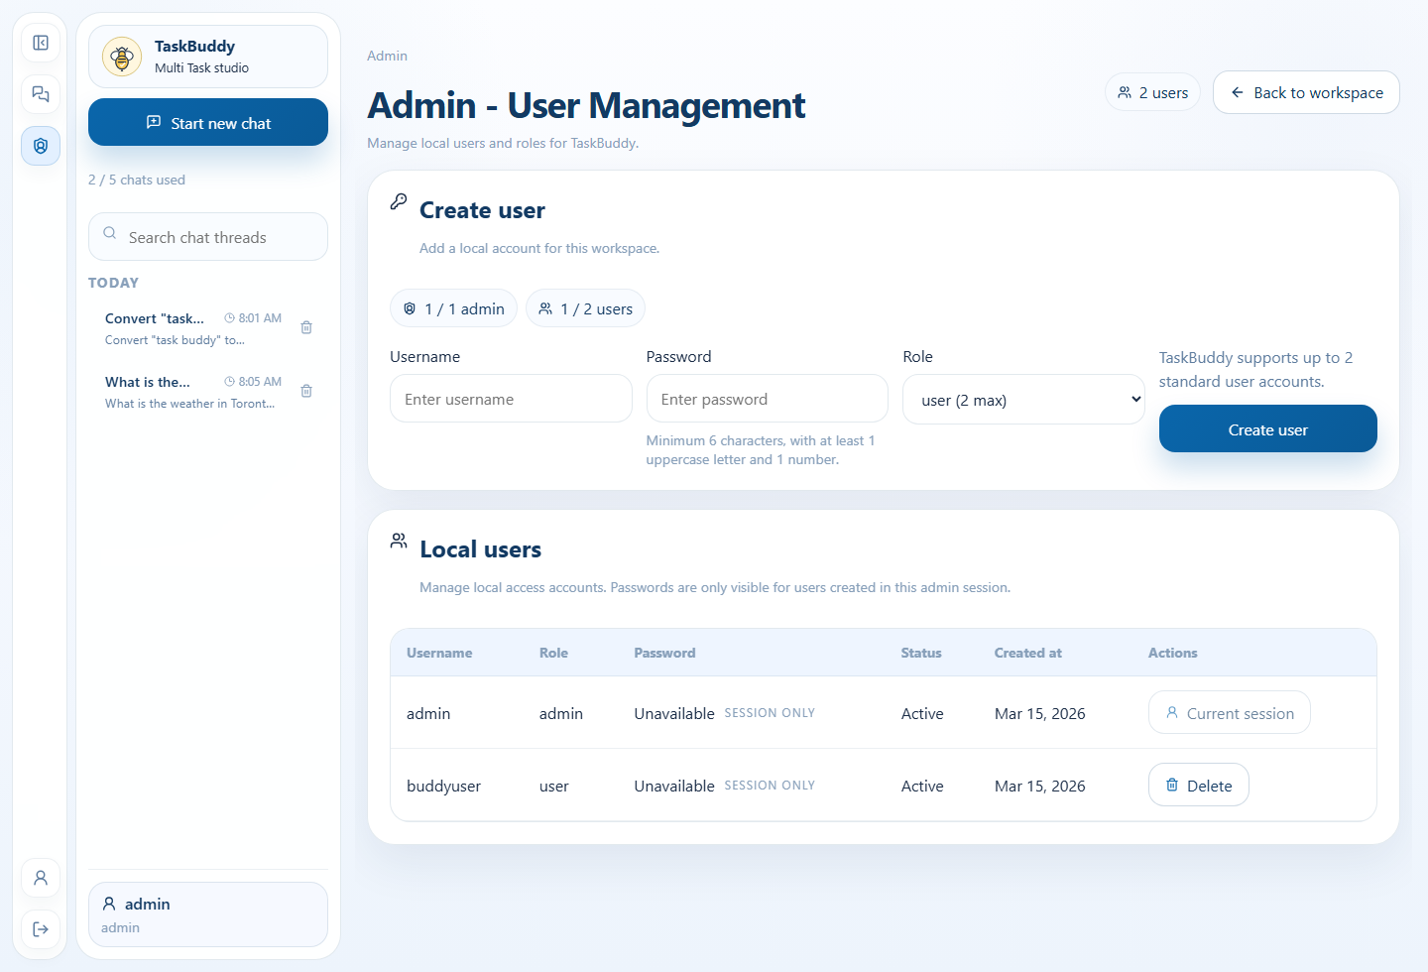
Roles and protected access
Target 20s
Bootstrap admin manages local users
Standard users work only inside their own threads
Thread APIs require authentication and admin APIs require the admin role
Admin user management page
TaskBuddy documentation pack
3
Notes:
The app has two roles: admin and user. The bootstrap admin can run tasks like any other user, but can also open the admin page to create or delete local accounts. Standard users can sign in, run supported tasks, and review their own thread history only. Authentication is cookie-based, thread APIs are protected, and the admin endpoints are restricted to the admin role, which keeps the local setup lightweight while still enforcing access boundaries.

Slide 4
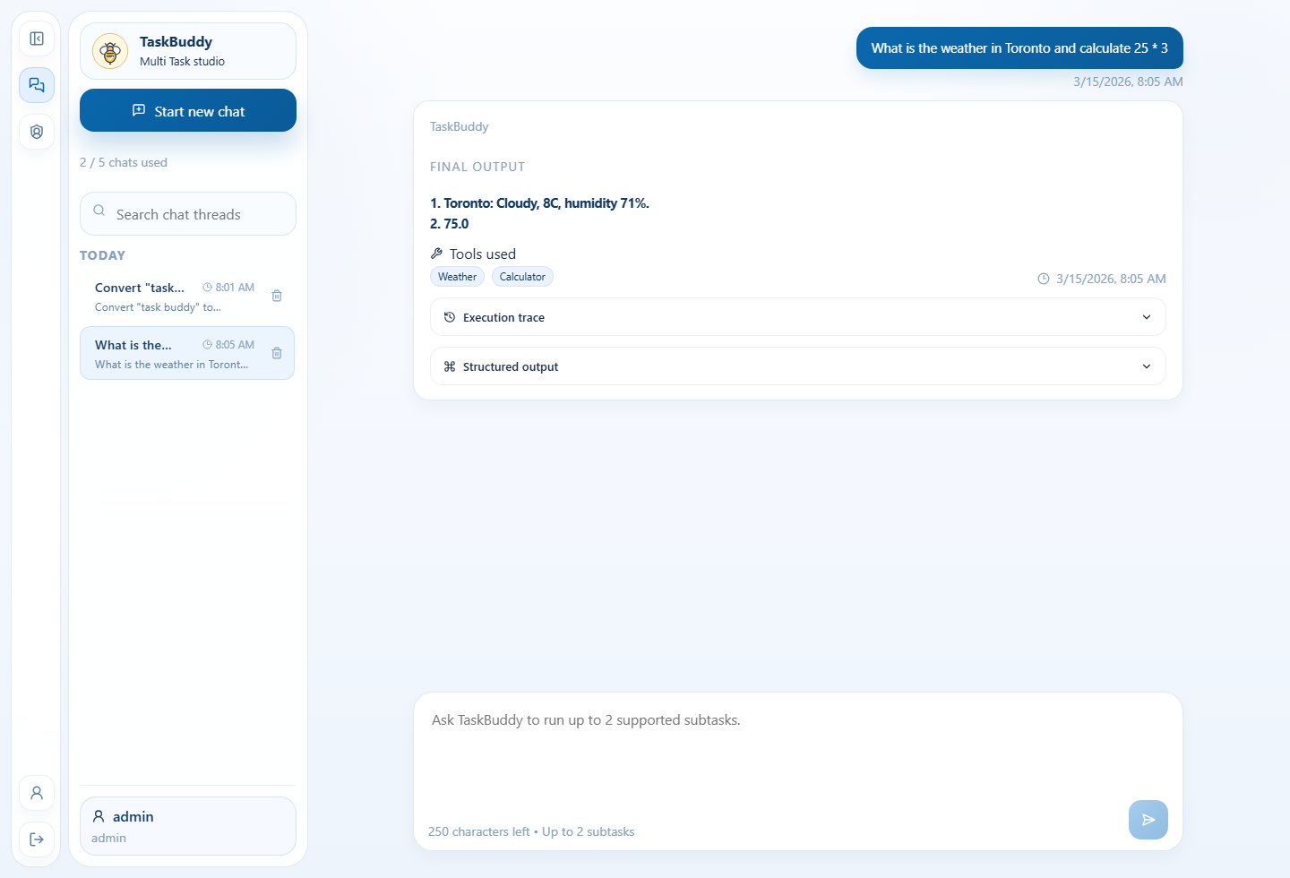
End-user workflow
Target 35s
Sign in, create a chat, and submit a supported prompt
Watch the response card update with final output, tools, structured data, and trace
Reopen history later from the thread sidebar
Multi-tool response and trace
TaskBuddy documentation pack
4
Notes:
The fastest way to demo the product is to start at the login screen, sign in as admin, create a new chat, and submit a simple text-processing request such as converting quoted text to uppercase. After that, switch to a multi-tool request so the audience can see the numbered final output and the two-step trace. This slide is where I call out the response-card order, the saved-thread history, and the fact that the active chat automatically scrolls to new output.

Slide 5

Tool catalog and sample prompts
Target 35s
Text processing, calculator, mock weather, currency conversion, and transaction categorization
Prompt routing is deterministic and documented in the technical guide
Manual test cases are included for every tool family
Validation example
TaskBuddy documentation pack
5
Notes:
TaskBuddy currently supports five tool families. Text processing handles case transforms and word or character counts. The calculator handles arithmetic expressions with natural-language operator phrases. The weather tool returns deterministic mock data for supported cities. The currency converter uses fixed rates for a small supported currency set. The transaction categorizer maps merchant descriptions to categories. The documentation pack includes sample prompts and manual tests so each tool can be validated quickly and consistently.

Slide 6
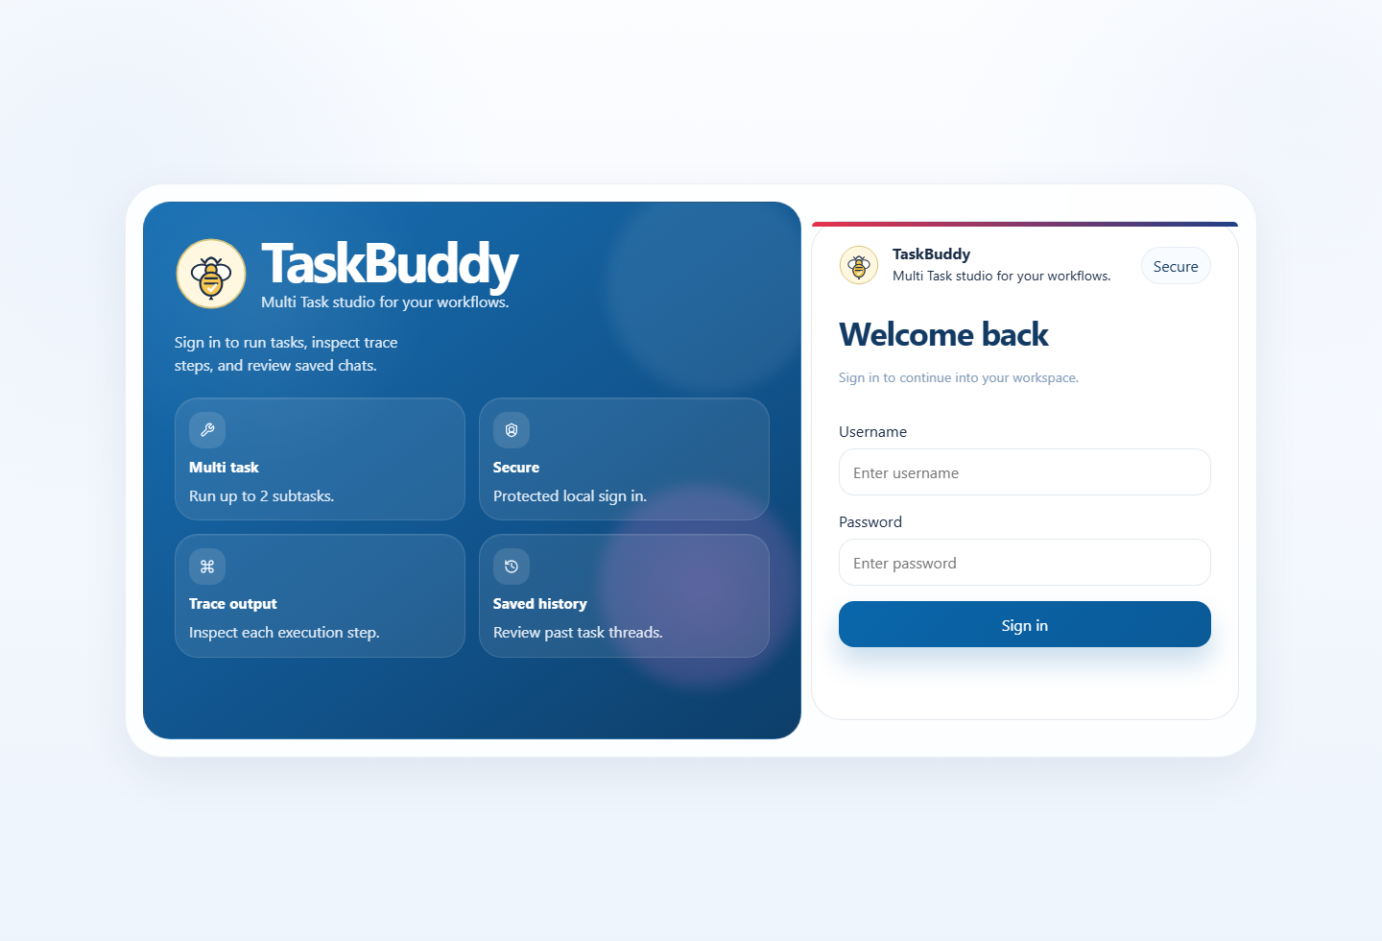
Access and run options
Target 30s
Run the app locally with one command from scripts/run-taskbuddy
Use Docker or Docker Compose when preferred
Build the documentation pack separately with its own .review-pack-venv
Sign-in screen
TaskBuddy documentation pack
6
Notes:
For normal app usage, the project exposes one-command startup scripts for Windows and for Linux, macOS, WSL, or Git Bash. Docker and Docker Compose are also documented. For documentation generation, the setup is now intentionally isolated: the app runtime keeps its own requirements in `.venv`, while the documentation pack uses `.review-pack-venv` and `requirements-review-pack.txt`. That means presentation, DOCX, Playwright, and video dependencies never pollute the app runtime environment.

Slide 7
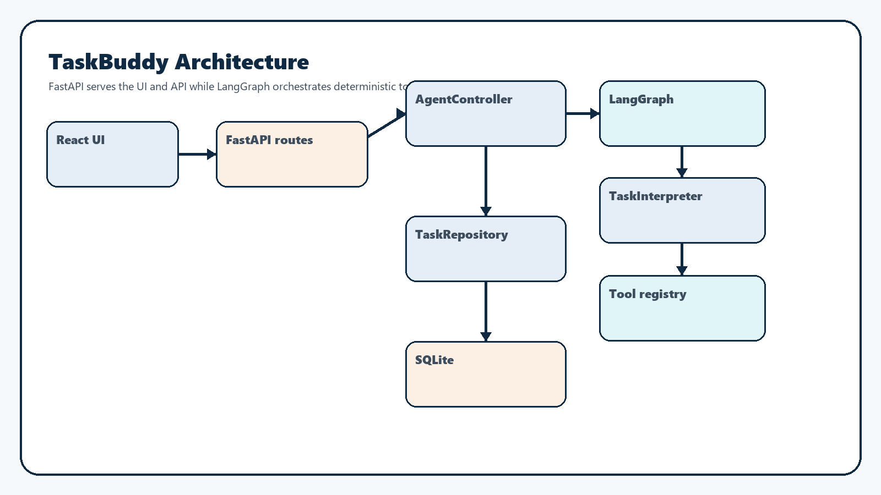
Architecture and LangGraph orchestration
Target 35s
FastAPI serves both the API and the built frontend
AgentController keeps a stable contract for the route layer
LangGraph drives validation, planning, tool execution, retry, and response assembly
Architecture overview
TaskBuddy documentation pack
7
Notes:
From a technical perspective, FastAPI serves both the REST and SSE APIs and the built frontend. The route layer hands task execution to the `AgentController`, which stays stable as the API-facing facade. Under that layer, LangGraph manages the orchestration stages: validation, planning, tool execution, retry handling, and response assembly. The actual tool selection remains deterministic through the interpreter, which means the graph improves structure and traceability without turning the app into a black-box model planner.

Slide 8
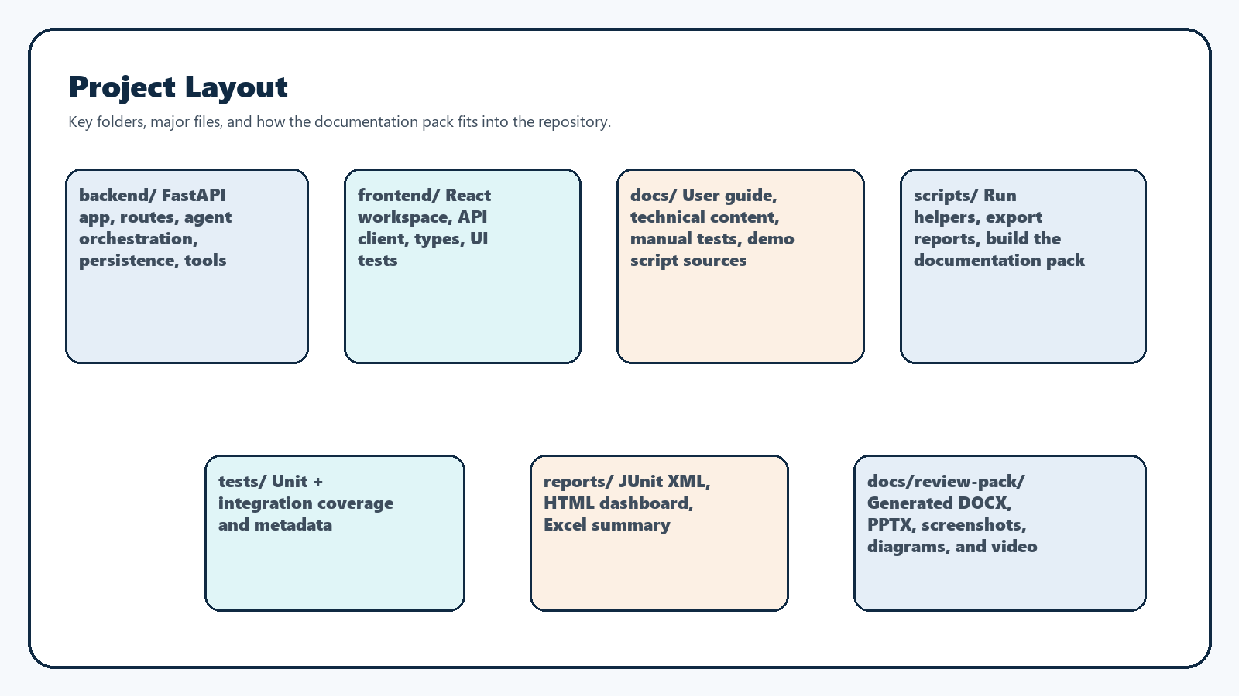
Folder structure, key files, and APIs
Target 45s
backend/, frontend/, docs/, scripts/, tests/, and reports each have a focused role
App entrypoints stay small while App.tsx, the interpreter, and the repository carry the main product logic
The technical documentation lists every major API endpoint and its purpose
Project layout overview
TaskBuddy documentation pack
8
Notes:
This slide ties the codebase back to the documentation. The `backend/` folder contains the FastAPI app, route definitions, persistence layer, safety checks, orchestration, and tool implementations. The `frontend/` folder contains the React app, API client, types, and tests. `docs/` holds the user guide, technical documentation, manual test plan, and demo script sources. `scripts/` holds the app launchers, report exporter, and documentation-pack generator. The technical document also lists the major endpoints and explains what each API exists to do.

Slide 9
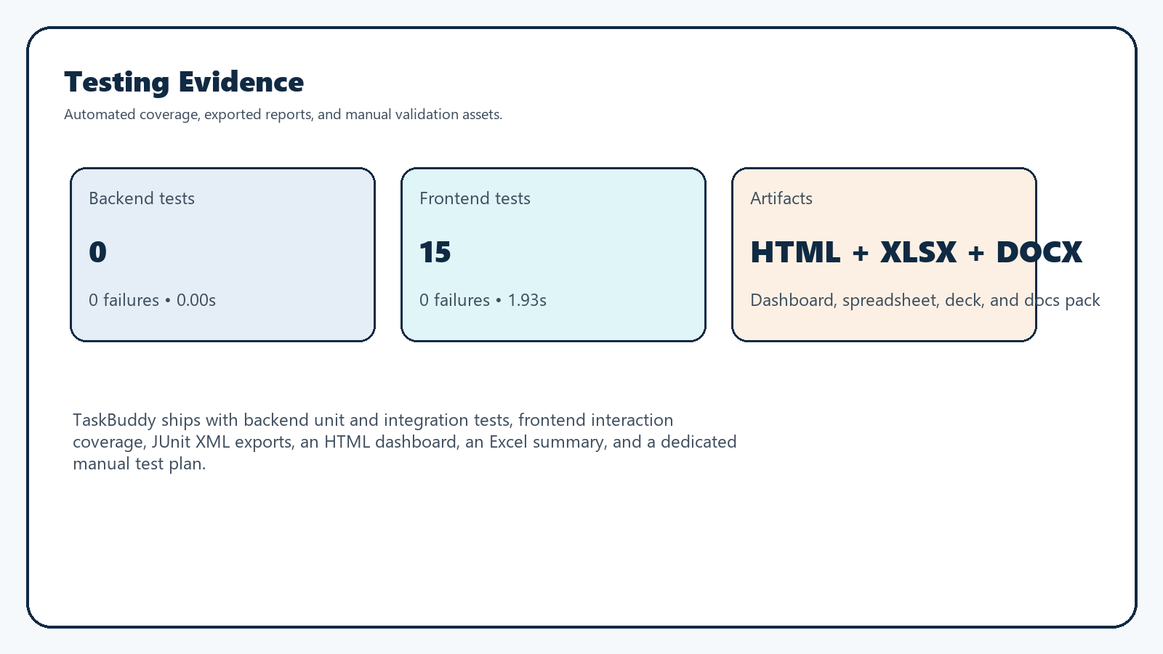
Testing evidence and outputs
Target 25s
Backend and frontend tests generate JUnit XML outputs
The report exporter builds an HTML dashboard and Excel summary
The manual test plan and user guide complement automated checks
Testing evidence summary
TaskBuddy documentation pack
9
Notes:
TaskBuddy includes automated backend and frontend coverage, plus exported evidence for review. Backend tests exercise the interpreter, controller, repository, tools, and API behavior. Frontend tests cover login, routing, thread limits, task-flow limits, auto-scroll, and admin interactions. JUnit XML outputs feed an HTML dashboard and an Excel summary, and the manual test plan adds tool-by-tool checks for local validation. Together, those assets make the product easier to assess from both correctness and presentation standpoints.

Slide 10
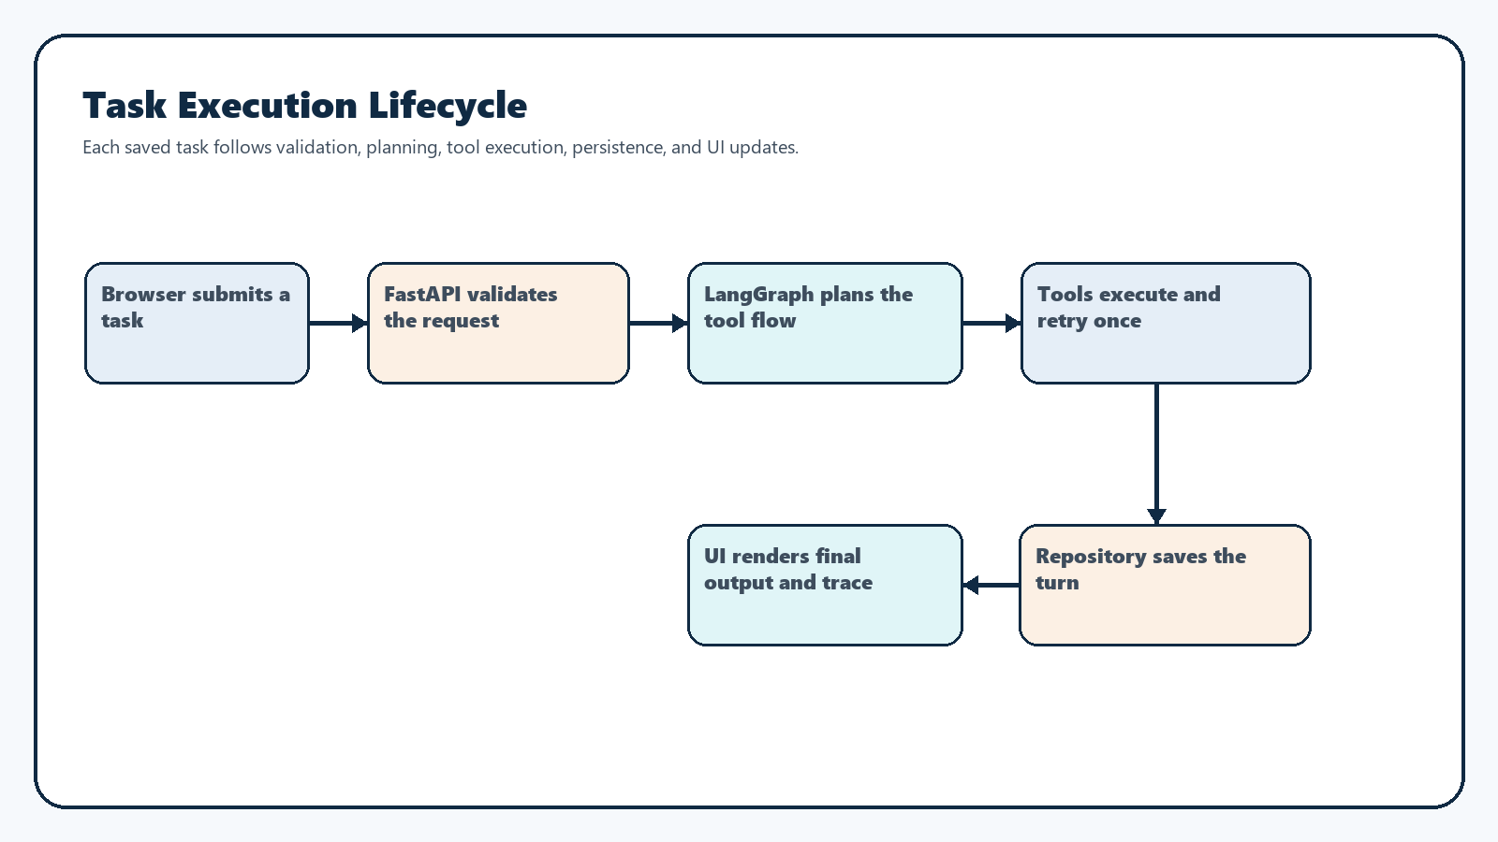
Limits and next improvements
Target 20s
Current limits are documented in the README and technical guide
The next technical improvements are model refinement, richer semantics, and more end-to-end automation
The documentation pack is reproducible without touching the runtime environment
Request lifecycle
TaskBuddy documentation pack
10
Notes:
The last slide closes with current limits and realistic next steps. The tool set is intentionally challenge-scoped, weather and currency data are mock-based, and routing remains deterministic for explainability. With more time, the biggest improvement area would be model refinement and richer semantic routing while preserving trace clarity. Other next steps include more end-to-end browser automation, deeper component modularization on the frontend, and continued improvement of the documentation pack and narrated demo workflow.

