Slide 1
Slip-Cast Ceramic Ocarina (OCA-001) — v3.1 smoke test
Musical instrument documentation capstone
Build packet: ocarina
Generated: 2026-05-02
Slip-Cast Ceramic Ocarina (OCA-001) — v3.1 smoke test | Slide 1 of 13

Slide 2
Project Intent
• Build a slip-cast ceramic Alto C 12-hole ocarina using a 3D-printed master and plaster mold workflow. The current table is focused on the standard "sweet potato" vessel-flute form, but the same model can be used as the baseline for sculptural vessel flutes.
Slip-Cast Ceramic Ocarina (OCA-001) — v3.1 smoke test | Slide 2 of 13

Slide 3
Physics Model
• Ocarinas behave primarily as Helmholtz resonators:
f = c/(2*pi) * sqrt(A_open/(V_chamber * L_eff))
Slip-Cast Ceramic Ocarina (OCA-001) — v3.1 smoke test | Slide 3 of 13

Slide 4
How To Use This Packet
• Start with design.md for intent and assumptions.
• Use bom.csv, sourcing.csv, and cut-list.csv before buying or cutting.
• Use drawing-brief.md and CAD/CNC folders before machining.
• Print the packet for shopping, shop work, and validation.
Slip-Cast Ceramic Ocarina (OCA-001) — v3.1 smoke test | Slide 4 of 13

Slide 5
File Map
• design.md: Project intent, catalog metadata, assumptions, and validation plan.
• bom.csv: Starter bill of materials with part categories, quantities, drawing refs, and notes.
• sourcing.csv: Supplier/search tracker with specs, price/date fields, lead time, substitutes, and risks.
• cut-list.csv: Rough/final stock sizes, material, grain/orientation, operations, yield, and offcuts.
• drawing-brief.md: Manufacturing drawing and technical product sketch brief.
• assembly-manual.md: Shop-facing sequence, tools, fixtures, safety, tuning, finishing, and maintenance notes.
• validation.csv: Target/measured values, tolerance, environment, result, and tuning/build action log.
• supplier-rfq.md: Supplier email/request-for-quote starter.
Slip-Cast Ceramic Ocarina (OCA-001) — v3.1 smoke test | Slide 5 of 13

Slide 6
Build Workflow
• Design and assumptions
• Source materials and hardware
• Prepare stock, fixtures, and CNC/laser/lathe setup
• Assemble, tune, finish, and validate
Slip-Cast Ceramic Ocarina (OCA-001) — v3.1 smoke test | Slide 6 of 13

Slide 7
Sourcing And BOM
• BOM gives part categories and drawing references.
• Sourcing tracks search terms, supplier candidates, price/date, lead time, substitutions.
• Visual BOM brief turns the parts list into a presentation-ready image board.
Slip-Cast Ceramic Ocarina (OCA-001) — v3.1 smoke test | Slide 7 of 13

Slide 8
Shop Packet
• Cut list for lumber/sheet/blank planning.
• Assembly manual for away-from-keyboard work.
• Validation sheet for measured dimensions, tuning, pass/fail checks.
Slip-Cast Ceramic Ocarina (OCA-001) — v3.1 smoke test | Slide 8 of 13

Slide 9
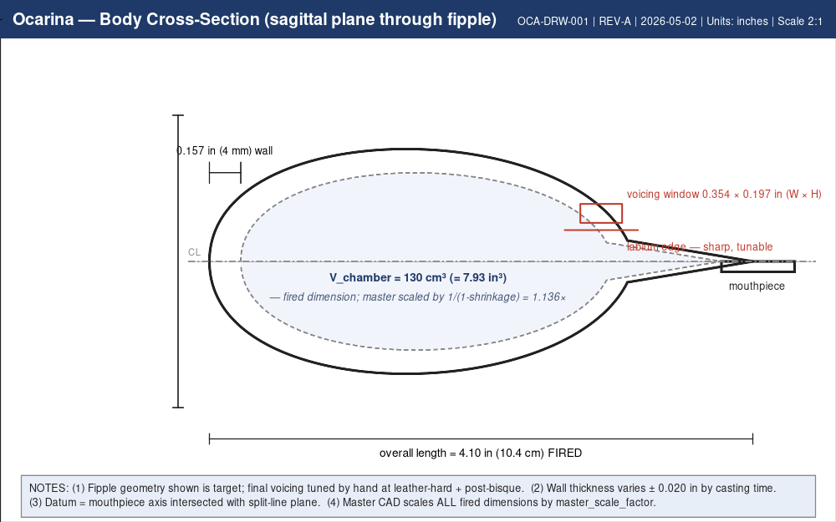
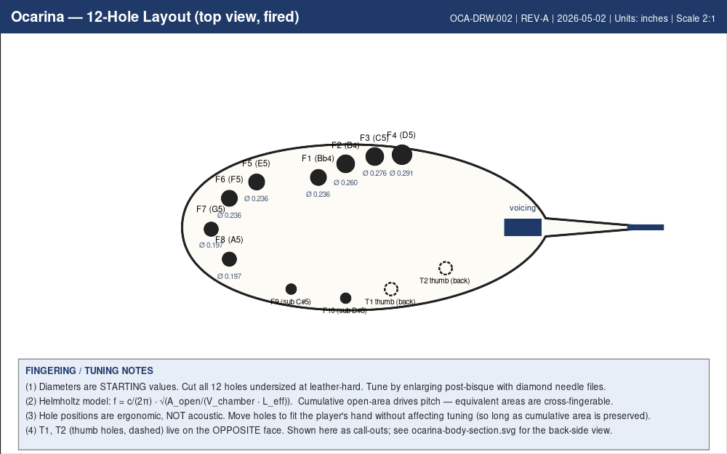
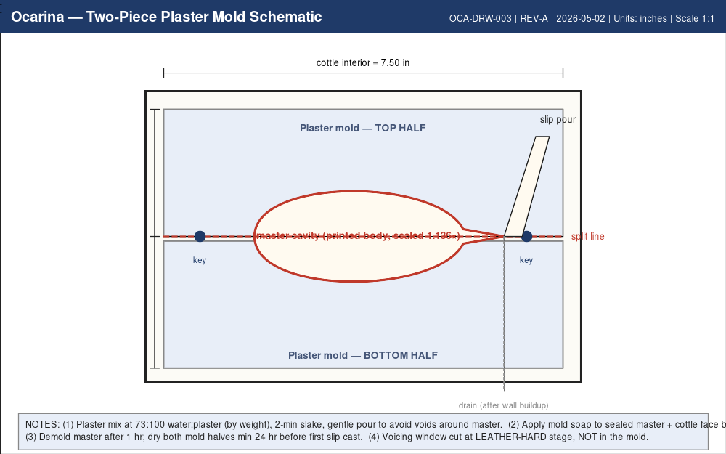
Drawings, CAD, CNC
• drawing-brief.md defines required views, dimensions, datums, sketch intent.
• cad/ holds models and design tables.
• cnc/ holds CAM, toolpaths, setup sheets, dry-run notes.
• drawings/ holds PDFs, SVGs, DXFs, drawing exports.
ocarina-body-section.png
ocarina-hole-layout.png
ocarina-mold-schematic.png
Slip-Cast Ceramic Ocarina (OCA-001) — v3.1 smoke test | Slide 9 of 13

Slide 10
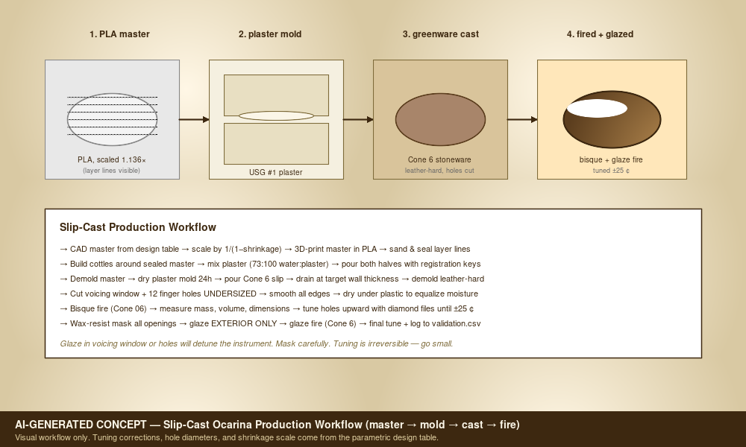
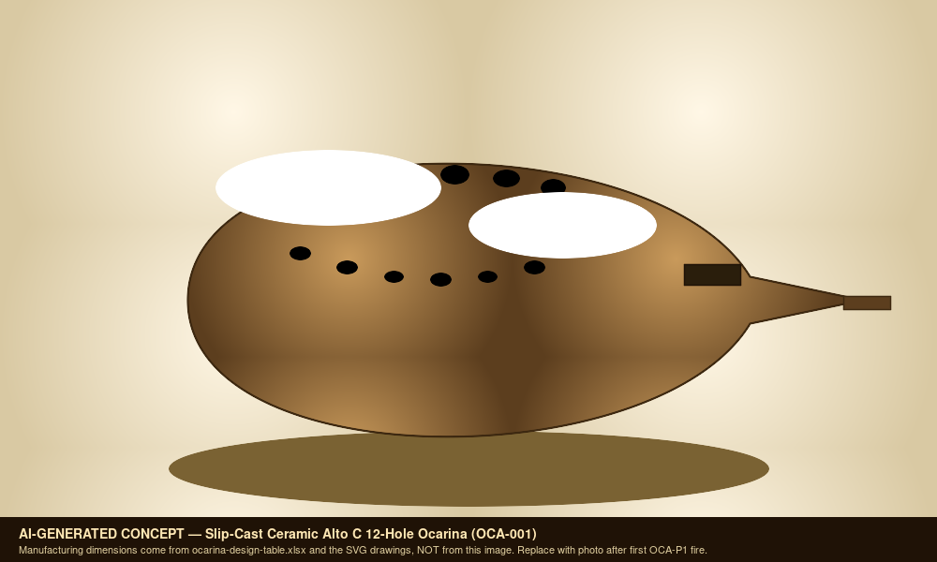
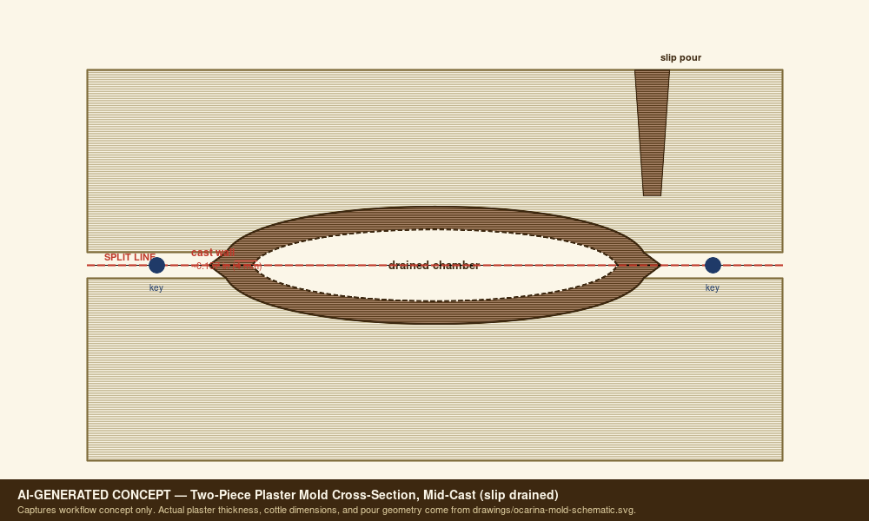
Images And Screenshots
• images\exploded-view-concept.png
• images\exploded-view-concept.svg
• images\hero-concept.png
• images\hero-concept.svg
• images\mold-cross-section-concept.png
• images\mold-cross-section-concept.svg
exploded-view-concept.png
hero-concept.png
mold-cross-section-concept.png
Slip-Cast Ceramic Ocarina (OCA-001) — v3.1 smoke test | Slide 10 of 13

Slide 11
Validation Plan
• A4 = 440 Hz reference check.
• Tuning targets logged in validation.csv.
• Critical dimensions verified against design sheet and CAD.
• Photos and revision notes after each major step.
Slip-Cast Ceramic Ocarina (OCA-001) — v3.1 smoke test | Slide 11 of 13

Slide 12
Open Risks / Decisions
• TBDs in design sheet and BOM.
• Supplier price/availability not yet verified.
• Generated images marked as concept placeholders.
• Empirical corrections await measured prototype data.
Slip-Cast Ceramic Ocarina (OCA-001) — v3.1 smoke test | Slide 12 of 13

Slide 13
Next Actions
• Replace TBDs with measured/source-backed values.
• Verify live supplier price and availability before buying.
• Export final drawings and visual BOM images.
• Regenerate this deck and print packet after final edits.
Slip-Cast Ceramic Ocarina (OCA-001) — v3.1 smoke test | Slide 13 of 13

