Slide 1
Slip-Cast Ceramic Udu Drum Family — v4.1 Capstone
Musical instrument documentation capstone
Build packet: udu
Generated: 2026-05-07
Slip-Cast Ceramic Udu Drum Family — v4.1 Capstone | Slide 1 of 15

Slide 2
Project Intent
• Build a slip-cast ceramic udu family — Small / Medium / Large / XL — with
repeatable chamber volumes and two playable Helmholtz tones: the main mouth
tone and the side-hole slap tone. The first production target is the
**Medium** standard udu (UDU-P2: 10 in × 12 in body, B3 mouth / G3 side),
followed by a scaled family. The udu (Igbo: *ụdụ*, "vessel") is a Nigerian
clay-vessel drum and the documentation here treats that lineage as fact, not
marketing.
Slip-Cast Ceramic Udu Drum Family — v4.1 Capstone | Slide 2 of 15

Slide 3
Physics Model
• The udu uses a shared chamber with two coupled Helmholtz resonators:
f_top = c/(2*pi) * sqrt( A_top / (V * L_top) )
f_side = c/(2*pi) * sqrt( A_side / (V * L_side) )
L = wall_thickness + 0.6 * sqrt(A/pi)
V = (pi/6) * body_diam^2 * body_height * shape_factor
Slip-Cast Ceramic Udu Drum Family — v4.1 Capstone | Slide 3 of 15

Slide 4
Hardware Alignment
• This repo is one of the slip-cast targets for the in-flight Bambu printer +
ceramic kiln pipeline shared with `ocarina/`, `gemshorn/`, and
`transverse-flute/`. The build chain:
Stage | Tool / pipeline | Notes
Design table | `udu-design-table.xlsx` Master_Inputs | Blue cells = inputs; volume formula derived
Master scaling | `master_scale_factor = 1/(1 - measured_shrinkage)` | Re-derive per slip batch — see risks.md SUP-01
Master print | Bambu X1C (UDU-S, UDU-M) or outsourced print (UDU-L, UDU-XL) | X1C envelope ≈ 256 mm; L/XL exceed it — see risks.md SUP-02
Mold | Two-piece plaster mother mold, USG #1 pottery plaster | Split line off the hand-contact equator
Cast | Cone 6 stoneware casting slip | Shrinkage coupon required per batch
Trim | Side hole cut at leather-hard, undersized | Final tune at bisque
Fire | Cone 06 bisque → Cone 6 glaze | Glaze exterior only
Validate | `validation.csv` mouth/side/coupled measurements | `record_measurement.py` updates per-family corrections
CAD round-trip | `UDU-000_MasterLayout.SLDPRT` ↔ `cad/sw-design-table.xlsx` | See `sw-reference/` for the SW workflow
Slip-Cast Ceramic Udu Drum Family — v4.1 Capstone | Slide 4 of 15

Slide 5
How To Use This Packet
• Start with design.md for intent and assumptions.
• Use bom.csv, sourcing.csv, and cut-list.csv before buying or cutting.
• Use drawing-brief.md and CAD/CNC folders before machining.
• Print the packet for shopping, shop work, and validation.
Slip-Cast Ceramic Udu Drum Family — v4.1 Capstone | Slide 5 of 15

Slide 6
File Map
• design.md: Project intent, catalog metadata, assumptions, and validation plan.
• bom.csv: Starter bill of materials with part categories, quantities, drawing refs, and notes.
• sourcing.csv: Supplier/search tracker with specs, price/date fields, lead time, substitutes, and risks.
• cut-list.csv: Rough/final stock sizes, material, grain/orientation, operations, yield, and offcuts.
• drawing-brief.md: Manufacturing drawing and technical product sketch brief.
• assembly-manual.md: Shop-facing sequence, tools, fixtures, safety, tuning, finishing, and maintenance notes.
• validation.csv: Target/measured values, tolerance, environment, result, and tuning/build action log.
• supplier-rfq.md: Supplier email/request-for-quote starter.
Slip-Cast Ceramic Udu Drum Family — v4.1 Capstone | Slide 6 of 15

Slide 7
Family Spec
member_id | target_note_mouth | target_hz_mouth | target_note_side | target_hz_side | body_diam_in | body_height_in | wall_thk_in | mouth_diam_in | side_diam_in | shape_factor | chamber_volume_cuin | predicted_hz_mouth | predicted_hz_side | cents_error_mouth | cents_error_side | master_scale_factor | clay_body | shrinkage_pct | reference_repo | notes
UDU-S | D#4 | 311.13 | A3 | 220.00 | 8.0 | 10.0 | 0.30 | 3.0 | 2.0 | 0.70 | 234.6 | 340.8 | 262.4 | +157 | +304 | 1.136 | Cone 6 stoneware | 12 | udu | Small/tabletop. Predictions sharp of targets — mouth dia likely needs to drop ~2.5 in OR shape factor increased to reduce predicted Hz; flag for empirical UDU-P1 measurement.
UDU-M | B3 | 246.94 | G3 | 196.00 | 10.0 | 12.0 | 0.30 | 3.0 | 2.0 | 0.70 | 439.8 | 248.9 | 191.6 | +14 | -39 | 1.136 | Cone 6 stoneware | 12 | udu | Medium/standard. Workbook prototype-1 target. Predictions within ±50¢ of targets — hits the v4 design-table band.
UDU-L | G#3 | 207.65 | D3 | 146.83 | 12.0 | 14.0 | 0.30 | 3.0 | 2.0 | 0.70 | 738.8 | 192.1 | 148.0 | -126 | +14 | 1.136 | Cone 6 stoneware | 12 | udu | Large/deep bass. Mouth prediction flat of target — port may need to enlarge slightly OR shape factor reduced; flag for empirical UDU-L measurement.
UDU-XL | F3 | 174.61 | C3 | 130.81 | 14.0 | 16.0 | 0.30 | 3.0 | 2.0 | 0.70 | 1148.7 | 153.9 | 118.5 | -220 | -172 | 1.136 | Cone 6 stoneware | 12 | udu | Concert bass. Predictions flat across both ports — XL may need port scaling (mouth 3.5+ in) to recover pitch; needs stand. Flag as design risk — see risks.md.
Slip-Cast Ceramic Udu Drum Family — v4.1 Capstone | Slide 7 of 15

Slide 8
Build Workflow
• Design and assumptions
• Source materials and hardware
• Prepare stock, fixtures, and CNC/laser/lathe setup
• Assemble, tune, finish, and validate
Slip-Cast Ceramic Udu Drum Family — v4.1 Capstone | Slide 8 of 15

Slide 9
Sourcing And BOM
• BOM gives part categories and drawing references.
• Sourcing tracks search terms, supplier candidates, price/date, lead time, substitutions.
• Visual BOM brief turns the parts list into a presentation-ready image board.
Slip-Cast Ceramic Udu Drum Family — v4.1 Capstone | Slide 9 of 15

Slide 10
Shop Packet
• Cut list for lumber/sheet/blank planning.
• Assembly manual for away-from-keyboard work.
• Validation sheet for measured dimensions, tuning, pass/fail checks.
Slip-Cast Ceramic Udu Drum Family — v4.1 Capstone | Slide 10 of 15

Slide 11
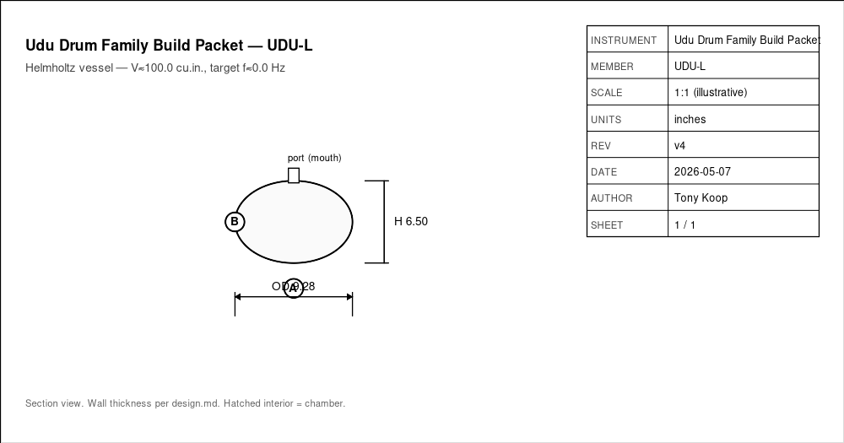


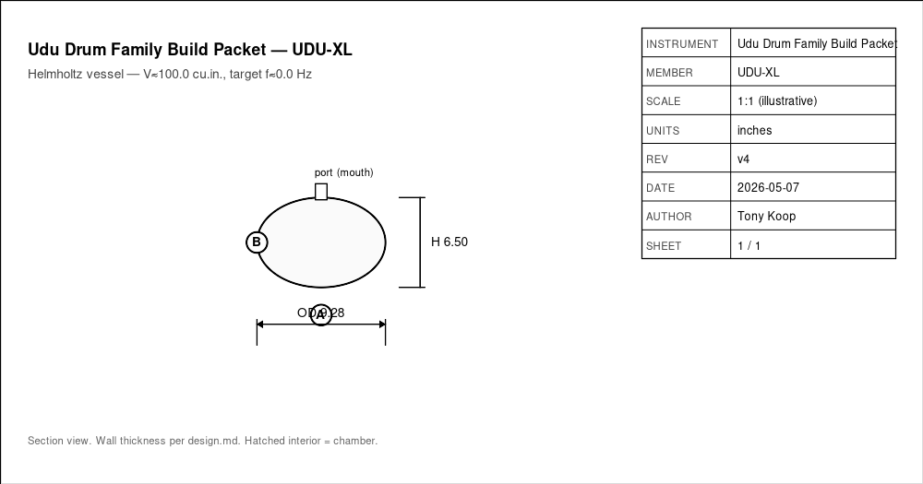
Drawings, CAD, CNC
• drawing-brief.md defines required views, dimensions, datums, sketch intent.
• cad/ holds models and design tables.
• cnc/ holds CAM, toolpaths, setup sheets, dry-run notes.
• drawings/ holds PDFs, SVGs, DXFs, drawing exports.
UDU-L-body.png
UDU-M-body.png
UDU-S-body.png
UDU-XL-body.png
Slip-Cast Ceramic Udu Drum Family — v4.1 Capstone | Slide 11 of 15

Slide 12
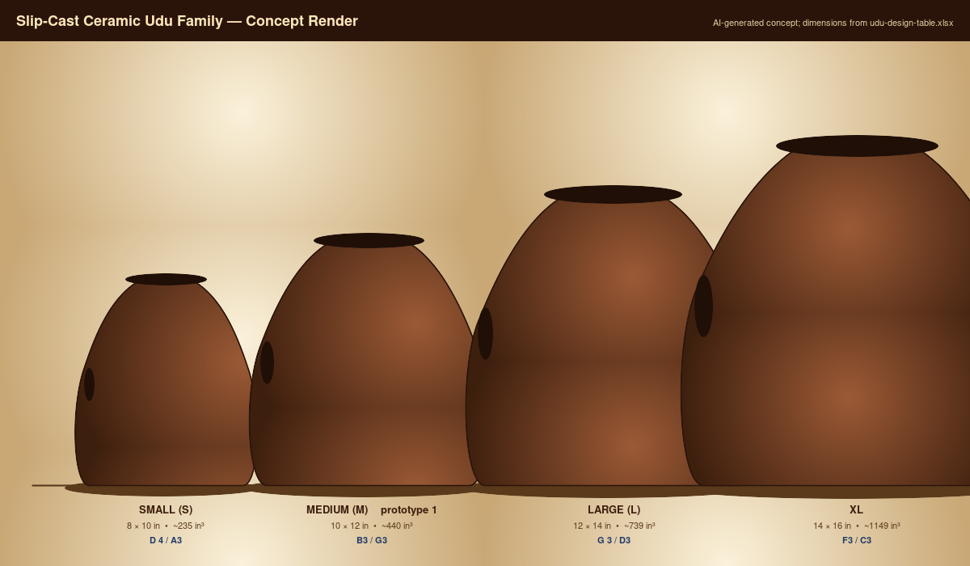

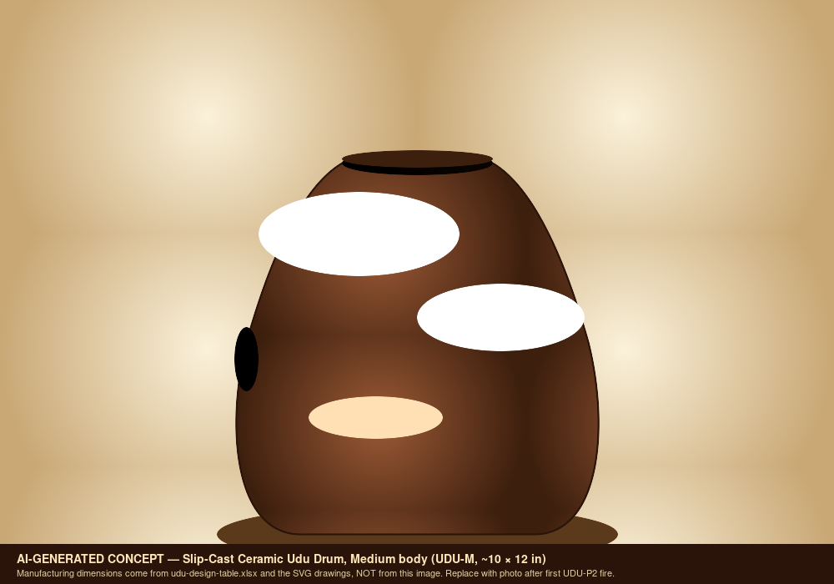

Images And Screenshots
• images/family-overview-concept.png
• images/family-overview-concept.svg
• images/hero-concept.png
• images/hero-concept.svg
family-overview-concept.png
family-overview-concept.png
hero-concept.png
hero-concept.png
Slip-Cast Ceramic Udu Drum Family — v4.1 Capstone | Slide 12 of 15

Slide 13
Validation Plan
• A4 = 440 Hz reference check.
• Tuning targets logged in validation.csv.
• Critical dimensions verified against design sheet and CAD.
• Photos and revision notes after each major step.
Slip-Cast Ceramic Udu Drum Family — v4.1 Capstone | Slide 13 of 15

Slide 14
Open Risks / Decisions
• TBDs in design sheet and BOM.
• Supplier price/availability not yet verified.
• Generated images marked as concept placeholders.
• Empirical corrections await measured prototype data.
Slip-Cast Ceramic Udu Drum Family — v4.1 Capstone | Slide 14 of 15

Slide 15
Next Actions
• Replace TBDs with measured/source-backed values.
• Verify live supplier price and availability before buying.
• Export final drawings and visual BOM images.
• Regenerate this deck and print packet after final edits.
Slip-Cast Ceramic Udu Drum Family — v4.1 Capstone | Slide 15 of 15

