Slide 1
Unit 1
Basic Digital Logic
EL-GY 9463: Introduction to Hardware Design
ProfS. Sundeep Rangan, Siddharth Garg

Slide 2
Learning Objectives
Write SystemVerilog descriptions for simple hardware modules
Draw high-level block diagram representations of the module implementations
Identify the critical path and its delay from the block diagram
Implement simple functions in synchronous logic
Visualize signals in a timing diagram
Write a testbench for the hardware modules
Simulate, and synthesize the SystemVerilog using Vivado tools
Extract value-change dump (VCD) files and synthesis reports and process them in python

Slide 3
Outline
Combinational Logic
Timing Diagrams for Combinational Logic
Registers, Clocks and Sequential Logic
Simulating and Synthesizing Simple Modules in Vivado

Slide 4





Simple Example: ReLU + Linear
Goal: Implement a module for the function
$$y=\max\left\{ax+b, 0\right\}$$
  Linear function + ReLU
  Used widely in machine learning
$$x$$
Input ports
$$a$$
$$y$$
Output port
$$b$$

Slide 5
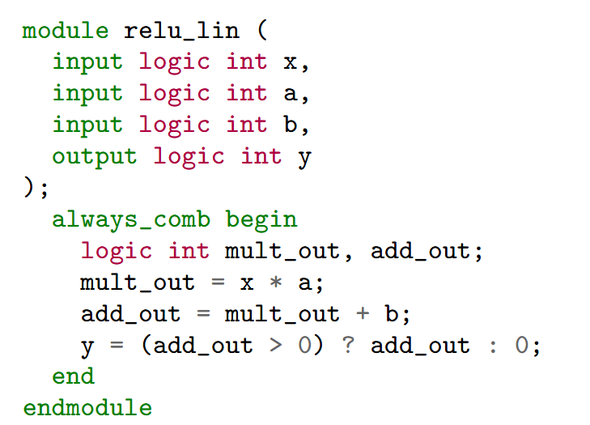
SystemVerilog Description
SystemVerilog:
  Language for behavioral description
  What the module should do
Each block is a module
  Has inputs and outputs
  Logical mapping from inputs to outputs
Description is behavioral only
  Does not say how it will be implemented
  We discuss that later

Slide 6
Module Components in SV
Module name
Ports:
  Defines inputs and outputs
  Each has a type (e.g., int)
Behavioral description
  In this case, a combinational block
  Sequence of operations
  From input to output

Slide 7


System Verilog vs Verilog
Verilog
  Created in 1983-84
  Standardized in 1995. Became mainstream RTL
  Largely used for legacy designs
System Verilog (this unit)
  Developed in 2002
  Extends Verilog
  Better abstraction, parameterization
  Significantly improved testbench
  Overwhelming design choice today

Slide 8
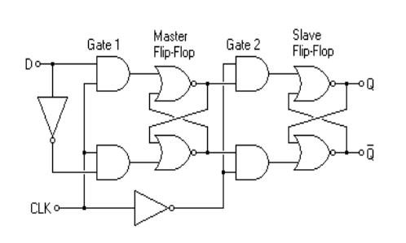
Synthesis
Behavioral Description
What module does?
Ex: Verilog, HLS, SV
Implementation
How functions maps to hardware
Synthesis

Slide 9
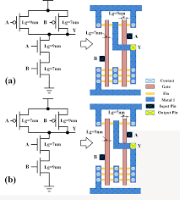
Implementation Depends on the Target
Components for implementation depend on target
Gate‑level netlist (classic implementation)
  AND, OR, XOR, NOT gates
  Multiplexers, adders, subtractors, flip‑flops, latches
Technology‑mapped standard cells for ASICs
  NAND2_X1, DFFR_X2, AOI21_X4, INV_X1
  Actual cells in foundry’s library
FPGA primitives
  DSP units, LUTS, BRAM, …
FinFET NAND gate
Cui, Tiansong, et al. "An exploration of applying gate-length-biasing techniques to deeply-scaled FinFETs operating in multiple voltage regimes." IEEE Transactions on Emerging Topics in Computing 6.2 (2016): 172-183.

Slide 10
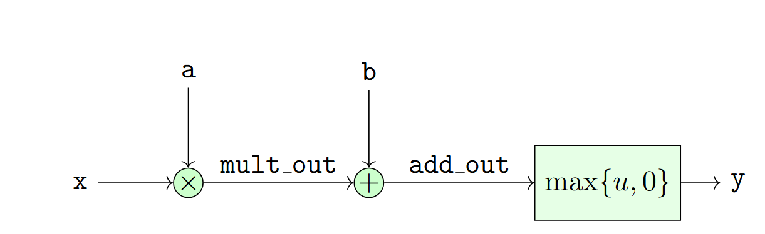
Block Diagram
Function of a module typically represented by a block diagram
Graphical representation of a potential implementation
Typically, diagram is at high-level
  Adders, multipliers not low-level details components like gates

Slide 11
Outline
Combinational Logic
Timing Diagrams for Combinational Logic
Registers, Clocks and Sequential Logic
Simulating and Synthesizing Simple Modules in Vivado

Slide 12
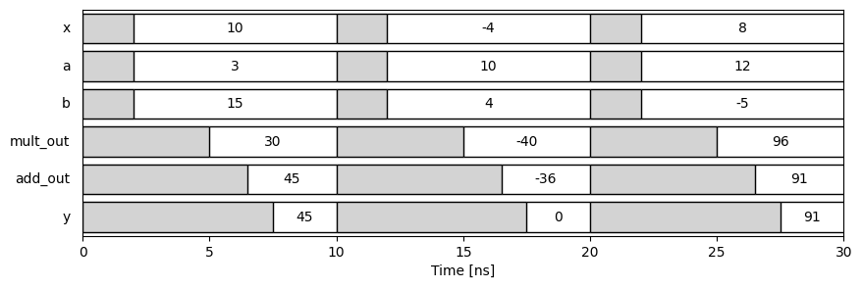
Timing Diagrams
Graphical representation of the signals in the circuit over time
Key to analyzing circuits
Demonstrates:
  Sequence of operations
  Latency in each step
  Critical paths

Slide 13
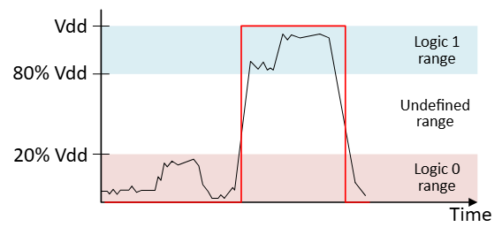
Binary Signals
Signal: Any time-varying quantity
Digital Binary Signals:
  Two logical values: 0 or 1
  Physically: Typically, a continuous voltage
  Logical value by thresholding
Other signals (e.g. integer, floats) built from binary signals

Slide 14
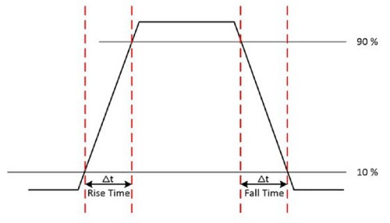
Undefined Logic Value: ‘X’
Signals take time to transition
  They are outputs of physical circuits
  Gates, computational units, …
Creates an undefined period
  Also called indeterminate, unknown, …
Usually denoted as X
So binary logic signals have three values:
  0, 1 and X
  Will discuss a fourth value Z later
0
X
1
X
0

Slide 15
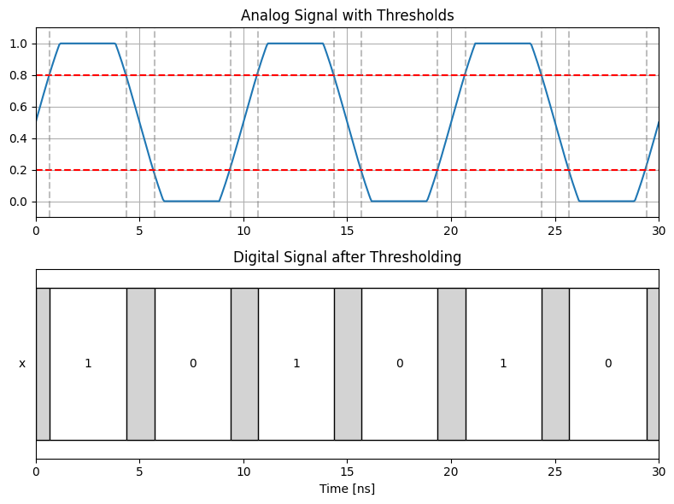
Undefined Regions Illustrated
Analog physical signal
  Typically, a voltage
  Continuous valued
  Has finite transition periods
Digital logic signal
  Three values 0, 1 and X
  X value shown in gray
X
X
X
X
X

Slide 16
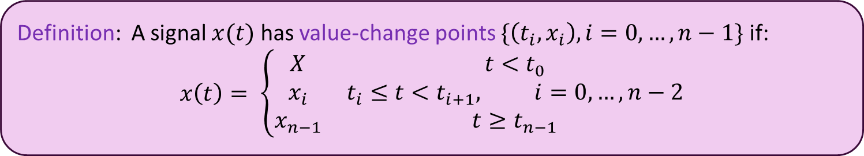
Value-Change Points
In digital logic, signals are often described by their value-change points
  Value change points also called valued change events, transitions, …
Definition: A signal $x(t)$ has value-change points $\{\left(t_{i},x_{i}\right), i=0, …, n−1\}$ if:
$$x\left(t\right)= \left\{\begin{matrix}X & t<t_{0} \\ x_{i} & t_{i}≤t<t_{i+1}, i=0,…,n−2 \\ x_{n−1} & t≥t_{n−1}\end{matrix}\right.$$

Slide 17
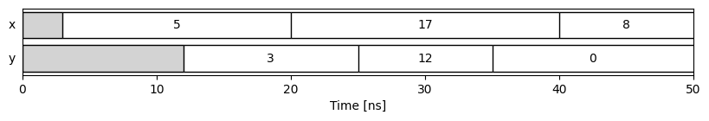

Timing Diagram
Timing diagram: A plot of signals over time showing with value-change points
Example with two signals:
VC points for $x$ : {(3,5), (20,17), (40,8)}
VC points for $y$ : {(12,3), (25,12), (35,0)}
In this plot, times are in ns

Slide 18
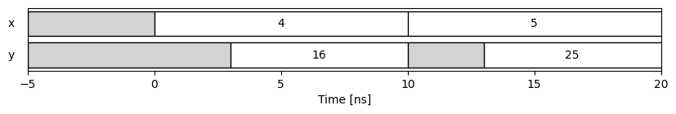


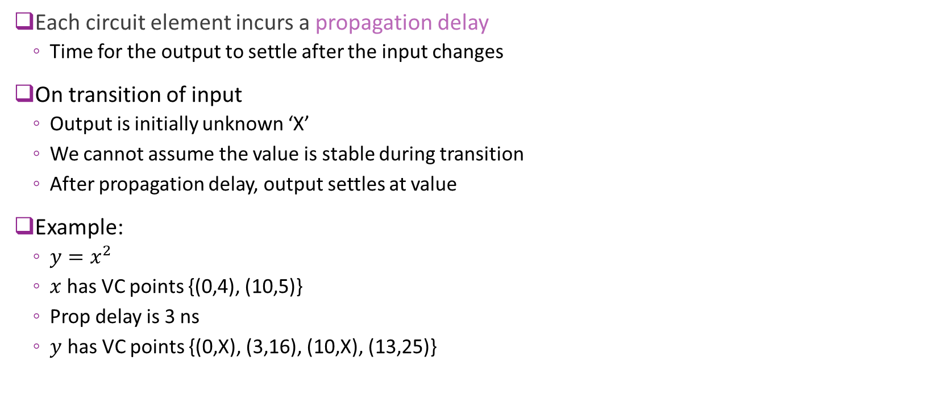


Propagation Delays
Each circuit element incurs a propagation delay
  Time for the output to settle after the input changes
On transition of input
  Output is initially unknown ‘X’
  We cannot assume the value is stable during transition
  After propagation delay, output settles at value
Example:
  $y=x^{2}$
  $x$ has VC points {(0,4), (10,5)}
  Prop delay is 3 ns
  $y$ has VC points {(0,X), (3,16), (10,X), (13,25)}
$$x$$
$$y=x^{2}$$
$T_{prop}=3$ ns
$T_{prop}=3$ ns

Slide 19

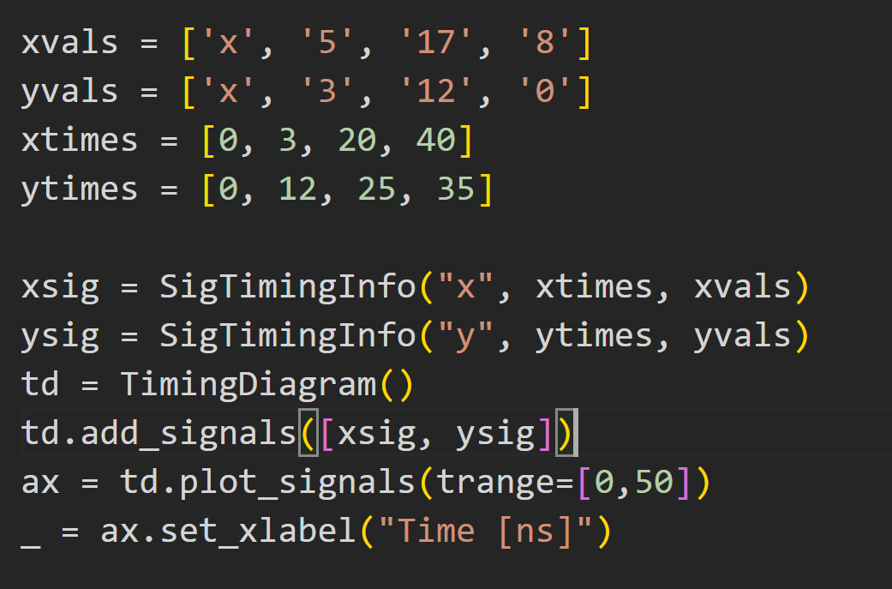
Drawing Timing Diagrams in Python
Course repo contains a xilinxutils package
  Custom package in this class
  Many helper routines for Xilinx tools
Tools for parsing and visualizing VCD files
Code to produce timing diagram

Slide 20




Propagation Delays of a Series
Our example: Three propagation delays
  Multiplier
  Adder
  Max operator
Propagation delays will add
Called the total propagation delay
  Or total path delay
Key property: When input $x$ changes
  All downstream values initially go to X
$$T_{mult}$$
$$T_{add}$$
$$T_{max}$$

Slide 21
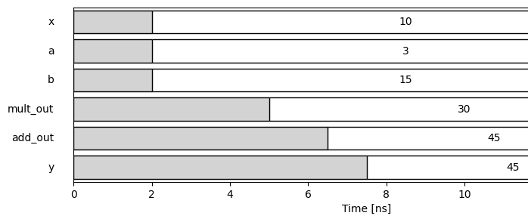


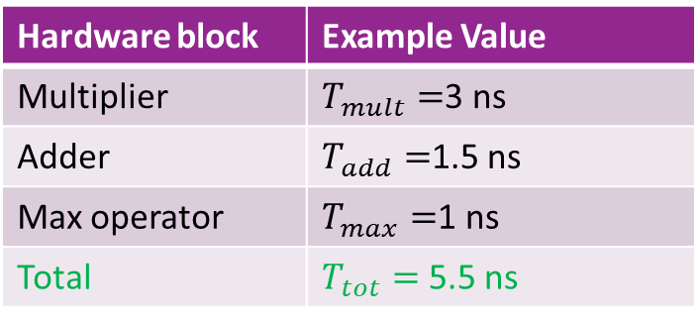


Example Total Propagation Delay
Hardware block | Example Value
Multiplier | $T_{mult}=$3 ns
Adder | $T_{add}=$1.5 ns
Max operator | $T_{max}=$1 ns
Total | $T_{tot}=$5.5 ns
$$T_{max}$$
$$T_{mult}$$
$$T_{add}$$
$T_{tot}=5.5$ns

Slide 22
Example Timing Over Multiple Inputs

Slide 23
Typical Propagation Delays: Low-End FPGA
Hardware block | FPGA resource | Typical range
32-bit adder | LUT + dedicated carry chain | 1.5–3.0 ns
16-bit multiplier | DSP48E1 block | 2.5–5.0 ns
16-bit comparator | LUT logic + carry chain | 1.0–2.0 ns
Rough delays for a low-end FPGA (e.g., Pynq Z2)
We will explain the FPGA resources more in later units
Routing delays not included
  May be large for more complex designs

Slide 24
Typical Propagation Delays: ASIC
Hardware block | Typical structure | Typical range
32-bit adder | Kogge‑Stone / Brent‑Kung / hybrid | 150-450 ps
16-bit multiplier | Wallace/Dadda tree + final adde | 300-700 ps
16-bit comparator | XOR/AND/OR chain with early‑out | 50-300 ps
Rough delays for TSMC 16nm
Custom ASICs are much faster than FPGAs
  Easily 5 to 10x faster

Slide 25
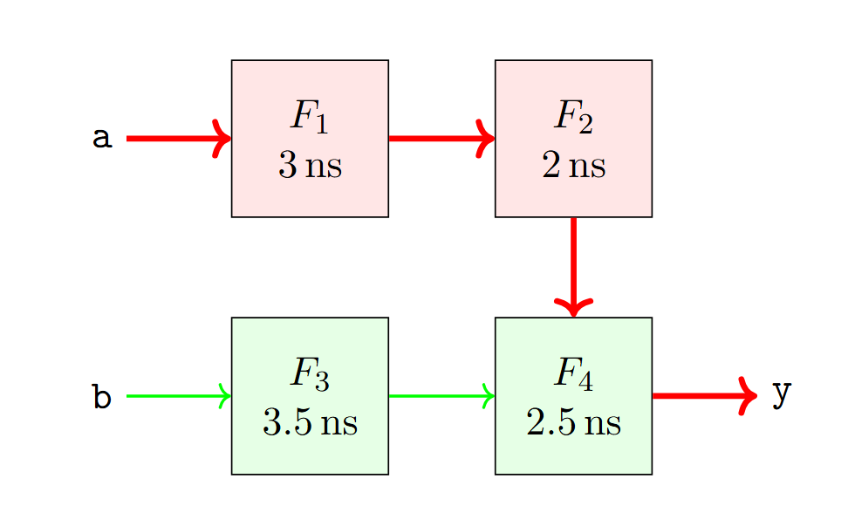
Critical Path
Signals may need to propagate over multiple paths
Each path accumulates different path delay
  Total propagation time on path
Critical path:
  The path with the highest total propagation delay
Critical path will determine total delay of module

Slide 26
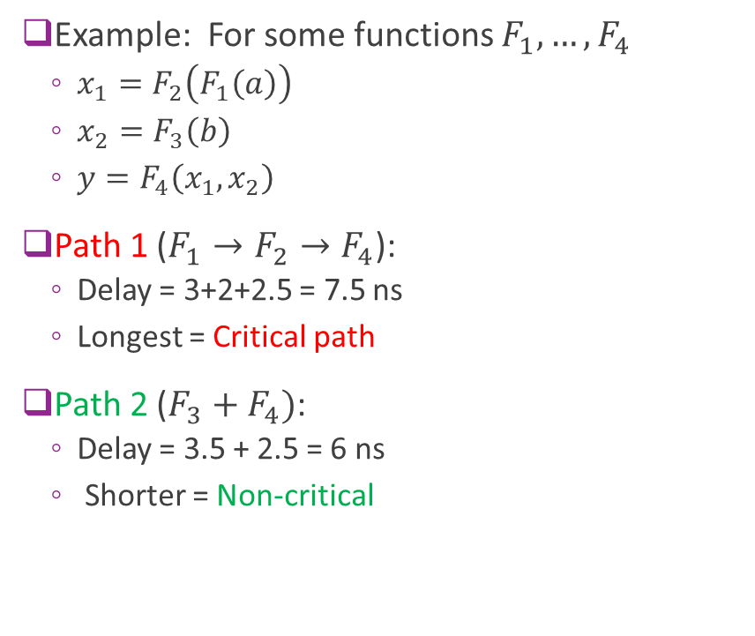
Critical Path Example
Example: For some functions $F_{1},…,F_{4}$
  $x_{1}=F_{2}\left(F_{1}\left(a\right)\right)$
  $x_{2}=F_{3}\left(b\right)$
  $y=F_{4}\left(x_{1},x_{2}\right)$
Path 1 ($F_{1}→F_{2}→F_{4}$):
  Delay = 3+2+2.5 = 7.5 ns
  Longest = Critical path
Path 2 ($F_{3}+F_{4})$:
  Delay = 3.5 + 2.5 = 6 ns
  Shorter = Non-critical

Slide 27
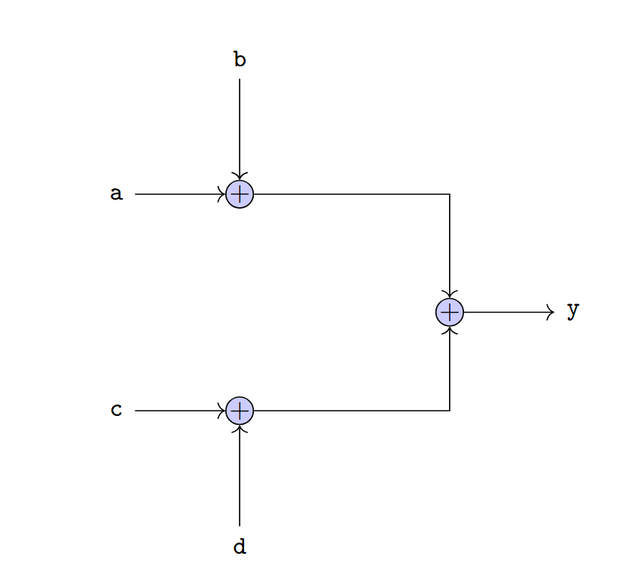
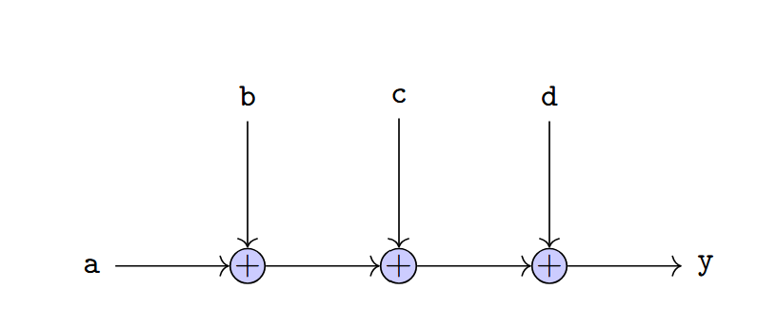

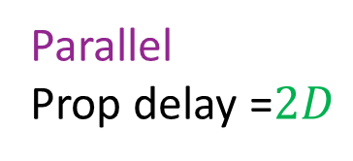
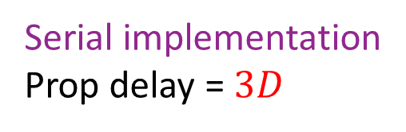
Delay Depends on Implementation
Example: Consider $y=a+b+c+d$
Suppose each add takes $D$ seconds
Synthesis tools try to find low delay implementations
Serial implementation
Prop delay = $3D$
Parallel
Prop delay =$2D$

Slide 28
Outline
Combinational Logic
Timing Diagrams for Combinational Logic
Registers, Clocks and Sequential Logic
Simulating and Synthesizing Simple Modules in Vivado

Slide 29
Limitations of Combinational Logic
No memory — cannot store past values
Output changes immediately with input changes (no control over timing)
Long combinational paths lead to large propagation delays
Hard to build large systems without controlled timing boundaries
Glitches and hazards can propagate freely
No notion of “steps” or “cycles” — everything is continuous

Slide 30
Synchronous (Sequential) Logic
Introduces state via flip‑flops or registers
Breaks long logic into clocked stages, improving performance
Provides predictable timing — changes only occur on clock edges
Makes large systems modular and easier to reason about
Eliminates most hazards/glitches from propagating across stages
Enables pipelining, finite‑state machines, and sequential algorithms
Allows clean interfaces between modules (valid/ready, handshakes, etc.)
Synchronous logic is the dominant paradigm for design

Slide 31
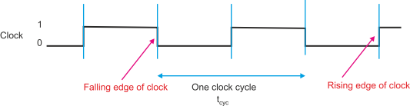

Clock Signal
Clock: An alternating binary signal
  Visualized as a square wave
Each period is called a clock cycle
  Typically, between two rising edges
Parameters:
  Clock period $T$
  Frequency $f=\frac{1}{T}$
Typical parameters:
  FPGA logic: 100 to 500 MHz
  ASIC: 500 MHz to 1 GHz

Slide 32
Synchronous Logic
Key idea: Save system state on each rising edge
Save state in a storage element
  This unit we will use registers (next slide)
Brings system to a known state in each cycle
Computation can be performed in known steps

Slide 33
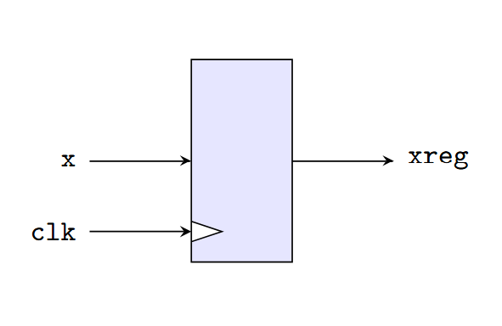
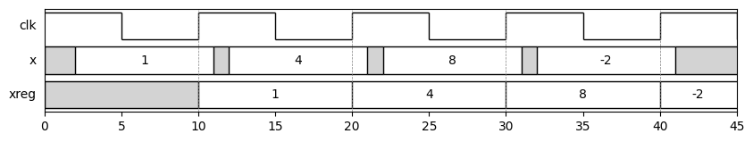
Register
Basic storage element in synchronous logic
On each rising edge of clk:
  Assigns xreg to x
Value of xreg is maintained even if x changes
Example below: Input is “sampled” at rising edges
  Unknown periods not propagated

Slide 34
Register
Samples input at each rising edge
Input may have X values
  Not propagated assuming input is vald on positive edges

Slide 35
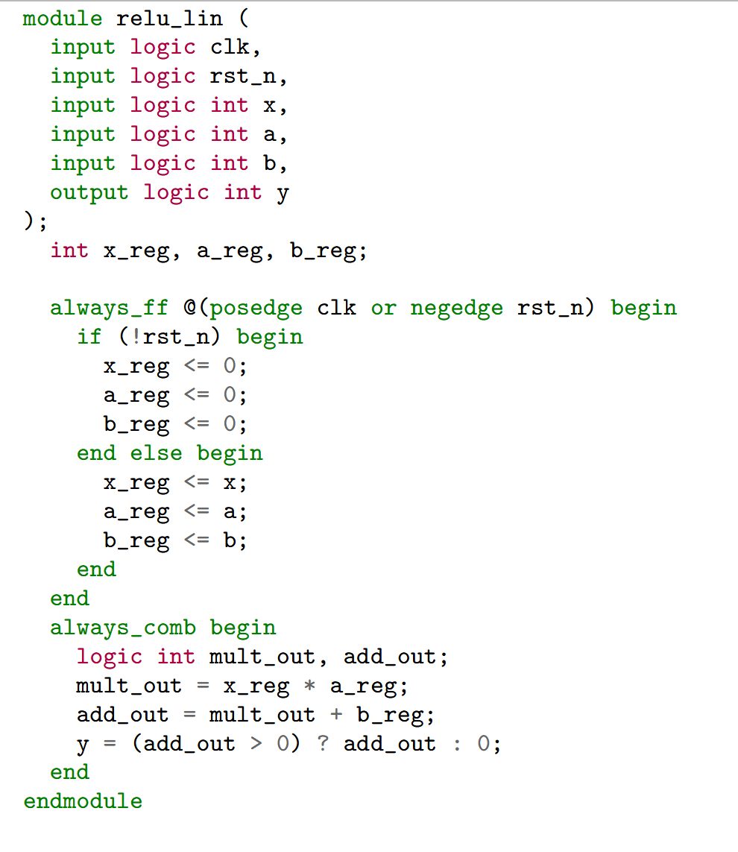
Making the Module Synchronous
Making module synchronous is easy
First add two inputs to ports
  Clock signal
  Reset on negative edge
Clock
Reset

Slide 36
System Verilog Main Body
Synchronous logic has two parts
always_ff:
  Assigns register outputs
  All operations are in parallel (non-blocking)
  Our example: Saves inputs to registers
always_comb:
  Assigns signals via combinational logic
  Operations are sequential (blocking)
  Our example: Computes output from registered inputs

Slide 37
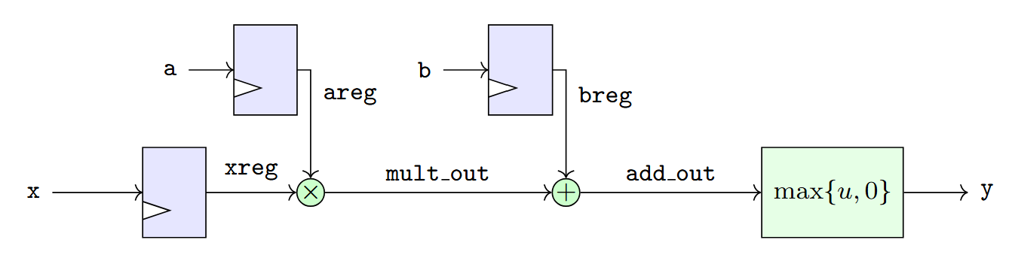
Synchronous Block Diagram
Inputs are registered
Output is combinational from input

Slide 38
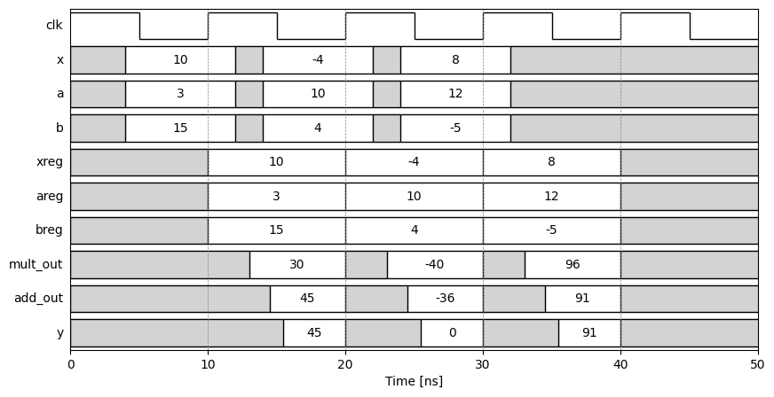
Synchronous Timing Diagram
Clk period = 10 ns
Clk frequency = 100 MHz

Slide 39
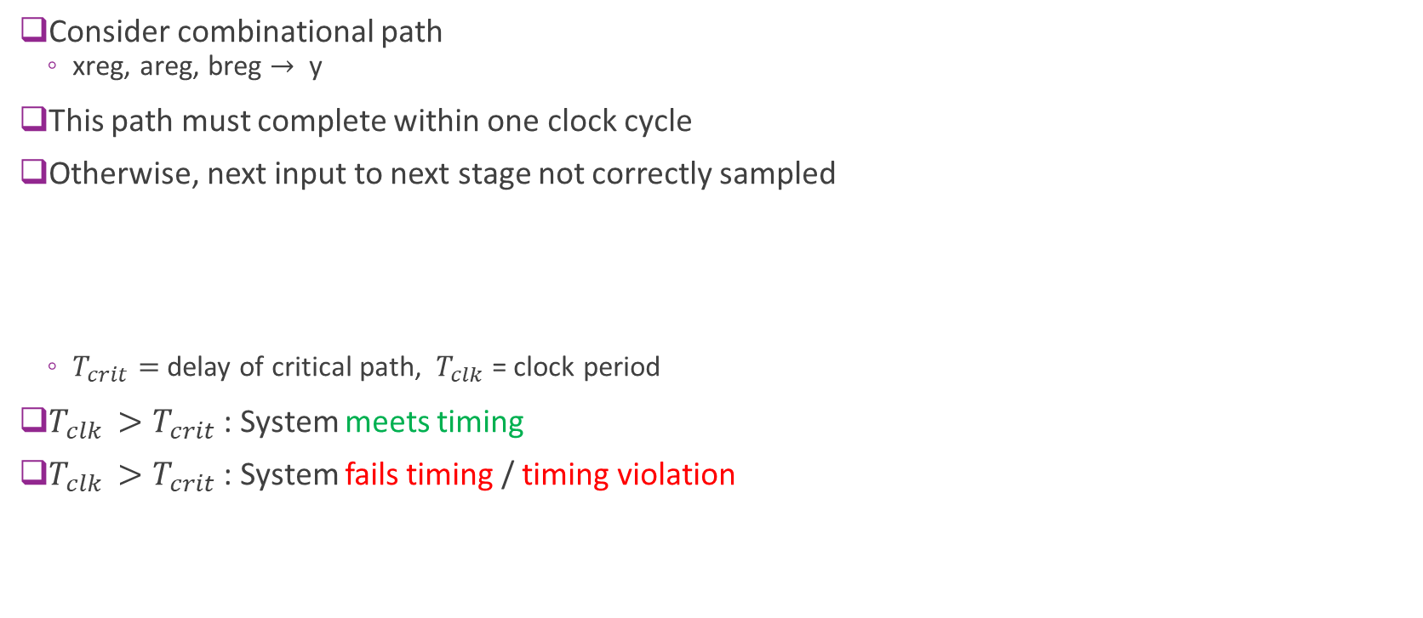

Maximum Clock Frequency
Consider combinational path
  xreg, areg, breg $→$ y
This path must complete within one clock cycle
Otherwise, next input to next stage not correctly sampled
  $T_{crit}=$ delay of critical path, $T_{clk}$ = clock period
$T_{clk }>T_{crit}$: System meets timing
$T_{clk }>T_{crit}$: System fails timing / timing violation
To meet timing: $T_{clk}>T_{crit}$

Slide 40
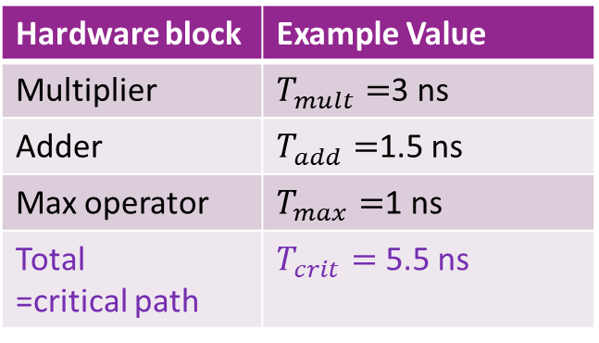
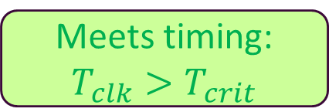


ReLU+Linear Example
Hardware block | Example Value
Multiplier | $T_{mult}=$3 ns
Adder | $T_{add}=$1.5 ns
Max operator | $T_{max}=$1 ns
Total =critical path | $T_{crit}=$5.5 ns
$T_{crit}=5.5$ns
Meets timing: $T_{clk}>T_{crit}$
$T_{clk}=10$ns

Slide 41

Max Clock Frequency Example
Max clock frequency in our example:
  Min $T_{clk}=T_{crit}=5.5$ ns
  Max clock frequency = $\frac{1}{5.5}≅180$MHz
$T_{crit}=5.5$ns
$T_{clk}=10$ns

Slide 42
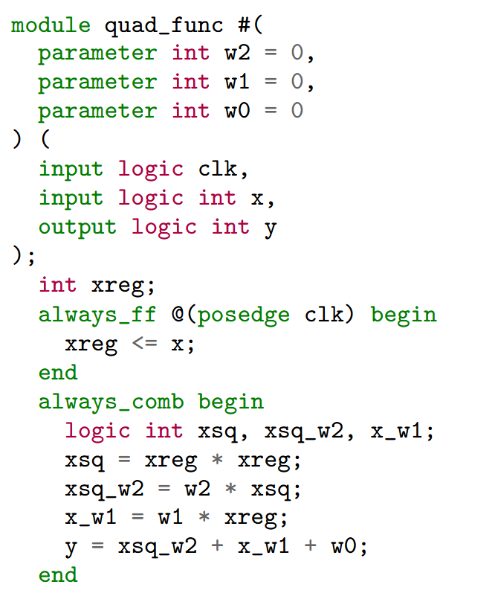
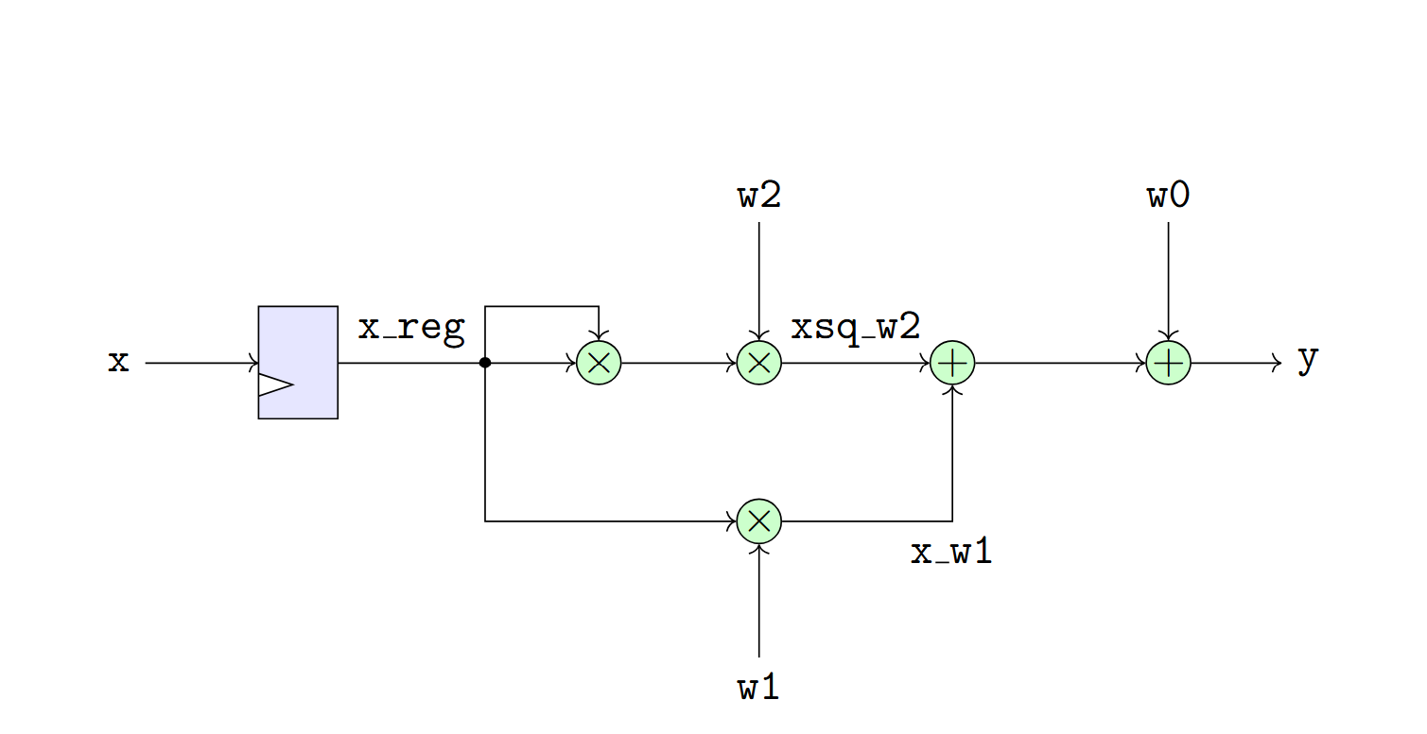

A More Complex Example
Consider a quadratic function: $y=w_{2}x^{2}+w_{1}x+w_{0}$
For simplicity, assume $w_{0},w_{1},w_{2}$ are fixed parameters
Single cycle implementation to the right

Slide 43
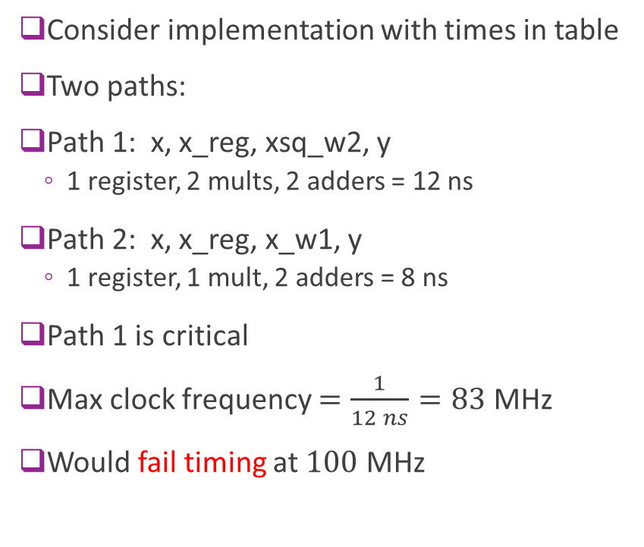
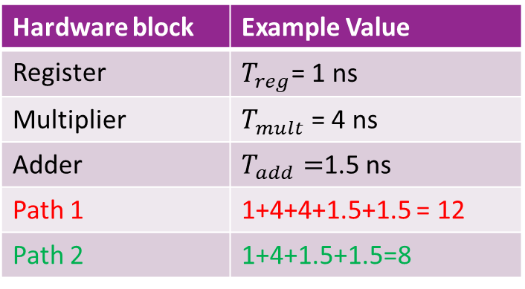
Finding the Critical Path
Hardware block | Example Value
Register | $T_{reg}$= 1 ns
Multiplier | $T_{mult}$ = 4 ns
Adder | $T_{add}=$1.5 ns
Path 1 | 1+4+4+1.5+1.5 = 12
Path 2 | 1+4+1.5+1.5=8
Consider implementation with times in table
Two paths:
Path 1: x, x_reg, xsq_w2, y
  1 register, 2 mults, 2 adders = 12 ns
Path 2: x, x_reg, x_w1, y
  1 register, 1 mult, 2 adders = 8 ns
Path 1 is critical
Max clock frequency $=\frac{1}{12 ns}=83$ MHz
Would fail timing at $100$ MHz

Slide 44
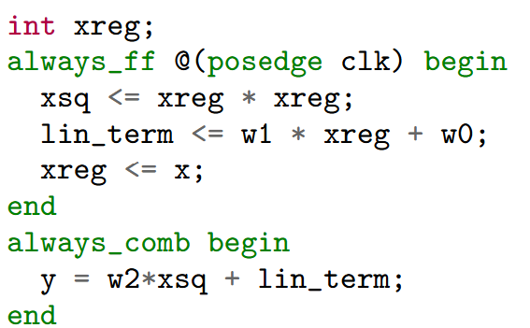
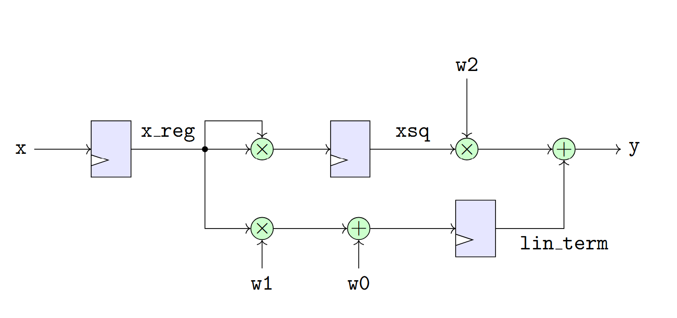
A Two Cycle Design
We can improve throughput by breaking computation over two cycles
Register two intermediate terms:
  xsq = xreg * xreg
  lin_term = w1*xreg + w0

Slide 45

Three Stages
Design is processed in three stages = 2 cycles
Stage 0
  Register input $x$ to xreg
Stage 1: Compute and register:
  xsq = xreg * xreg
  lin_term = w1*xreg + w0
Stage 2: Compute output
  y = w2*xsq + lin_term

Slide 46
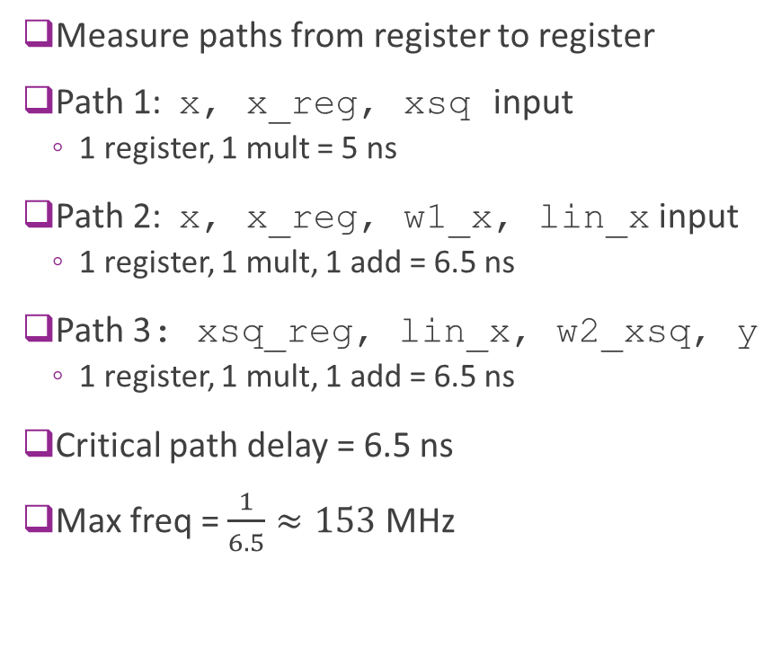
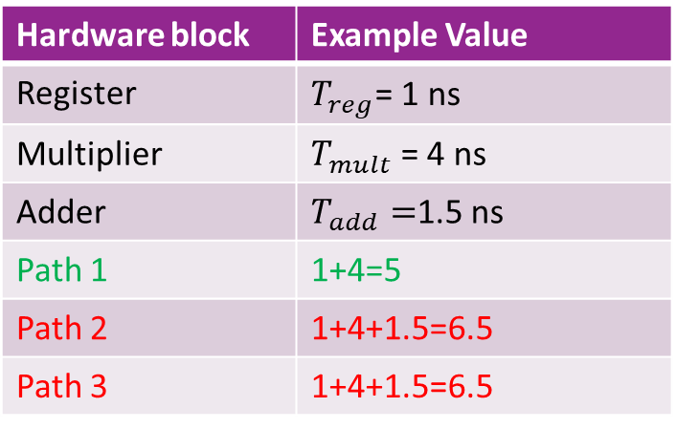
Critical Path with Three Stages
Hardware block | Example Value
Register | $T_{reg}$= 1 ns
Multiplier | $T_{mult}$ = 4 ns
Adder | $T_{add}=$1.5 ns
Path 1 | 1+4=5
Path 2 | 1+4+1.5=6.5
Path 3 | 1+4+1.5=6.5
Measure paths from register to register
Path 1: x, x_reg, xsq input
  1 register, 1 mult = 5 ns
Path 2: x, x_reg, w1_x, lin_x input
  1 register, 1 mult, 1 add = 6.5 ns
Path 3: xsq_reg, lin_x, w2_xsq, y
  1 register, 1 mult, 1 add = 6.5 ns
Critical path delay = 6.5 ns
Max freq = $\frac{1}{6.5}≈153$ MHz

Slide 47
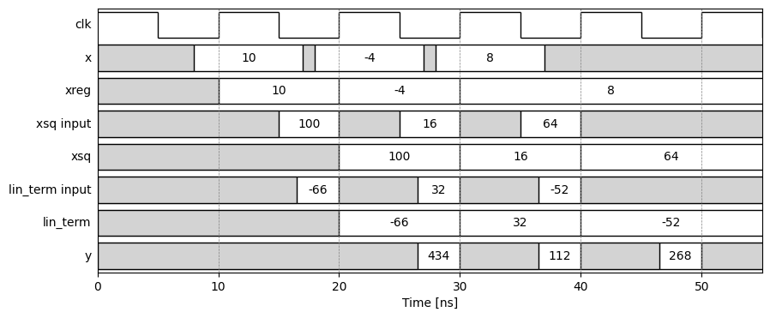

Two Cycle Timing Diagram
Example with
  $w=[4,−7,5]$
$x$ inputs 10, -4, 8

Slide 48

Latency, Throughput and Pipelining
Suppose that we run at our design at 100 MHz clock
Latency:
  Suppose input is valid on rising edge of clock $n$
  Then output is valid before rising edge of clock $n+2$
  Latency = 2 clock cycles = 20 ns
Throughput:
  Circuit can take a new input each cycle
  Throughput = 1 input / cycle = $100$ MHz
Process is called a pipeline
  Circuit is processing multiple inputs
  at the same time

Slide 49
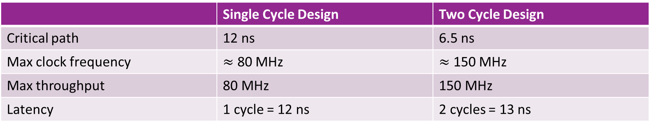
Performance Comparison
 | Single Cycle Design | Two Cycle Design
Critical path | 12 ns | 6.5 ns
Max clock frequency | $≈$ 80 MHz | $≈$ 150 MHz
Max throughput | 80 MHz | 150 MHz
Latency | 1 cycle = 12 ns | 2 cycles = 13 ns
Pipelining benefit:
For small increase in latency, we dramatically improve throughput

Slide 50
Outline
Combinational Logic
Timing Diagrams for Combinational Logic
Registers, Clocks and Sequential Logic
Simulating and Synthesizing Simple Modules in Vivado

Slide 51
FPGA Development Flow
Design
Functional simulation
Synthesis
Timing Simulation
Generate
bitstream
FPGA evaluation
Provided in documents in github.io page
Not covered for this unit
Covered in later units with Vitis HLS
Covered in this unit
We only show the first two steps

Slide 52

Linear+ReLU Example
All code in github repo
We test code on the right
Similar to discussed
Main difference:
  Module in test uses 16-bit integer
  Code before used int = 32 bit

Slide 53


Test Vectors
Create a set of test inputs
Loop through inputs
Put one new input each clock cycle
Testbench uses an initial construct
  Enables sequential set of events

Slide 54


Testbench Declaration
Testbench: a module to test the module
  Will not be synthesized
  Can have un-synthesizable constructs
  Ex: Read / write from file
Create a clock
Instantiate an instance of module to test
  Called the DUT = device under test
  Connect DUT to testbench signals

Slide 55


Run Simulation
We show how to run from the command-line
  A Vivado GUI option is also available
  But command-line is more flexible and automatable
Start a virtual environment with xilinxutils
  Xilinxutils: Python package provided in the course repo
Run command
Command is equivalent to
  sv_sim is a short-cut

Slide 56

Parsing the VCD File
Simulation produces a VCD file: Value Change Dump
  File with value-change points of all the signals
VCD can be parsed in a jupyter notebook
Use Xilinxutils to:
  Parse the VCD file
  Visualize the timing diagram

Slide 57

Timing Diagram
Matches expected value output
Produces an idealized timing diagram
  Timing simulation requires synthesis

Slide 58

Quadratic Example
Code in github repo
We use 16-bit integers with wraparound
Process is similar

Slide 59

Quadratic Timing Diagram
Can see two cycle latency and pipelining

