Slide 1
Unit 0
Course Introduction
EL-GY6143: Introduction to Hardware Design
Prof. Sundeep Rangan, Siddharth Garg

Slide 2
Outline
Course Admin
What is Custom Hardware and What Can it Do?

Slide 3
Course Details
Instructors
  Sundeep Rangan, 370 Jay St, 9-th floor
  Siddharth Garg, 370 Jay St, 10-th floor
TA’s: TBD
Office Hours:
  Instructor: Either Siddharth or Sundeep. Wednesdays, 3-4
Time and Location:
  Jacob’s Hall, 6 Metrotech Room 774
  Tuesdays 2-4:30

Slide 4
Learning Objectives
Identify tasks for hardware acceleration
Design, simulate, and evaluate designs for hardware accelerators
  Called Intellectual Property or IPs
  Use state-of-the-art tools
  High-level synthesis (HLS) and AI
Integrate IP into processor-based systems for real-world applications
Deploy and test systems on FPGA boards

Slide 5
Pre-Requisites
Anyone can learn hardware
No prior hardware experience is required!
No hard pre-requisites!
Just have
  Some software experience (e.g., C, python)
  Desire to learn
Many possible disciplines
  Robotics, wireless, scientific computation, cryptography, networking, …

Slide 6
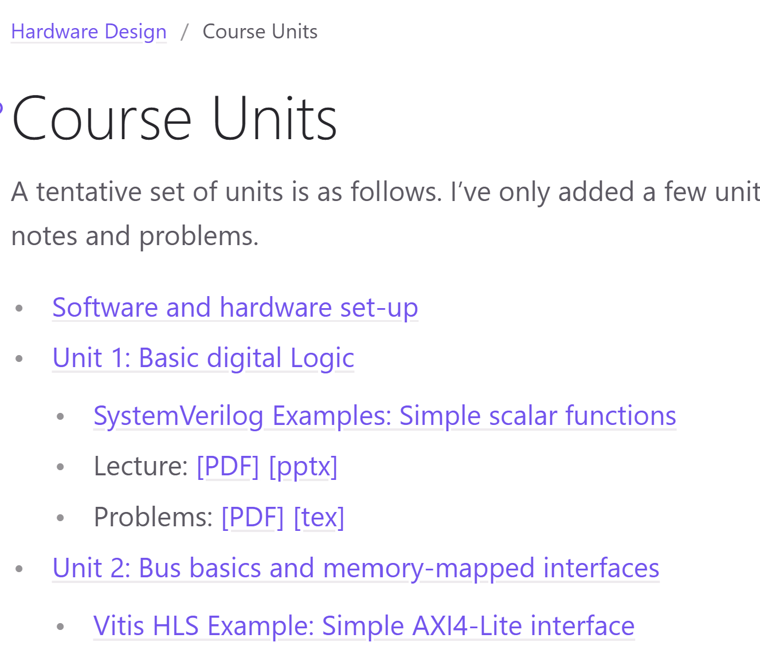
Course Webpage
All the material for the class is on GitHub
Demos:
  SystemVerilog
  Vitis HLS
  Python
Lecture notes
Problems, Lab assignnments
Repository is work in progress
  Re-sync periodically
https://sdrangan.github.io/hwdesign

Slide 7
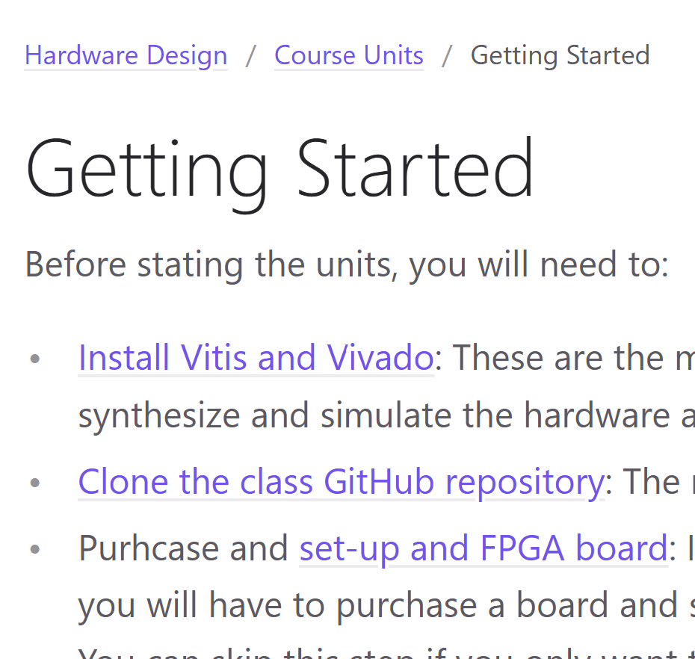
Software Set-Up
To perform this course, you will need to:
Install Vitis and Vivado
  Software tools for designing hardware
Clone the class repository
Optional: Purchase an actual FPGA board
  See next slide
Vitis and Vivado options:
  Run locally on a Windows machine
  MacOS: You must run it in Linux virtual machine
  Use NYU server. Details to be provided shortly

Slide 8
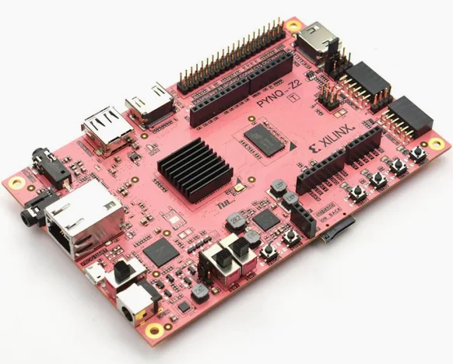
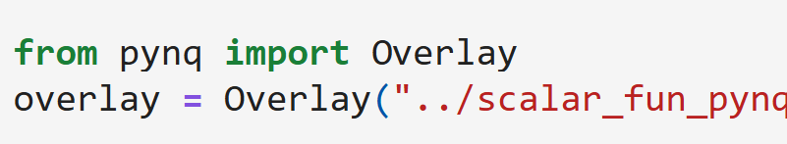
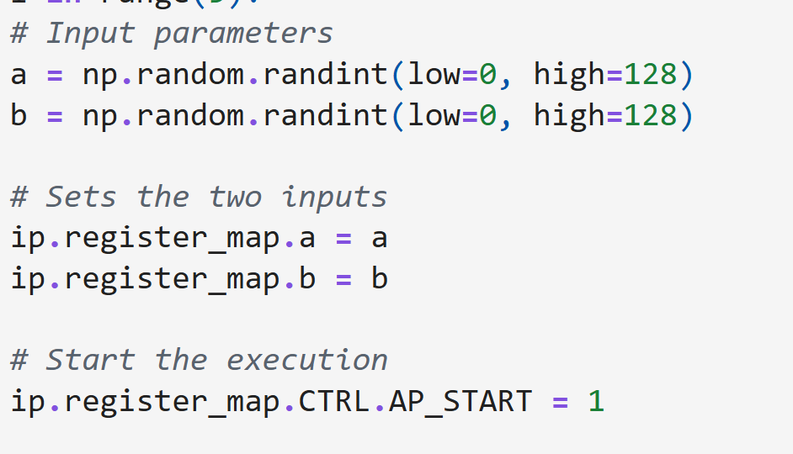
FPGA Boards
Projects and labs can be deployed on actual hardware
  Currently optional due to price
We suggest: Pynq-Z2 board
  $300
  USB connection to your laption
  Pynq: Simple python interface
  Low-end, but ideal for teaching
Other boards may be available in lab
  Ex: RFSoC 4x2 for wireless communications

Slide 9
Tentative Grading
Points
  Homework + Labs: 25%
  Midterm: 25%
  Final: 25%
  Project: 25%
Homework will be mostly written problems
Labs will be mostly VitisHLS
  Approximately 5 Vitis HLS assignments
  Approximately 5 written assignments
Midterm and Final are in class and

Slide 10
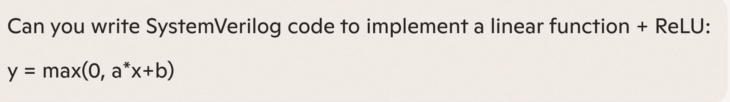
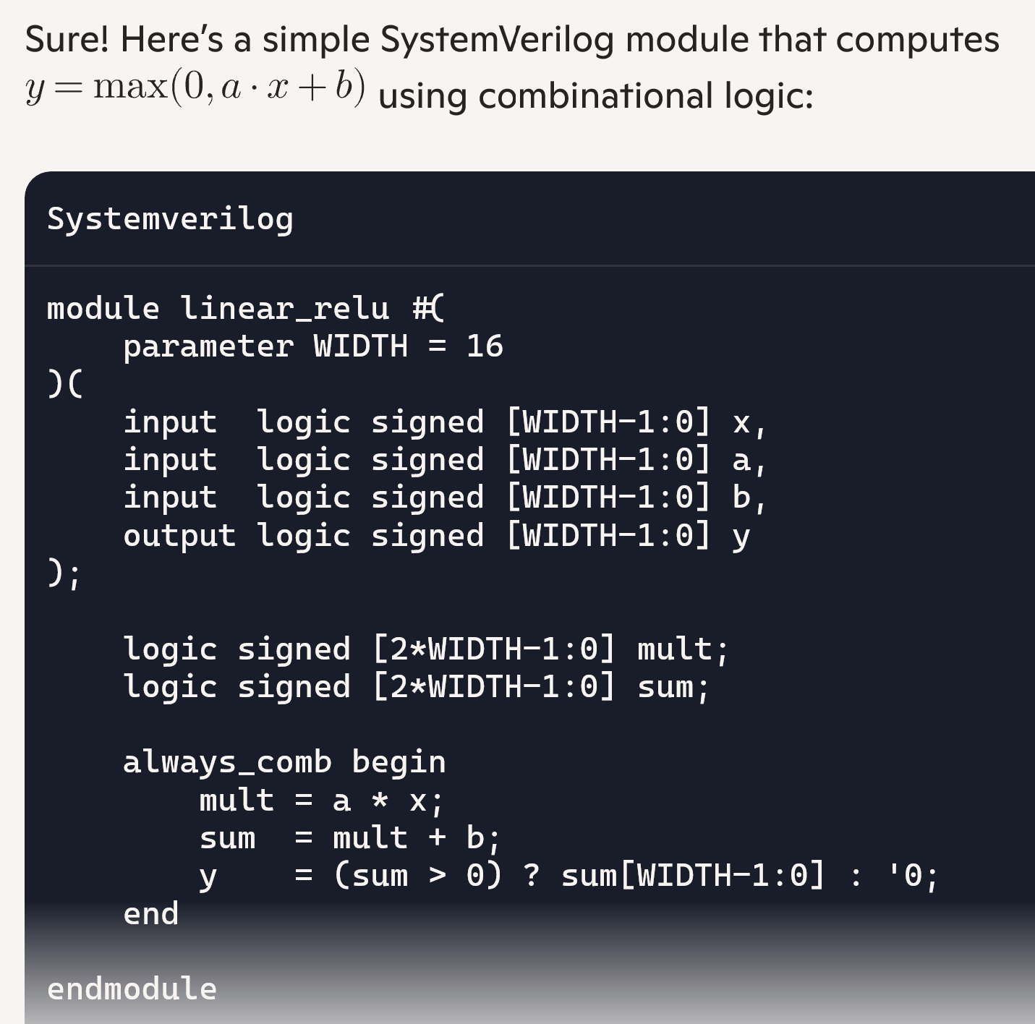

Using AI
It is encouraged!
  Use it for labs, problems, projects
But learn to use it well:
  It still makes mistakes.
  Learn to test the results
  Write clear, specific prompts
  Use it as a tutor
  Have it generate questions
  Explain results
On the midterm & final there are no aids!

Slide 11
Tentative Syllabus 1
Week | Date | Material
1 | 1/20/2026 | Course Admin Unit 1. Basic digital logic
2 | 1/27/2026 | Unit 2. Bus basics and processor interface
3 | 2/3/2026 | Unit 3. FIFO interfaces
4 | 2/10/2026 | Unit 4. Loop optimization
5 | 2/17/2026 | Unit 5. Arithmetic representation and hardware units
6 | 2/24/2026 | Unit 6. Systolic Arrays
7 | 3/3/2026 | Buffer
8 | 3/10/2026 | Midterm

Slide 12
Tentative Syllabus 2
Week | Date | Material
9 | 3/17/2026 | Spring Break- No class
10 | 3/24/2026 | Unit 7. Shared memory and the load-store compute pattern
11 | 3/31/2026 | Unit 8. FIR filters and convolutional layers
12 | 4/7/2026 | Unit 9. Multi-threaded control
13 | 4/14/2026 | Unit 10. Multiple processes and message passing architectures
14 | 4/21/2026 | Buffer
15 | 4/28/2026 | Final Exam
 | 5/5/2026 | Project presentations

Slide 13


Project
Build your own IP
You must provide:
  A clearly defined hardware IP block (RTL or HLS)
  A well‑specified interface and integration model with a host system
  A testbench and evaluation methodology
  Documentation that allows others to reproduce your result
Any topic of choice
  Computer vision, communications, computing, …
Work in groups of 2 to 4
  Individual projects require instructor permission
Hardware IP
or accelerator
Host system

Slide 14
Project Grading
See full rubric on project page on the GitHub pages
Submission on GitHub
  Create a repo for the project. You can start now!
  Submit only the repo URL.
IP definition and interface: Clear role, well-justified boundary between host and IP
IP implementation: Efficient design, correct, design choices
Evaluation:
  Testbench that are comprehensive, test corner cases, evaluate performance
  Measure design options
Process: Graded on GitHub commit history. No last minute drop before deadline
Presentation: Assume you are pitching to a prospective employer

Slide 15
Outline
Course Admin
What is Custom Hardware and What Can it Do?

Slide 16


Hardware vs. Software
Hardware
Any electronic circuit that performs some computation
Software
Instructions executed on hardware

Slide 17
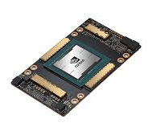
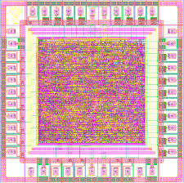
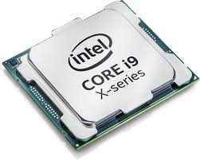
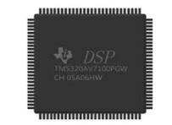
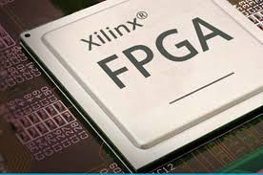
Hardware Comes in Many Forms
General purpose CPU
Intel, AMD, ARM
DSP
Texas Instruments,
Qualcomm
Hexagon
GPU
Nvidia
Intel Radeon
FPGA
Xilinx / AMD,
Intel / Altera
Custom ASIC
Qualcomm,
Apple,
Broadcomm

Slide 18
General Purpose vs. Custom
General purpose CPU
DSP
GPU
FPGA
Custom ASIC
General purpose,
Applies in many domains,
Re-programmed with software,
Performance via SW optimization, multi-cores
Domain specific,
HW optimized for specific task,
Can enable:
Higher performance,
Lower power / OP, size
Focus of this course

Slide 19

Accelerator or IP Model
Host system
Runs main application,
User interface,
May be embedded as well
(e.g., smartphone)
Embedded Processor
(DSP, ARM,…)
Configures HW,
Manages data transfer,
Performs some DSP
Hardware IP or accelerator
Compute intensive tasks
Domain specific
High-speed IO
Network interface,
Digital communication data
This class

Slide 20
What is Custom Hardware Good At
Compute‑intensive kernels
  High arithmetic density, many operations per data
Structured, repetitive tasks
  Same operation repeated many times
  Regular data flow, memory access
Regular dataflow and memory patterns
  Tight control of timing, no OS jitter
High throughput with low energy
  Custom datapaths, optimized bit-widths, specialized memories
Examples: DSP, linear algebra, ML inference, crypto, compression

Slide 21
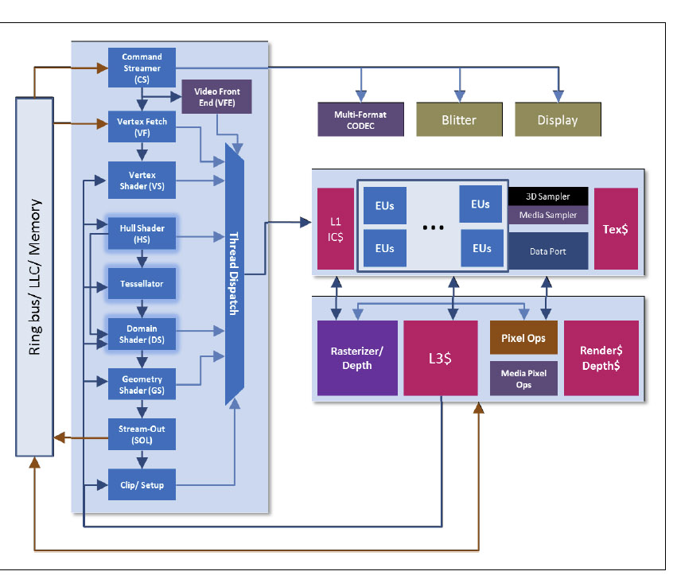
Example: Intel Quick Sync Media Processor
Intel specialized graphics units
  Programmable shaders for parallel math
  Fixed‑function blocks (rasterizer, tessellator, texture units)
  Media engines for video encode/decode (Quick Sync)
Integrated into Core‑i3 / i5 / i7 / i9 processors
  Physically part of the CPU die
  Shares memory hierarchy with CPU cores
  High‑speed on‑chip interfaces
Direct access to system memory
  High‑bandwidth internal fabric
  Connecting CPU, GPU, and media engines
  Low‑latency paths

Slide 22

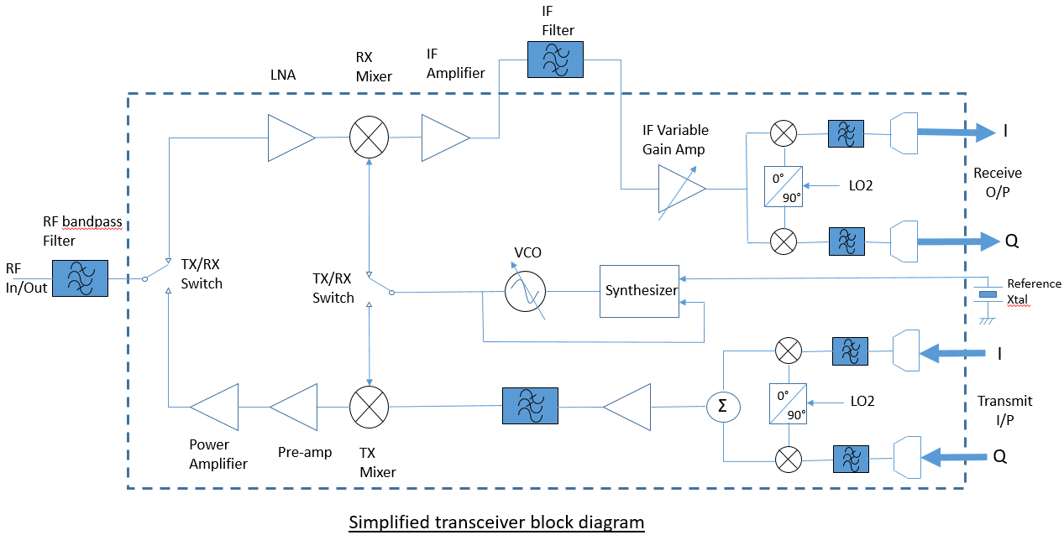
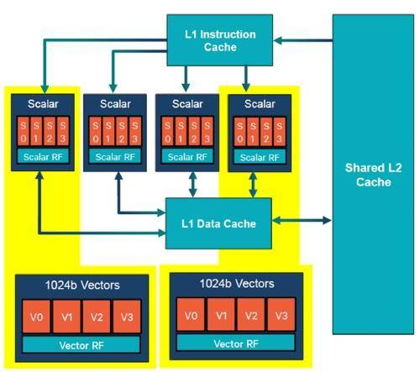
Example: 5G Modem Core
Gsamps / s
ARM Core
Upper layer SW,
Configuration,
Networking,
Packet processing
5G HW
Filtering,
Equalization,
Decoding,
…
RFIC
Antenna interface,
Radio frequency operations,
DACs / ADCs
Hexagon DSP
Control channels,
Infrequent, but complex,
data processing

Slide 23
FPGA vs. ASIC
FPGA: Field‑Programmable Gate Array
  Reconfigurable hardware
  Great for prototyping and teaching: no fabrication needed
  Slower and less power‑efficient than ASICs
  Research, rapid development, low‑volume products, networking gear, some accelerators
ASIC: Application‑Specific Integrated Circuit
  Custom hardware chip designed for one purpose (e.g., video codec, 5G modem, ML accelerator)
  Much faster and more power‑efficient than FPGAs
  Cannot be changed after fabrication — the design is permanent
  Manufactured (“fabricated”) at a semiconductor foundry
  Ex: TSMC,
  Smartphones, GPUs, Automotive, …

Slide 24


Turnaround Time Contrasted
Seconds
Write code
Compile
Run
Software
Design
Simulate
Synthesize
Generate
Bitstream
Run
FPGA
Custom
ASIC
Design
Simulate
Synthesize
Layout
Fabrication
Package
Integrate
Run
Months

Slide 25



HW Design Is Getting Easier
Traditional view: HW is Hard
Rarely-used languages
Small, elite community
Complex tool chain
Long turnaround time
Need to design concurrent systems
New Tools
High-Level Synthesis
  Program in C/C++/Python
AI-assisted design
  LLMs are learning HW fast
Python-based tool flow
  FPGA Python APIs
  Python simulation, …

Slide 26
In-Class Exercise
Break into small groups
Select any domain of interest to your group
  Robotics, scientific computing, finance, gaming, …
Propose a hardware accelerator for a specific task in that domain
  Be specific
  Ex., “Fast solver for molecular simulations”, “Real-time obstacle detection for drones”, …
What would it interface with?
  CPU, Any sensor data / peripherals? How much data does it need?
Why would custom hardware help?
  What are the computations involved? Is it structured, compute intensive?

