Slide 1

Cooperative Relay Selection in Cognitive Radio Networks
TONY MOHAN VARGHESE
IWC2015006
MTECH Wireless Communication Engineering
Indian Institute of Information Technology Allahabad

Slide 2
Introduction and Motivation
A Cognitive Radio is an intelligent wireless system that is aware of its environment and able to accordingly change its mode of operation.
Cognitive radio improves the spectrum usage efficiency and minimize the problem of spectrum over crowdedness.
Two types of users in Cognitive radio : Primary users ( PUs) and Secondary users (SUs).
Primary users are already assigned to specific and fixed parts of the channel, and have the right to freely access it at any given time.
Secondary Users (SUs) can sense the unused spectrum bands, which are referred to as the spectrum holes, and share them with the Primary Users (PUs) to improve spectrum utilization.
Direct transmissions from a primary transmitter to its primary receiver might be severely damaged due to the unstable environment in wireless communications.
This paper considers a Cooperative relaying framework in which the PUs select the SUs that may have better channel conditions as cooperative relays to help transmit their packets.

Slide 3
Problem Definition
Cooperative Relay Selection : How to efficiently find an appropriate relay that can satisfy the primary transmitter’s quality of service.
Objectives of this paper:
Formulate the problem of cooperative relay selection as an optimal stopping problem and derive the optimal stopping rule for relay selection.
Investigate the impact of observation order obtain an optimal observation order that maximizes the observation efficiency.
Simulation study to validate the Performance Evaluation of Optimal relay selection scheme. Compare it with random relay selection scheme.
Investigate the impact of Number of observation steps versus the observation duration.

Slide 4
Analysis of Recent Similar Works
Various Relay Selection Approaches are being used.
Using channel related information from all the candidate relay nodes
Inefficient when the number of candidate relays is large.
Partial channel state information, channel assignment, and signal-to noise ratio (SNR) etc. are required.
Scan all the relay nodes and choose the best node .
Relay selection jointly considered with other network functions such as spectrum management, energy consumption, location condition.
Optimal stopping theory has been applied to opportunistic scheduling and spectrum sensing.
Some related research has been done to investigate the optimal order for spectrum sensing in CRNs.
Simple descending order based on SNR
Based on dynamic programming approach
Searching an optimal order dynamically based on reinforcement learning.

Slide 5
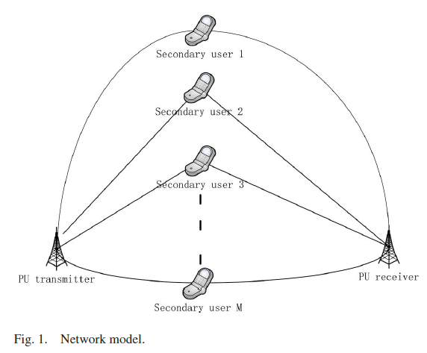
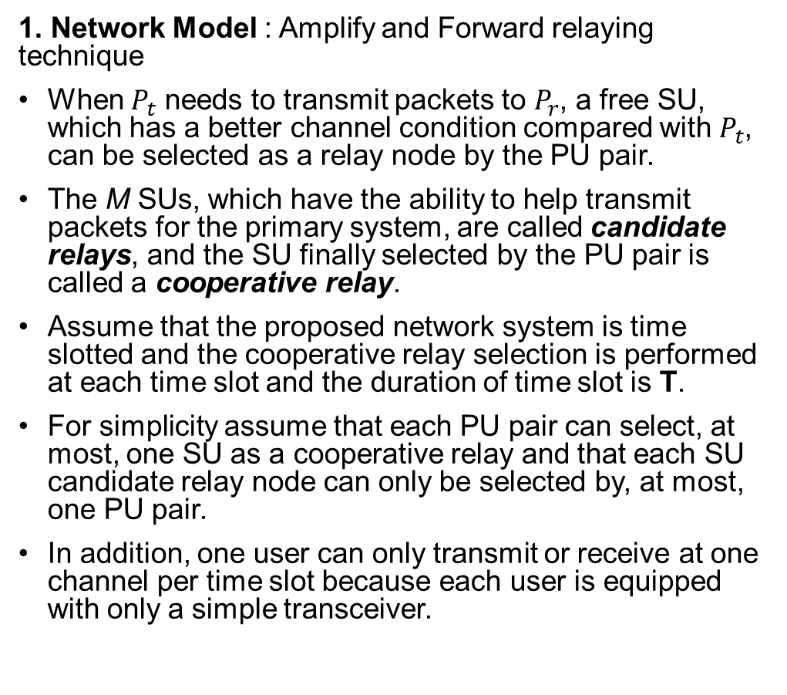
Proposed Methodology : System Models

Slide 6
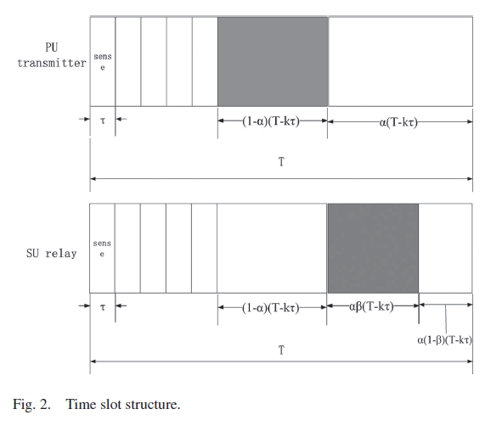
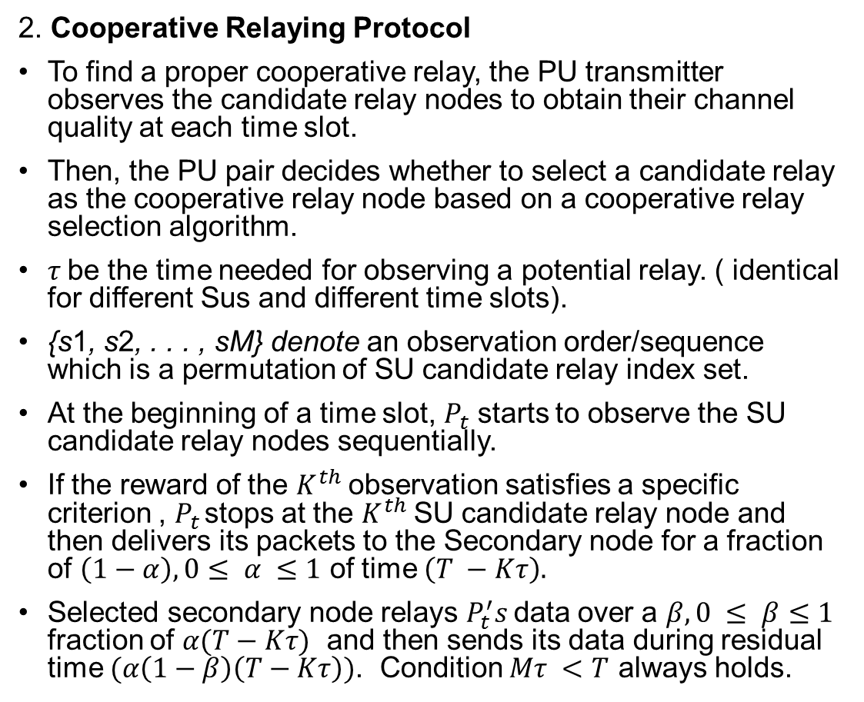
Proposed Methodology : System Models

Slide 7
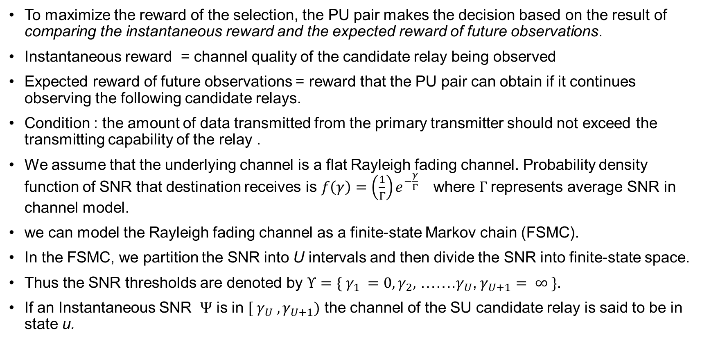
Optimal Stopping Policy

Slide 8
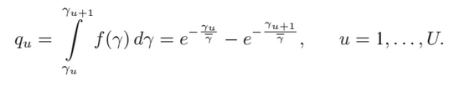
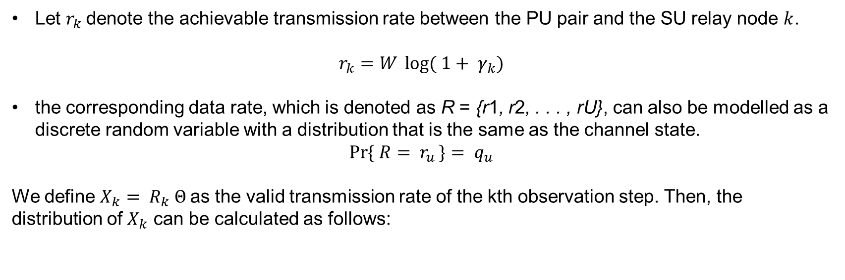
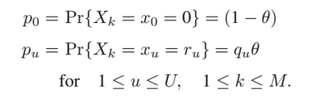
When the PU pair observes the channel of the candidate relay, the probability of the SU being in state u for the channel can be given by

Slide 9
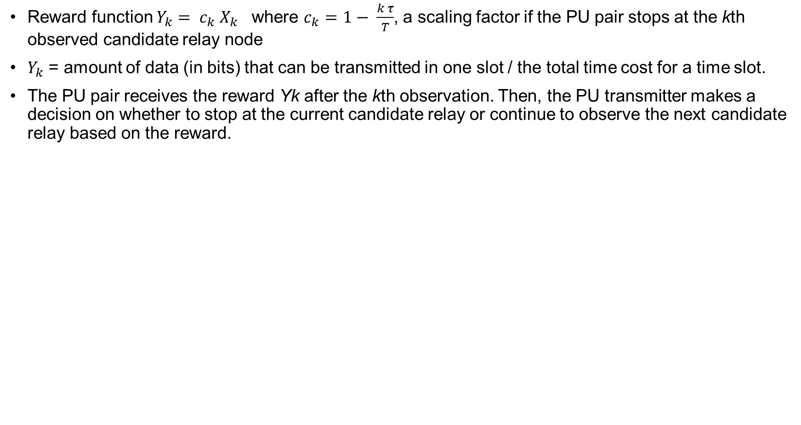
If the PU pair stops and selects a suitable cooperative relay more quickly when observing the SU candidate relays based on an observation order denoted by S1 compared with another observation order denoted by S2, we say that the order S1 is more efficient than the order S2.
If an observation order S = {s1, s2, . . . , sM } is constructed according to the descending order of Xk, the observation order is called an Intuitive Order of observation.

Slide 10
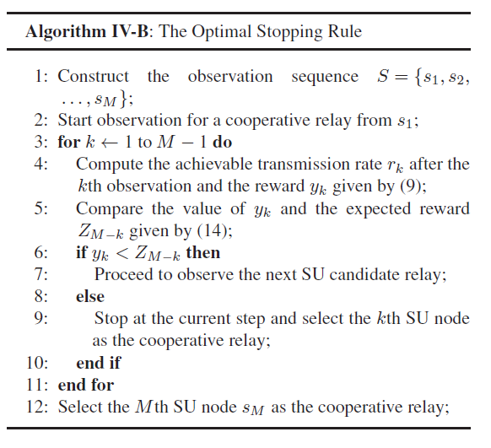
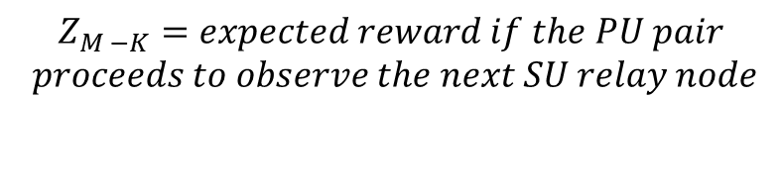

Slide 11
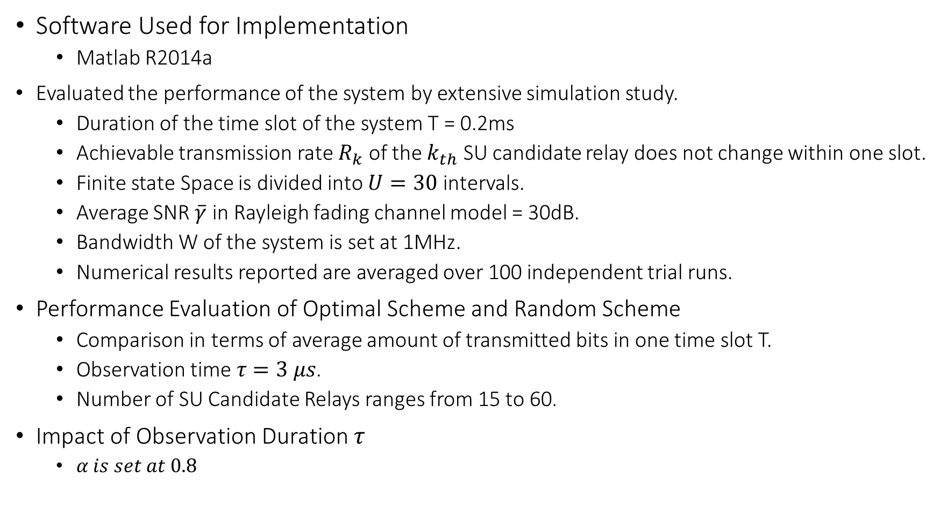
System Implementation And Result
Software Used for Implementation
Matlab R2014a
Evaluated the performance of the system by extensive simulation study.
Duration of the time slot of the system T = 0.2ms
Achievable transmission rate $R_{k}$ of the $k_{th}$ SU candidate relay does not change within one slot.
Finite state Space is divided into $U=30$ intervals.
Average SNR $\overline{γ}$ in Rayleigh fading channel model = 30dB.
Bandwidth W of the system is set at 1MHz.
Numerical results reported are averaged over 100 independent trial runs.
Performance Evaluation of Optimal Scheme and Random Scheme
Comparison in terms of average amount of transmitted bits in one time slot T.
Observation time $τ=3 μs$.
Number of SU Candidate Relays ranges from 15 to 60.
Impact of Observation Duration $τ$
$α is set at 0.8$

Slide 12
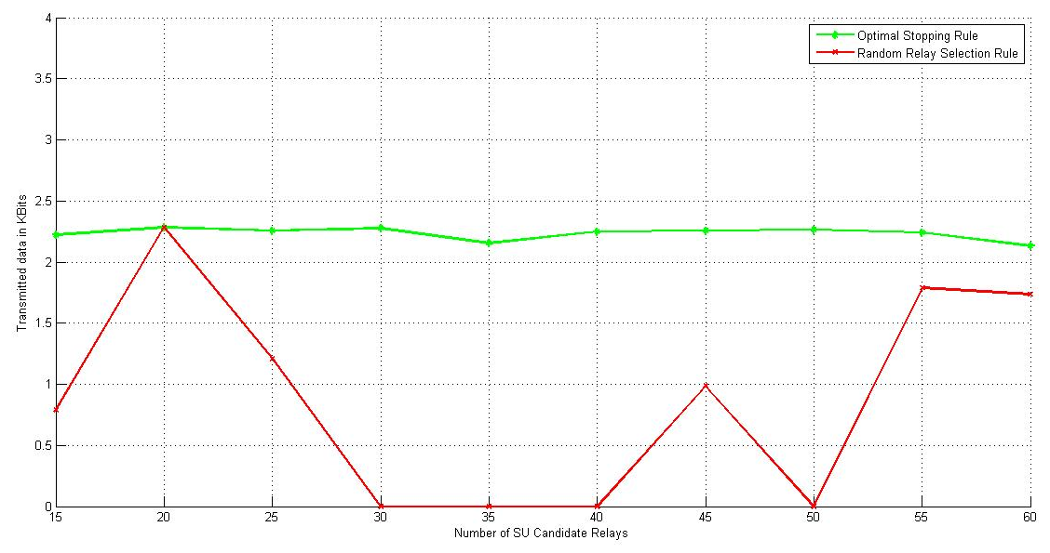
1. Performance Comparison Between Optimal Scheme and the Random Scheme

Slide 13
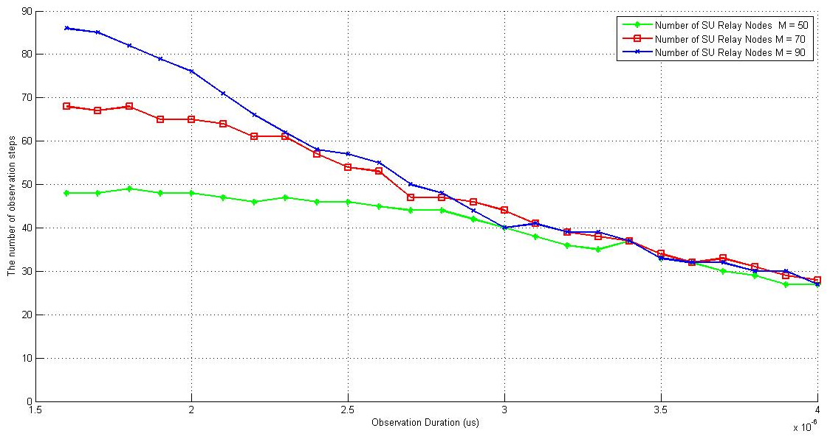
2. Impact of Observation Duration $τ$ vs Number of Observation steps

Slide 14
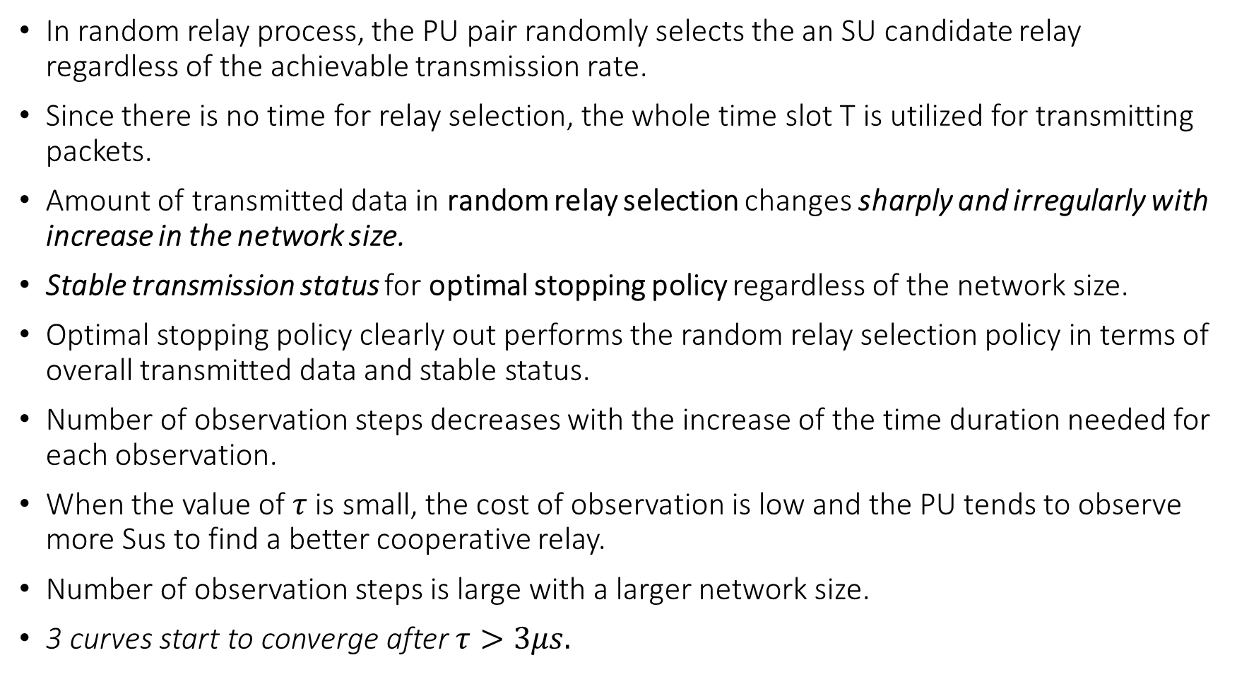
Discussion
In random relay process, the PU pair randomly selects the an SU candidate relay regardless of the achievable transmission rate.
Since there is no time for relay selection, the whole time slot T is utilized for transmitting packets.
Amount of transmitted data in random relay selection changes sharply and irregularly with increase in the network size.
Stable transmission status for optimal stopping policy regardless of the network size.
Optimal stopping policy clearly out performs the random relay selection policy in terms of overall transmitted data and stable status.
Number of observation steps decreases with the increase of the time duration needed for each observation.
When the value of $τ$ is small, the cost of observation is low and the PU tends to observe more Sus to find a better cooperative relay.
Number of observation steps is large with a larger network size.
3 curves start to converge after $τ>3μs.$

Slide 15
Conclusion
Proposed an optimal stopping policy to solve the problem of cooperative relay selection in CRNs.
PU pair observes the SU candidate relays in certain order and selects one as their cooperative relay if the transmission requirement of the SU is satisfied.
Formulated an optimal stopping problem.
Derived the optimal stopping policy to find the optimal solution.
Defined an intuitive observation order of nodes.
Superiority of the optimal scheme was demonstrated by comparing with the random relay selection scheme through MATLAB simulation.
Also simulated the impact of observation duration on number of observation steps.

Slide 16
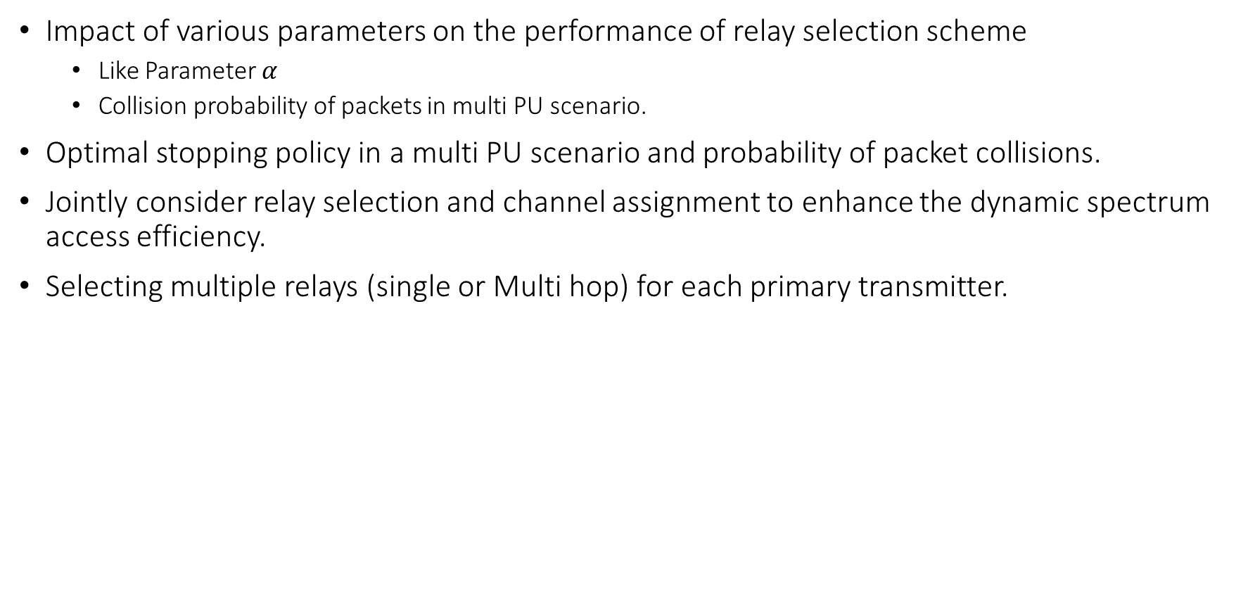
Future Scope
Impact of various parameters on the performance of relay selection scheme
Like Parameter $α$
Collision probability of packets in multi PU scenario.
Optimal stopping policy in a multi PU scenario and probability of packet collisions.
Jointly consider relay selection and channel assignment to enhance the dynamic spectrum access efficiency.
Selecting multiple relays (single or Multi hop) for each primary transmitter.

Slide 17
References
[1] T. Ferguson, Optimal Stopping and Applications. [Online]. Available: http://doi.acm.org/10.1145/1614320.1614325
[2] T. Jing, S. Zhu, H. Li, X. Cheng, and Y. Huo, “Cooperative relay selection in cognitive radio networks,” in Proc. IEEE INFOCOM-Mini, 2013, pp. 175–179.
[3] D. Zheng, W. Ge, and J. Zhang, “Distributed opportunistic scheduling for ad-hoc communications: An optimal stopping approach,” in Proc. 8th ACM Int. Symp. Mobile ad hoc Netw. Comput., 2007, pp. 1–10.
[4] H. S. Wang and N. Moayeri, “Finite-state Markov channel—A useful model for radio communication channels,” IEEE Trans. Veh. Technol., vol. 44, no. 1, pp. 163–171, Feb. 1995.
[5] H. Jiang, L. Lai, R. Fan, and H. Poor, “Optimal selection of channel sensing order in cognitive radio,” IEEE Trans. Wireless Commun., vol. 8, no. 1, pp. 297–307, Jan. 2009.
[6] T. Shu and M. Krunz, “Throughput-efficient sequential channel sensing and probing in cognitive radio networks under sensing errors,” in Proc. 15th Annu. Int. Conf. Mobile Comput. Netw., New York, NY, USA, 2009, pp. 37–48.

Slide 18

Thank you

