Slide 1

FLUTON Inc.

Slide 2
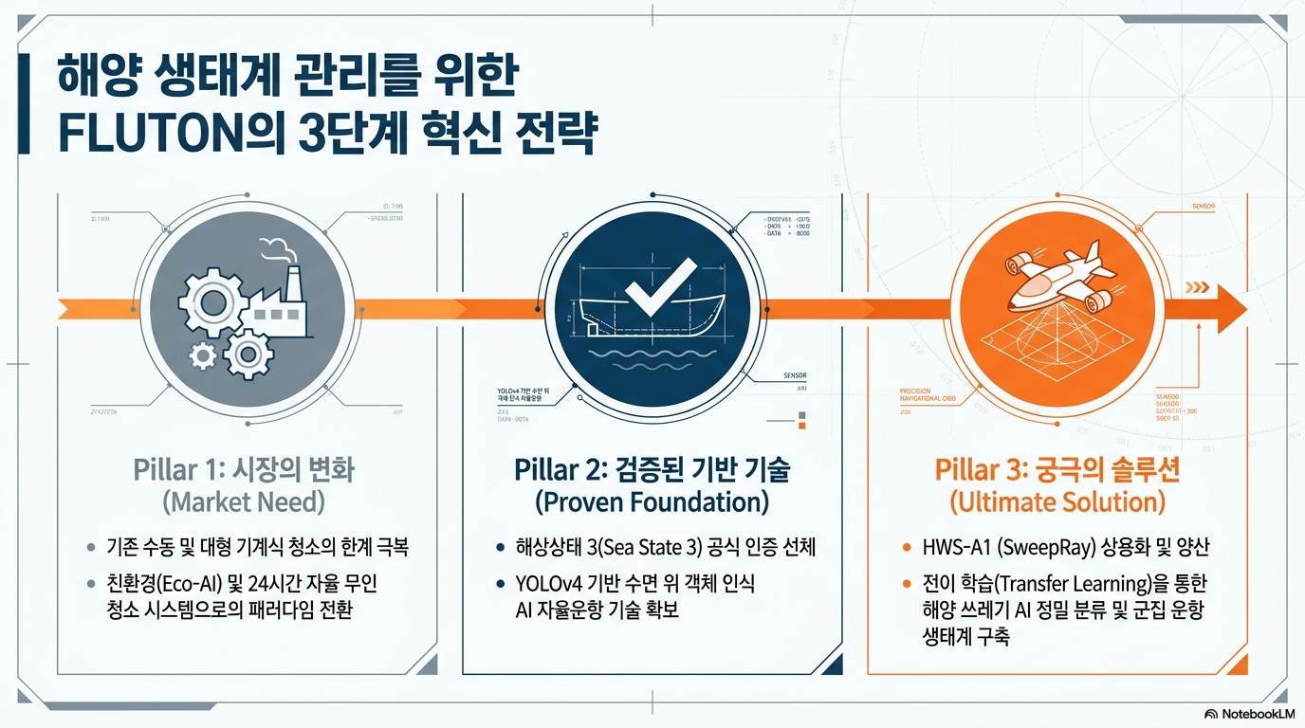
FLUTON Inc.

Slide 3
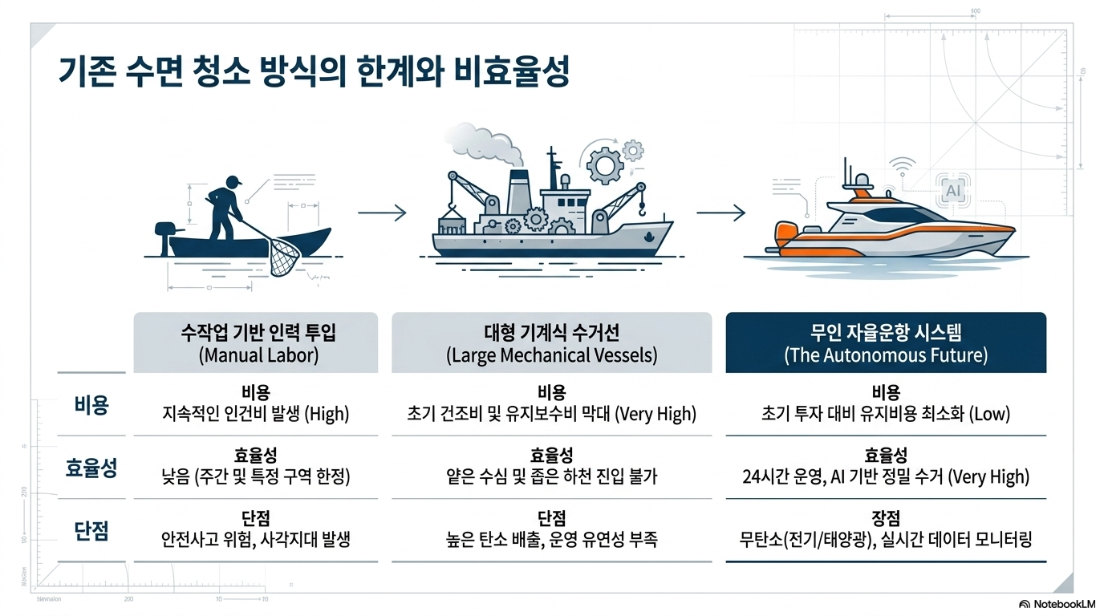
FLUTON Inc.

Slide 4
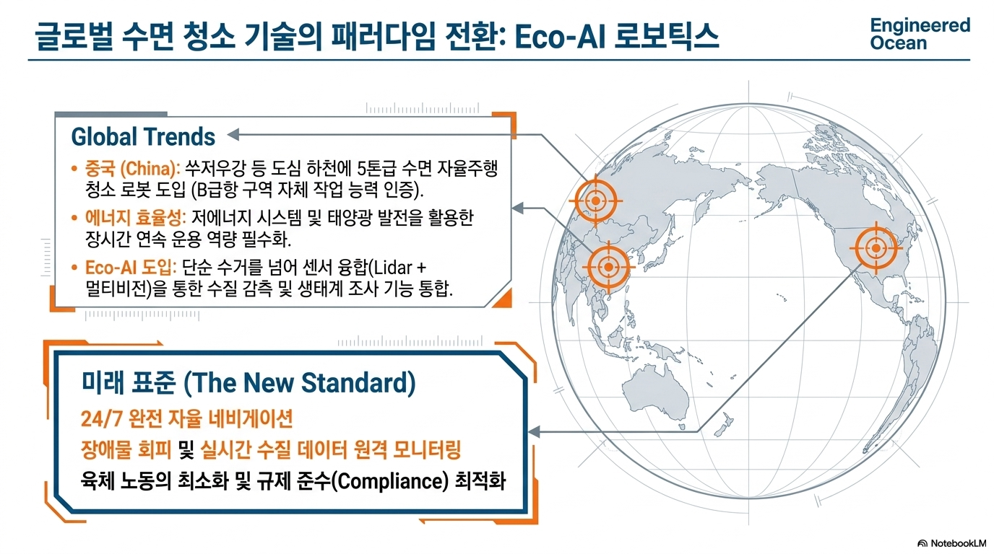
FLUTON Inc.

Slide 5
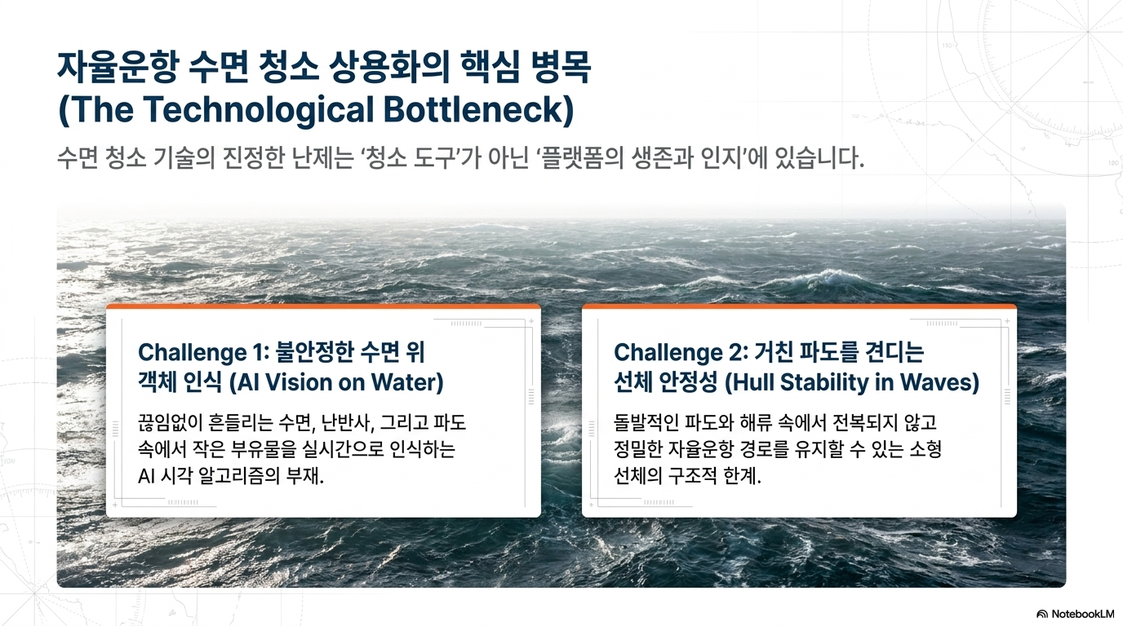
FLUTON Inc.

Slide 6
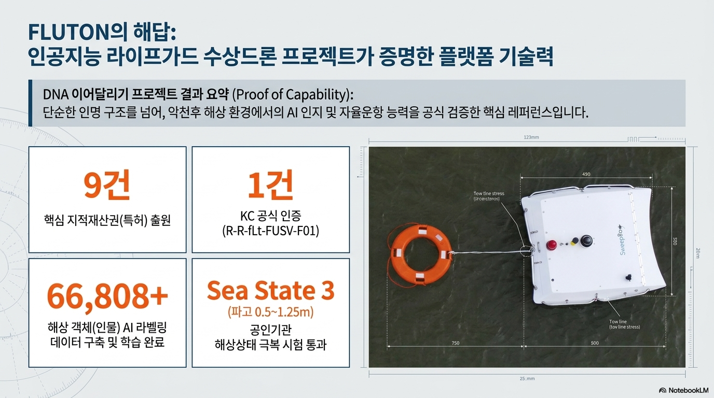
FLUTON Inc.

Slide 7
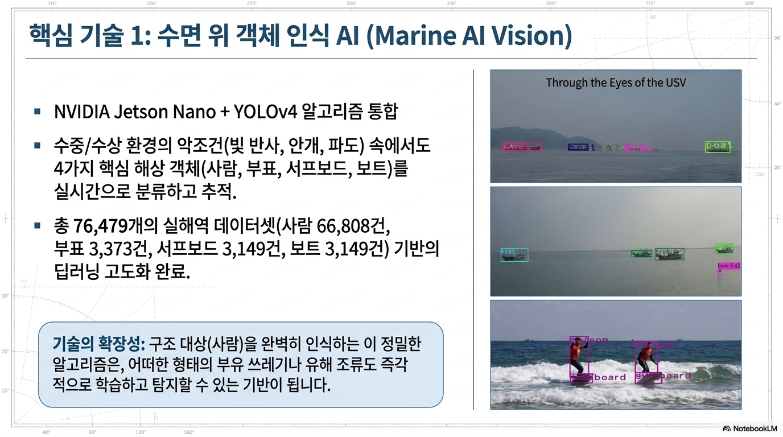
FLUTON Inc.

Slide 8
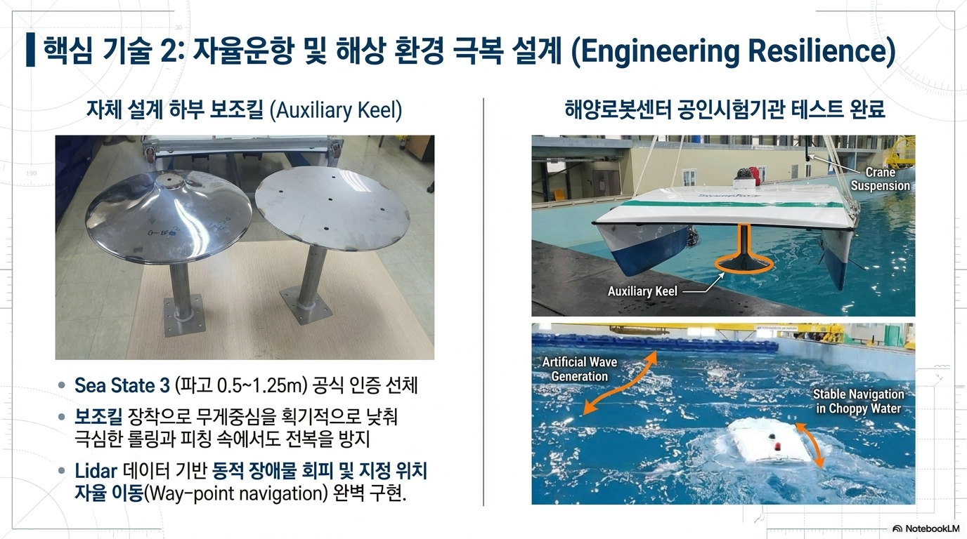
FLUTON Inc.

Slide 9
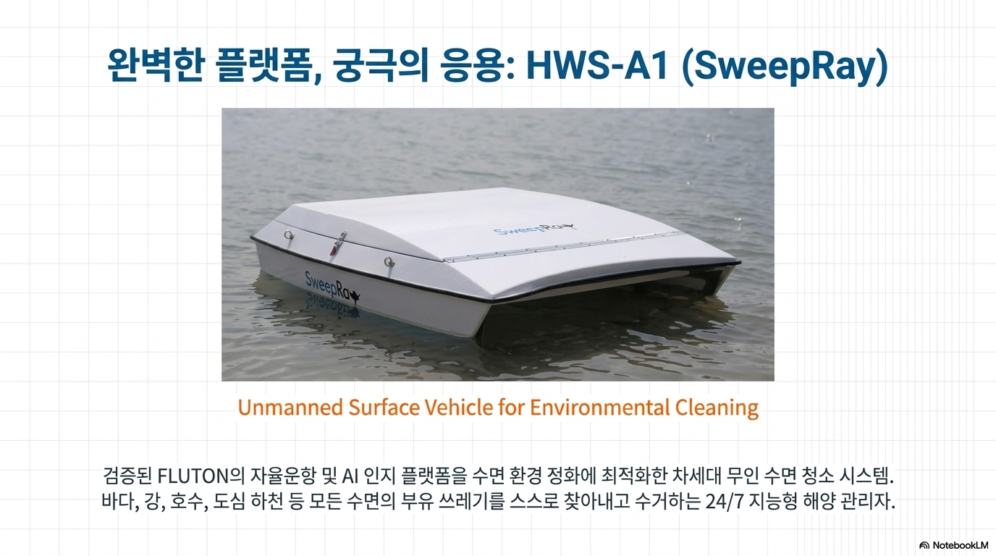
FLUTON Inc.

Slide 10
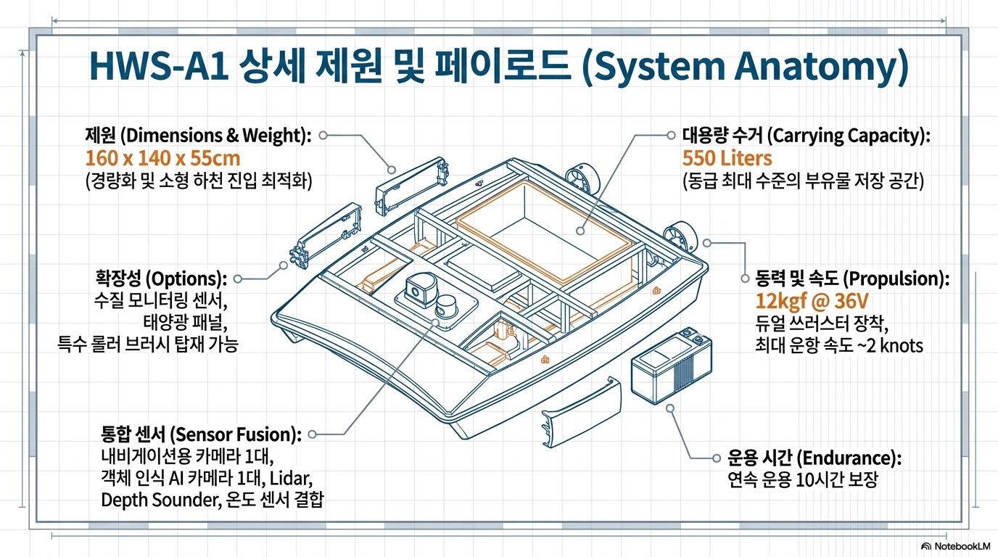
FLUTON Inc.

Slide 11
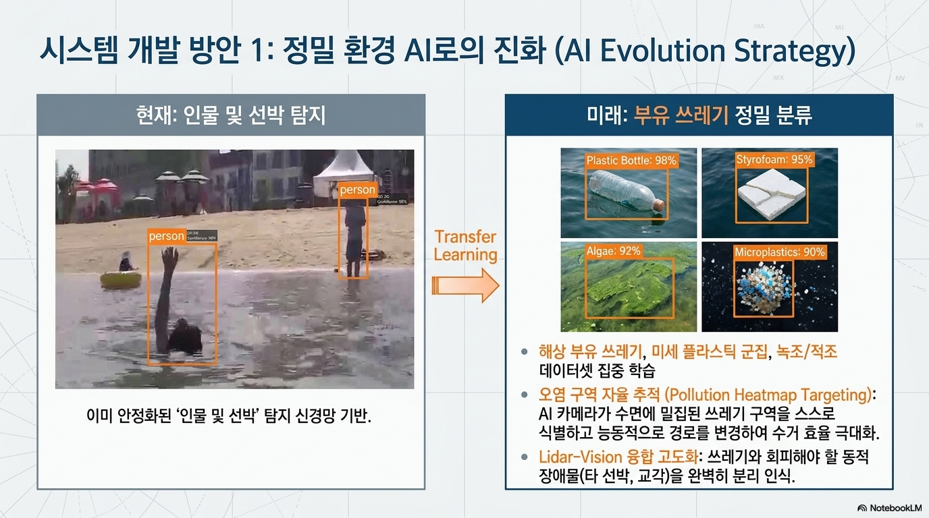
FLUTON Inc.

Slide 12
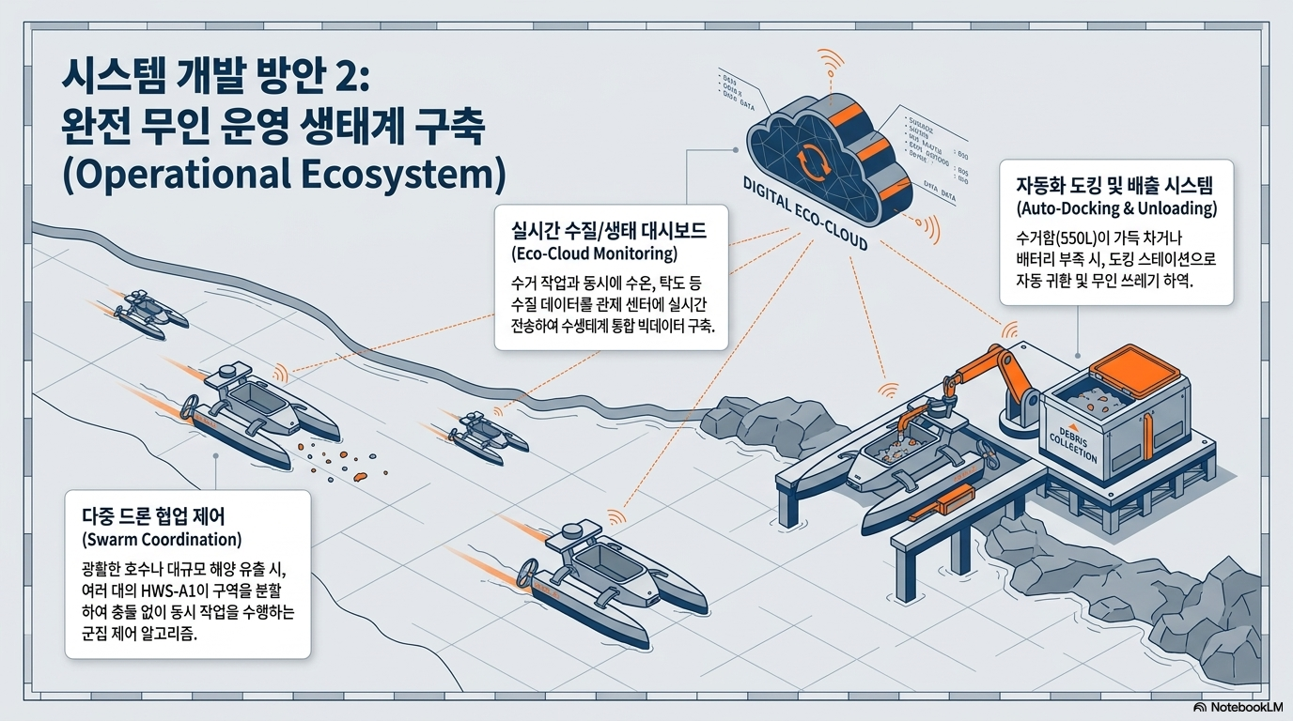
FLUTON Inc.

Slide 13
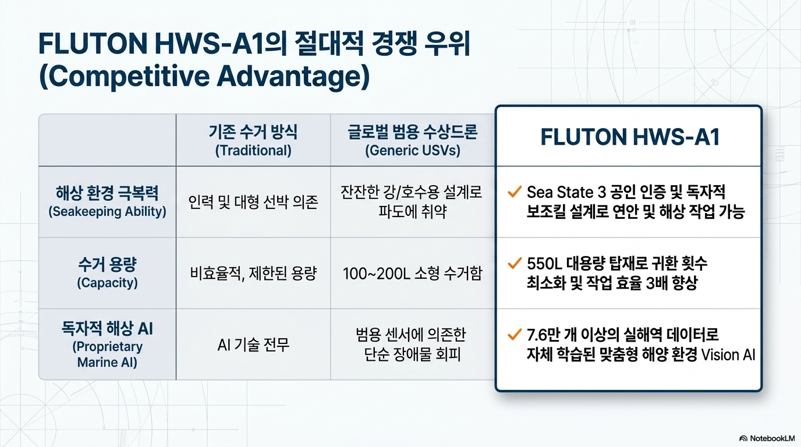
FLUTON Inc.

Slide 14
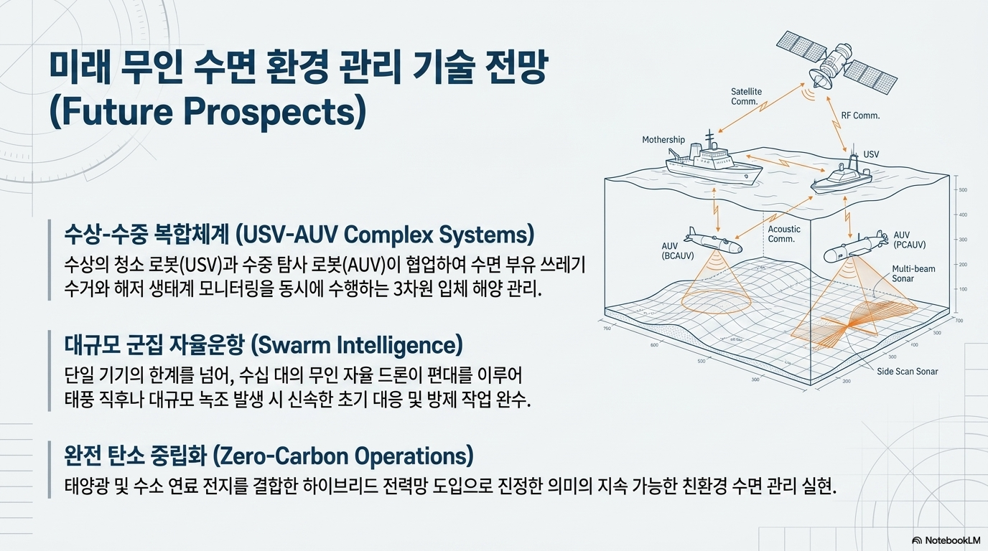
FLUTON Inc.

Slide 15


FLUTON Inc.

