Slide 1
Shuffle Bag Randomization
Baltimore Indie Game Devs
October 14, 2023

Slide 2
Does God Play Dice with the Universe?
No true random in digital computers

Slide 3
Does God Play Dice with the Universe?
No true random in digital computers
Pseudo-random number generators (RNGs) generate a distribution of numbers that appear random for all practical purposes in games

Slide 4
Does God Play Dice with the Universe?
No true random in digital computers
Pseudo-random number generators (RNGs) generate a distribution of numbers that appear random for all practical purposes in games
Random numbers / die rolls straight from RNG is unbiased randomization

Slide 5
Probability
Which sequence is more likely? 00000000 or 10110101

Slide 6
Probability
Which sequence is more likely? 00000000 or 10110101
Equally likely since each coin flip is independent (assuming fair coin)

Slide 7
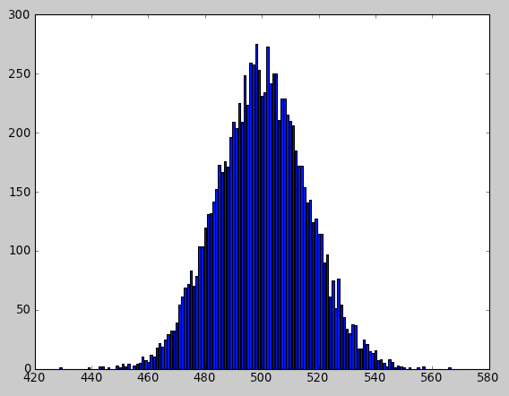
Probability
Which sequence is more likely? 00000000 or 10110101
Equally likely since each coin flip is independent (assuming fair coin)
On the other hand, the distribution of total 1’s trends toward a bell curve:

Slide 8
Probability
Which sequence is more likely? 00000000 or 10110101
Equally likely since each coin flip is independent (assuming fair coin)
On the other hand, the distribution of total 1’s trends toward a bell curve:
Players, however, experience games in the moment, not over trends
Notes:
See C# example: 01_UnbiasedRandom

Slide 9
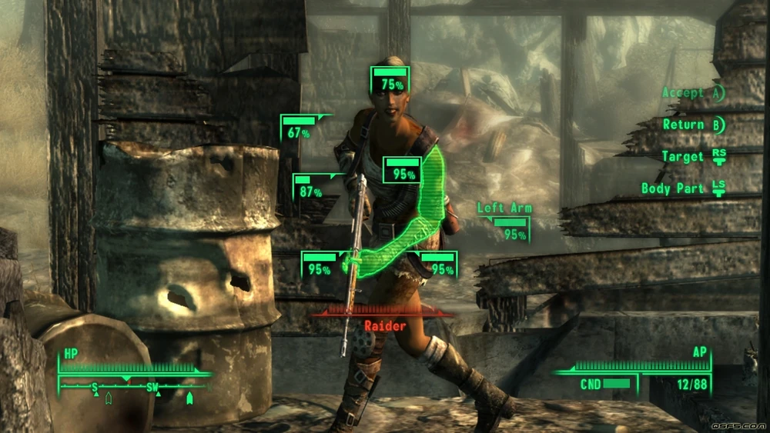
Easy Shot!

Slide 10
Easy Shot…
Roll: 98. Miss!
Darn. Next time I’ll hit.

Slide 11
Easy… Shot?
Roll: 98. Miss!
Roll: 96. Miss!
What?! Surely next time.

Slide 12
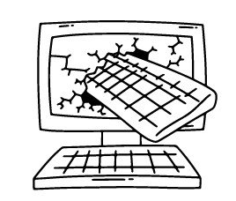
Easy Shot my @#$!…
Roll: 98. Miss!
Roll: 96. Miss!
Roll: 97. Miss!
@#$! Broken game!!!

Slide 13
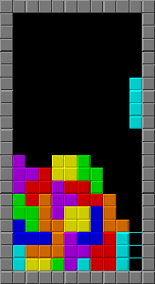
Not Just For Numbers
Original Tetris used unbiased randomization
It was possible to get a string of “bad” blocks that forced a loss (aka “block drought”)

Slide 14


Gambler’s Fallacy
The belief that a random event is more/less likely due to the outcomes of previous independent events
Three 1’s in a row doesn’t mean you’re due for a 6:
Side note: Distributions, on the other hand, are different. 3d6 is more likely to produce 10 (1+3+6, 2+3+5, 2+2+6, etc.) than 3 (1+1+1)
⇻

Slide 15
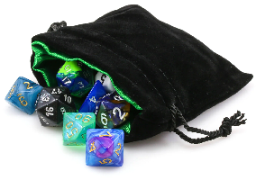

Less Random Feels More Random
Solution: Shuffle Bags
Start with a bag (list) of numbers / die rolls:

Slide 16


Less Random Feels More Random
Solution: Shuffle Bags
Start with a bag (list) of numbers / die rolls:
Remove one at random:

Slide 17


Less Random Feels More Random
Solution: Shuffle Bags
Start with a bag (list) of numbers / die rolls:
Remove one at random:
Remove another at random:
Feels more fair!
Notes:
See C# example: 02_ShuffleBags

Slide 18
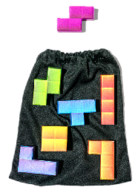
Shuffle Bags - Not Just For Numbers
NES Tetris used a rule to reduce duplicates

Slide 19
Shuffle Bags - Not Just For Numbers
NES Tetris used a rule to reduce duplicates
Tetris Worlds went one better and used shuffle bags

Slide 20
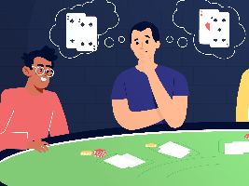


But Can’t the Player “Count Cards”?
Previous rolls:
Alright, I’m due for a:
Breaks the illusion of chance

Slide 21

But Can’t the Player “Count Cards”?
Previous rolls:
Alright, I’m due for a:
Breaks the illusion of chance
Solution: At some point: Refill/reshuffle the bag before it’s empty: (20-50% empty is a good threshold)
Notes:
See C# example: 03_PreventCardCounting

Slide 22
Distributions
Shuffle bags work for uneven distributions, too

Slide 23
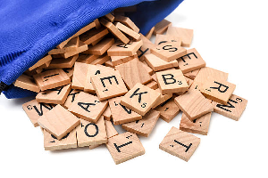
Distributions
Shuffle bags work for uneven distributions, too
Scrabble bags are shuffle bags

Slide 24
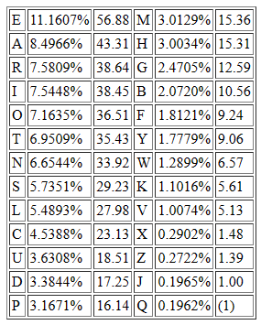
Distributions
Shuffle bags work for uneven distributions, too
Scrabble bags are shuffle bags
Just add an amount equal to the frequency of the letter (12 E’s, 8 A’s, …, 1 Q).
Notes:
See C# example: 04_Distributions

Slide 25
Actually Shuffling the Bag
Instead of picking randomly, shuffle bag (ordered list)
Fisher-Yates Shuffle (aka Knuth Shuffle)
A | B | C | D | E
A | B | C | D | E | [1] Roll 3, swap 1 & 3
C | B | A | D | E

Slide 26
Actually Shuffling the Bag
Instead of picking randomly, shuffle bag (ordered list)
Fisher-Yates Shuffle (aka Knuth Shuffle)
A | B | C | D | E
A | B | C | D | E | [1] Roll 3, swap 1 & 3
C | B | A | D | E | [2] Roll 5, swap 2 & 5
C | E | A | D | B

Slide 27
Actually Shuffling the Bag
Instead of picking randomly, shuffle bag (ordered list)
Fisher-Yates Shuffle (aka Knuth Shuffle)
A | B | C | D | E
A | B | C | D | E | [1] Roll 3, swap 1 & 3
C | B | A | D | E | [2] Roll 5, swap 2 & 5
C | E | A | D | B | [3] Roll 4, swap 3 & 4
C | E | D | A | B

Slide 28
Actually Shuffling the Bag
Instead of picking randomly, shuffle bag (ordered list)
Fisher-Yates Shuffle (aka Knuth Shuffle)
Then just use list in order. No need to reallocate new bags, just reshuffle.
A | B | C | D | E
A | B | C | D | E | [1] Roll 3, swap 1 & 3
C | B | A | D | E | [2] Roll 5, swap 2 & 5
C | E | A | D | B | [3] Roll 4, swap 3 & 4
C | E | D | A | B
Notes:
See C# example: 05_FisherYatesShuffle

Slide 29
Bonus: O(1) Lazy Shuffle
Traditional shuffle bag is O(1) to get a value but O(n) when need to reshuffle
Instead, fill bag (list) in any order:
A | B | C | D | E

Slide 30
Bonus: O(1) Lazy Shuffle
Traditional shuffle bag is O(1) to get a value but O(n) when need to reshuffle
Instead, fill bag (list) in any order
Go through list in order, swapping elements before returning value:
A | B | C | D | E
C | B | A | D | E | [1] Roll 3, swap 1 & 3, return C

Slide 31
Bonus: O(1) Lazy Shuffle
Traditional shuffle bag is O(1) to get a value but O(n) when need to reshuffle
Instead, fill bag (list) in any order
Go through list in order, swapping elements before returning value:
A | B | C | D | E
C | B | A | D | E | [1] Roll 3, swap 1 & 3, return C
C | E | A | D | B | [2] Roll 5, swap 2 & 5, return E

Slide 32
Bonus: O(1) Lazy Shuffle
Traditional shuffle bag is O(1) to get a value but O(n) when need to reshuffle
Instead, fill bag (list) in any order
Go through list in order, swapping elements before returning value:
A | B | C | D | E
C | B | A | D | E | [1] Roll 3, swap 1 & 3, return C
C | E | A | D | B | [2] Roll 5, swap 2 & 5, return E
C | E | D | A | B | [3] Roll 4, swap 3 & 4, return D

Slide 33
Bonus: O(1) Lazy Shuffle
Traditional shuffle bag is O(1) to get a value but O(n) when need to reshuffle
Instead, fill bag (list) in any order
Go through list in order, swapping elements before returning value:
A | B | C | D | E
C | B | A | D | E | [1] Roll 3, swap 1 & 3, return C
C | E | A | D | B | [2] Roll 5, swap 2 & 5, return E
C | E | A | D | B | [3] Roll 4, swap 3 & 4, return D
C | E | D | A | B | Loop back to [1] before end

Slide 34
Bonus: O(1) Lazy Shuffle
Traditional shuffle bag is O(1) to get a value but O(n) when need to reshuffle
Instead, fill bag (list) in any order
Go through list in order, swapping elements before returning value:
A | B | C | D | E
C | B | A | D | E | [1] Roll 3, swap 1 & 3, return C
C | E | A | D | B | [2] Roll 5, swap 2 & 5, return E
C | E | A | D | B | [3] Roll 4, swap 3 & 4, return D
C | E | D | A | B | Loop back to [1] before end
O(1)
Never need
To reshuffle
Notes:
See C# example: 06_LazyShuffle

Slide 35
Code Examples
https://github.com/tonyli99/shufflebags

