Slide 1
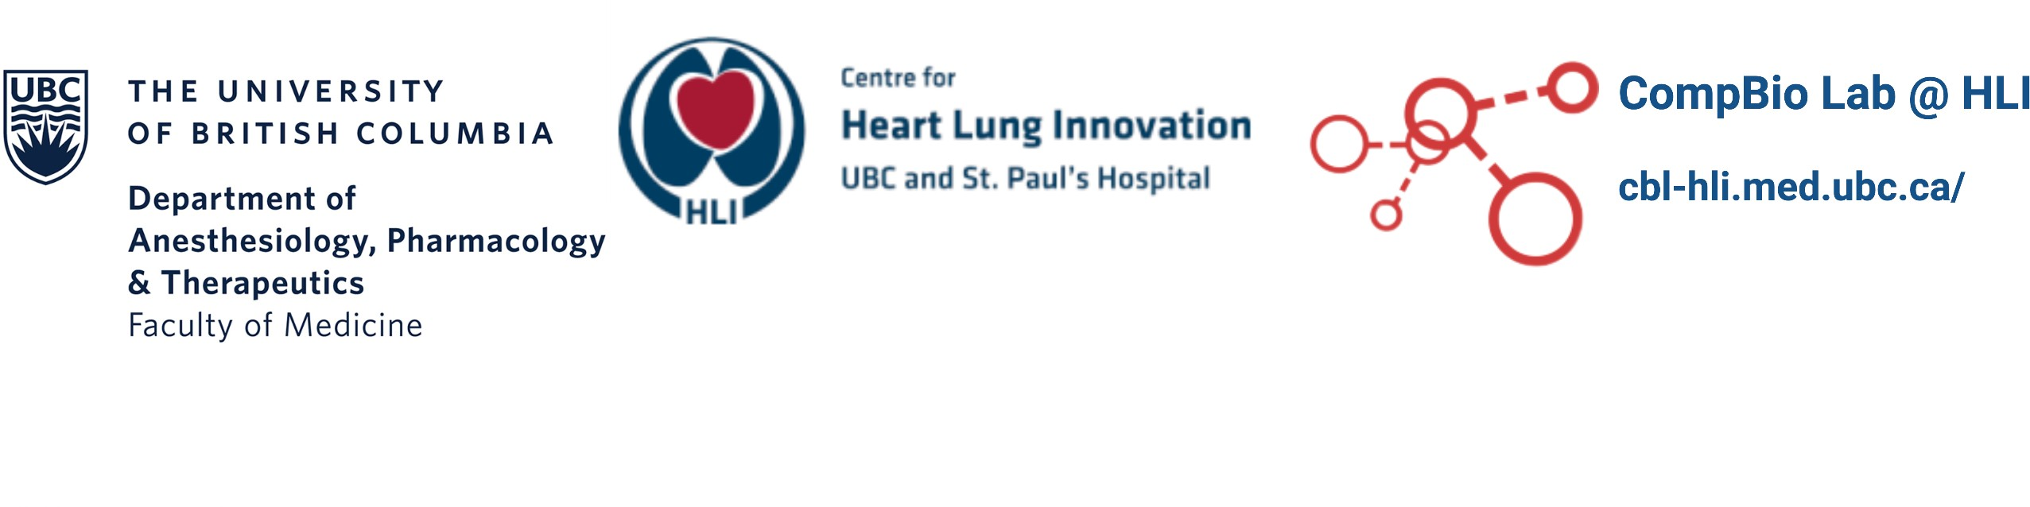
MESSI: Multiomics Experiments with SyStematic Interrogation
A pipeline for benchmarking multi-omics integration methods on classification problems using Nextflow
Chunqing Tony Liang
Msc student in Bioinformatics Supervisor: Dr. Amrit Singh
March 7, 2024

Slide 2
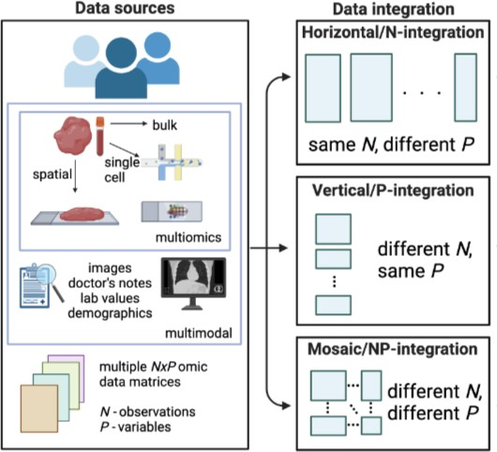

Multiomics data and analysis
Motivation
Technological advancement and reduced costs –> studies with multiomics data
Multiomics data –> bulk/single-cell/spatial data
More generalized –> “multimodal data”, other non-omics data Types of integrations: by sample (N), by omics (P), or both
Figure 1: Overview of multiomics data and integration ¹
1. Shannon et al., Manuscript Under Revision, 2024.

Slide 3
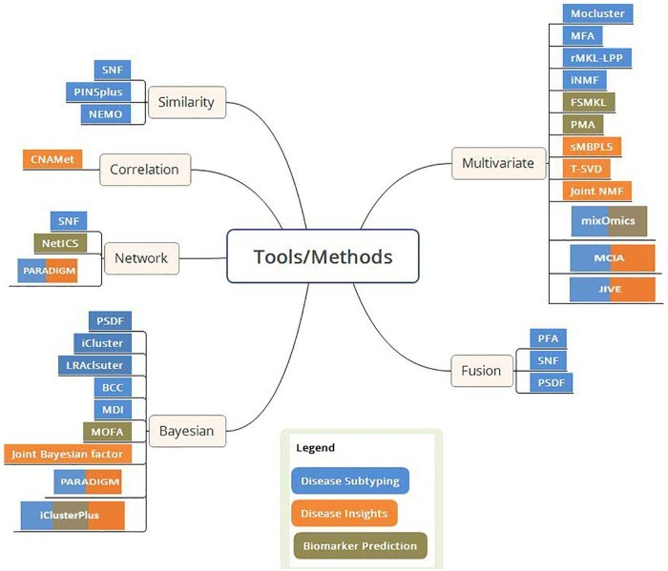

Multiomics data integration methods
Question arises
Many integration methods
—> Which to use, how to choose them? Reproducibility crisis
—> How to reproduce method and get reliable results?
Existing benchmark studies are not 100% complete or all- encompassing
—> Technical difficulty in implementation?
Figure 2: Overview of multi-omics data integration tools ¹
1. Indhupriya Subramanian et al., “Multi-Omics Data Integration, Interpretation, and Its Application,” Bioinformatics and Biology Insights
14 (2020): 1177932219899051.
3 / 5

Slide 4
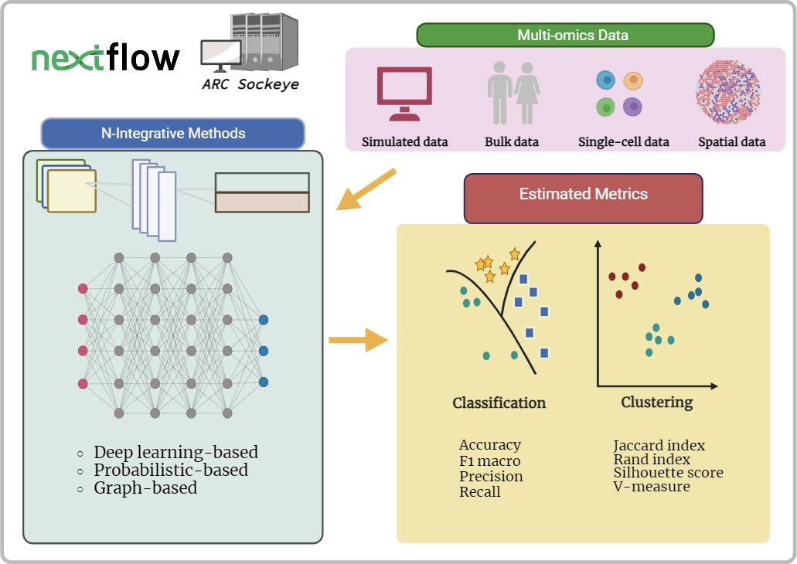
Overview of MESSI
Figure 3: Overview of MESSI workflow
Generalizable for more integration methods
Data transformable for Python or R based methods Reproducible workflow, results/findings
Multiple data types (bulk, sc, spatial)
Help to develop new integration method Compare large set of independent data at once

Slide 5


Acknowledgements
Dr. Amrit Singh
Dr. Young Woong Kim
Dr. Maryam Ahmadzadeh Rishika Daswani
Roy He Michael Yoon Jeffrey Tang
Akshdeep Sandhu Yovindu Don
Raam Sivakumar Prabhleen Sandhu Mingming Zhang Samuel Leung

