Slide 1

MESSI: Multiomics Experiments with SyStematic Interrogation
A Nextflow pipeline for benchmarking multiomics integration methods
Chunqing Tony Liang
PhD student in Bioinformatics Supervisor: Dr. Amrit Singh March 20, 2025

Slide 2
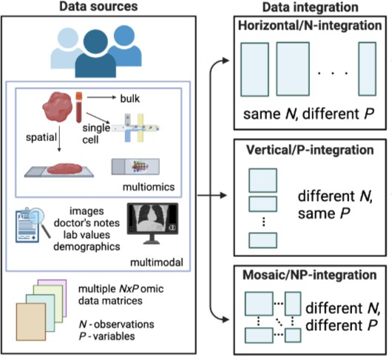

Multiomics data and analysis
Motivation
Technological advancement and reduced costs –> studies with multiomics data
Multiomics data –> /single-cell/spatial data
More generalized –> “multimodal data”, other non-omics data Types of integrations: by sample (N), by omics (P), or both
Figure 1: Overview of multiomics data and integration (1)
Notes:
- Recent update in tech --> cheap and easy access of multiomics data
- Which has different types
- Moreover, we now consider modalities , not just omics but images, doctor notes, so on
- Now, how to integrate them, simplest is same N different P, N means subjects P being predictors

Slide 3
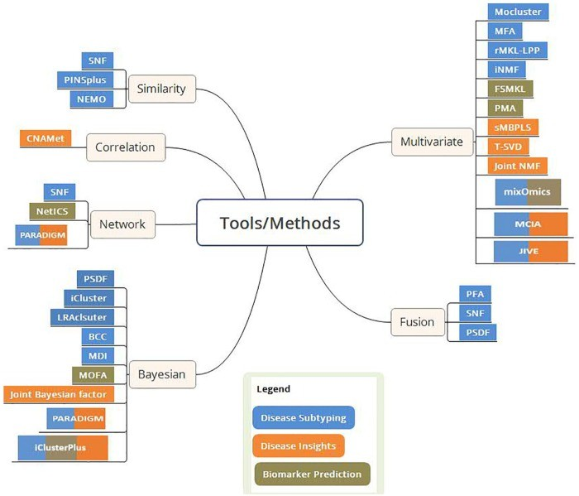

Multiomics data integration methods
Question arises
Many integration methods
—> Which to use, how to choose them? Reproducibility crisis
—> How to reproduce method and get reliable results?
Existing benchmark studies are not 100% complete or all- encompassing
—> Technical difficulty in implementation?
Figure 2: Types of multiomics integration method (2)
Notes:
- Earlier talk about data, but which way we know could maximize / make use of full potential from data
- Then, which task are we performing, and how do you know if it is better in your data not just by chance?
- Fast way to validate them? Hard to reproduce, not really work on custom data
- Have anyone try setting this validation up?
- Reliable? Covered all? Easy to access?

Slide 4
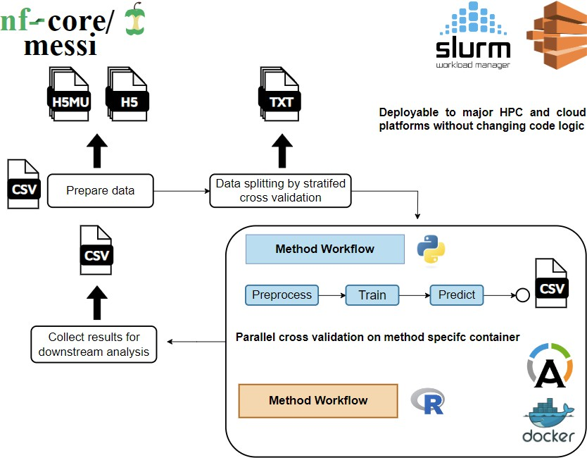
The MESSI workflow
This is done in Nextflow (3) and will be publicly available in nf-core (4).
Compare large set of data at once
Solves reproducibility issue through independent method containers
Generalizable for more integration methods, without affecting existing workflows
Standardized data format transferrable between
MultiAssayExperiment and MuData
Figure 3: Overview of MESSI workflow
Notes:
- Workflow is this, gather your data in MAE and MuData, these two are transferrable
- Requires a binary response here in the data, and just numeric data
- Perform classification task here, could simply extend to regression and other
- Split data prior to perfrom stratified CV
- Not all methods have built-in CV
- And accounts for imbalanced data
- The data could make multiple copies to feed into many method workflow possible
- 1 method is single short pipeline consist of its own prepro, train, and pred
- Gather predicted probabilities of P(Y=1), or positive case
- Each method has its own container --> independet from every other method
- Due to independence, possible to parallel all, at extreme method-data-fold
- Through this we ensure reproducibility, same environment, same seed of splitting, make sure same data flow
- Adding or editing or deleting method do not alter rest

Slide 5
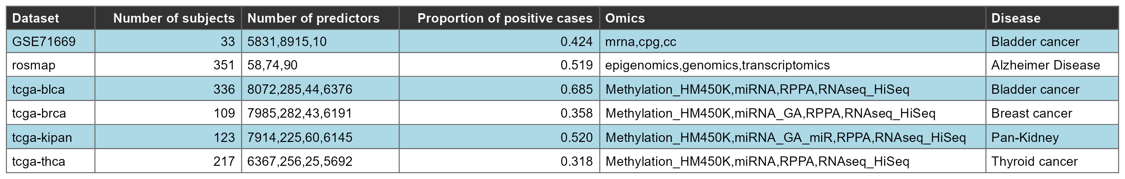
Methods
Looking into multiview (5), DIABLO (6), RGCCA (7), MOFA (8), MOGONET (9) Using a 5-fold cross validation with AUC score as metric
Validating with known ground truth data from 500+ simulated data with varying parameters “Signal” to distinguish groups (binary response)
Correlation between omics Evaluating on 6 real world data (Figure 4)
Figure 4: Real world data demographics
Notes:
- To verify pipeline, we run on 5 integration methods, high impact journal, see reference
- As mentioned focused on classification task and have pred prob as output from pipeline, so use auc as metric
- Set different threshold could yield diff output --> so use auc
- auc measures model’s ability to assign higher predicted probabilities to the positive class than to the negative class.
- Higher (close to 1) able to tell which is positive / negative
- Lower (close to 0) struggles to differentiate
- 0.5 model do not learn, random guessing
- Now, we need ground truth, have code to simulate multiomics data
- Given choices and number of parameters we have 500+ unique data
- most important have a signal to distinguish group (response)
- correlation between omics (covariance)
- ~~Could improve then~~
- Lastly on some real world data, high dim, study different disesase or condition
- R-based one are usually not deep learning based, this is of bad GPU support and focus more on statistics

Slide 6
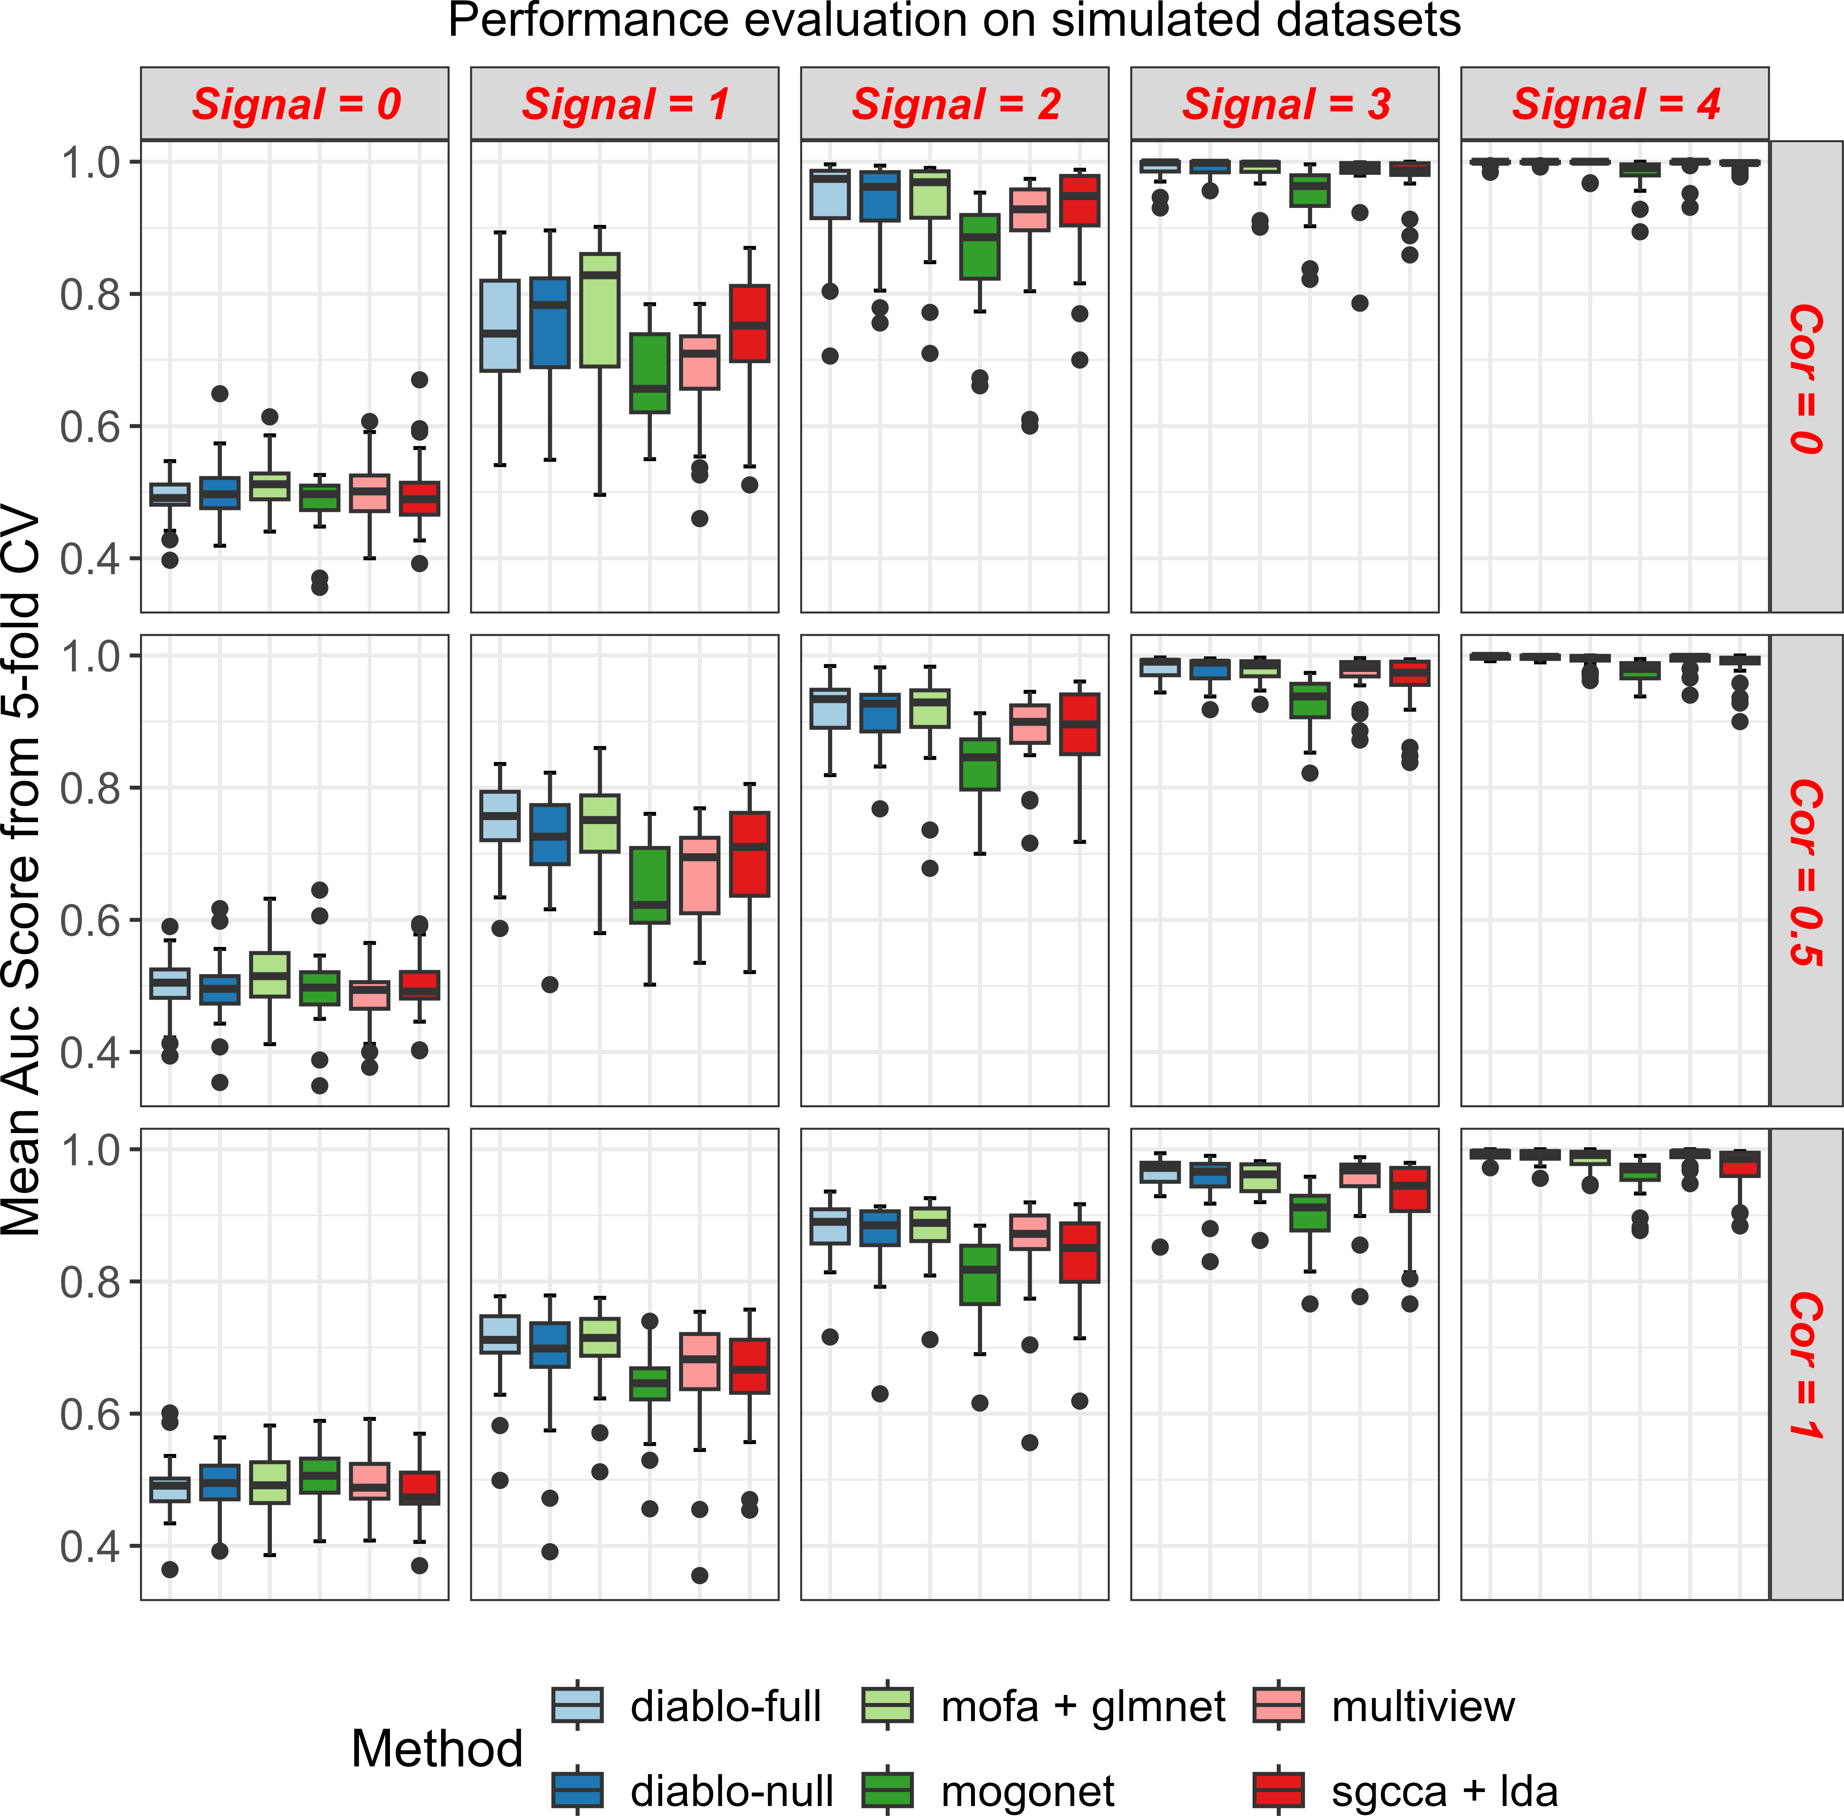
Method are sensitive to the signal in the data
Higher signal, better performance, since it is easier for methods to predict the response
Correlation does not have obvious effect on performance, additional test required
DIABLO is the best, with marginal difference to mofa + glmnet
MOGONET is the worst despite being deep learning-based
Methods perform quite well even when given little signal, with AUC score of ~ 0.7
Figure 5: 5-fold CV AUC on simulated data with varying correlation and signal
Notes:
- No signal, hard to tell, all equally fail and end at 0.5
- Little signal --> quickly to 0.7, to some point it reaches close to 1
- This obvious, since now we make response i.e. pos and neg to have very distinct values
- Corr do not have very obvious effect, arguably lower performance
- As high corr between omics, redundant info, hence not good?
- Bit small, but seems diablo full or null design matrix (covariance matrix of omics) do good
- Some see suffix is because original model do not perform classification, so some tricks
- MOGONET is bad in almost all, deep learning is not always good

Slide 7
High variability when identifying the important predictors
Multiview has consistently identified important predictors, even when the signal or correlation is low.
The other methods exhibited varying sensitivity with different parameter settings, making them unstable.
MOGONET performed the worst, with low median sensitivity capped at around 0.1.
Figure 6: Sensitivity of methods identifying important predictors
Notes:
- Guide people, let them laugh a bit wow result not always good looking
- Since simulated, we know which predictor are useful (biomarker), which are garbage just noise, can model still pick the good ones? at what prop -> sensitivity
- vice versa, we could extend it to specificity and so on, lot of possibilities
- if you like to call stable, mogonet consistent bad at 0.1, but pink multiview is doing great at lesat stable
- diablo best model before still do good jobm but sometimes just fails a identifying biomarkers
- Discuss later that simulation could be improved or explored more

Slide 8
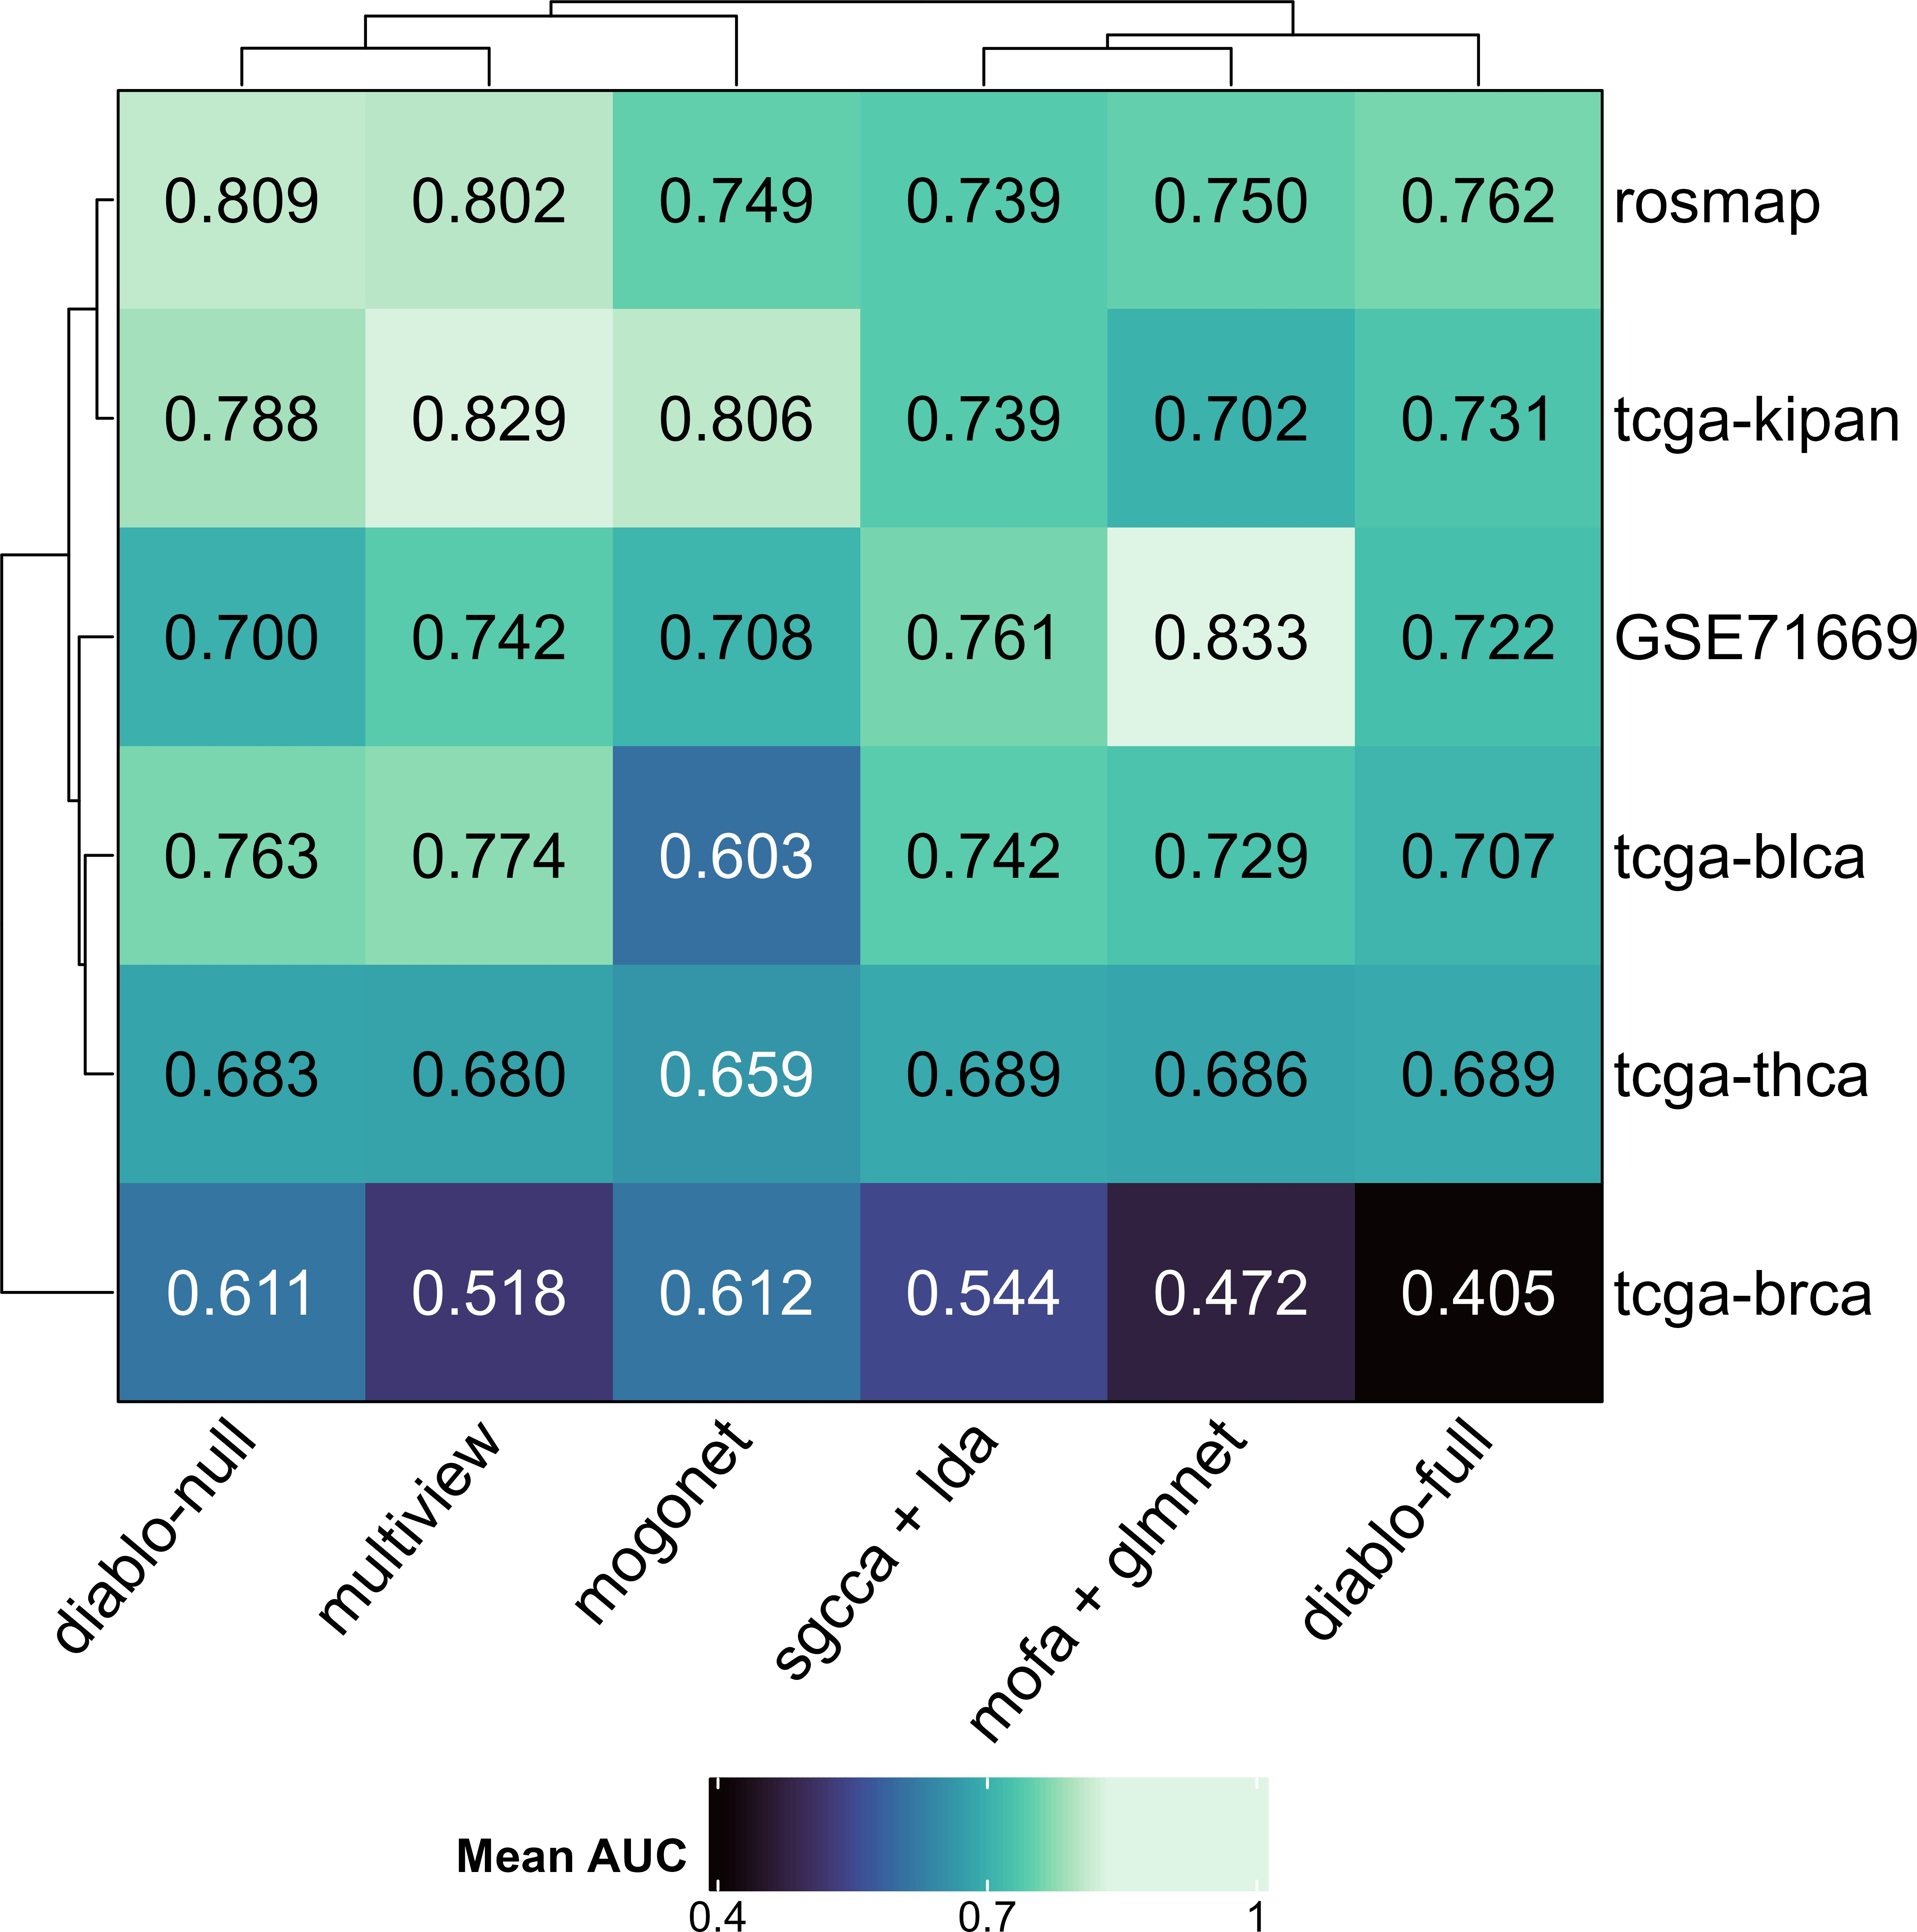
No universal method that work well on all datasets
All methods are unique in their design — “no method work well on all data”
Some data exhibits very complex patterns, making them challenging to predict
Some methods are similar to each other,
i.e. solving similar optimization problem, model setup
Similarly, data could have alike distributions The pattern follows from previous simulation
Figure 7: 5-fold CV AUC score on real data
Notes:
- When comes to real, we dont see extreme settings like in simulation
- Turns out they perform quite good with 0.7 most , this kinda follows like before
- Given signal, we have 0.7 as well wow, that why we use simulation first
- Now, some data is just complex, brca, all do poorly
- Looking at clusters, methods relate model setup, data relate distribution

Slide 9
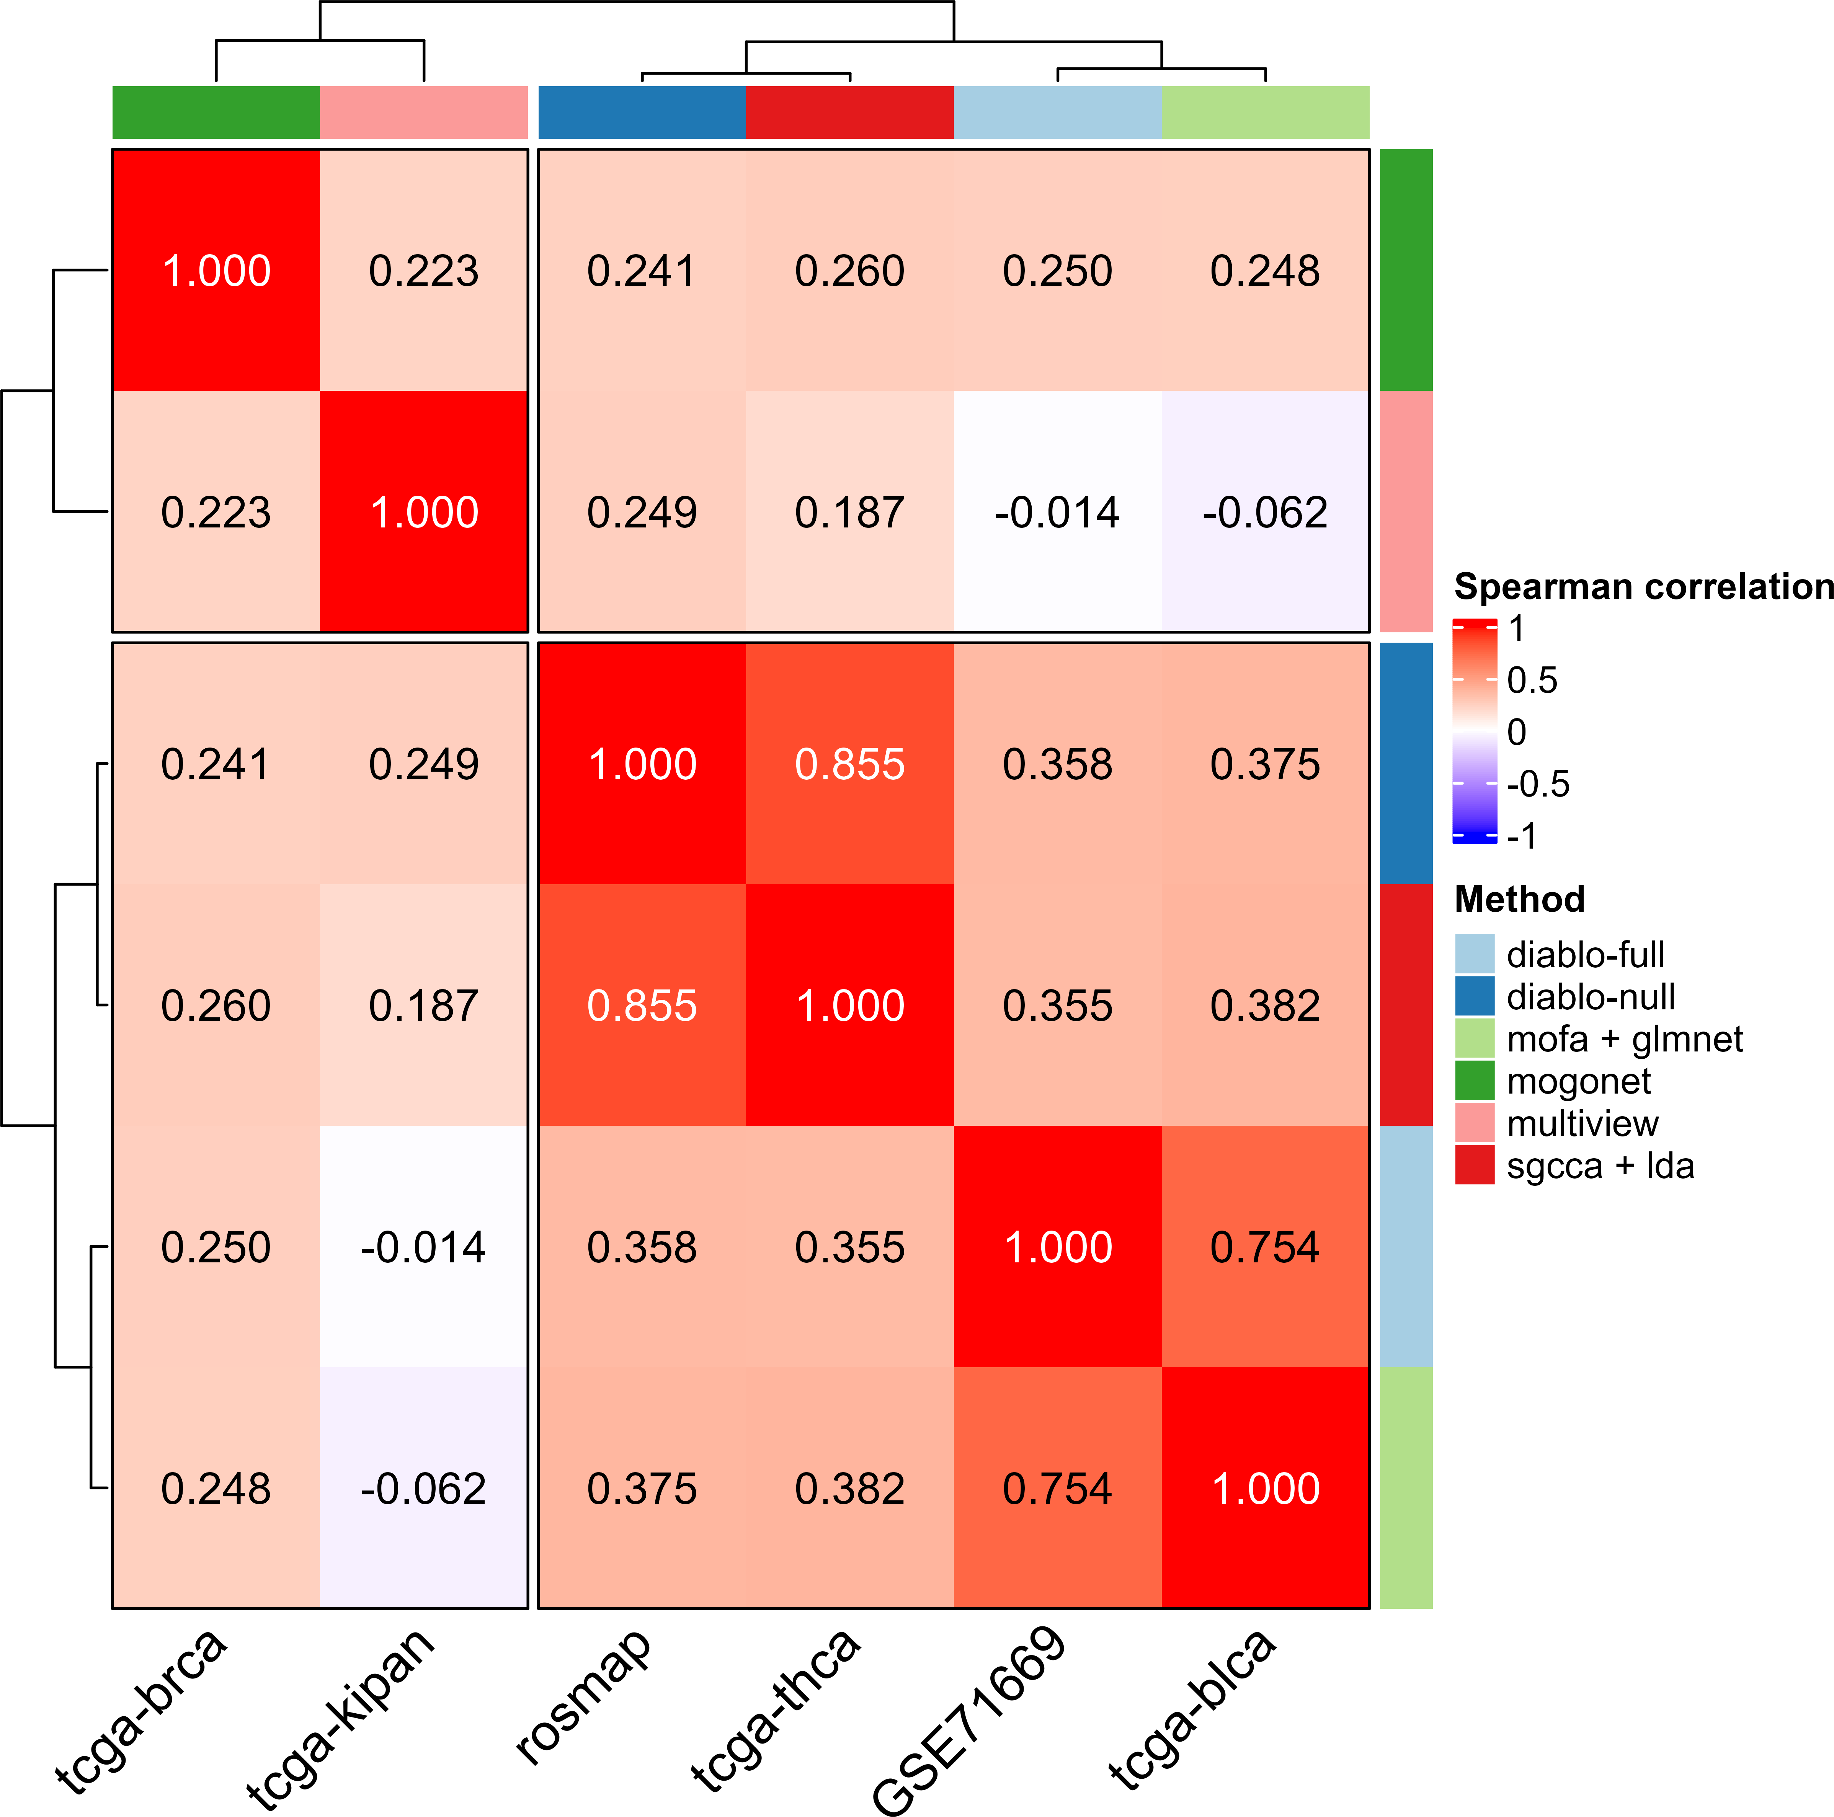
Ranking of biomarkers varies by method
Methods do not use same metric to quantify whether certain biomarker is important, so ranks on these are usually different
Some methods relate due to similar model design like DIABLO and SGCCA
Similar data tend to cluster together,
i.e. GSE71669 with tcga-blca, both study bladder cancer
Figure 8: Spearman ranking correlation of biomarkers in methods
Notes:
- In here, we do not know what are actual useful biomarker, so instead let methods weights all predictors and rank them
- important ones should be picked up and rank higher than those useless one
- can we see similarity there? --> spearman rank correlation
- Due to diff method nature, we dont expect them to rank same, hope they all retrieve up important ones
- if not means method need improvement? we could use pipeline to access multiple method
- hence telling if your method need work
- SGCCA coincides with diablo-null, since both use canonical correlation analysis, to maximize correlation /covariance between linear combination of variables nad projects them in lower dimension

Slide 10
Discussion & Future directions
“No method works universally well on all datasets”
Classic statistical methods still work, and sometimes even better than deep learning (DL) Pipeline proves way to reproducibly explore, benchmark different aspects of integration methods
Resumable
Parallel to compute as many resources as allowed at the same time Ease burden of setting up environment
Need to add more methods and datasets Especially DL models are more popular now
Explore if any dataset could have relation to another despite different disease/condition
Collaboration is welcomed!
This is ongoing work, and it would be great to have more community involvement

Slide 11
Thanks!

Slide 12

Acknowledgements
Dr. Amrit Singh
Dr. Young Woong Kim
Dr. Maryam Ahmadzadeh Rishika Daswani
Roy He Michael Yoon Jeffrey Tang
Akshdeep Sandhu Yovindu Don
Raam Sivakumar Prabhleen Sandhu Mingming Zhang Samuel Leung

Slide 13
References
1.
Shannon CP, Lee AH, Tebbutt SJ, Singh A. A commentary on multi-omics data integration in systems vaccinology. Journal of molecular biology. 2024;436(8):168522.
Subramanian I, Verma S, Kumar S, Jere A, Anamika K. Multi-omics data integration, interpretation, and its application. Bioinformatics and biology insights. 2020;14:1177932219899051.
Di Tommaso P, Chatzou M, Floden EW, Barja PP, Palumbo E, Notredame C. Nextflow enables reproducible computational workflows. Nature biotechnology. 2017;35(4):316–9.
Ewels PA, Peltzer A, Fillinger S, Patel H, Alneberg J, Wilm A, et al. The nf-core framework for community-curated bioinformatics pipelines. Nature biotechnology. 2020;38(3):276–8.
Ding DY, Li S, Narasimhan B, Tibshirani R. Cooperative learning for multiview analysis. Proceedings of the National Academy of Sciences. 2022;119(38):e2202113119.
Singh A, Shannon CP, Gautier B, Rohart F, Vacher M, Tebbutt SJ, et al. DIABLO: An integrative approach for identifying key
molecular drivers from multi-omics assays. Bioinformatics. 2019;35(17):3055–62.
Girka F, Camenen E, Peltier C, Gloaguen A, Guillemot V, Le Brusquet L, et al. Multiblock data analysis with the RGCCA package. Journal of Statistical Software. 2023;1–36.
Argelaguet R, Velten B, Arnol D, Dietrich S, Zenz T, Marioni JC, et al. Multi-omics factor analysis—a framework for unsupervised integration of multi-omics data sets. Molecular systems biology. 2018;14(6):e8124.
Wang T, Shao W, Huang Z, Tang H, Zhang J, Ding Z, et al. MOGONET integrates multi-omics data using graph convolutional networks allowing patient classification and biomarker identification. Nature Communications. 2021;12(1):3445.
2.
3.
4.
5.
6.
7.
8.
9.

