Slide 1
COM3107
Mask Detection Application
S198255 Ma Man To, s198258 Ng Wang Kei, S198262 Tam Wai Yin

Slide 2
Background
Human and Mask
Since the breakout of covid-19, the spread of the disease has been alarming and the mask becomes a necessary product in human daily lives.
In different country, putting their mask on is recommended, in certain region/city, wear a mask is a must, in order to control the spread of the covid. Wearing a mask is the easiest way to contribute to the society from the COVID condition. Wear the mask is the way back to our normal life.
During this project, we are going to build an application to for detecting over mask over peoples’ face in the public area, in order to help the authority to put more manpower and resources on dealing the COVID situation, which also in order to lower the risk of the spread of covid in the crowd.

Slide 3

Objective
❌
Classify
Wearing a mask
✔️
Mask Detection Application
Not wearing a mask
❌
Wearing a mask wrongly

Slide 4
Implementation Flow
Mask
Classifier
Classifying a face is:
i) wearing mask
ii) not wearing a mask
iii) wearing wrongly
Part A
Result
Capturing Photo
Capturing photo from the webcam
Part B
Photo
Part C
Face Detector
i)Detecting a face in the PartB captured photo
ii) Cropping the face
Cropped
Photo
Image
Prediction
Part C
Cropped Photo
Part A
Mask Classifier
Prediction
Result
Part D

Slide 5
ResNet
ResNet stands for Residual Network
A residual neural network (ResNet) is an artificial neural network (ANN)
Typical ResNet models are implemented with double- or triple- layer skips that contain nonlinearities (ReLU) and batch normalization in between
Notes:
Pt1: ResNet stands for Residual Network. It is an innovative neural network that was first introduced by Kaiming He, Xiangyu Zhang, Shaoqing Ren, and Jian Sun in their 2015 computer vision research paper titled ‘Deep Residual Learning for Image Recognition’
Pt2: A residual neural network (ResNet) is an artificial neural network (ANN) ,Residual neural networks utilize skip connections, or shortcuts to jump over some layers

Slide 6
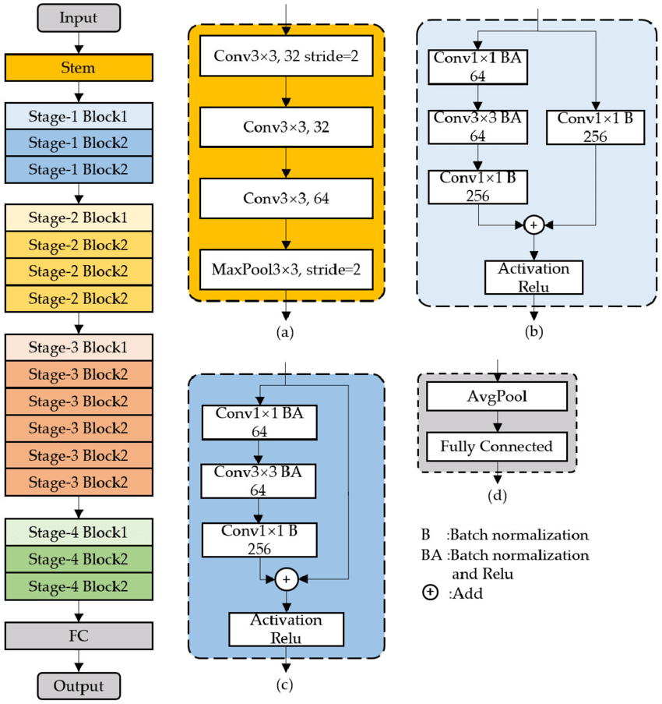
ResNet

Slide 7
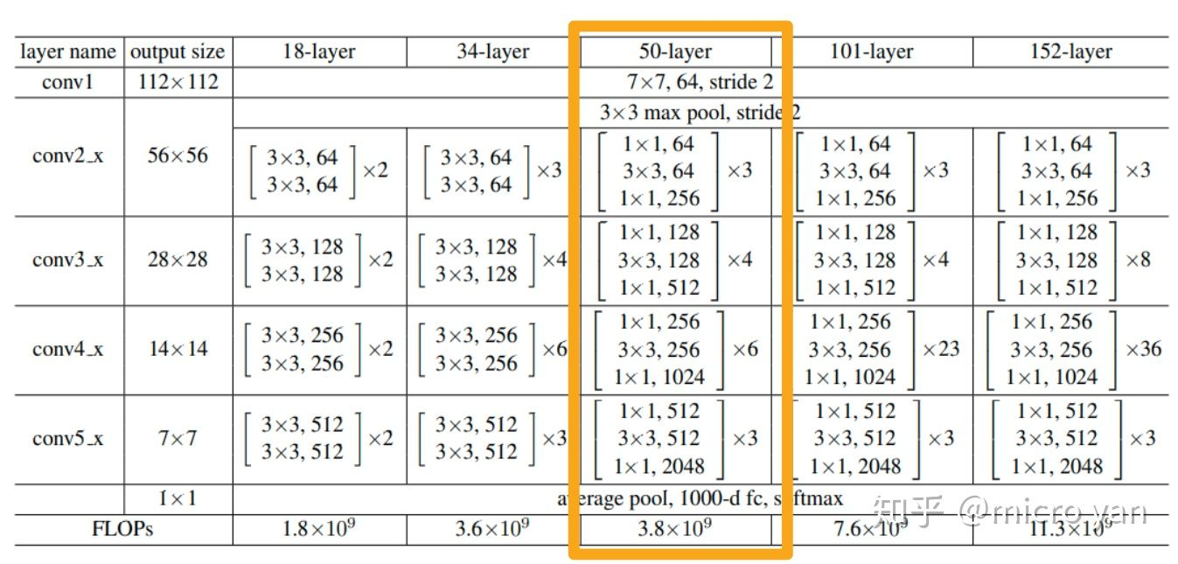
ResNet50

Slide 8
ResNet50
ResNet has many variants
Resnet50 architecture is based on the Resnet34 model, there is one major difference
Bottleneck design due to concerns over the time taken to train the layers
It used a stack of 3 layers instead of the earlier 2
50-layer ResNet achieves a performance of 3.8 bn FLOPS
Notes:
Pt1: ResNet has many variants that run on the same concept but have different numbers of layers. Resnet50 is used to denote the variant that can work with 50 neural network layers
Pt2: The building block of Resnet50 was modified into a bottleneck design due to concerns over the time taken to train the layers
Comparing to 34, 50 has much higher accuracy than the 34-layer ResNet model

Slide 9
Classifier - ResNet 50
Pros:
Accelerate the speed of training of the deep networks
Increasing depth of the network results in less extra parameters
Reduce the effect of Vanishing Gradient Problem
Can obtain higher accuracy in network performance especially in Image Classification
The building block was modified into a bottleneck design due to concerns over the time taken to train the layers
Cons:
Increased the complexity of architecture
Implementation of Batch normalization layers
Since ResNet was heavily depends on it
Adding skip level connections for which you have take into account the dimensionality between the different layers which can become a headache

Slide 10
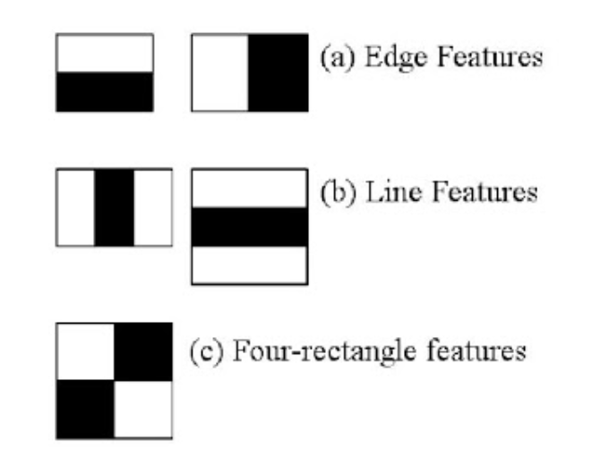
Face Recognition - Haar Cascade
Haar Cascade is an algorithm to check human face in an image and video
(proposed by Paul Viola and Michael Jones based on AdaBoost algorithm)
3 kinds of features (White = positive Dark = Negative)
Notes:
Used for Face Recognition (BGR color only) (One face only per test) (may not able to check clearly) (cant check when ware mask)

Slide 11
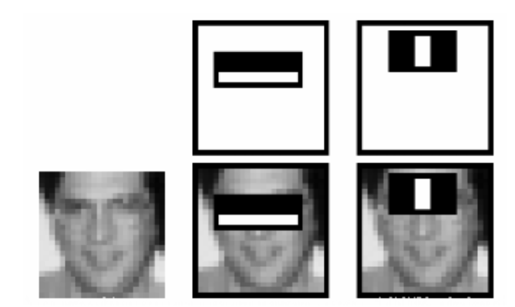
Face Recognition - Haar Cascade
Check the photo with ONLY MONOCHROME COLOUR (Black, Gray, White)
Use different features to check the numberized picture
To calculate if the picture has the person face or not

Slide 12
It will test like this
When phase 1 test was finish successfully (passed phase)
It will start phase 2 test to check if there are any faces
If there are something blocked the face, stage 1 check will not
be done, so no face will be detected.

Slide 13
Project Preparation
Importing the package
Importing the dataset from Kaggle
Reading the images and annotation files (XML)
Creating a function to show a few labeled images
Saving the data into the dataframe
Building the dataset {image+label}
Splitting the dataset into train, validation, test
Project Preparation Finish
Building the train, validation, test dataloader

Slide 14
Part A - Classifier
Getting the ResNet50 Model
Rebuilding the fc layer and the output channel
Setting the parameter
Using the CUDA (GPU) as device
Setting the NLLLOSS, the cross entropy, and the optimizer
Start training (training and validation):
50 epochs
During each epoch,
Show the train/valid loss and train/valid accuracy
Saving the model if the accuracy is the highest in the history
Using the test data to test the model accuracy
Showing the model prediction by test images

Slide 15
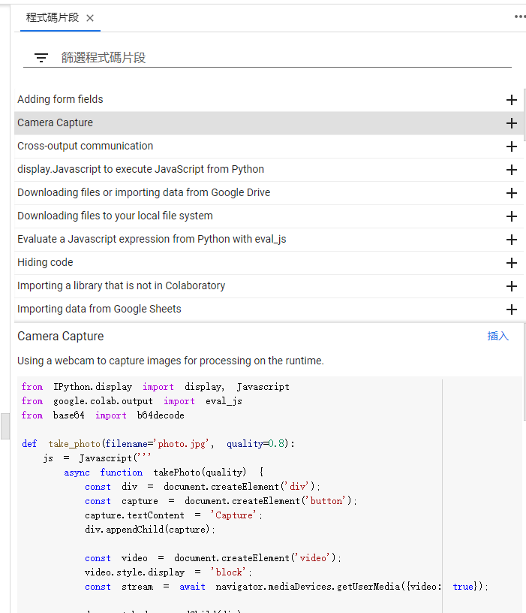
Part B - Capturing Photo Function
Importing the code from Colab Built-in function

Slide 16
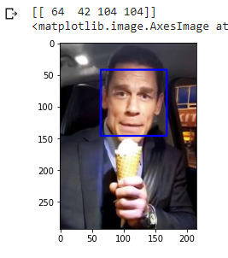
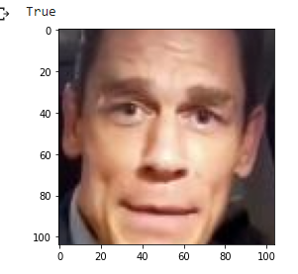
Part C - Face Detector
Importing the Haar Cascade Classifier
Convert the image from BGR to GRAY
Cropping the detected face
Testing the boxing ability
Saving the cropped image

Slide 17
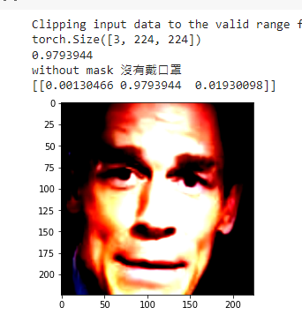
Part D - Image Prediction
Loading the saved ResNet50 Model
Start Prediction
Showing the cropped face and prediction result

Slide 18
Application Demonstration
Demonstration Time

Slide 19
Reflection - Limitations & Reflection
i) The mask sample is not perfect.
[Solution] Doing more data augmentation on the data people wore masks wrongly.
ii) The face recognition - Haar Cascade Classifier (front-face) hard to recognize humans when human is wearing the mask.
[Solution] Need to train a new model which is only focusing on handling human faces.
iii) The current application only predicts one human face.
[Solution] Altering the function to allow predicting all faces at the same time.
iv) Using two models is not efficient.
[Solution] Using one model to detect the faces and mask status at the same time. Maybe building a face recognition model can achieve it.

