Slide 1

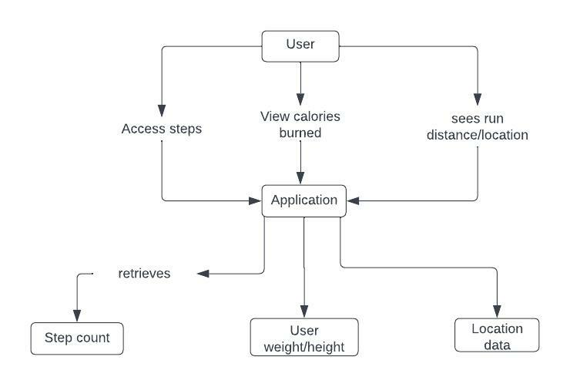
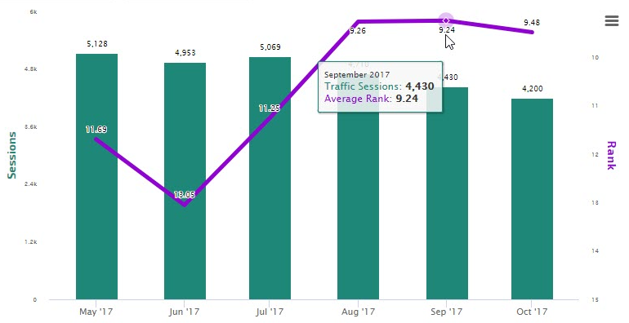
Fit-work Run Tracking Application
Software Engineering
Anthony Olori
194234
Introduction:
Modules:
This is a fitness and run tracking application.
Centered around privacy and user autonomy, users have full control over what features and modules will be available in this application.
Run tracker
it will track run
speed and run distance.
Location Tracker
This will use the phones gps data and will display the location on google maps
Step counter
Record total steps
and display to the user.
Calorie calculator
Calculates calories burned.
Insights:
Using past data the application will produce graphs depicting trends and activity over time by the user.

