Slide 1
INTRODUCTION

Slide 2
What is the project
A Fitness application Centered around tracking a users run in real time and displaying relevant information.
This project was chosen as a means to build up experience in application development.
It is built upon the idea of fitness tracking but with a focus run sessions..

Slide 3
Aim
Develop an application with certain features.
User Run session tracking.
Calorie calculation, based on run data.
Provide visual feedback on the users exercise habits.

Slide 4
METHOD

Slide 5
METHOD
To meet the goal of creating an application, the flutter Graphical user interface(GUI) was chosen.
For visualization of the users location. Google maps Api was implemented.
To accommodate for multiple users and to expand the application to allow for multiple users it integrates firebase Authentication as well as firebase data storage capabilities.

Slide 6
Modules
Run Tracking module.
Calorie calculation module.
Firebase Authentication module.(User account creation)
Firestore storage module. (images, User details)

Slide 7
RESULTS
The following pages are the realization of the idea

Slide 8
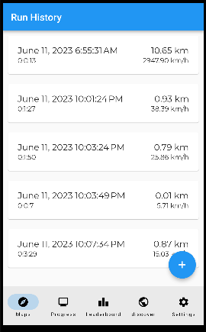
Run History
The first screen a user sees when they open the application, this screen enables the user to see their past runs.

Slide 9
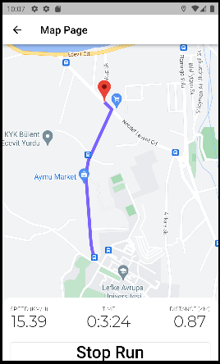
Map page
On click of the floating button on the previous screen the user is directed to this page where they can

Slide 10
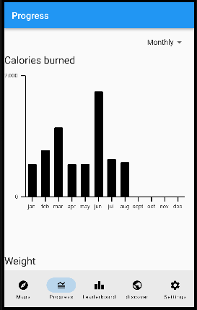
Charts
This chart shows a history of calories burned.

Slide 11
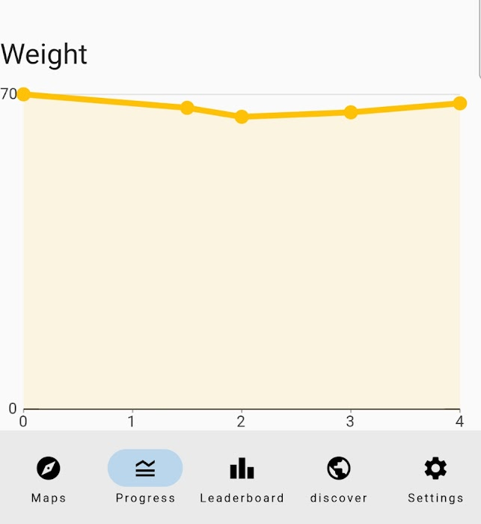
Charts
A graph of the users recorded
weight over time

Slide 12
The social aspect

Slide 13
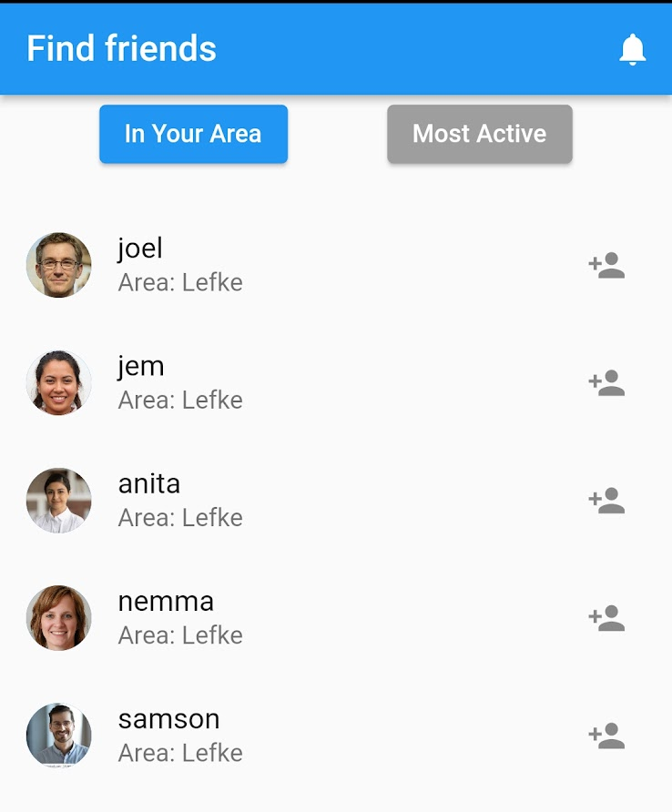
Find Friends

Slide 14
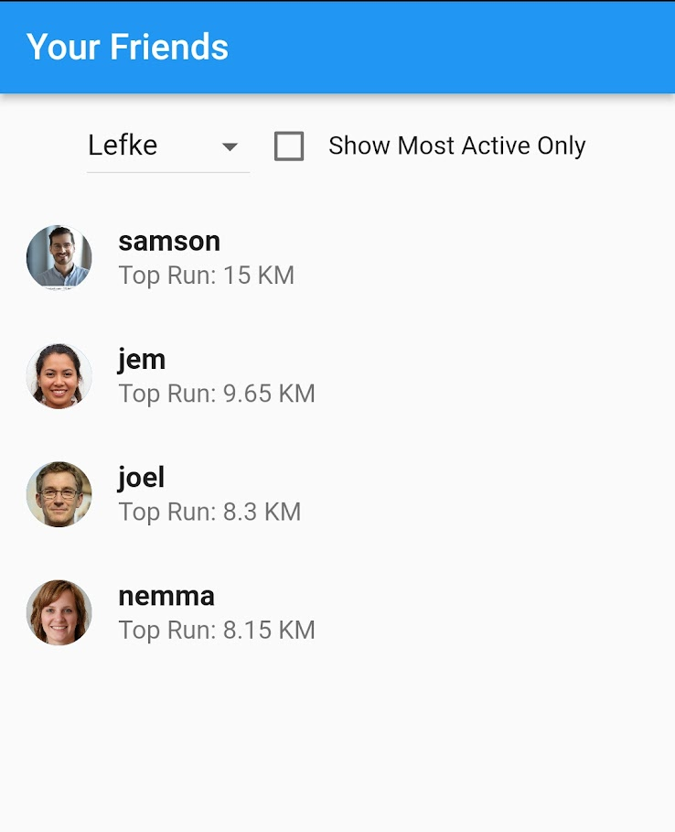
Friends
This page allows the user to see the activiity of their friends, each friend. The

Slide 15
THE END

