Slide 1
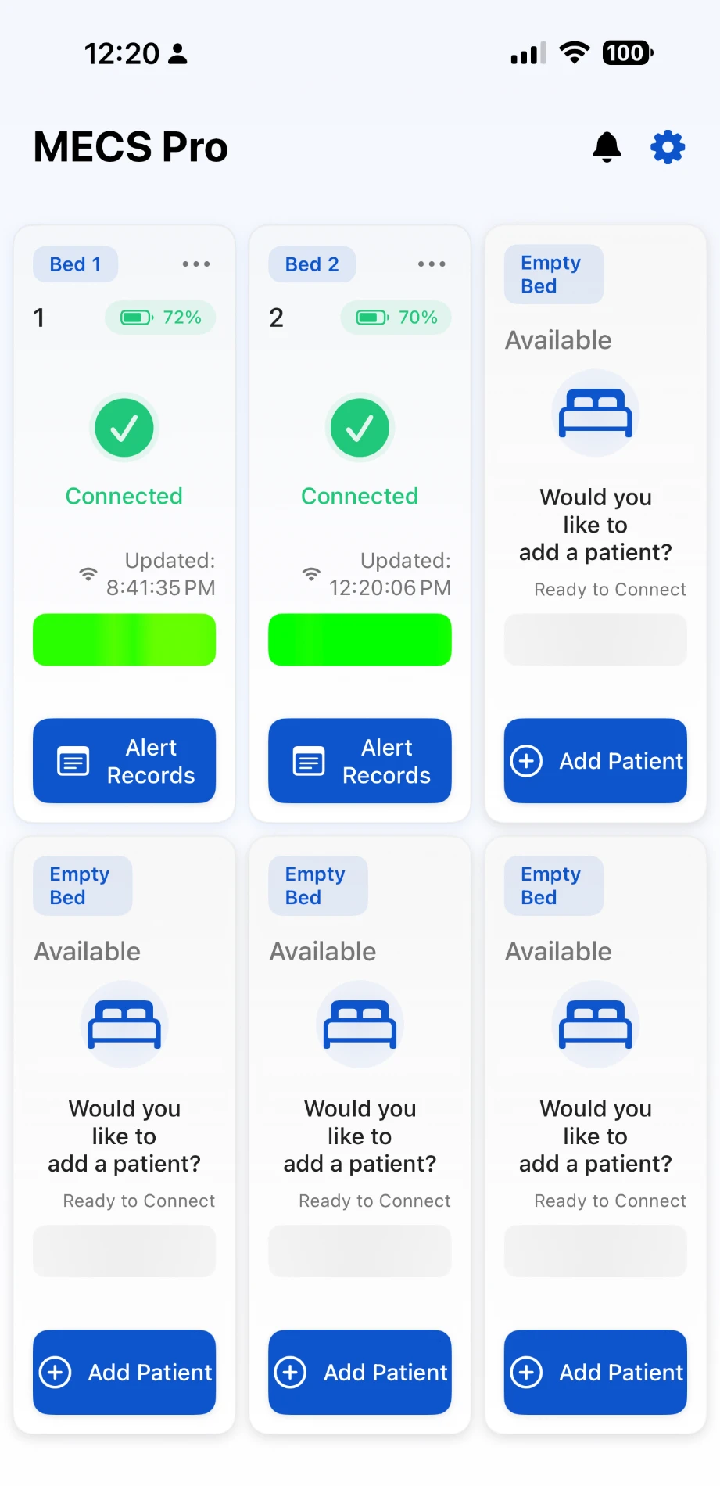
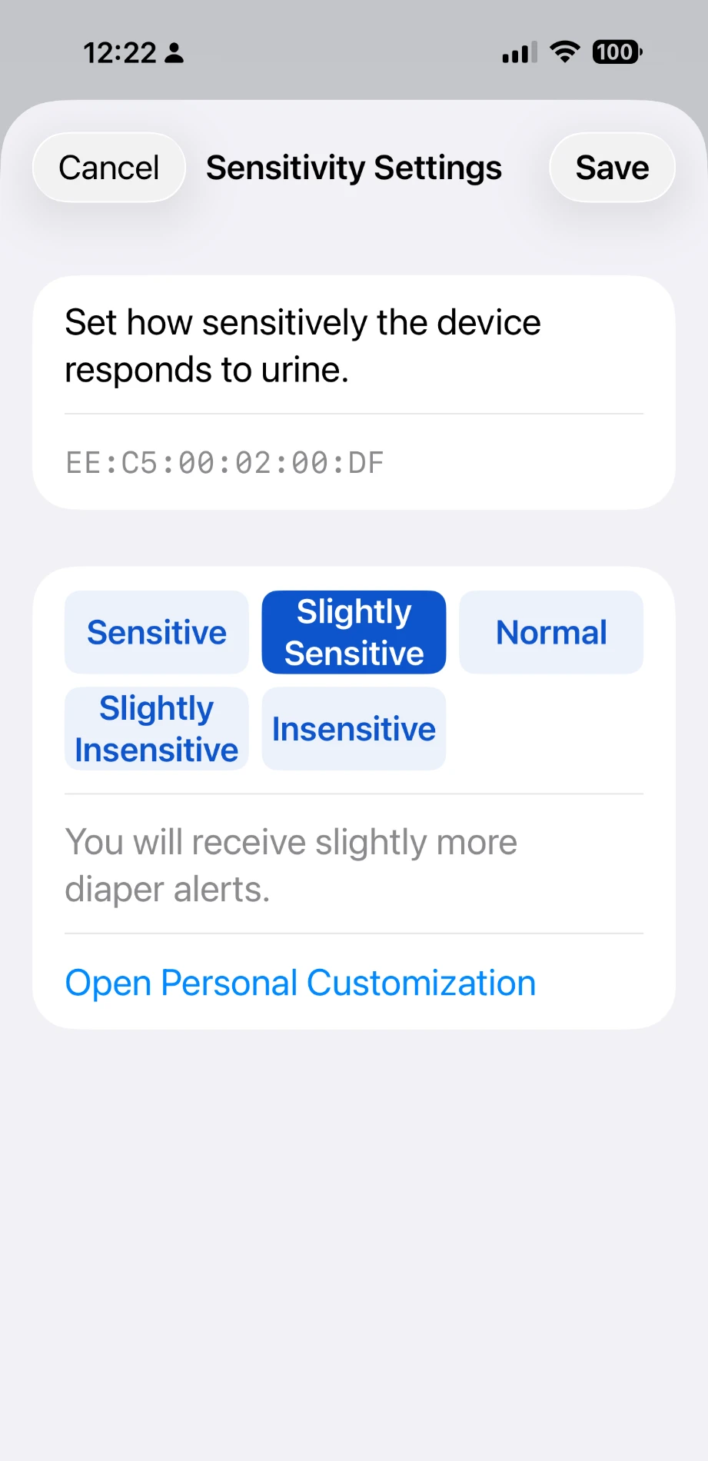
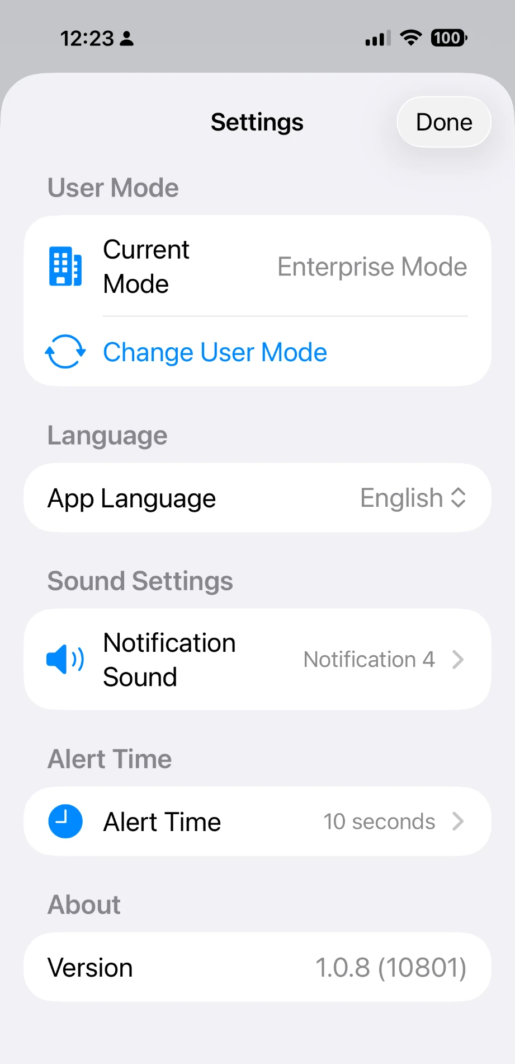
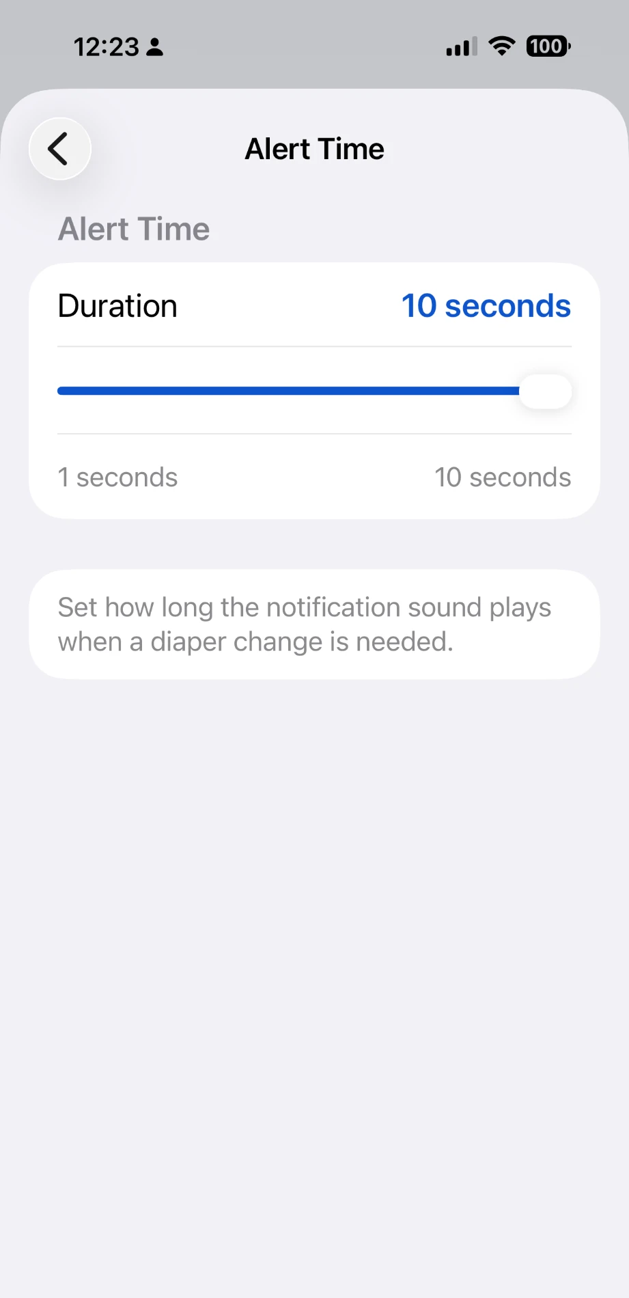
MECS PRO Mobile App – Feature Description
iOS app with the same core functions as the web platform: bedside monitoring, diaper alerts and sensitivity control
① Bed-by-bed monitoring
Card per bed: bed no., patient no., battery %, Connected status, last-updated time and status bar. Empty beds show “Available – Ready to Connect” with Add Patient. Alert Records per patient; bell and gear icons on top.
② Per-device sensitivity
Choose 5 presets from Sensitive to Insensitive (selected level explained, e.g., “slightly more diaper alerts”), or open Personal Customization. Applies to the selected sensor ID; Save / Cancel.
③ Settings
User Mode (e.g., Enterprise Mode, switchable), App Language (English), Notification Sound selection, Alert Time and app version.
④ Alert Time
① Bed dashboard
② Sensitivity Settings
③ Settings
④ Alert Time
Slider (1–10 seconds) sets how long the notification sound plays when a diaper change is needed.
Screens show sample data from a test environment. The notification (bell) page and the per-bed “⋯” menu are not shown here.
Attachment 1 to the MOU · MONIT Corp. · MECS PRO Mobile App
1 / 1

