Slide 1
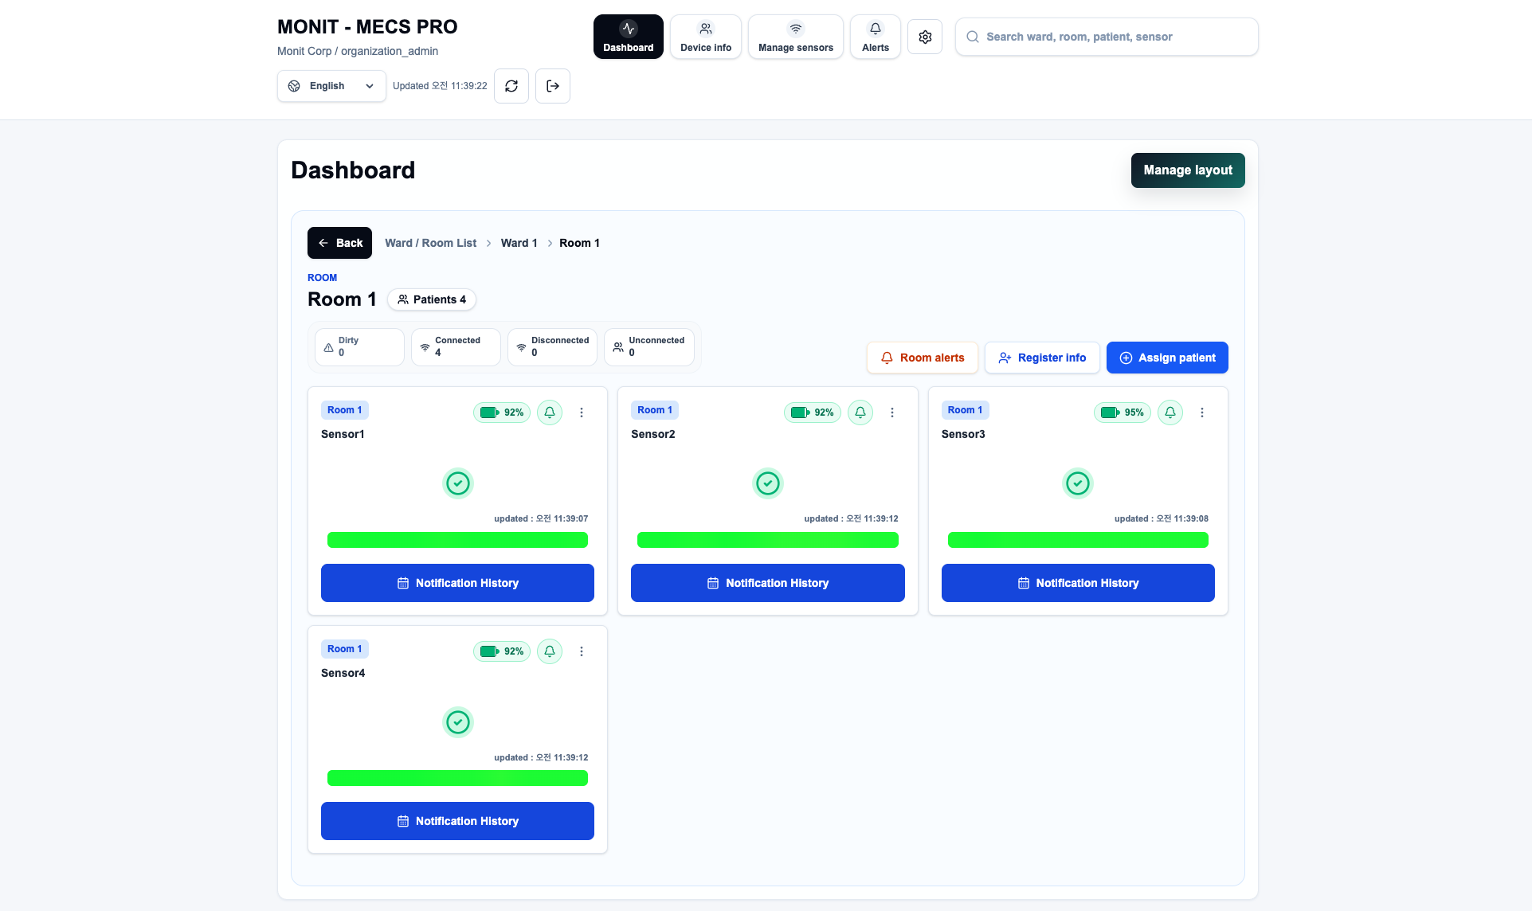
MECS PRO Monitoring Platform – Overview
Web-based AIoT diaper monitoring and caregiver alert dashboard
Main navigation
Dashboard
Real-time view of wards, rooms, patients and sensors
Device info
Information on registered devices
Manage sensors
Registration and management of sensors
Alerts
Alert list and notification handling
Settings
System / account configuration
Figure: Room view of the MECS PRO web dashboard (sample data)
Also: global search (ward, room, patient, sensor), language selector, manual refresh with last-updated time, and secure sign-out.
Attachment 1 to the MOU · MONIT Corp. · MECS PRO Platform
1 / 3

Slide 2
Key Features – Real-time Monitoring & Alerts
What caregivers see and do from the Room view
Hierarchical drill-down
Status summary
Ward / Room List → Ward → Room navigation with breadcrumb and Back button; patient count shown per room.
At-a-glance counters per room: Dirty, Connected, Disconnected and Unconnected sensors.
Per-patient sensor card
Automatic refresh
Each card shows room tag, sensor name, battery level (%), alert toggle, health/status indicator, status bar and last-updated time.
Sensor data updates in near real time; page shows the last-updated time and supports manual refresh.
Alerts & notifications
Battery & connectivity awareness
Per-sensor alert on/off, Room alerts shortcut, and a Notification History view for each sensor.
Battery % per sensor and connection state counters help staff spot devices needing attention.
Attachment 1 to the MOU · MONIT Corp. · MECS PRO Platform
2 / 3

Slide 3
Key Features – Management & Administration
Configuration tools for administrators and nursing staff
Patient assignment
Manage layout
Assign patient to a sensor from the Room view; Register info to enter patient / sensor details.
Administrators can arrange the dashboard layout of wards and rooms to match the facility.
Sensor & device management
Global search
Dedicated Manage sensors and Device info menus for registering and reviewing devices.
Single search box to find a ward, room, patient or sensor quickly.
Role-based organisation access
Multi-language UI
Sign-in under an organisation account (e.g., organization_admin) scoped to that organisation’s data.
Language selector (English shown) for international deployments.
Note: Features are described from the dashboard screen shown above; Device info, Manage sensors, Alerts and Settings menus are listed by name. Functions may evolve with product versions.
Attachment 1 to the MOU · MONIT Corp. · MECS PRO Platform
3 / 3

