Slide 1


MONIT
AI-Enabled Smart Diaper Care System
Response to KTPH-RFP-26-165-MJ — discussion with ALPS and the KTPH, Woodlands Health and TTSH project teams
8 October 2026 | Confidential

Slide 2


MONIT is a Samsung spin-off digital-health company focused on making incontinence care smarter and more dignified
1 · COMPANY INTRODUCTION
Company | Established | CEO | Head office (Korea) | Singapore
MONIT Corp. | 10 April 2017 | Tony (Dohyeong) Park | Seocho AICT Center, 56 Yangjae-daero 12-gil, Seoul | 9 Straits View, Marina One West #05-07 · distributor Intega Healthcare
Technology and business
B2G (Korea)
AIoT urine and faecal soiling sensing technology
Senior Diaper Care System (sensor, relay, dashboard) and Senior Diaper Subscription
B2B: general hospitals, elderly-care hospitals and care facilities
Selected as an innovative welfare device by NHIS, Korea's National Health Insurance Service
1
Proven history
Samsung spin-off, invested by Samsung Venture Investment · NHIS innovative welfare device · customers in Korea, Japan, Singapore, the Netherlands and Australia
2
Proven technology
Clinically trialled at KTPH Ward B76 (7 weeks, 15 patients) · IMDA, KC and CE registered · ISO 27001 / 27017 / 27018 certification in November 2026
3
Complete, integrated system
Sensor → relay → hospital Wi-Fi → cloud → nurse dashboard, delivered and supported by one team with Intega on site
Source: MONIT company records; NHIS (National Health Insurance Service, Korea) innovative welfare device listing; IMDA, KC and CE registrations (Section 2).

Slide 3
Product registrations are in place, and ISO 27001 / 27017 / 27018 certification follows in November 2026
2 · INDUSTRY CERTIFICATIONS AND STANDARDS
Standard | What it covers | Status | Timing
ISO/IEC 27001 — information security (ISMS) | Systematic protection of patient-related data across platform and dashboard | Certification audit in progress | November 2026
ISO/IEC 27017 — cloud security controls | Security controls for the cloud platform hosting hospital data | Certification audit in progress | November 2026
ISO/IEC 27018 — PII protection in public cloud | Safeguards for personal data processed in the cloud; supports PDPA compliance | Certification audit in progress | November 2026
Registration | Sensor | Relay gateway | Validity
IMDA (Singapore) | Registered — ESER/26/5288 · BLE diaper sensor for sale and use in Singapore | Registered — ESER/26/5450 · relay gateway for sale and use in Singapore | Sensor Aug 2031 · Gateway Sep 2031
CE (EU) | Certified — RED 2014/53/EU (radio, EMC and electrical safety) | Certified — EMC 2014/30/EU (EU conformity assessment) | No expiry
KC (Korea) | Registered — R-R-mNT-SEMSYS200KSEN · radio and EMC conformity | Registered — R-R-mNT-SSG · radio and EMC conformity | No expiry
ISO certification is scoped to the MECS PRO platform, dashboard and Azure Singapore hosting used for the three hospitals.
Source: IMDA, CE and KC registration records; MONIT ISMS programme. ISO certificates will be provided on issue.

Slide 4
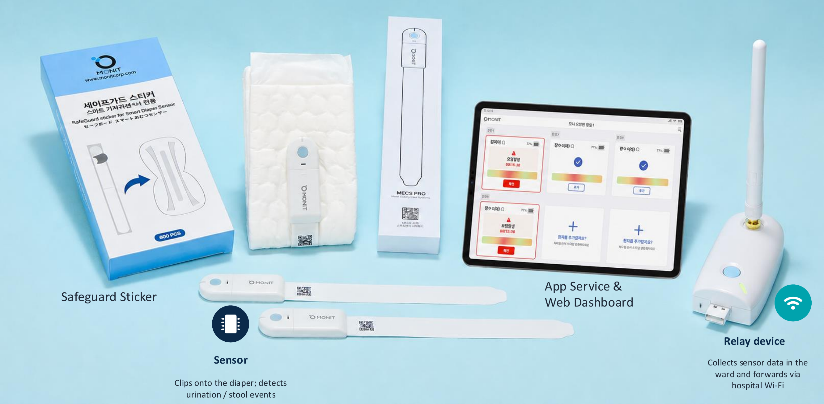
MECS PRO: an AI diaper care system built for professional care settings
3 · INTRODUCTION TO THE SMART DIAPER SYSTEM
Components: sensor (clips onto the diaper), Safeguard sticker, relay gateway (hospital Wi-Fi), app service and web dashboard.

Slide 5
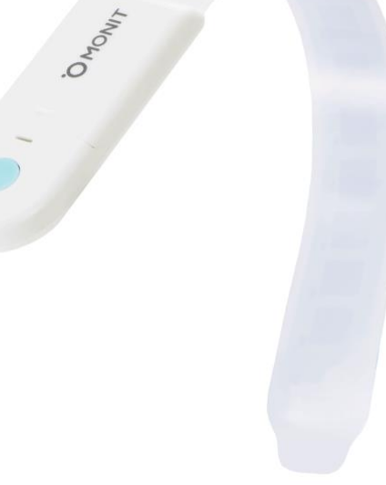




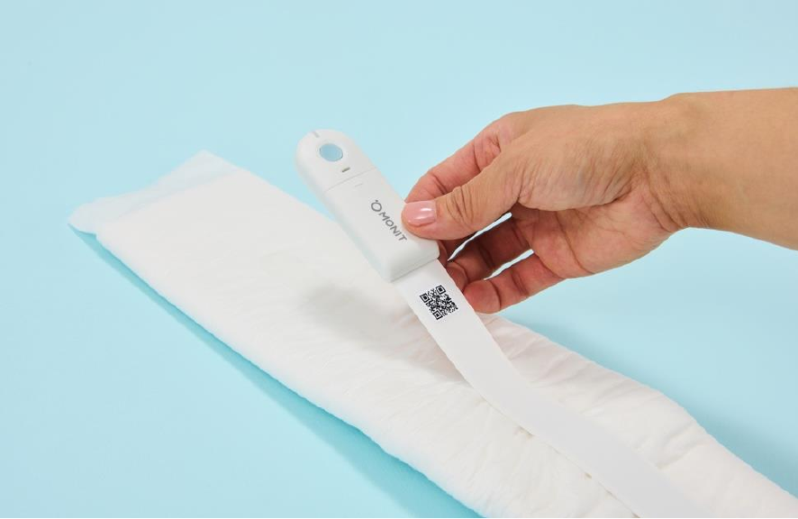
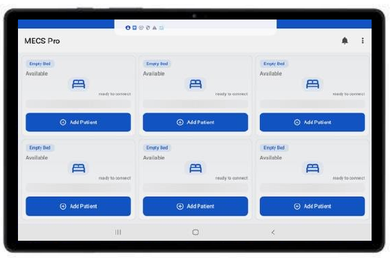
Smart care for health, dignity and efficiency: changes at the right time, not on a fixed round
3 · INTRODUCTION TO THE SMART DIAPER SYSTEM
Value to hospitals
Right-time diaper changes instead of routine checks
Less nurse time on manual rounds; fewer disturbances for patients
Objective data to support skin-integrity and continence care
Patients
Hospital
Caregivers
Skin integrity
Consumables
Workload
Prompt changes lower the risk of incontinence-associated dermatitis and pressure injury
Up to 25% fewer unnecessary diaper changes
Fewer manual checks; alerts go to the nurse who needs them
Source: MONIT; KTPH Ward B76 trial (9 Jul – 24 Aug 2025): 4.73 wet diapers per patient-day on average. Diaper saving is a MONIT customer estimate.

Slide 6
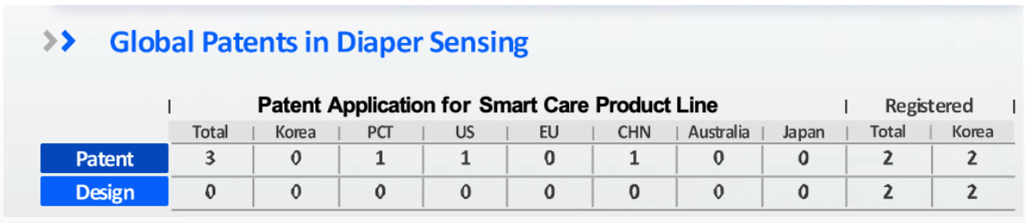

AI pattern learning and a multi-channel sensor give a graded soiling level, not just wet or dry
3 · INTRODUCTION TO THE SMART DIAPER SYSTEM
Global patents in diaper sensing
MONIT
Typical alternatives
Measured detection
Accuracy 76.2% · specificity 82.6% · sensitivity 72.7%, measured by KTPH nurses on Ward B76
Typically wet / dry threshold only
Soiling display
Colour spectrum shows the soiling level so staff can judge urgency
Two states (wet / dry); staff cannot judge urgency
Developed from Samsung Electronics sensing research
Sensitivity tuning
AI pattern analysis plus 5 presets and 15 personal levels per patient
Fixed threshold or manual configuration
Source: KTPH Smart Diaper Sensor Trial, Ward B76, Phase 1 (9 Jul – 24 Aug 2025), 7-week mean, dropouts excluded; MONIT patent register.

Slide 7


The KTPH Ward B76 trial measured the sensor in real care, and staff feedback shaped the final system
3 · INTRODUCTION TO THE SMART DIAPER SYSTEM
76.2%
82.6%
72.7%
818
Accuracy
Specificity
Sensitivity
Readings
(TP+TN) / all readings
dry diaper correctly left alone
wet diaper correctly alerted
108 patient-days, 15 patients
Trial design
Why Singapore, why KTPH
Khoo Teck Puat Hospital, Ward B76 (B105 Nesting Ward)
Team 3 male and Team 2 female cubicles
15 patients enrolled
Phase 1: 9 July – 24 August 2025 (7 weeks)
Wet-diaper rate: mean 4.73 per patient-day (median 4.56)
KTPH recorded 33 patients with IAD in 2024
Another restructured hospital reports IAD in ~20–30% of inpatients
Tests local climate and humidity, diverse patients and staff acceptance
Feedback (alarm handling, sensor placement) fed into the current release
Source: Smart Diapers Sensor Trial — Phase 1 consolidated results, Week 1 to 7, KTPH (report dated 3 Dec 2025). Phase 2 continues on the B105 Smart Ward.

Slide 8
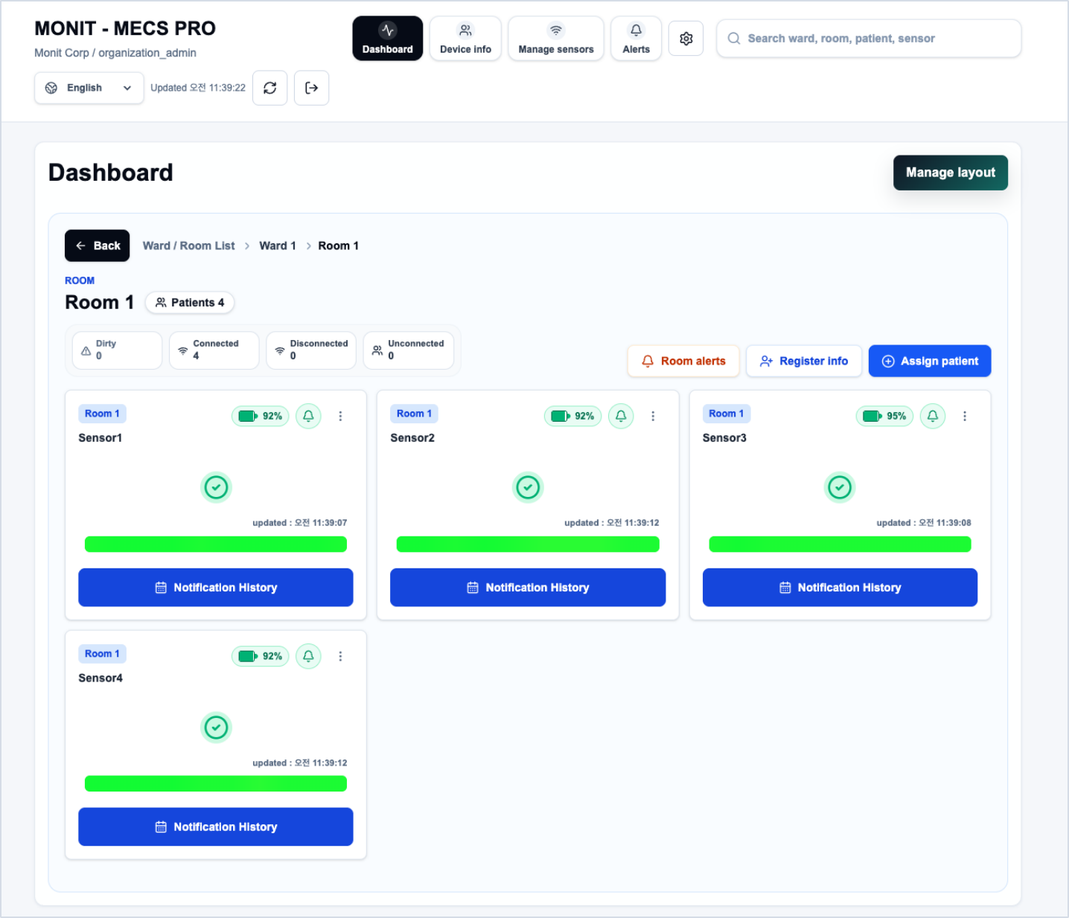
The MECS PRO web platform gives each ward a real-time view of every patient's sensor
3 · INTRODUCTION TO THE SMART DIAPER SYSTEM
Main navigation
Dashboard
Real-time view of wards, rooms, patients and sensors; layout editor for wards and rooms
Device info
Information on registered devices
Manage sensors
Sensor registry with search and filters, patient assignment, sensitivity, logs and CSV export
Alerts
Alert list and notification handling
Settings
System and account configuration
Screens show sample data from a test environment. Also: global search (ward, room, patient, sensor), language selector, manual refresh with last-updated time and secure sign-out.

Slide 9
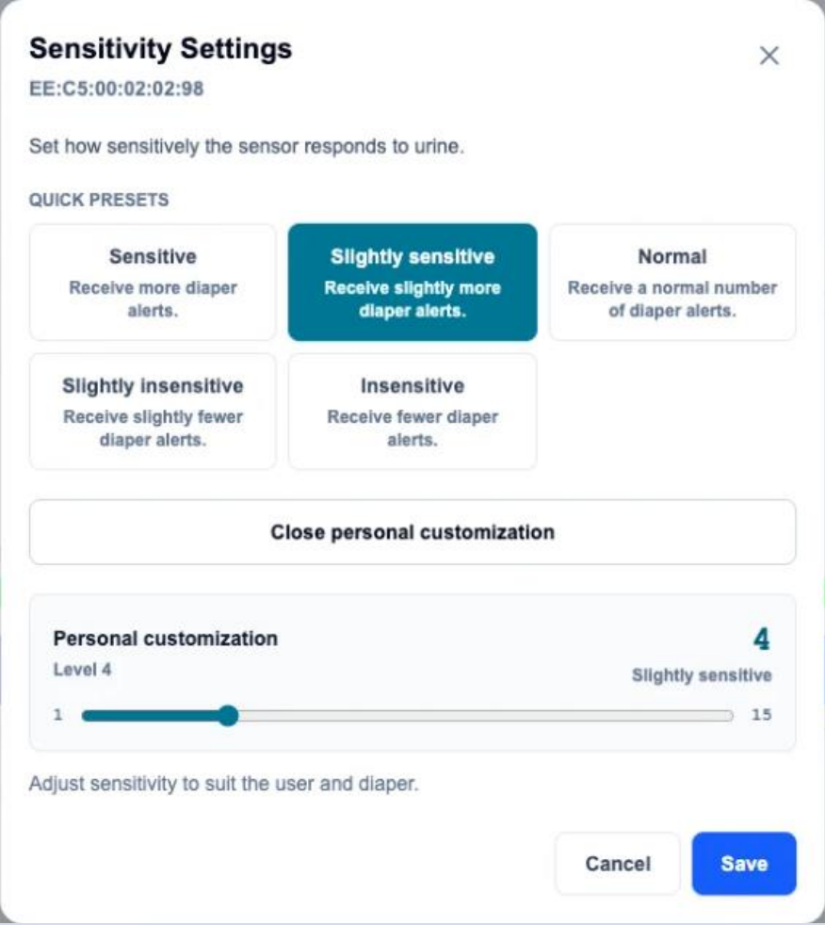
Real-time monitoring and alerts: caregivers see status, act on alerts and tune sensitivity per patient
3 · INTRODUCTION TO THE SMART DIAPER SYSTEM
Hierarchical drill-down
Status summary
Ward / room list → ward → room, with breadcrumb and back button; patient count per room
Per-room counters: dirty, connected, disconnected and unconnected sensors
Per-patient sensor card
Notifications
Room tag, sensor name, battery %, alert toggle, status bar and last-updated time
Per-sensor alert on/off, room-alert shortcut and notification history
Sensor action menu
Patient workflow
Sensitivity · move room · edit device info · view sensor info · unassign
Register and assign patients from the room view; data refreshes automatically
Sensitivity settings: 5 quick presets (Sensitive → Insensitive) or a personal level of 1–15, set per sensor to suit the patient and diaper.

Slide 10
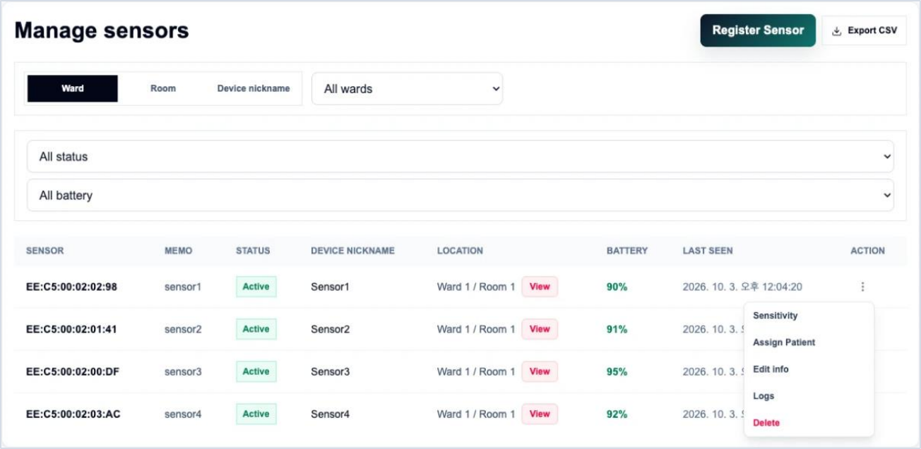
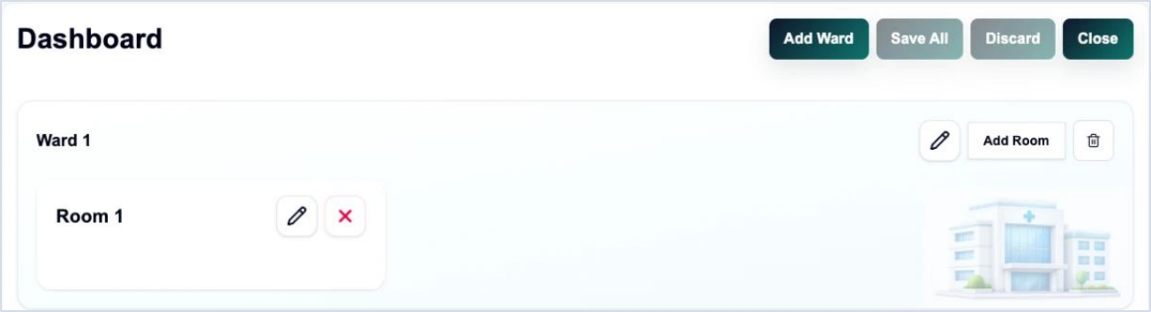
Management and administration: one sensor registry and simple layout tools for each hospital
3 · INTRODUCTION TO THE SMART DIAPER SYSTEM
Sensor registry
Sensor ID, memo, status, nickname, location, battery and last seen; register sensor and export CSV
Search and filters
Filter by ward, room or nickname, plus status and battery level
Per-sensor actions
Sensitivity · assign patient · edit info · logs · delete
Layout management
Add, rename or delete wards and rooms; save all, discard or close
Access and localisation
Organisation-scoped sign-in, global search and language selector
Screens show sample data from a test environment.

Slide 11
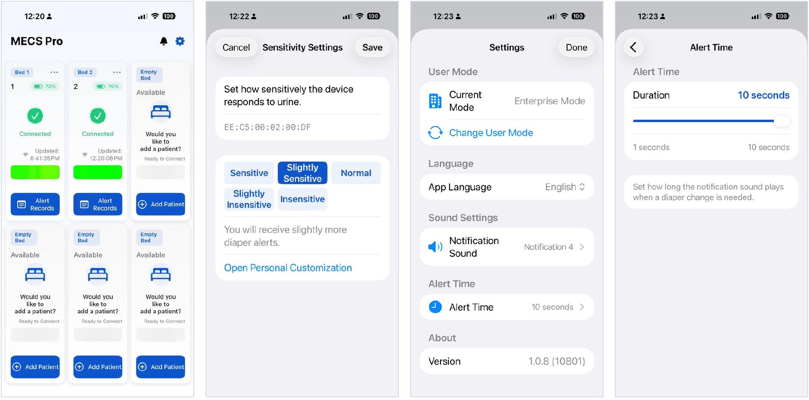
The MECS PRO mobile app brings the same core functions to the bedside
3 · INTRODUCTION TO THE SMART DIAPER SYSTEM
① Bed-by-bed monitoring
Card per bed: bed and patient no., battery, connection, last update and status bar; empty beds offer Add Patient
② Per-device sensitivity
5 presets from Sensitive to Insensitive, or personal customisation; saved per sensor ID
③ Settings
User mode (e.g. Enterprise), app language, notification sound, alert time, app version
④ Alert time
Slider (1–10 s) sets how long the alert sound plays when a change is needed
iOS app. Screens show sample data from a test environment; the notification page and per-bed menu are not shown.

Slide 12




Maintenance keeps a hospital-grade service running: each charge maps to work that would otherwise stop
3 · MAINTENANCE, SERVICE AND TECHNICAL SUPPORT
Singapore hosting
S$225.4k over 5 years
Security and compliance
S$65.3k over 5 years
Azure Singapore servers, web application firewall and the MONIT SaaS platform run 24×7, with a separate tenancy per hospital and n+1 redundancy. Without it, alerts stop.
Yearly penetration re-test, ISO 27001/27017/27018 surveillance and recertification audits, and certificate renewal (now every 200 days) — the evidence hospital IT asks for.
Remote support and monitoring
S$96.9k over 5 years
On-site preventive maintenance
S$102.0k over 5 years
24×7 security and service monitoring, incident response, firmware and app updates as phones, OS versions and security patches change.
Four rounds a year across the three hospitals with Intega: relay checks, battery and sensor health, coverage re-test after ward changes.
Why a fixed annual charge: prices cannot change for the contract term, so costs that recur every year are priced up front with 5% escalation instead of re-quoted.
Source: MONIT cost basis (Rev. 2) with ISO 27001/27017/27018 added; Master Agreement Clause 13.1 (Charges fixed for the term).
Notes:
New slide for the 8 Oct ALPS meeting (agenda: why a maintenance charge is needed). Each card maps to a line on the next slide.

Slide 13



Five-year operating and maintenance cost is S$489.7k, with 5% annual escalation built in so charges stay fixed
3 · MAINTENANCE, SERVICE AND TECHNICAL SUPPORT
S$97.9k
S$489.7k
S$387.7k
S$102.0k
Average operating cost / year
Five-year operating cost
Annual subscription (79% of total)
Preventive maintenance (21% of total)
Line item | Year 1 | Year 2 | Year 3 | Year 4 | Year 5 | 5-year total
Azure server (Singapore, site-isolated) | 24,000 | 25,200 | 26,460 | 27,783 | 29,172 | 132,615
Azure Front Door (WAF / CDN) | 4,800 | 5,040 | 5,292 | 5,557 | 5,834 | 26,523
MONIT SaaS platform (Azure PaaS) | 12,000 | 12,600 | 13,230 | 13,892 | 14,586 | 66,308
Penetration re-test (one per year) | 12,000 | 7,000 | 7,350 | 7,718 | 8,103 | 42,171
ISO 27001/27017/27018 certification & audits | 8,000 | 2,800 | 2,940 | 6,174 | 3,241 | 23,155
Remote support & 24×7 monitoring | 16,800 | 18,000 | 19,290 | 20,675 | 22,158 | 96,923
Subscription (Section 3.1) subtotal | 77,600 | 70,640 | 74,562 | 81,797 | 83,096 | 387,695
Preventive maintenance labour (Item 6) | 19,200 | 19,800 | 20,400 | 21,000 | 21,600 | 102,000
Total annual operating cost | 96,800 | 90,440 | 94,962 | 102,797 | 104,696 | 489,695
Initial set-up (one-off) – to confirm | 14,286 | – | – | – | – | 14,286
Total annual expenditure | 111,086 | 90,440 | 94,962 | 102,797 | 104,696 | 503,980
What the price covers
Hosting in Singapore with a separate tenancy for each hospital and n+1 redundancy
Encrypted backup, replication and a web application firewall
Annual penetration re-test by a licensed provider
ISO 27001/27017/27018 certification, yearly surveillance audits and Year-4 recertification
Remote support, incident response and 24×7 security monitoring
Four preventive-maintenance rounds a year across all three hospitals
Source: MONIT cost basis (Rev. 2, 16 Sep 2026); Master Agreement Clause 13.1. SGD, ex-GST, rounded; 5.0% a year from Year 2. ISO: Y1 initial certification; Y2, Y3, Y5 surveillance (1/3) and Y4 recertification (2/3) of the initial audit, per ISO/IEC 17021-1.

Slide 14
Six phases take each hospital from Letter of Award to hand-over, each closed by a hospital sign-off
4 · UNDERSTANDING OF THE PROJECT
Phase | Key activities | MONIT deliverable | Hospital input | Sign-off | Timing
1 Mobilise | Kick-off with ALPS and the three hospitals; project managers named; insurance in place | Project plan and contact list | Leads named for IT, nursing and facilities | Plan agreed at kick-off | Within 28 days of award (RFP)
2 Survey and design | Review ward layouts; survey 2.4 GHz Wi-Fi and power points incl. day rooms and corridors; fix relay count per ward | Site design per ward: relay positions and quantities | Ward layouts, SSID and VLAN details, ward access | Site design signed by hospital IT and ward | PROPOSED Weeks 2–4
3 Test and deliver | Factory test of every sensor and relay; kits labelled by hospital and ward; advance delivery notice | Test records and delivery note | Receiving point and storage | Delivery accepted | Before installation (MA)
4 Install and commission | Pilot ward first at each hospital, then ward by ward; relays mounted to each hospital's rules; sensors registered; dashboard at the nurse station | Commissioning checklist per ward | Escorted access at agreed times; IT on call for network join | Ward commissioning signed | PROPOSED 1–2 wards per day
5 Accept | Acceptance tests witnessed by hospital staff: alerts, dashboard, connectivity, reconnection after power loss | Test report and certificate | Witnesses from nursing and IT | Final Acceptance Notice per hospital | Invoice within 7 days of acceptance (MA)
6 Train and stabilise | On-site training for nurses and IT administrators; quick-reference guides; daily check of connectivity and alerts during hypercare | Training records; hypercare report | Staff released for training; ward nursing champions | Hand-over to maintenance | Plan ≤ 14 days of contract; training ≤ 14 days of delivery (MA)
Source: RFP and Master Agreement (MA) timings as marked; teal cells are MONIT proposals to be confirmed.

Slide 15
Site-readiness checks built on our Singapore deployments fix issues before go-live
4 · UNDERSTANDING OF THE PROJECT
Risk | How we prevent it | When checked
Relays use 2.4 GHz Wi-Fi only | Confirm SSID (English characters), authentication and VLAN with hospital IT; test the join at every relay position | Survey; commissioning
No power point where a relay is needed | Map power points in the survey: ceiling power at KTPH, concealed plug-in at WH, wall plug-in without drilling at TTSH | Survey
Patients spend hours in day rooms and corridors | Survey covers day rooms and common areas; add or move relays where patients spend time | Survey; first week of hypercare
Relay plug knocked or damaged | Mount away from walkways and secure the plug; keep spare relays in Singapore for quick swap | Installation; maintenance
Dashboard and app show different status | One registration per sensor; check dashboard, app and nurse-station view match before sign-off | Acceptance test
Patient or bed changes | Simple re-assignment steps in training and the quick-reference guide | Training
Result: each ward is accepted only after coverage, power, network and dashboard checks pass.
Source: MONIT deployment experience at KTPH and other Singapore sites.

Slide 16

Clear roles, a fixed meeting rhythm and written change control keep all three hospitals on one plan
4 · UNDERSTANDING OF THE PROJECT
Role | Who | Responsibility
Project manager | MONIT | Single point of contact; plan, progress, risks and reporting
Engineering and cloud | MONIT | Platform set-up, security, hosting in Singapore, remote support
On-site support | Intega Healthcare (Singapore partner) | Installation, on-site troubleshooting, part replacement
Hospital IT | KTPH / WH / TTSH | 2.4 GHz Wi-Fi access, network approvals, power points
Nursing champions | Each ward | Workflow sign-off, user feedback, first-line help
Procurement | ALPS | Contract, change approval, acceptance records
Meeting rhythm
Quarterly project-manager meetings (Master Agreement)
PROPOSED Weekly progress call and one-page written report while deployment is under way
PROPOSED Changes agreed in writing through ALPS before work starts (change log shared weekly)
Source: Master Agreement Clauses 4 and 23 (project managers, quarterly meetings, change control); MONIT. Teal boxes are MONIT proposals to be confirmed.

Slide 17
Rollout follows the six phases in four stages, ward by ward, starting with one pilot ward per hospital
4 · UNDERSTANDING OF THE PROJECT
1 Plan
2 Pilot
3 Roll out
4 Optimise
Kick-off and governance
Wi-Fi / RF site survey with hospital IT
Final relay count and placement
Security and PDPA review
Install in one pilot ward per hospital
Credential provisioning once
Staff training
UAT and acceptance
Ward-by-ward installation
Minimise disruption to care
Daily progress tracking
Sign-off per ward
Hypercare period
Alert-rule tuning
Usage and benefit reporting
Hand-over to service team
Ward sequence by hospital
KTPH
Woodlands Health
TTSH
Tower D → Tower B
A41 → W62 → W74
5A → 7C → 13B → 5H
Stages group the six phases: Plan = phases 1–2 · Pilot = phases 3–5 on the first ward · Roll out = phases 4–5 ward by ward · Optimise = phase 6. Ward order to be confirmed with each hospital.

Slide 18
Relay quantities follow a transparent, coverage-based method that is verified by an on-site survey
4 · UNDERSTANDING OF THE PROJECT
1
Map
2
Cover
3
Check capacity
4
Add resilience
5
Verify
Mark bed locations and wall types on each ward floor plan
Place relays so every bed lies within the validated coverage radius
Keep sensors per relay below the maximum
Add redundancy for critical gaps (e.g. 10% spare)
Confirm with the Wi-Fi / RF survey and pilot ward
Khoo Teck Puat Hospital
Woodlands Health
Tan Tock Seng Hospital
60 sensors · ceiling mount preferred · barcode scanner at monitoring station
Minimal, concealed relays (behind cabinet, not on ceiling) · dashboard at monitoring station
40 sensors · wall power-point plug-in · no drilling · dashboard at nursing station
KTPH ward | Relays
Tower D (7-series) | 14
Tower B (acute stroke unit) | 13
Tower D (8-series) | 14
Total | 41
WH ward | Relays
A41 | 14
W62 | 6
W74 | 10
Total | 30
TTSH ward | Relays
5A (Class C) | 6
7C (Class B2) | 8
13B (Class A) | 19
5H (Class B2) | 19
Total | 52
Source: NHG ward requirement tables for KTPH, Woodlands Health and TTSH; relay reception about 20 m indoors. Final counts confirmed by the Wi-Fi / RF survey and pilot ward.

Slide 19

Installation is a short, repeatable routine per ward once the hospital has confirmed Wi-Fi and power
4 · UNDERSTANDING OF THE PROJECT
Hospital provides before installation
1
Survey
Walk the ward with a test relay; confirm coverage and power points
2.4 GHz Wi-Fi network (5 GHz not supported) with an SSID in English characters
Wi-Fi name and password, or a dedicated IoT SSID / VLAN
MAC-address whitelisting if required — MONIT supplies relay MAC addresses before delivery
One power point per relay position (USB adapter supplied)
Escorted ward access at agreed times; IT contact on call
2
Mount
Upper wall or corridor ceiling, away from metal cabinets; secure the plug
3
Connect
Power on; enter the hospital Wi-Fi once on the relay's set-up page (region code 1002)
4
Register
Scan each sensor QR code to the bed in the dashboard
5
Verify
Test alert on every bed; dashboard, app and nurse-station view must match
6
Sign off
Ward commissioning checklist signed by nursing and IT
PROPOSED 1–2 wards per day per team; pilot ward first at each hospital
Source: MECS PRO BLE Gateway installation guide; MONIT site-preparation checklist (6 Oct 2026). Detailed relay set-up in Section 8.
Notes:
New slide for the 8 Oct ALPS meeting (agenda: installation process).

Slide 20
Implementation can start on award and reach full go-live in about five months
5 · PROJECT TIMELINE
M1
M2
M3
M4
M5
Contract and insurance
Mobilisation (within 28 days)
Wi-Fi / RF site survey, final relay count
Procurement and shipment (lead time)
Pilot ward install — KTPH, WH, TTSH
UAT and pilot acceptance
Ward-by-ward rollout
Training (nurses, IT)
Hypercare and optimisation
Source: RFP (mobilisation within 28 days of award); Master Agreement (training plan ≤ 14 days of contract). Production lead time depends on the final relay count.

Slide 21
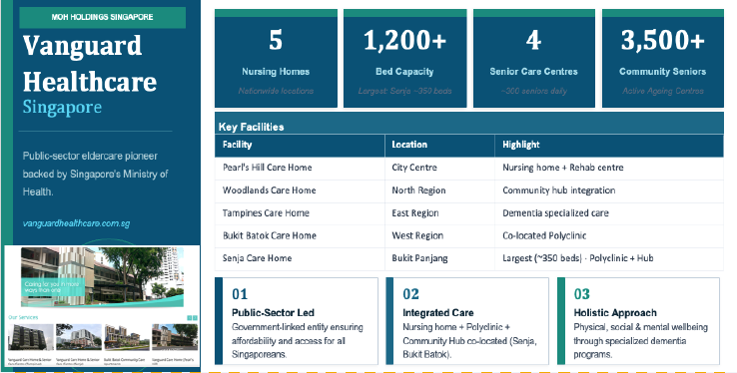
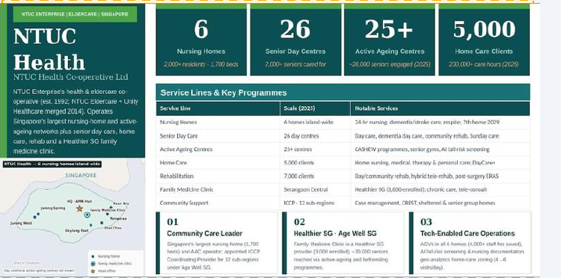
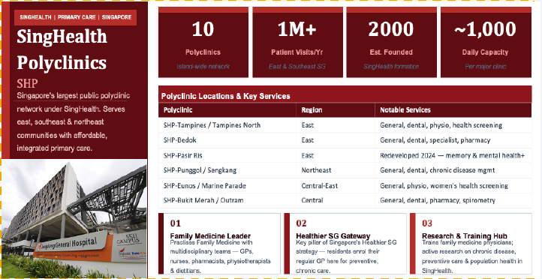
Our Singapore track record starts at KTPH itself and extends to public eldercare and primary care
6 · REFERENCES AND TRACK RECORD
Khoo Teck Puat Hospital
Vanguard Healthcare
NTUC Health
SingHealth Polyclinics
Where: Ward B76, Singapore
Where: Tampines Care Home
Where: Geylang East, Singapore
Where: Sengkang, Pasir Ris
Scale: 15 patients, 818 readings
Scale: PoC with 2 residents
Scale: 6 residents
Scale: 30 participants
Timeline: 9 Jul – 24 Aug 2025 · Phase 2 ongoing
Timeline: 20 May – 3 Jul 2026 · subscription roll-out under discussion
Timeline: From 7 Sep 2026
Timeline: From 10 Jul 2026
Accuracy 76.2%, specificity 82.6%, sensitivity 72.7% measured by KTPH nurses. Staff feedback on alarm handling and sensor placement went into the current release.
Source: MONIT customer records; KTPH Smart Diapers Sensor Trial report (3 Dec 2025).

Slide 22
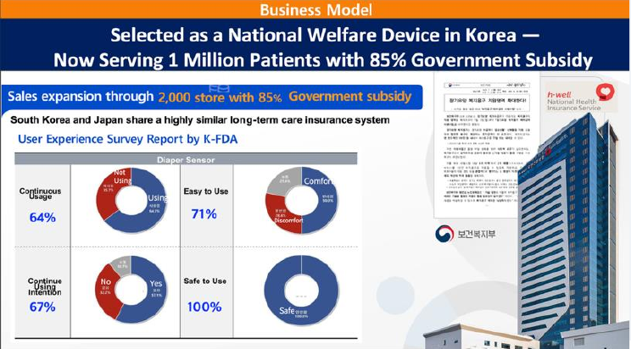

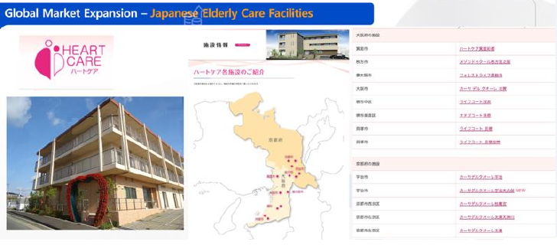
Larger programmes in Japan and Korea show the system running at scale
6 · REFERENCES AND TRACK RECORD
Heart Care (Japan)
NHIS innovative welfare device (Korea)
Korean elderly hospitals
Where: 14 elderly-care facilities, Osaka
Where: National Health Insurance Service
Where: Samsung Noble County and premium elderly hospitals
Scale: About 2,000 sensors; 1 million diapers supplied
Scale: National long-term-care programme (1.23 million)
Scale: 180 residents · Noble County PoC of 25 confirmed
Timeline: From Dec 2025
Timeline: Listed March 2024
Timeline: Ongoing; Noble County from late Oct 2026
Source: MONIT customer records and NHIS listing. Heart Care figures as reported by the customer.

Slide 23






Environmental policy: MECS PRO cuts unnecessary diaper changes and the waste that goes with them
7 · SUSTAINABILITY INITIATIVES
Other criteria
Environmental policy — in place
Policies and practices on waste, recycling and packaging
MECS PRO can reduce unnecessary diaper consumption by up to 25%: changes happen when a diaper is soiled, not on a fixed round
Reusable sensor — only the battery is replaced, every 2–3 months
Renewable energy
Not applicable
Use of solar or other renewable energy in operations
Energy tracking
Not applicable
Tracking of energy use in offices and factories
Green products
Not applicable
Green Label products and energy-efficient equipment in offices and sites
Source: MONIT. Diaper reduction is a MONIT customer estimate.

Slide 24
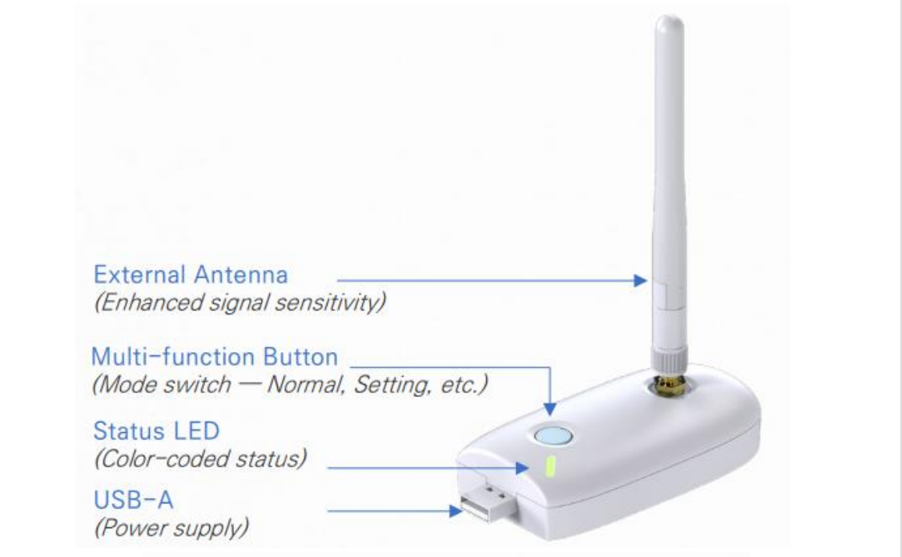
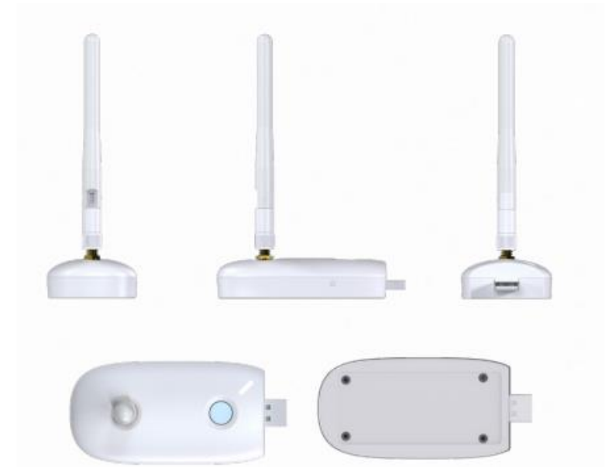
The MECS PRO BLE gateway relays sensor data over the hospital Wi-Fi so wards are covered without new infrastructure
8 · NETWORK CONNECTIVITY AND RELAY DEVICES
Item | Specification
Function | Receives MECS PRO sensor data over BLE and sends it to the cloud over Wi-Fi, for the nursing station and tablets
Communication | BLE 5 (beacon) receive · Wi-Fi 2.4 GHz transmit (5 GHz not supported)
Reception range | About 20 m indoors; varies with obstacles, interference and antenna orientation
Data cycle | Collects all nearby sensors every minute; stores and re-sends if Wi-Fi drops
Updates | Remote firmware update checked every hour — wireless, no cable
Registrations | IMDA ESER/26/5450 · CE · KC
Dimensions / weight | 9.5 × 4.5 × 5.5–11.3 cm (antenna incl.) · 42 g
Power | 5 V USB-A, always on; restarts automatically after power loss
Installation | Upper wall or corridor ceiling, away from metal cabinets, frames and pillars; exact number confirmed on site
Data privacy | No personal information stored — sensor identifiers and soiling data only
Package / origin | Gateway and quick-start guide (adapter not included) · made in China, developed and owned by MONIT (Korea) · HS 8517.62
Model SEM-SYS200K_GAT. Registrations in Section 2.

Slide 25
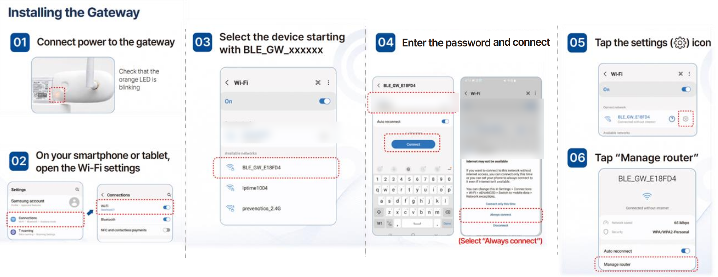
Each relay is set up once from a phone or tablet in a few minutes — no new network infrastructure
8 · NETWORK CONNECTIVITY AND RELAY DEVICES
PROPOSED Relays supplied to the three hospitals carry a unique set-up password per device (strict-institution firmware); MONIT hands the password list to hospital IT.
Set-up screens from the installation guide; network names and passwords are masked.

Slide 26
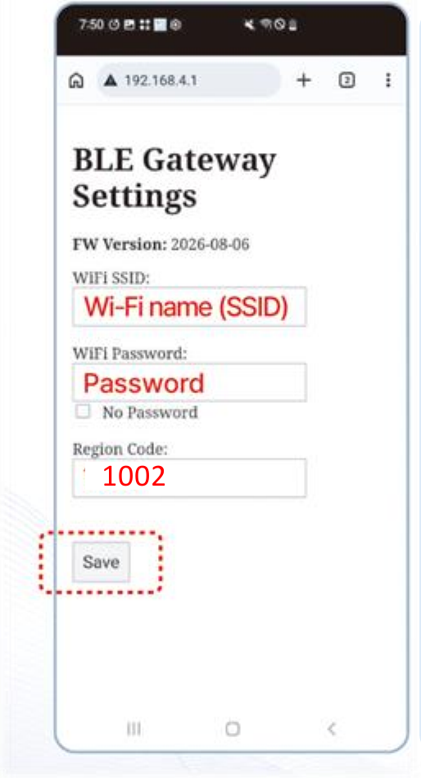
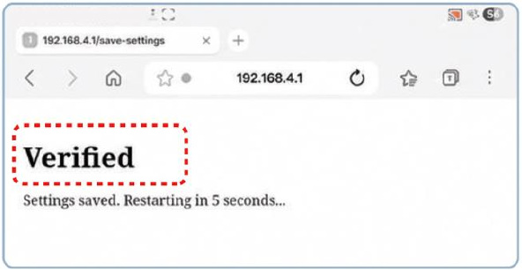
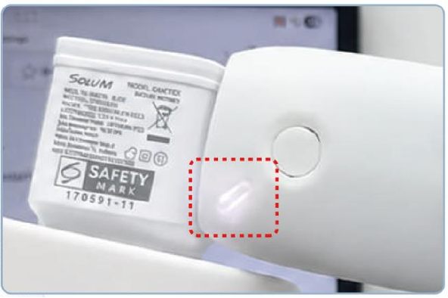
The relay joins the hospital Wi-Fi as a standard client — only a 2.4 GHz Wi-Fi network is required
8 · NETWORK CONNECTIVITY AND RELAY DEVICES
Enter the Wi-Fi details
Verified
When the page shows 'Verified', relay set-up is complete.
① Wi-Fi name (SSID)
② Wi-Fi password
③ Region code 1002
④ Save
Solid white LED
When the LED turns solid white, the relay is online.
Region code 1002 = Singapore. The set-up page closes once the relay restarts.

Slide 27




Wi-Fi credentials are stored once on the relay — no re-entry after power outages or firmware updates
8 · NETWORK CONNECTIVITY AND RELAY DEVICES
Event | What happens on the relay | Re-enter Wi-Fi password?
Power outage / restart | Credentials reloaded from non-volatile memory; relay restarts and reconnects automatically | No
Firmware update (over the air) | Wi-Fi settings are kept across the update | No
Wi-Fi drops temporarily | Sensor data is stored on the relay and re-sent when Wi-Fi returns | No
Hospital changes the Wi-Fi password | Hospital IT enters the new credentials on each relay's set-up page | Yes — once, by hospital IT
Replacement unit | New relay starts in set-up mode | Yes — one-time set-up
How the solution achieves this
Credentials kept in non-volatile memory
Settings kept across firmware updates
Automatic reconnection after any outage
Local buffering while Wi-Fi is down
Source: MECS PRO BLE Gateway installation guide and FAQ.

Slide 28






Patient data stays in Singapore, is kept only as long as needed, and is protected to ISO 27001/27017/27018
8 · NETWORK CONNECTIVITY AND RELAY DEVICES
Data residency
Minimal personal data
Encryption and access
Hosted on Microsoft Azure, Singapore region
Separate tenancy for each hospital
No name, birth date or gender collected at device registration — device nickname only
Relays store no personal information
Azure SQL TDE and AES-256 encryption
Web application firewall; organisation-scoped sign-in
Retention
Breach response
Assurance
Care events kept 14 days
Audit logs kept 12 months
Notification within 1 day of a confirmed breach
Named Data Protection Officer
ISO 27001 / 27017 / 27018 certification in November 2026
Annual penetration re-test by a licensed provider
Source: MONIT Corp Data Protection Notice v1.0 (10 Sep 2026); MONIT platform security design.
Notes:
New slide: summary of data-protection commitments asked for in the RFP security review.

