Slide 1
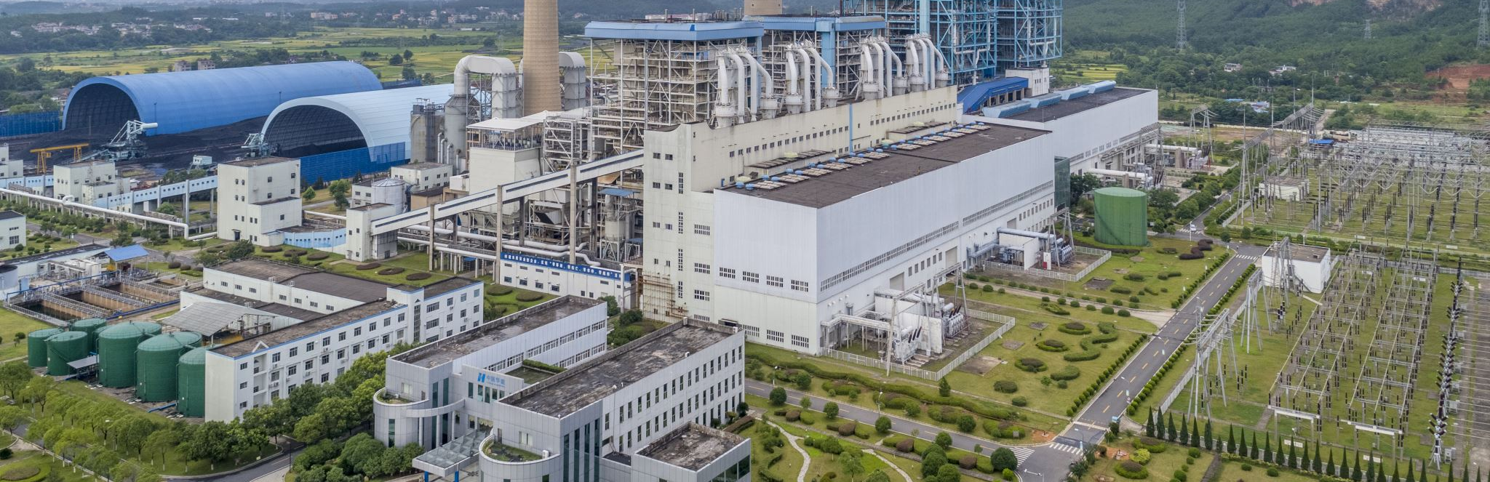
Food System Emissions
By Tony Pennoyer

Slide 2
What are food system emissions?

Slide 3

Land Use

Slide 4

Land Use
Processing

Slide 5

Processing
Transportation
Land Use

Slide 6

Processing
Transportation
Land Use
Packaging

Slide 7

Processing
Transportation
Land Use
Packaging
Retail

Slide 8

Processing
Transportation
Land Use
Packaging
Retail
Consumption

Slide 9

Processing
Transportation
Land Use
Packaging
Retail
Consumption
Waste

Slide 10
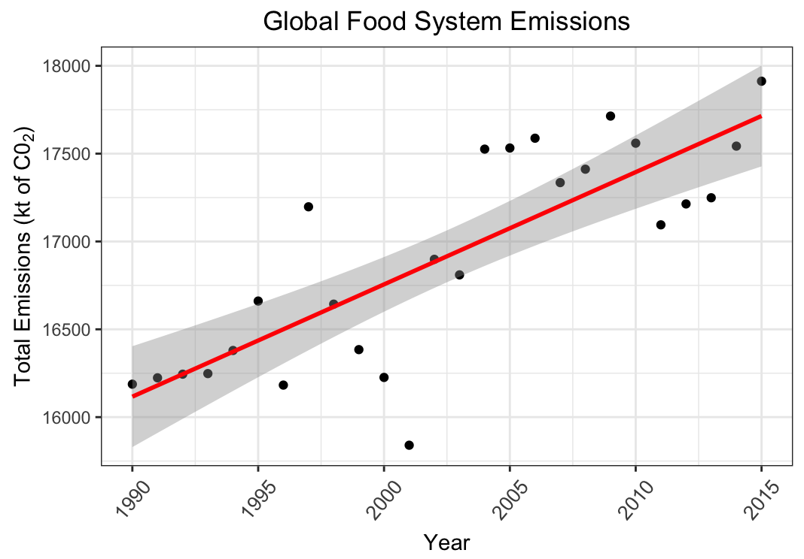

Slide 11
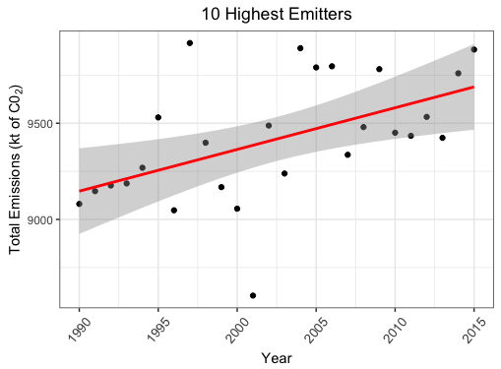

Slide 12
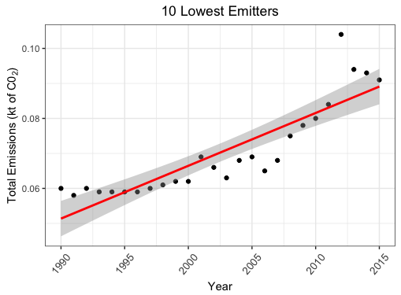

Slide 13
5-Year Change: (2010 – 2015)
10 highest emitters +4.5%
10 lowest emitters +13.75%

Slide 14
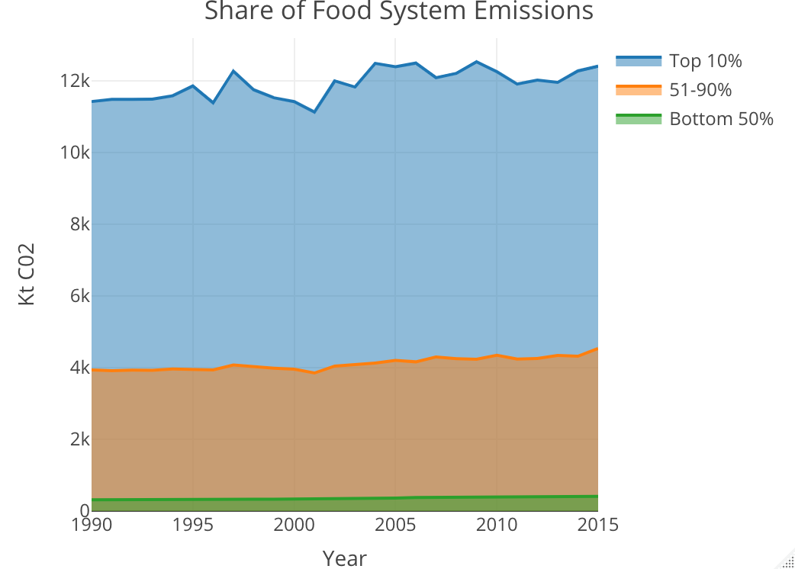

Slide 15
Rating Food System Emissions by Country
A = >95% -- 19 Countries
B = ~85%-95% -- 53 Countries
C = ~50%-85% -- 64 Countries
D = ~25%-%50 –- 34 Countries
F = <25% -- 9 Countries

Slide 16
Going Forward
I would like to include more parameters in my interactive map and implement that into a Shiny Dashboard.
Some more things I’d like to take into account are:
Region (i.e., Europe & Central Asia, Middle East & North Africa, Sub-Saharan Africa)
Income Group (i.e., High income, Upper middle income, Lower middle income, Low income)
Industrialized or Developing

Slide 17
Sources:
Dataset: Crippa, M., Solazzo, E., Guizzardi, D., Monforti-Ferrario, F., Tubiello, F.N. and Leip, A. EDGAR-FOOD data. Figshare, doi:10.6084/m9.figshare.13476666 (2021).
UN World Population Data: https://population.un.org/wpp/Download/Archive/Standard/
Wiston M. Status of Air Pollution in Botswana and Significance to Air Quality and Human Health. J Health Pollut. 2017;7(15):8-17. Published 2017 Sep 7. doi:10.5696/2156-9614-7.15.8

