Slide 1
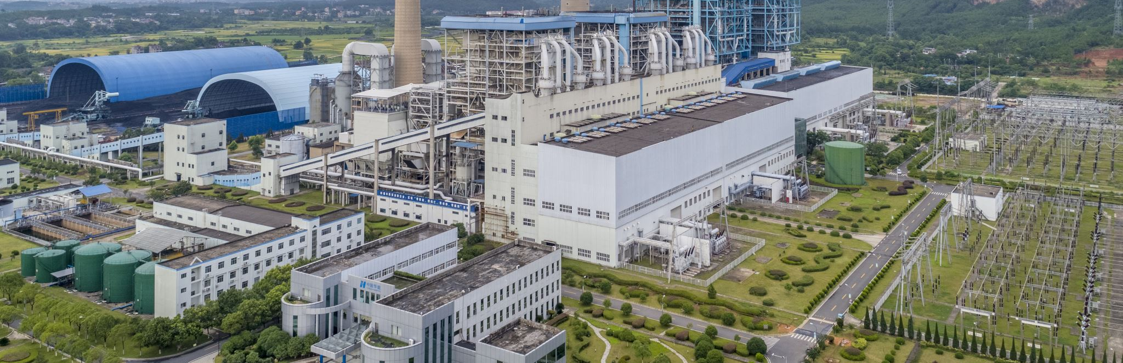
Food System Emissions
By Tony Pennoyer

Slide 2
What are food system emissions?

Slide 3

Land Use

Slide 4

Land Use
Processing

Slide 5

Processing
Transportation
Land Use

Slide 6

Processing
Transportation
Land Use
Packaging

Slide 7

Processing
Transportation
Land Use
Packaging
Retail

Slide 8

Processing
Transportation
Land Use
Packaging
Retail
Consumption

Slide 9

Processing
Transportation
Land Use
Packaging
Retail
Consumption
Waste

Slide 10
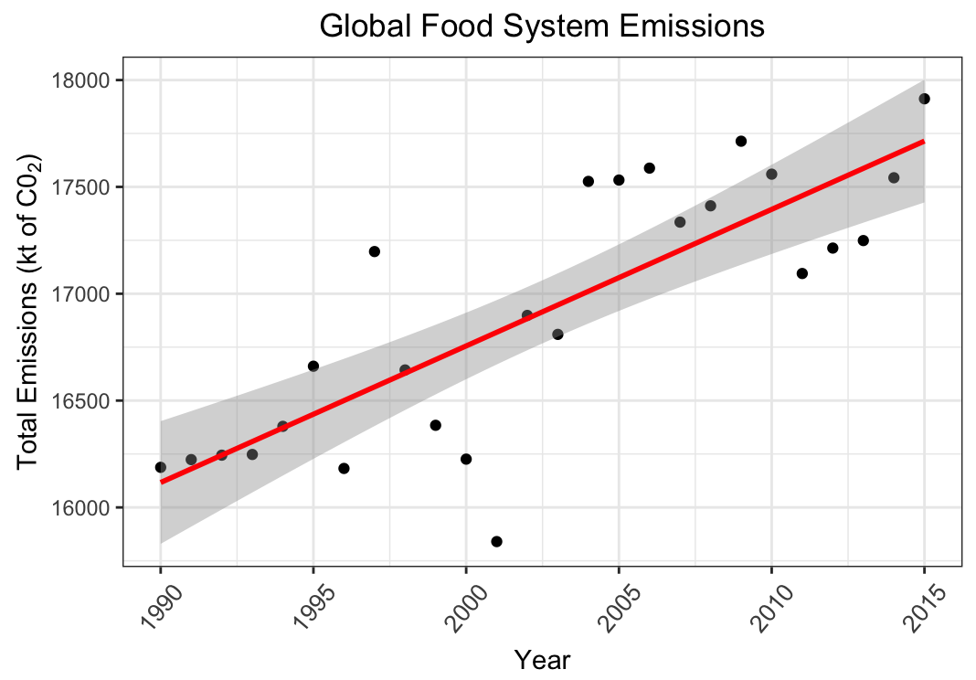

Slide 11
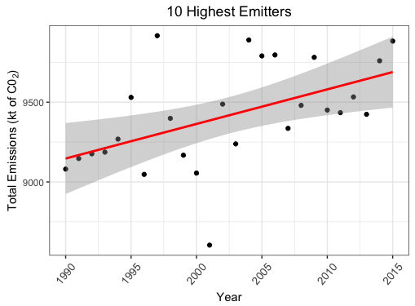

Slide 12
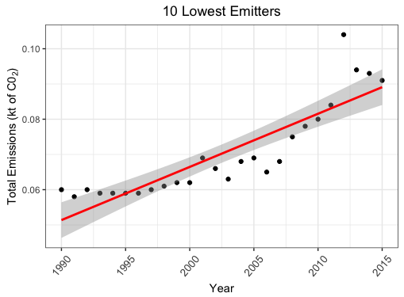

Slide 13
5-Year Change: (2010 – 2015)
10 highest emitters +4.5%
10 lowest emitters +13.75%

Slide 14
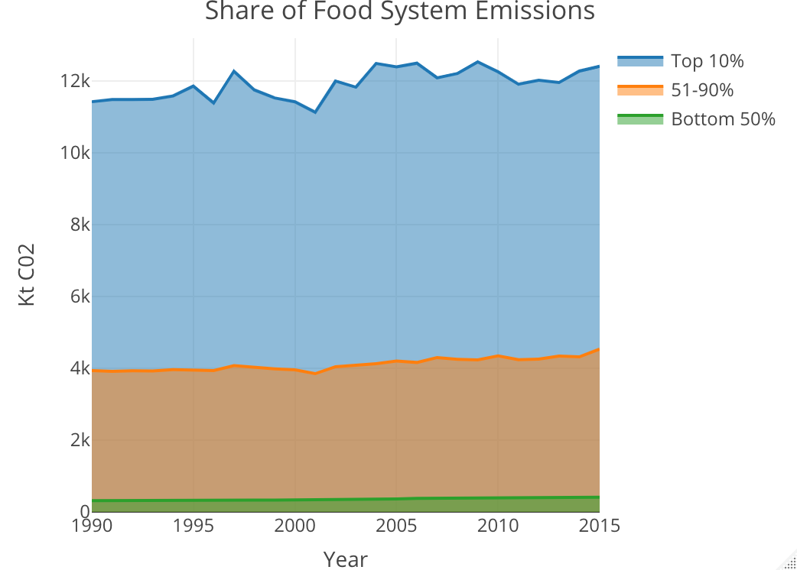

Slide 15
file:///Users/tonypennoyer/Desktop/R_data/Rplot.html

