Slide 1
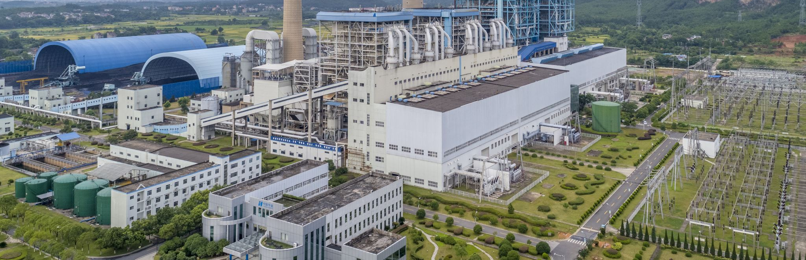
Food System Emissions
By Tony Pennoyer

Slide 2
What are food system emissions?

Slide 3

Land Use

Slide 4

Land Use
Processing

Slide 5

Processing
Transportation
Land Use

Slide 6

Processing
Transportation
Land Use
Packaging

Slide 7

Processing
Transportation
Land Use
Packaging
Retail

Slide 8

Processing
Transportation
Land Use
Packaging
Retail
Consumption

Slide 9

Processing
Transportation
Land Use
Packaging
Retail
Consumption
Waste

Slide 10
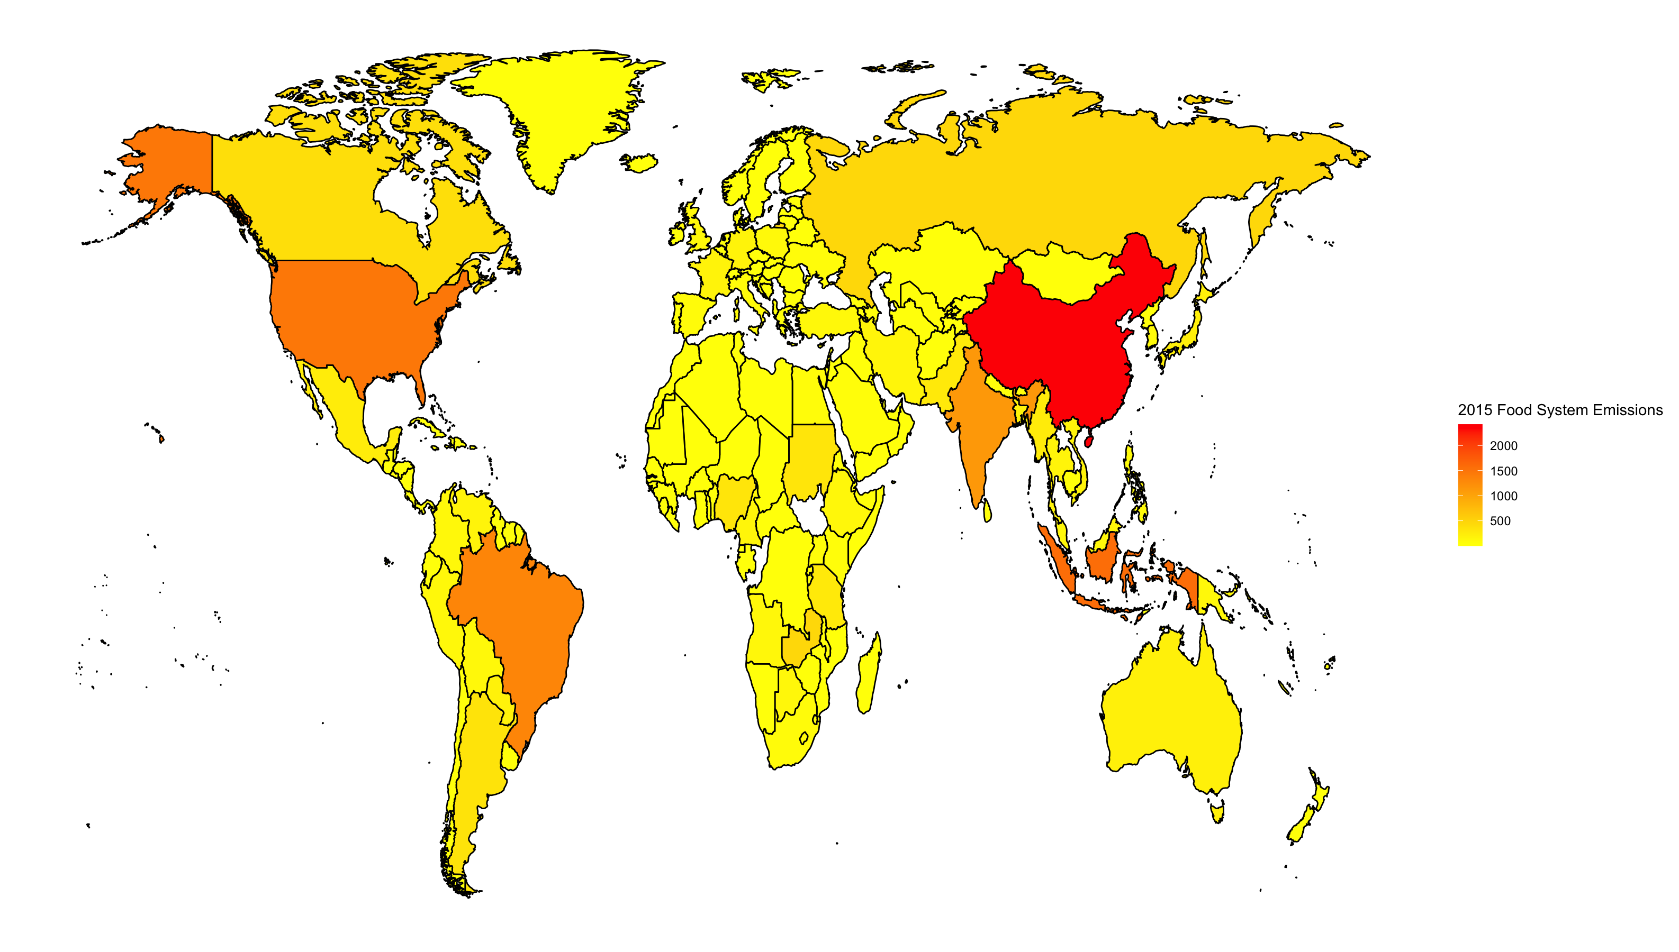

Slide 11
