Slide 1
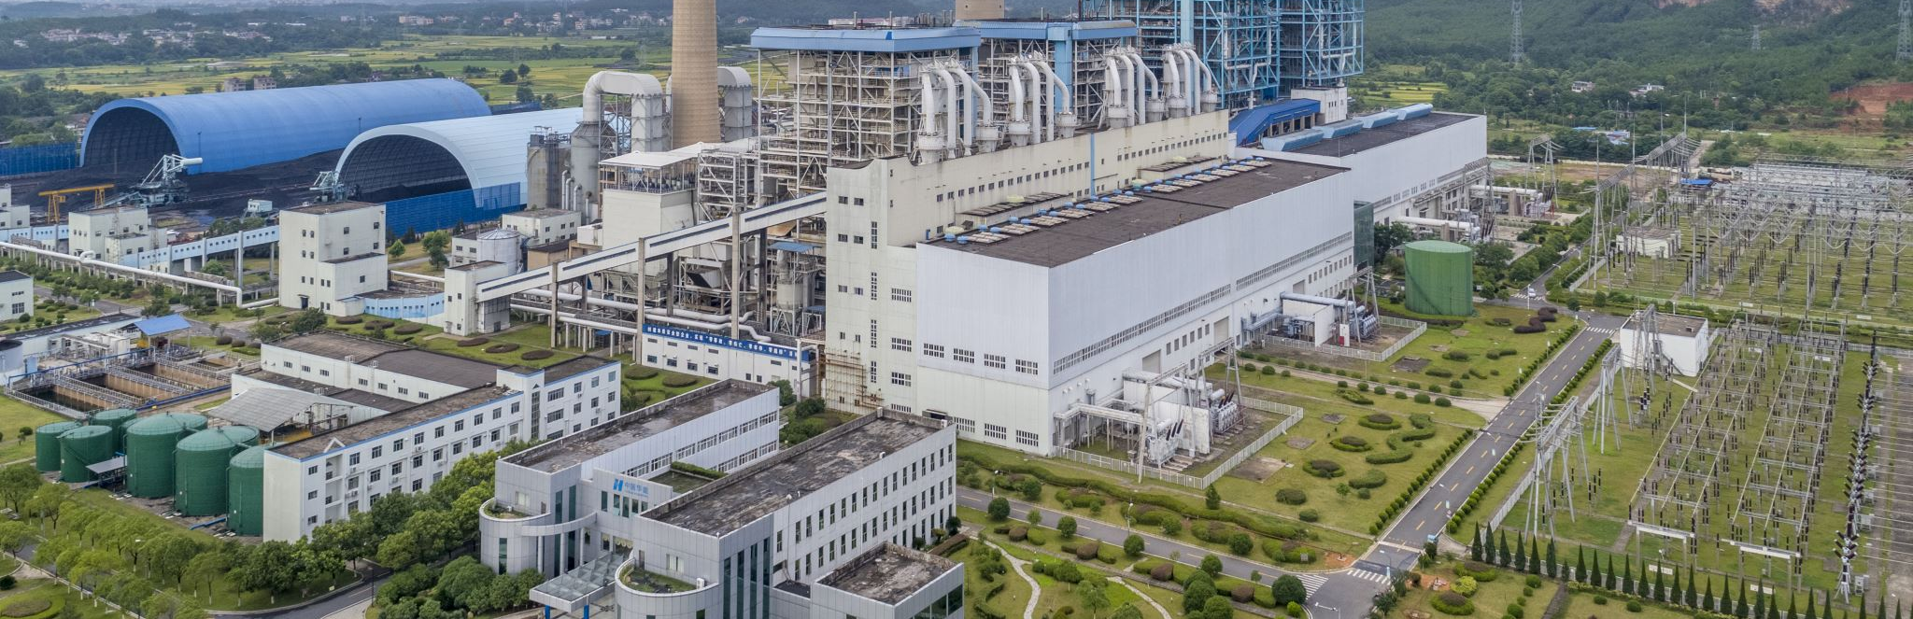
Food System Emissions
By Tony Pennoyer

Slide 2
What are food system emissions?

Slide 3

Land Use

Slide 4

Land Use
Processing

Slide 5

Processing
Transportation
Land Use

Slide 6

Processing
Transportation
Land Use
Packaging

Slide 7

Processing
Transportation
Land Use
Packaging
Retail

Slide 8

Processing
Transportation
Land Use
Packaging
Retail
Consumption

Slide 9

Processing
Transportation
Land Use
Packaging
Retail
Consumption
Waste

Slide 10
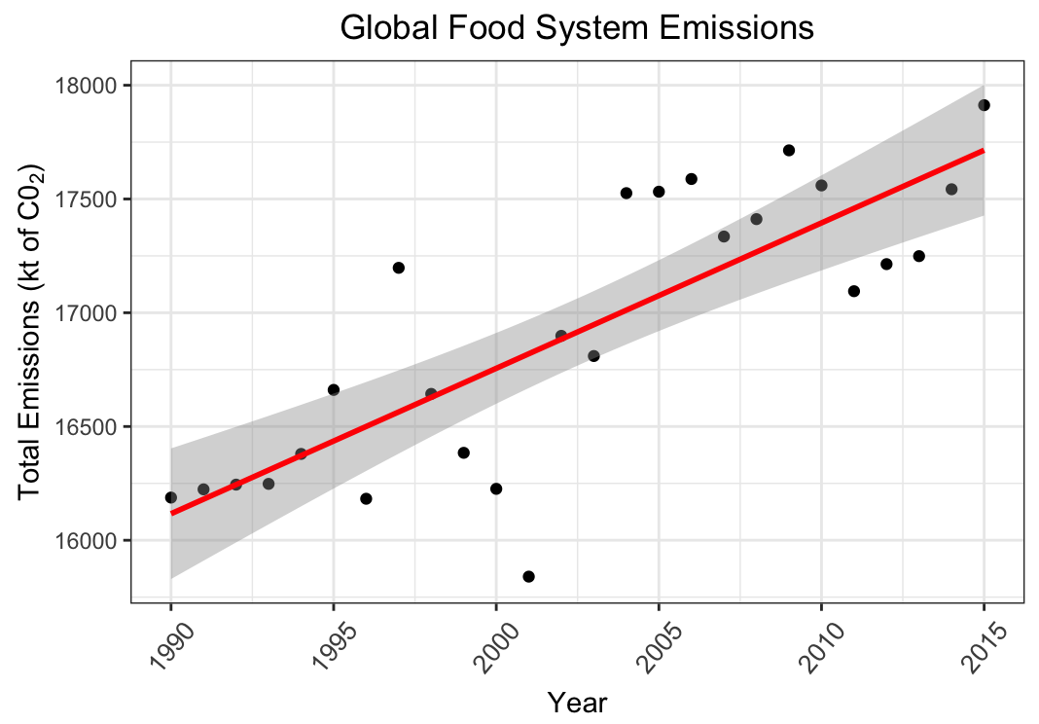

Slide 11
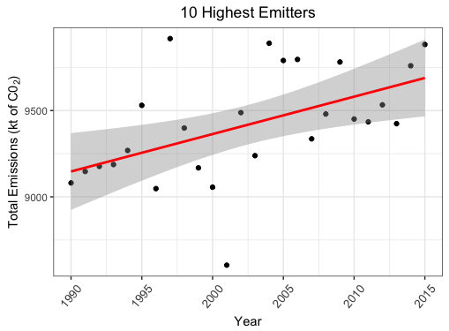

Slide 12
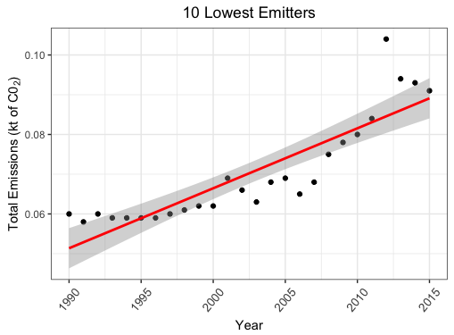

Slide 13
5-Year Change: (2010 – 2015)
10 highest emitters +4.5%
10 lowest emitters +13.75%

Slide 14
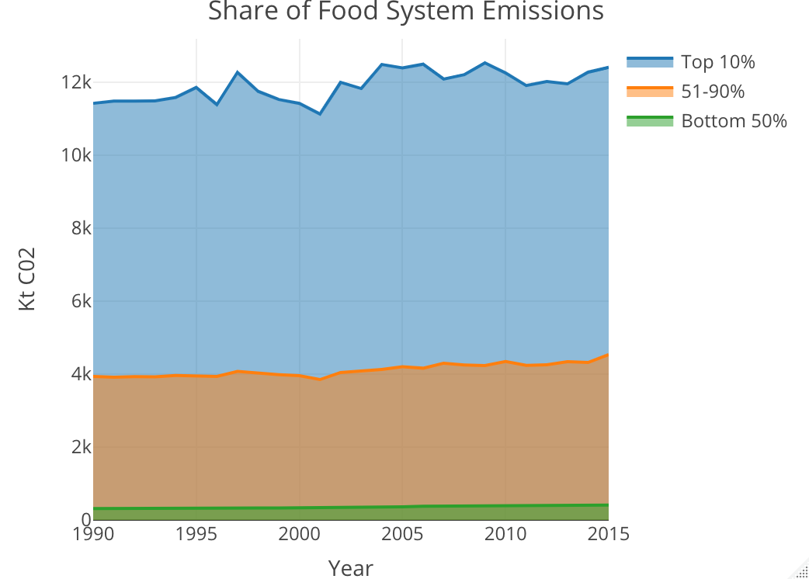

Slide 15
file:///Users/tonypennoyer/Desktop/R_data/Rplot.html

Slide 16
Sources:
Dataset: Crippa, M., Solazzo, E., Guizzardi, D., Monforti-Ferrario, F., Tubiello, F.N. and Leip, A. EDGAR-FOOD data. Figshare, doi:10.6084/m9.figshare.13476666 (2021).

